Slide 1
Implications of the African Continental Free Trade Area for demand of Transport Infrastructure and Services
Fifth Africa Business Forum
2022
Addis Ababa, Ethiopia

Slide 2
Outline
Key messages
African Continental Free Trade Area (AfCFTA) in brief
Current status and upgrade requirements of infrastructure for different transport modes
Share of freight for different transport modes
Equipment needs for different transport modes
Investment opportunities
Conclusions

Slide 3
Key Messages (1)
The transport sector will strongly benefit from AfCFTA
This benefit will be optimized if AfCFTA is accompanied by implementation of regional infrastructure projects
The estimated cost of trucks required as a result of AfCFTA is US$ 345 billion
The estimated cost of aircrafts required as a result of AfCFTA is US$ 25 billion
The estimated cost of rail wagons required as a result of AfCFTA is US$36 billion
The estimated cost of vessels required as a result of AfCFTA is US$ 4 billion

Slide 4
Key Messages (2)
Implementing AfCFTA and planned infrastructure projects would result in the need for 2,213,579 trucks, 169,339 rail wagons, 135 vessels and 243 aircraft
Rail currently transports just 0.3% of total intra-Africa freight. This increases to 6.8% with the implementation of AfCFTA
The estimated cost of equipment required by different transport modes to cope with AfCFTA is about U$411 billion
Investment opportunities in infrastructure development and fleet expansion vary across subregions for different modes of transport

Slide 5
AfCFTA in brief
African Continental Free Trade Area (AfCFTA) Agreement entered into force in 2019
Implementation commenced in 2021
Negotiations still ongoing on investment, intellectual property rights, competition policy and e-commerce
Objective: create single continental market for goods & services, with free movement of people and investments, enhancing competitiveness and supporting economic transformation

Slide 6
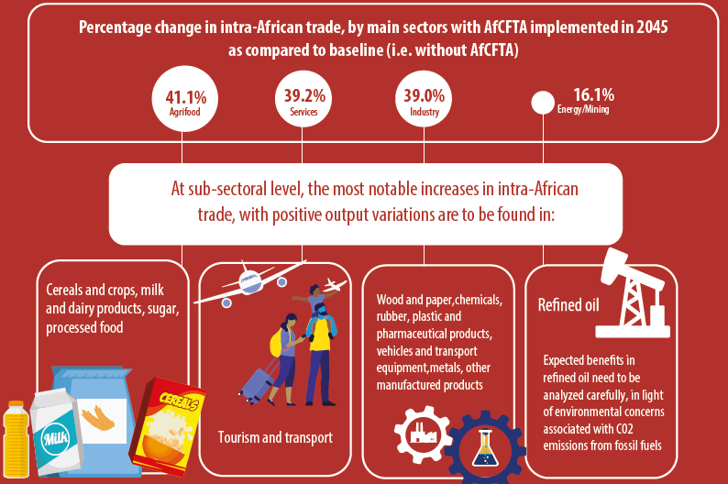
AfCFTA to boost intra-African trade by around 40 percent, with substantial benefits to all main sectors
Source: ECA (https://uneca.org/sites/default/files/keymessageanddocuments/en_afcfta-infographics-11.pdf)

Slide 7
Transport sector to strongly benefit from the AfCFTA
According to ECA’s latest estimates, intra-African trade in transport services has the potential to increase by nearly 50 %.
In absolute terms, over 25% of intra-African trade gains in services would go to transport alone; and nearly 40% of the increase in Africa’s services production would be in transport
Distribution of absolute gains in intra-African trade in services in 2045, by main services sectors,
under the Agreement compared with the baseline scenario (without AfCFTA)
AfCFTA therefore expected to significantly increase traffic flows on all transport modes: Road, Rail, Maritime, and Air.

Slide 8
ECA’s research unpacks AfCFTA investment opportunities in the transport sector by answering the following questions
How will implementation of AfCFTA affect demand for transport infrastructure and services?
What would be the demand for different modes of transport, and what are the implications for investment in infrastructure development?
What would be the infrastructure and equipment needs for different transport modes?

Slide 9
Research adds value by identifying infrastructure and equipment needs to support investment decisions

Slide 10
+ Growth in freight movement depends on time horizon, implementation of AfCFTA and planned infrastructure projects + S2 is optimal from an AU policy perspective
FTA/economic development | S1 max ambition (with FTA) Infrastructure do-nothing | S2 max ambition (with FTA) Infrastructure do-everything
 | S3 baseline (without FTA) Infrastructure do-nothing | S4 baseline (without FTA) Infrastructure do-everything
 | Infrastructure
S0 = 2019

Slide 11
Defining the scenarios: unpacking the factors that affect growth in freight
Long-term horizon: 2030
Scenarios based on two dimensions
Implementation of Free Trade Area (FTA)
Baseline (2019)
AfCFTA not fully implemented (Without FTA)
AfCFTA fully implemented (With FTA): This is the maximum ambition (max ambition)
Transport infrastructure development
Planned infrastructure not implemented (Do-nothing)
Planned infrastructure implemented (Do-everything)

Slide 12
Roads

Slide 13
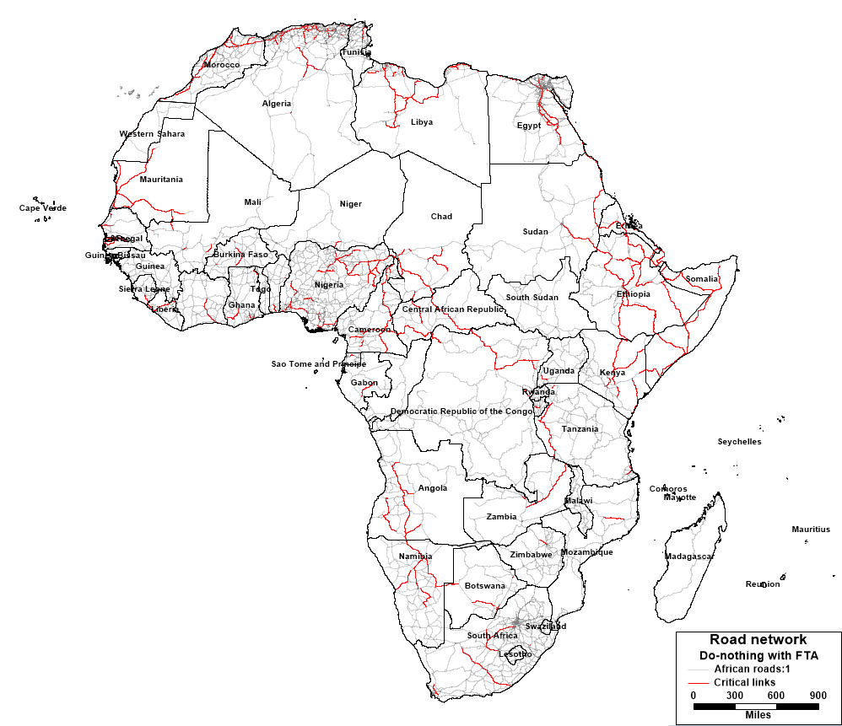
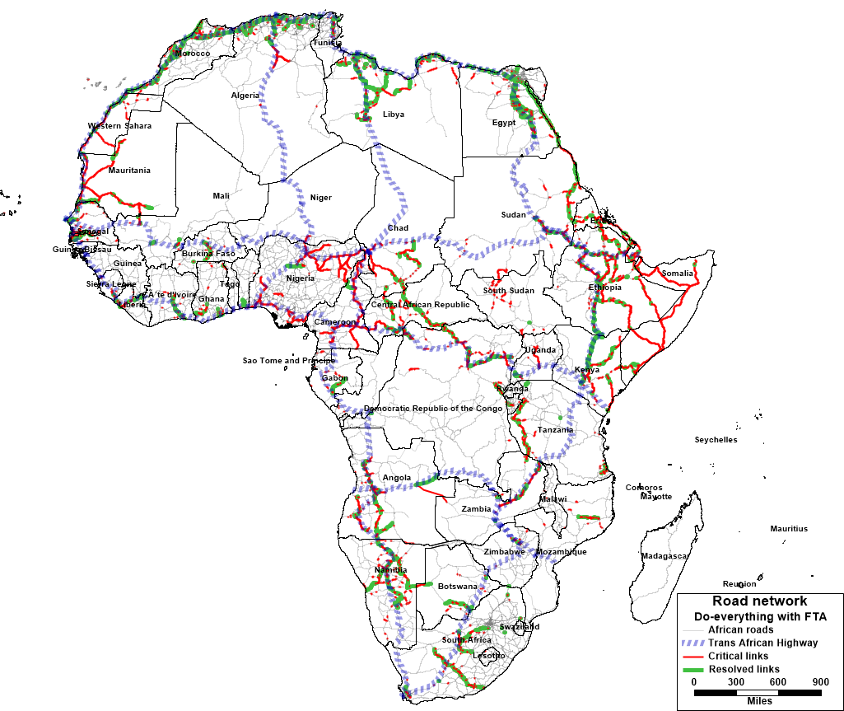
Africa’s Road Network
Critical links with current network
Critical links with current network plus planned projects
Study on AfCFTA

Slide 14
Africa’s road networks is inadequate, but implementing planned projects will significantly increase its size
Africa’s road network is about 2.8 million km while that of the U.S. exceeds 6.5 million km
The length of Africa’s road network linked to cross-border trade is more than 445,018 km, made up of over 810,000 links
Implementing Trans-African Highways (TAH) & Programme for Infrastructure Development (PIDA) will significantly increase size of network
TAH has 10 highway sections crisscrossing the continent; total length of 57,300km
Aims to connect areas of production and consumption

Slide 15
+ Africa needs to upgrade sections of its roads to cope with increased freight generated by AfCFTA
Freight traffic growth envisaged to be higher in some sections of Africa’s road network than continent-wide average growth
These are critical links
They require upgrading to accommodate increased freight resulting from AfCFTA
Implementing AfCFTA will double road freight from 201 to 403 million tonnes
Critical links will not cope with this growth
Total length of critical links in Africa’s road network is 61,540km
High concentration of critical links in West and Central Africa (Nigeria, Central African Republic, and Cameroon) and East Africa (Ethiopia, Eritrea and Somalia)

Slide 16
+ Implementing TAH and PIDA projects increases capacity of transport networks to accommodate freight growth
Several links that require upgrading are TAH links like Cairo-Dakar; Tripoli-Windhoek; and Cairo-Gaborone
Implementing TAH, PIDA and other planned infrastructure projects reduces the length of critical links by 20,031km (33%)

Slide 17
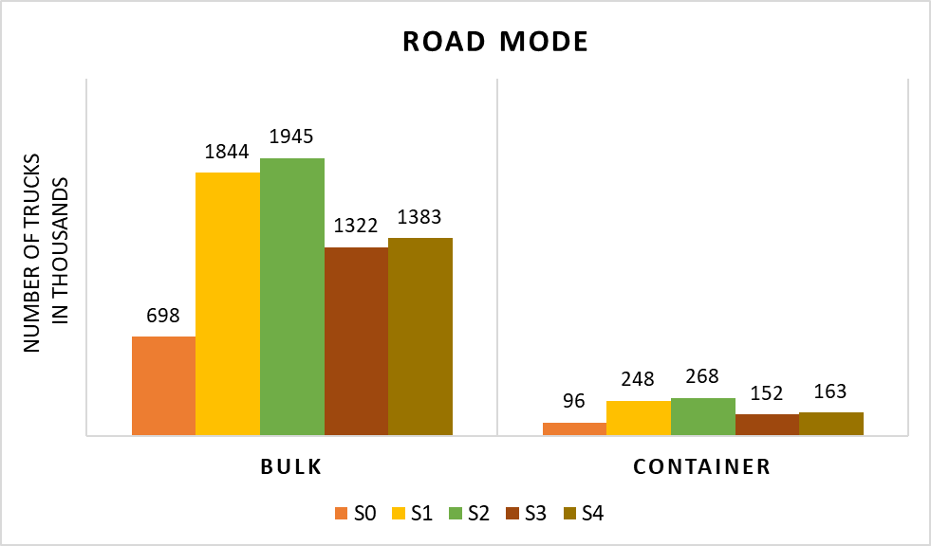
AfCFTA requires 1,844,000 trucks for bulk cargo and 248,000 trucks for container cargo by 2030. This increases to 1,945,000 and 268,000 trucks respectively if planned infrastructure projects are also implemented
Number of trucks in thousands according to the scenario by type of load

Slide 18
The largest demand for trucks to support AfCFTA is within West Africa (39%); demand from West to Southern Africa is 19.8% and from Southern Africa to Western Africa by 9.9%
39% of total fleet
Scenario Do-everything, With FTA (S2)

Slide 19
Rail

Slide 20
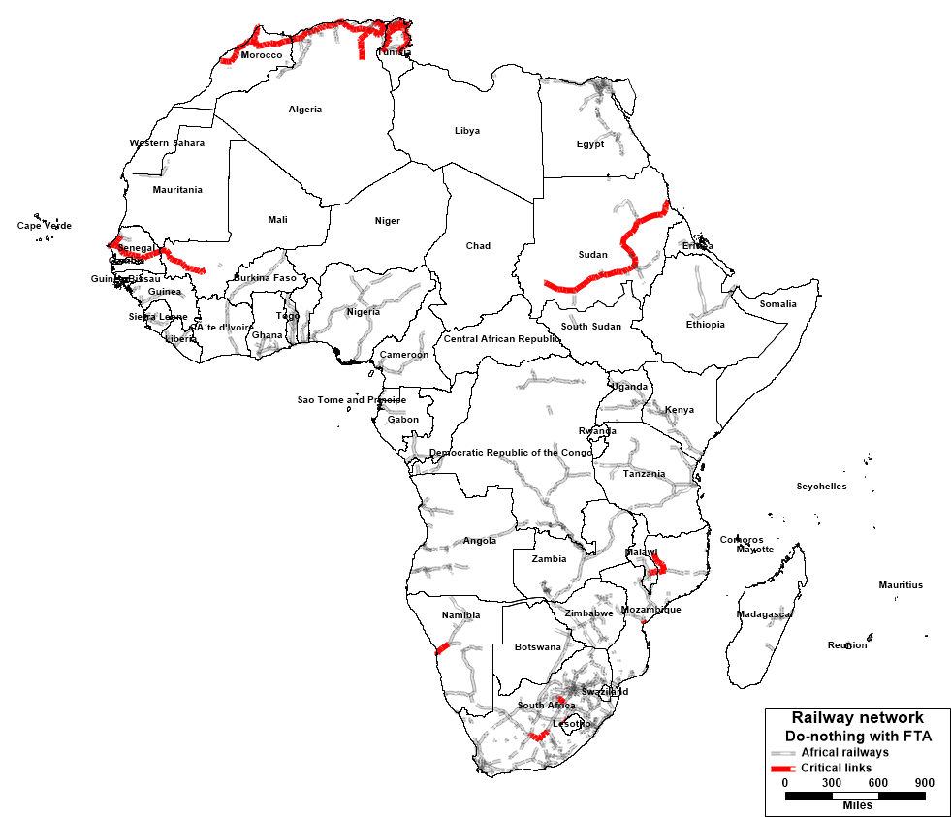
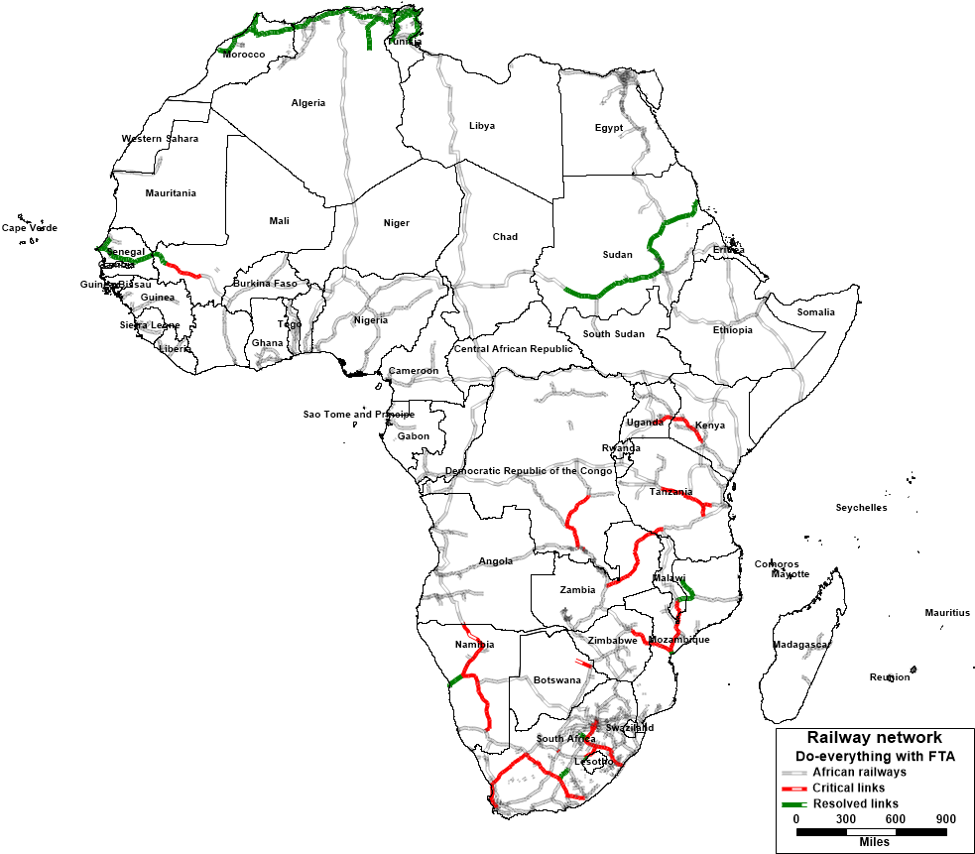
Africa’s Rail Network
Critical links with current network
Critical links with current network
plus planned projects
Study on AfCFTA

Slide 21
Africa’s Rail networks is inadequate, but implementing PIDA and other planned projects will significantly increase its size
Africa’s rail network is about 80,607km while that of the U.S. exceeds 150,500km
Implementing planned projects will increase the network by almost 26,500km
Africa has at least 40 freight stations

Slide 22
+ Implementing AfCFTA will increase rail freight 52 times, from 0.76 to 39 million tonnes
Rail currently transports just 0.3% of total intra-Africa freight
This increases to 6.8% with the implementation of AfCFTA
The total length of current railways that require upgrading (critical links) if AfCFTA is implemented and planned projects are not implemented is 8,760 km
Critical links are located mostly in Central Africa ( Chad, Congo, DRC) Eastern Africa (Kenya, Tanzania, Uganda) and Southern Africa (South Africa, Namibia, Botswana, Zimbabwe, Mozambique, Malawi) and a section of the railway network in Mali

Slide 23
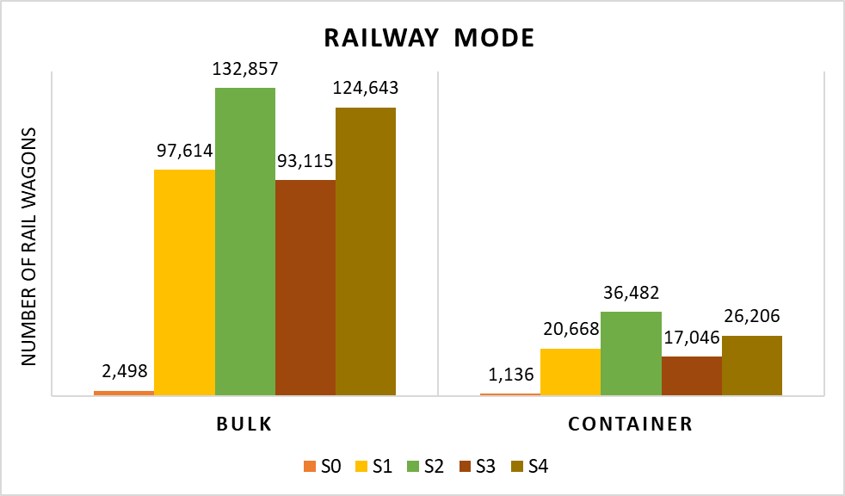
AfCFTA requires 97,614 wagons for bulk cargo and 20,668 wagons for container cargo by 2030. This increases to 132,857 and 36,482 wagons respectively if planned infrastructure projects are also implemented
Number of rail wagons in thousands according to the scenario by type of load

Slide 24
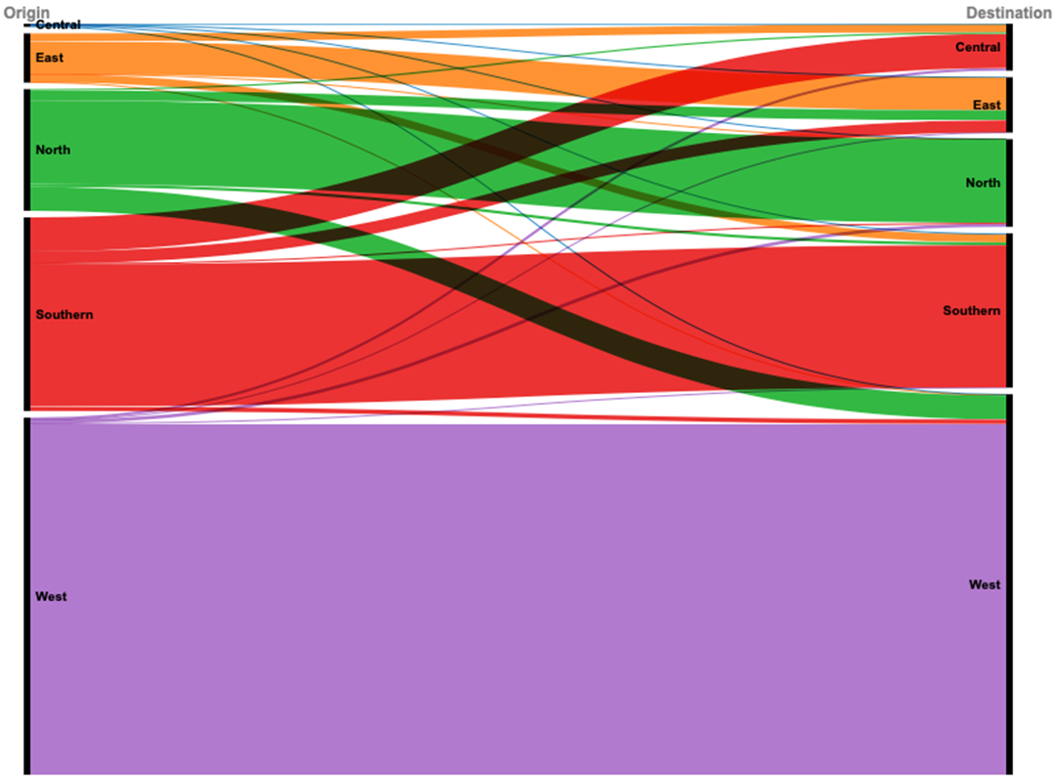
The largest rolling stock demand to support AfCFTA is within West Africa with 48.8%; within Southern Africa with 19.6% and within North Africa with 11.5%

Slide 25
Maritime Transport

Slide 26
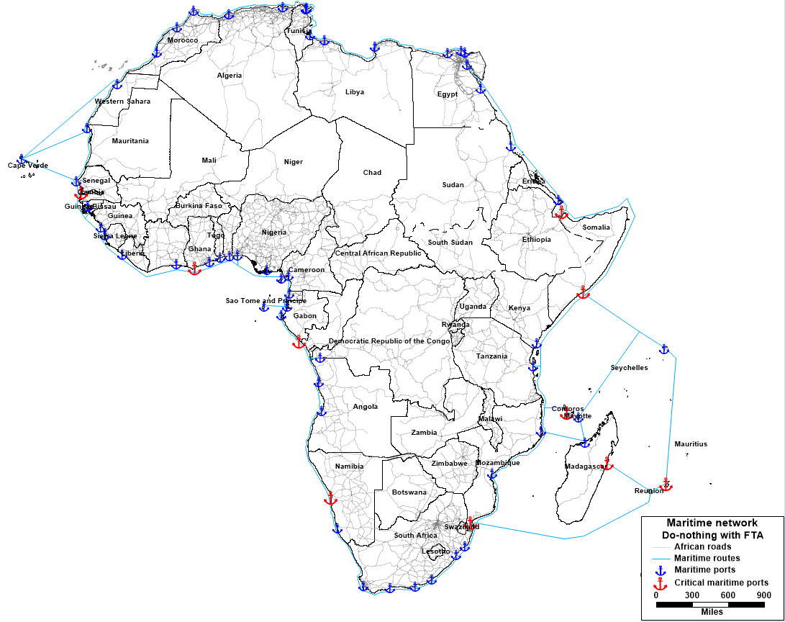
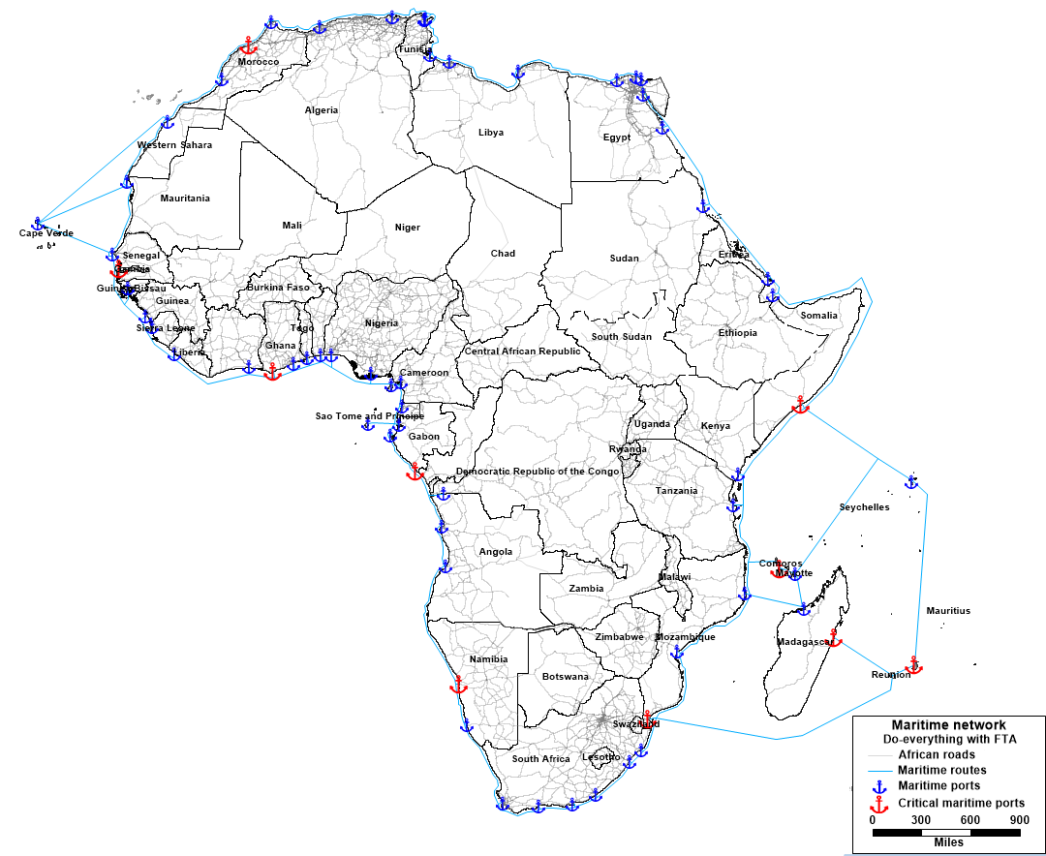
Africa’s Maritime Transport Infrastructure
Critical ports with current network
$$\text{Critical} \text{ports} \text{with} \text{current} \text{network}$$
$$\text{plus} \text{planned} \text{projecst}$$
Study on AfCFTA

Slide 27
Implementing AfCFTA would double maritime freight from 58 to 131.5 million tonnes
Africa’s maritime network includes 142 links connecting 65 ports; accounts for 22.1% of intra-African freight transport
Share will increase by 0.6% to 22.7% if both AfCFTA and planned infrastructure projects are implemented
Will increase by 1.5% if AfCFTA is implemented but planned projects are not
Maritime ports that require upgrades (critical ports) are located in: Central Africa (Gabon), Western Africa (Ghana, Gambia), Eastern Africa (Somalia, Comoros, Mauritius) and Southern Africa (Mozambique, Madagascar, Namibia)
Study on AfCFTA

Slide 28
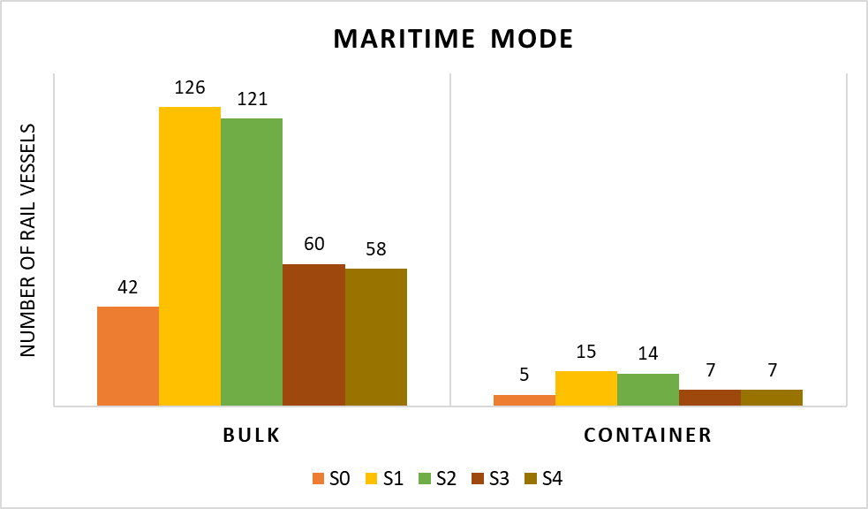
AfCFTA requires 126 vessels for bulk cargo and 15 vessels for container cargo by 2030. This reduces to 121 and 14 vessels respectively if planned infrastructure projects are also implemented
Number of vessels according to the scenario by type of load.

Slide 29
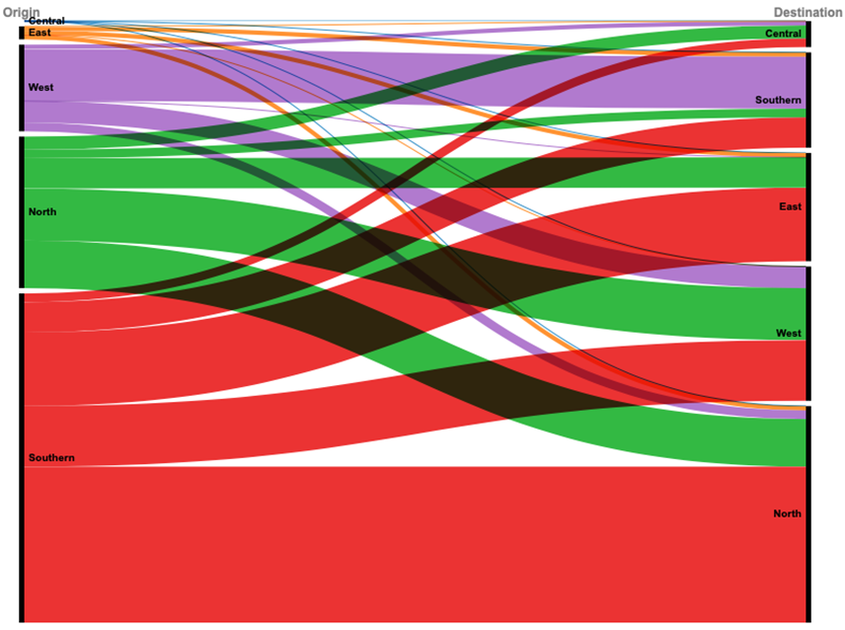
The largest demand for vessels to support AfCFTA is within North Africa (35%); demand from North to East Africa is 15.2% and from North to West Africa is 11.4%

Slide 30
Air Transport

Slide 31
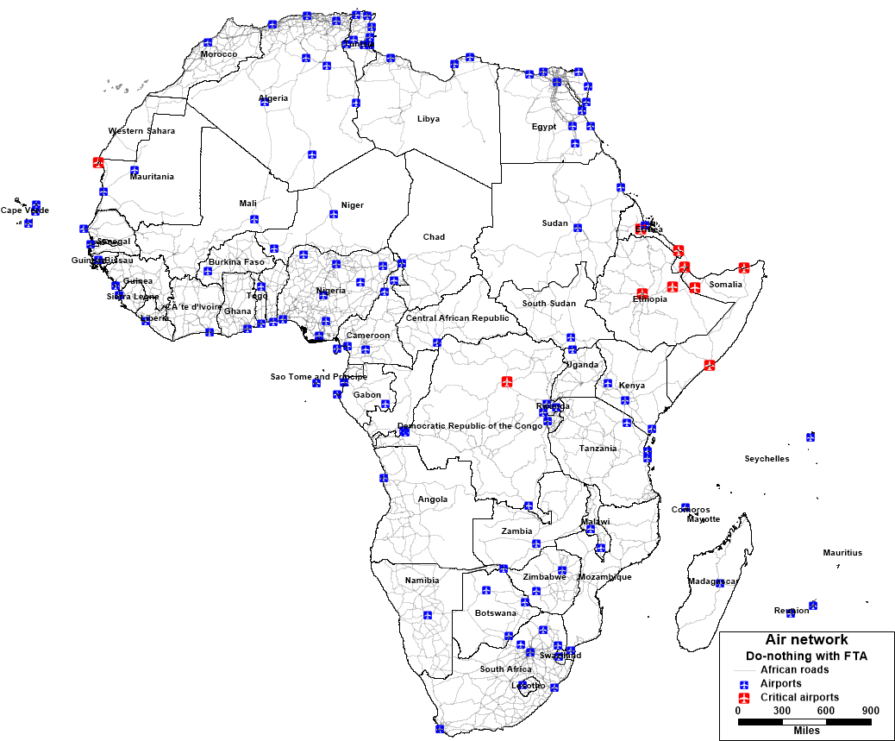
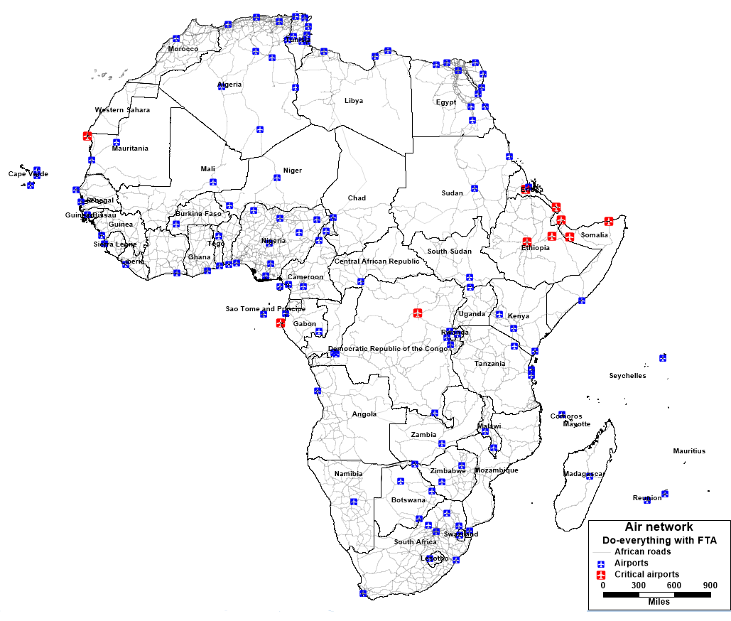
Africa’s Air Transport Infrastructure
Critical airports with current network
Critical airports with current network
Plus planned projects
Study on AfCFTA

Slide 32
Africa has multiple airports of importance to intra-African trade
Africa has 925 airports out of which 122 are identified as international airports
The continent’s air transport network includes a total of 14,762 air routes (connecting each airport with the other 121 airports)

Slide 33
Implementing AfCFTA would double the number of tonnes transported by air from 2.3 to 4.5 million
In 2019, air accounted for only 0.9% of intra-Africa freight transport
Implementation of AfCFTA would double airfreight from 2.3 to 4.5 million tonnes
Air traffic is therefore expected to double in 2030 compared to 2019
Critical airports are located in Mauritania (North Africa), DRC, Gabon (Central Africa), Somalia, Ethiopia, Eritrea, Djibouti (Eastern Africa)

Slide 34
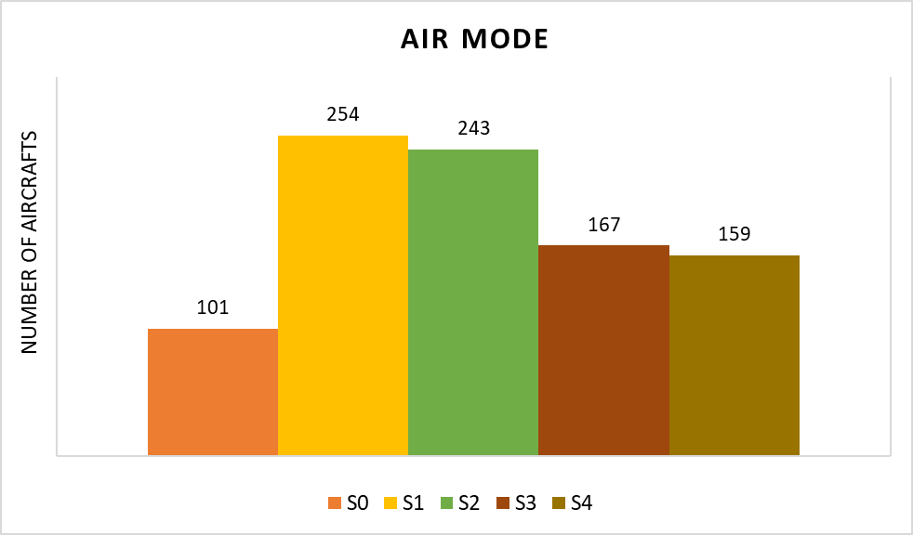
AfCFTA requires 254 aircraft by 2030. This reduces to 243 if planned infrastructure projects are also implemented
Number of aircrafts according to the scenario by type of load.

Slide 35
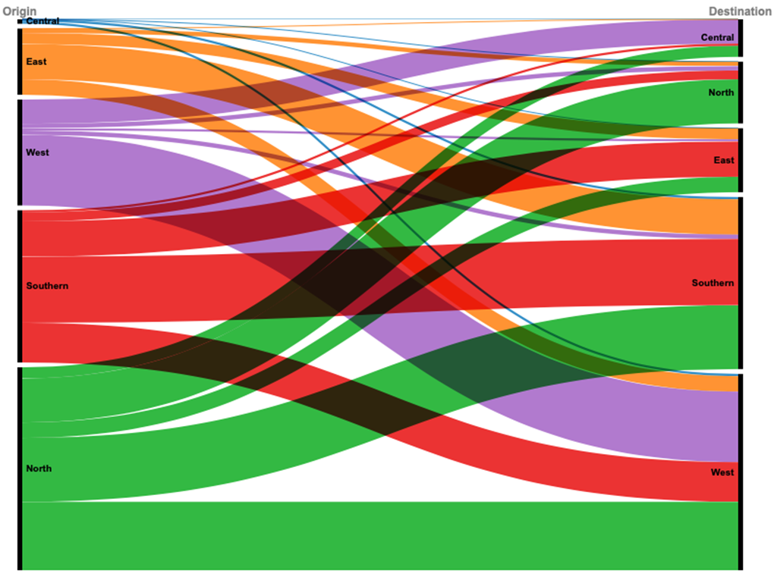
The largest demand for aircraft to support AfCFTA is within West Africa (13.2%); demand from North to West Africa is 15.2% and within Southern Africa is 12.2%

Slide 36
Multimodal Transport: Comparison by Mode

Slide 37
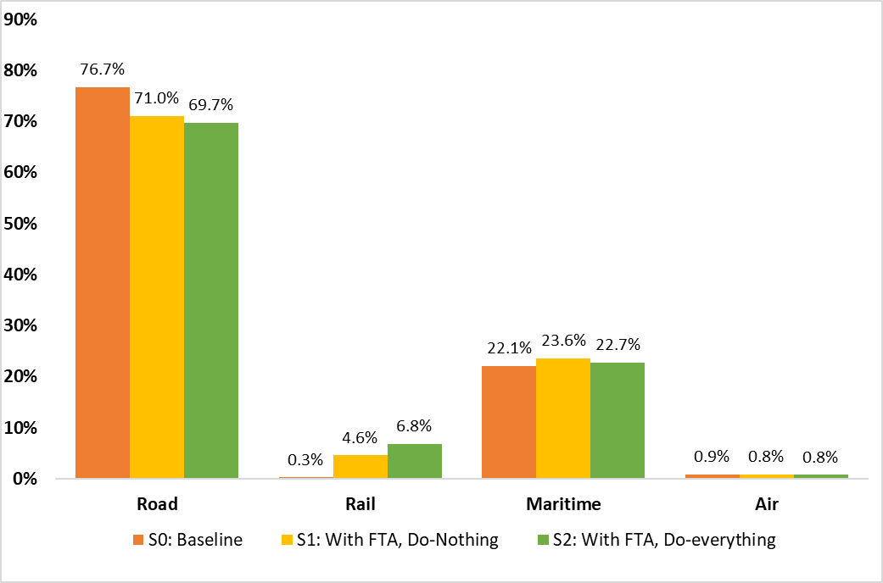
+ Roads currently carry the lion’s share of freight in Africa + AfCFTA provides an opportunity to build Africa’s railway network

Slide 38
AfCFTA would increase intra-Africa freight demand by 28%; demand for maritime freight will increase the most

Slide 39
AfCFTA would increase transport equipment needs significantly for all modes of transport (1)

Slide 40
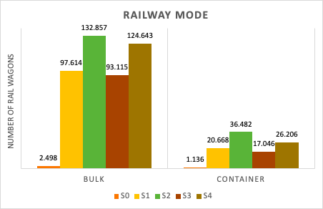
AfCFTA would increase transport equipment needs significantly for all modes of transport (2)
With FTA
Without FTA

Slide 41
Investment Opportunities

Slide 42
Roads and Railways
Location of critical links in road network (those that require upgrading)
Western Africa and Central Africa (Nigeria, Central African Republic, and Cameroon)
Eastern Africa (Ethiopia, Eritrea and Somalia)
Location of critical links in current rail network
Northern Africa (Algeria, Tunisia, Morocco)
Eastern Africa (Sudan, Kenya, Tanzania, Uganda)
Western Africa (Senegal, Mali)
Southern Africa (South Africa, Namibia, Mozambique, Botswana, Zimbabwe, Malawi)
Central Africa (Chad, Congo, DRC)

Slide 43
Airport and Maritime Port Infrastructure
Location of critical maritime ports
Central Africa (Gabon)
Western Africa (Ghana, Gambia)
Eastern Africa (Somalia, Comoros, Mauritius)
Southern Africa (Mozambique, Madagascar, Namibia).
Location of critical airports
Northern Africa (Mauritania)
Central Africa (DRC, Gabon)
Eastern Africa (Somalia, Ethiopia, Eritrea, Djibouti).

Slide 44
Number of equipment required by transport mode if AfCFTA and planned infrastructure are implemented
Unit | Truck | Railway wagon | Vessel | Aircraft
Bulk | 1,945,141 | 132,857 | 121 | 243
Container | 268,438 | 36,482 | 14 | -

Slide 45
Estimated costs for equipment required by transport mode (million USD)
Parameter | Trucks | Rail wagons | Vessels | Airplanes
Bulk (million USD) | 291,771.2 | 26,571.4 | 4,235 | 25,758
Container (million USD) | 53,687.6 | 9,120.5 | 420

Slide 46
Regional Investment Opportunities
Expected high demand for trucks in West and Southern Africa
Expected high demand for rolling stock in West Africa, and North Africa
Expected high demand for aircraft in West Africa, North Africa and Southern Africa
Expected high demand for vessels in North Africa, East Africa and West Africa.

Slide 47
Investing in PIDA is essential for AfCFTA
69 priority PIDA projects adopted by AU Heads of State in 2021
Implementation cost estimated at US$ 160.8bn
25 transport project
Roads (11); Rail (6), Air (1), Port (2), Inland Water (4), Border Post (1)

Slide 48
Conclusions
AfCFTA and Africa’s transport infrastructure programmes are intrinsically linked and should be implemented simultaneously
TAH, PIDA and the Single African Air Transport Market (SAATM) should be prioritised at the same level with AfCFTA
Current infrastructure and services, in all modes of transport, in Africa require upgrading to cope with increased freight from AfCFTA
Implementing TAH, PIDA and SAATM will close the anticipated capacity gaps
Reaping the huge benefits of AfCFTA to the transport sector requires implementation of regional infrastructure and services programmes

Slide 49
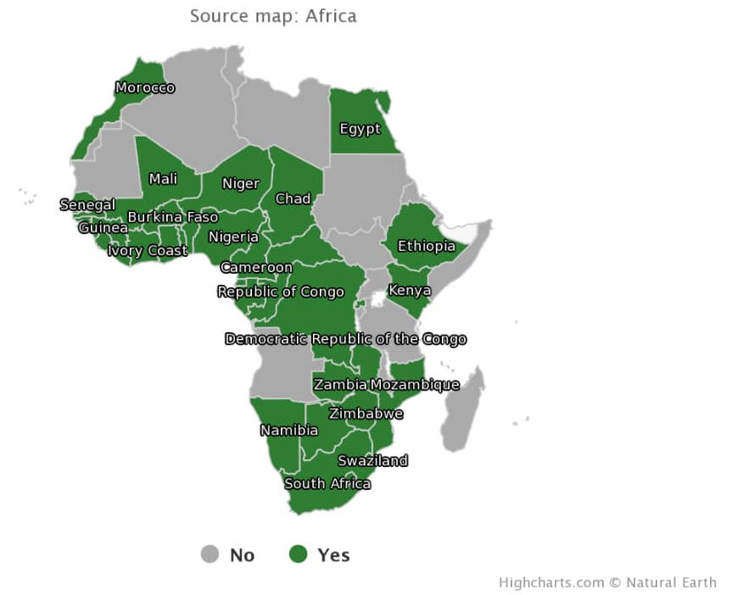
35 countries are signatories to the Solemn Commitment to SAATM: All African countries should sign and implement SAATM

Slide 50
THANK YOU!

