Slide 1

International Comparison Program for Africa (ICP-Africa)
Highlights of the results of the ICP-Africa 2011 round
“Comparing the Real Size of African Economies”
Statistics Commission for Africa Meeting
December 10-12 2014, Tunis, Tunisia

Slide 2
Outline
  Introduction
  Overview of the ICP 2011 round
  Some highlights of the results
  Africa in the World – Overview
  Dissemination of results
  Potential uses of ICP data
  Main Lessons Learnt and Recommendatons
  The Way Forward

Slide 3
Introduction 1/4
Each country estimates its GDP and component expenditures at national price levels and in national currencies.
In order to make sound comparison of economic & social data - they need to be valued at a common price level and expressed in a common currency.
  Countries must use an approach which removes the distortion caused by using exchange rates. Giving rise to;
  The ICP - uses “Purchasing Power Parities” (PPPs) to effect this double conversion: expressed in a common currency & valued at a common price level

Slide 4
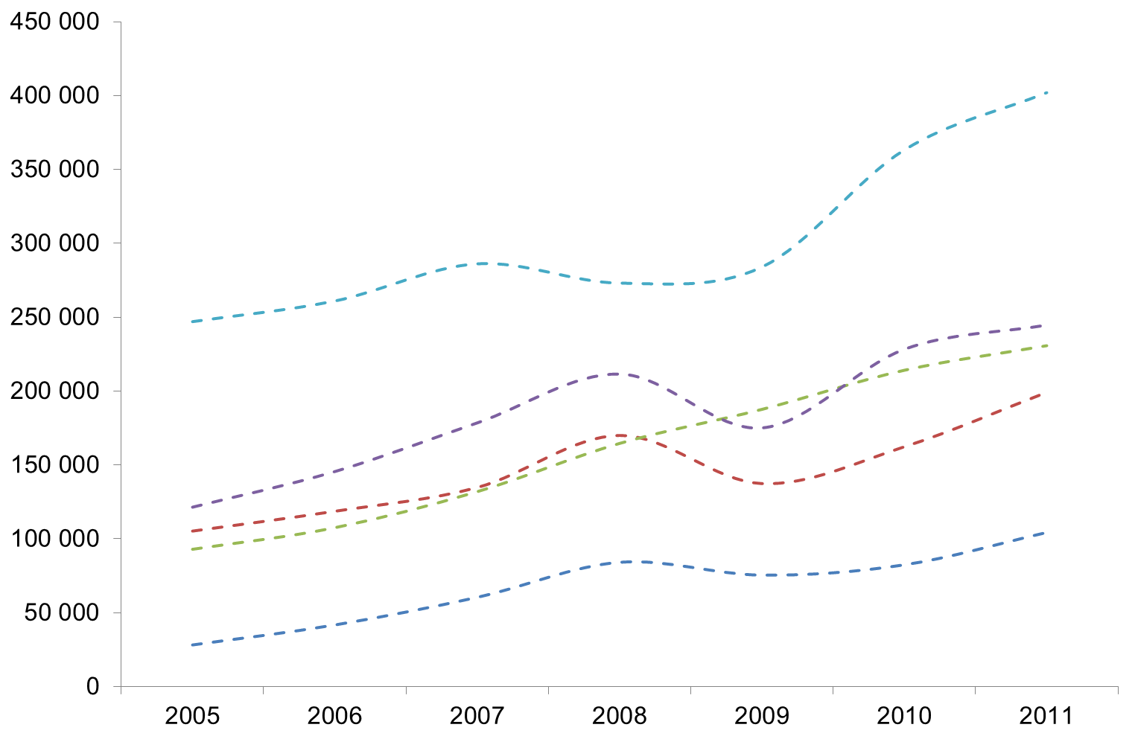





Introduction Size of African Economies unadjusted for currency & price levels 2/4
GDP in constant prices for top five countries
2005-2011
08
05
09
10
11
07
20
06
South Africa
Billions ($)
Nigeria
Algeria
Egypt
Angola

Slide 5
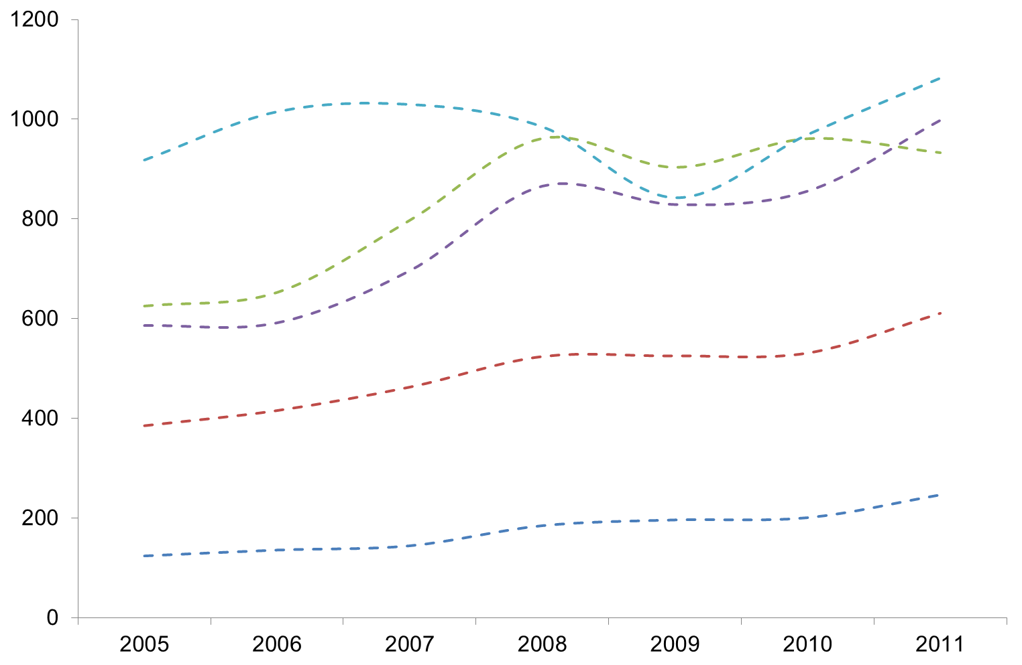





Introduction Size of African Economies unadjusted for currency and price levels 3/4
GDP in constant prices for bottom five countries
2005-2011
08
05
09
10
11
07
20
06
Seychelles
Gambia
Billions ($)
Guinea-Bissau
Comoros
Sao Tome & Principe

Slide 6
Introduction 4/4
  Why ICP?
To produce internationally comparable price levels, economic aggregates in real terms and Purchasing Power Parity estimates
Simply put - to compare the GDPs of different countries with a view to determining their relative size, productivity and material well-being.
  What is a PPP?
PPP allows one to estimate what the exchange rate between two currencies would have to be in order for the exchange to be on par with the purchasing power of the two countries' currencies.
  As an example between two countries - is an exchange rate at which the currency of one country needs to be converted into that of the second country in order to purchase the same volume of goods and services in both countries
Formally, PPPs are expenditure-weighted averages of relative prices of a vast number of goods and services on which people spend their incomes.

Slide 7
Overview of the ICP 2011 Number of participating countries 1/3
More than 100% increase in number of African Country Participation between 1993 and 2005
No increase in African Country Participation between 1985 and 1993

Slide 8

Overview of the 2011 ICP - Participating countries in Africa 2/3
50
participating countries
26%
of ICP participating countries
Non participating countries

Slide 9
Overview of the 2011 ICP Regional coordination and Activities 3/3
The AfDB provided the overall management and coordination of the 2011 International Comparison Program (ICP) in Africa
Activities were conducted in close collaboration with participating countries and sub-regional Organizations, AFRISTAT, COMESA, ECOWAS and SADC

Slide 10
Highlights of Results

Slide 11

Nominal GDP Country Shares ( Africa = 100%) 1/18
With 48 participating Countries (excluding Algeria & Seychelles)
06
07
08
09
10
11
2005
2011
20
05

Slide 12
Nominal GDP Country Shares ( Africa = 100%) 2/18
With 50 participating countries (including Algeria & Seychelles)
2011

Slide 13
Real GDP Country Shares ( Africa = 100%) 3/18
With 48 participating Countries (excluding Algeria & Seychelles)
06
07
08
09
10
11
20
05

Slide 14
Real GDP Country Shares ( Africa = 100%) 4/18
(With 50 participating Countries (including Algeria & Seychelles)

Slide 15
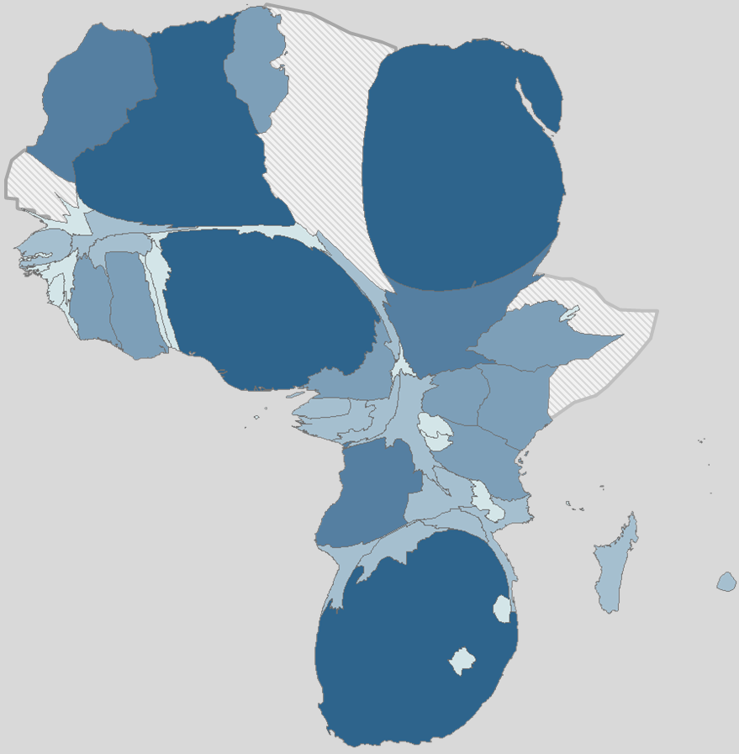
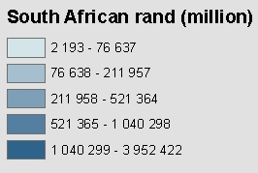
5/18
Algeria
(4)
Egypt
(1)
Nigeria
(3)
The four giants
Countries by real GDP
South African rand (million)
South Africa
(2)

Slide 16
New Scenario: GDP Country Shares ( Africa = 100%) 6/18
Using Nigeria new revised figures for 2013

Slide 17
7/18
New scenario of four giants in 2013
Real GDP
4
Algeria
9.7%
2
Egypt
18.6%
1
Nigeria
19.3%
3
South Africa
13.7%

Slide 18

Africa’s share to World in 2011 8/18
Population
Share
14%
Africa
13%
GDP Share
4.5 %
18
Africa
4.5 4%

Slide 19
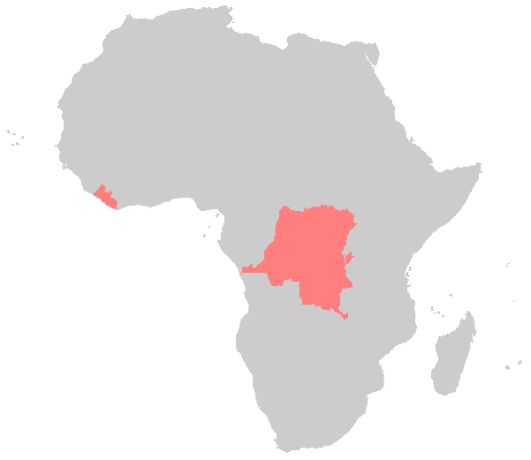
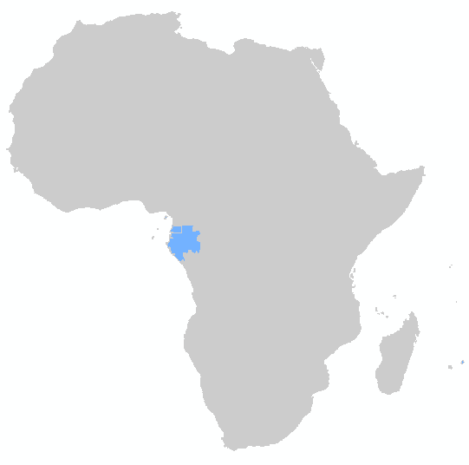


High and Low income countries and their distribution 9/18
Four small countries have the Highest Per capita GDP
Equatorial Guinea
Seychelles
Gabon
Mauritius
The Bottom of the ranking
Liberia
Comoros
Congo, Democratic Republic
Burundi

Slide 20
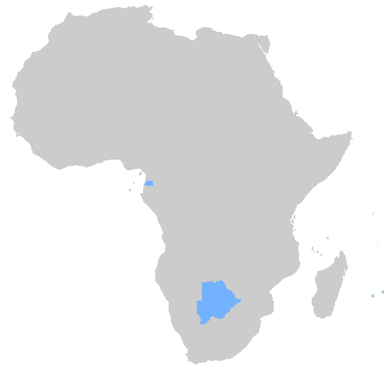

Investment: Gross Fixed Capital Formation per capita (ZAR) 10/18
High in
Equatorial Guinea
Seychelles
Botswana
Mauritius
Low savings
Poverty
Low investment
Low in
Liberia
Comoros
Burundi,
Central African Republic
Per Capita investment in 2011

Slide 21







Income and Investment 11/18
Correlation between per capita Gross Domestic Product and per capita Gross Fixed Capital Formation

Slide 22

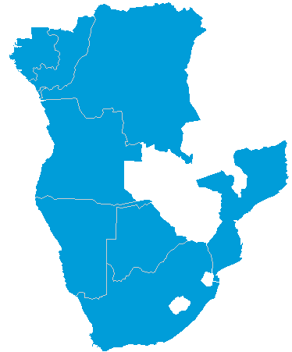
2011 Price Level Index For GDP By Country, Africa Average = 1.0
Most expensive Countries 12/18
(Price Level Index)
Africa average =
1

Slide 23
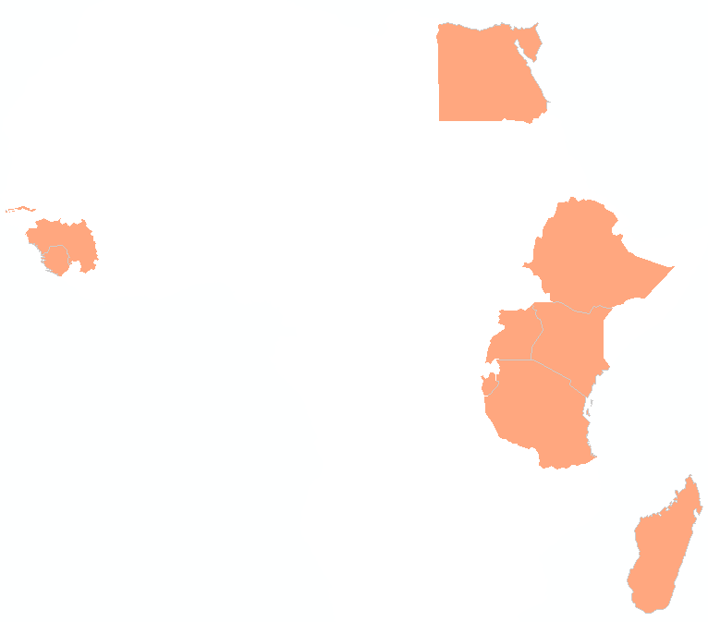
2011 Price Level Index For GDP By Country, Africa Average = 1.0
Less expensive countries 13/18
(Price Level Index)

Slide 24
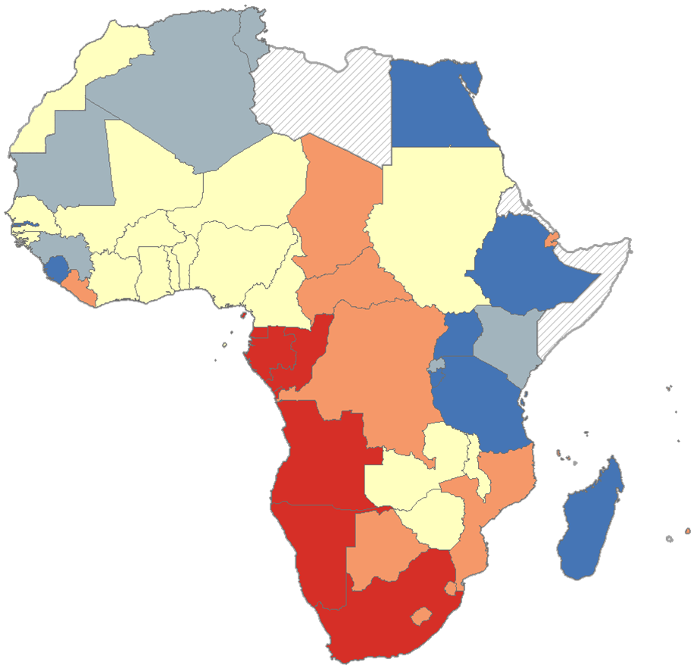
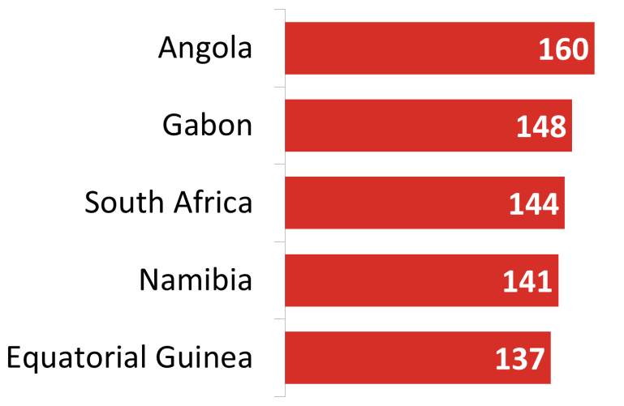
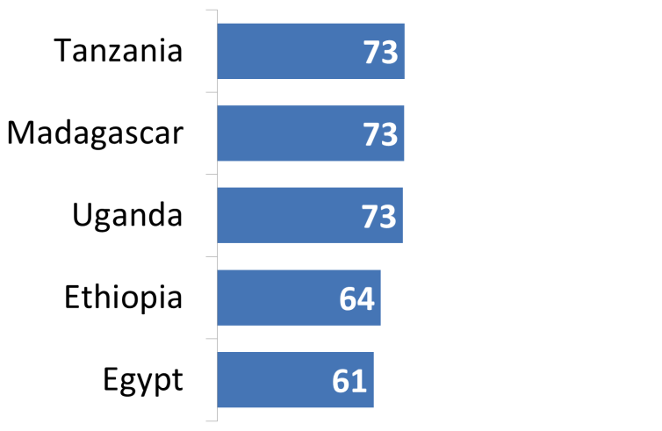
14/18
Most expensive countries
The cost of living across Africa
Africa average = 100
Least expensive countries
Less expensive
More expensive
Average

Slide 25
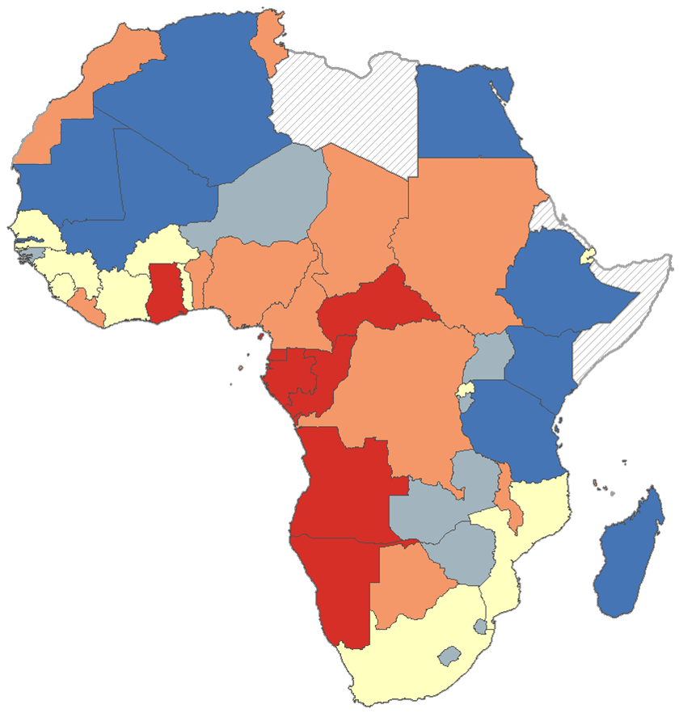
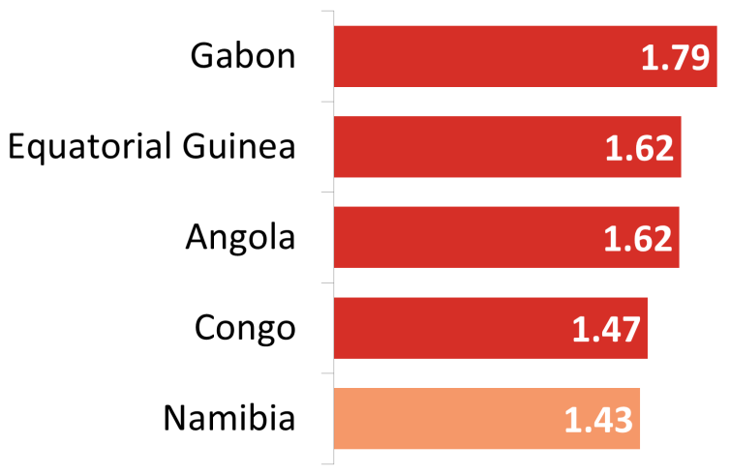
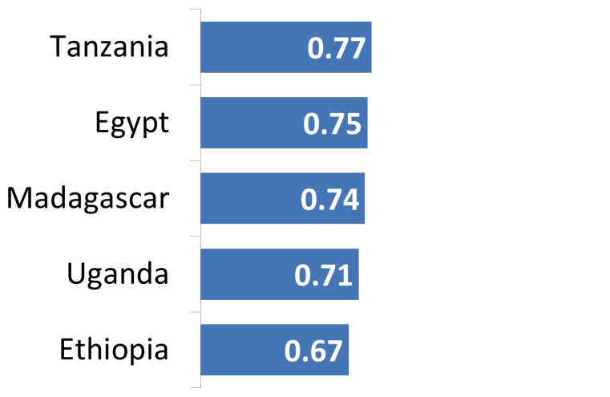
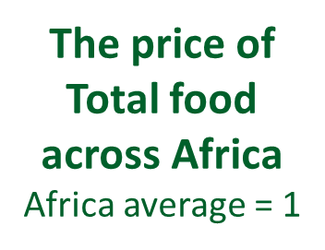
15/18
Most expensive
Least expensive
Less expensive
More expensive
Average

Slide 26

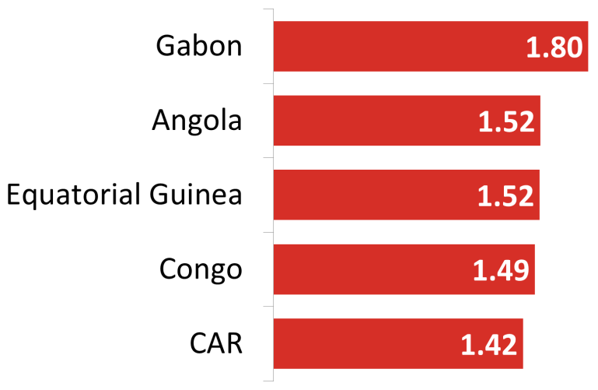
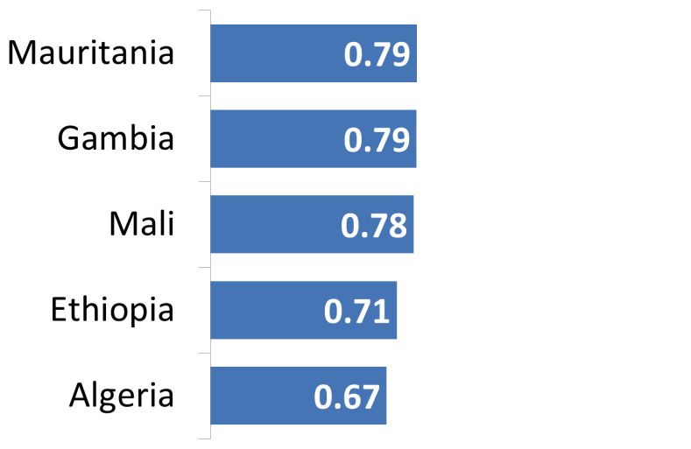
16/18
Most expensive
Least expensive
The price of bread & cereals across Africa
Africa average = 1
Bread & cereals includes rice, other cereals & flour, bread, other bakery products, and pasta products
Less expensive
More expensive
Average

Slide 27
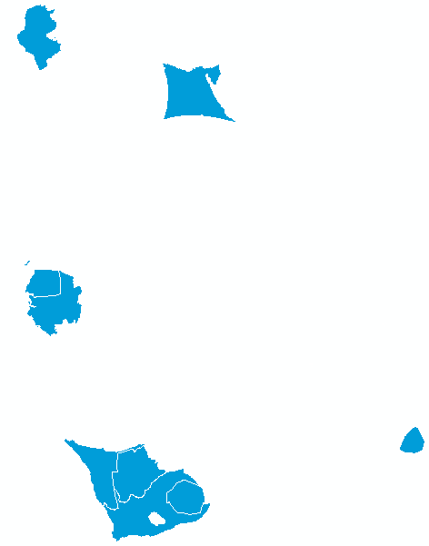
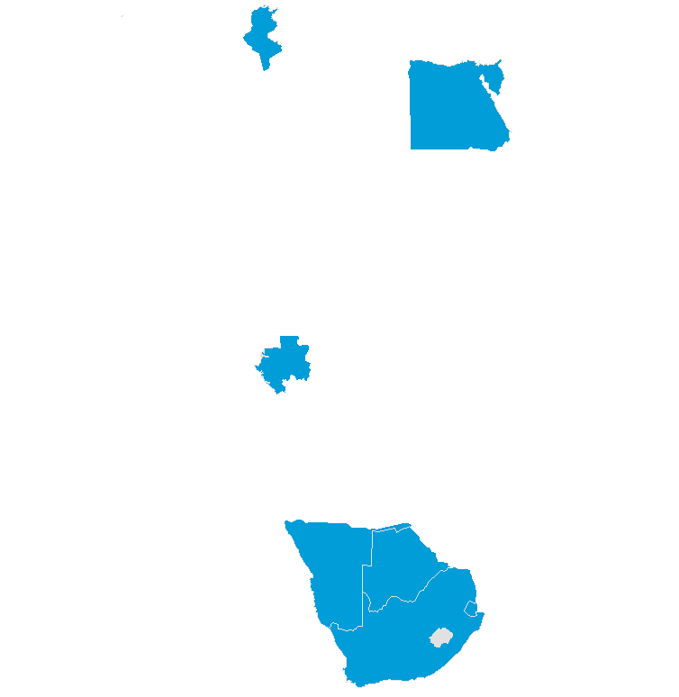
Household welfare 17/18
Per capita Actual Individual Consumption (Africa = 100)
10 highest countries

Slide 28
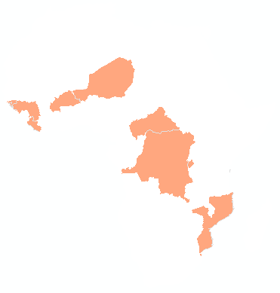
Household welfare 18/18
2011 Per capita Actual Individual Consumption (Africa = 100)
10 lowest countries

Slide 29
Africa in the World - Overview

Slide 30
Africa in the World – Overview 1/2
Regional Average Expenditures per capita, PPP-based
(Percent of World Average, World = 100)

Slide 31
Africa in the World – Overview 2/2
Regional Average Price Level Index
(Percent of World Average, World = 100)

Slide 32
Dissemination of Results 1/1
Reports :
  Comparing the Real Size of African Economies – Highlights of the Main Findings of the 2011 Round of the International Comparison Program in Africa (English and French)
  Comparing the Real Size of African Economies –Results of the 2011 International Comparison Program for Africa (English)
Results of the 2011 ICP-Africa have been presented to:
  NSOs’ Director Generals at the ASSD in February 2014 in Gaborone
  Bank Economists and Senior Management early November 2013
  Bank Governors and Board of Directors at the Bank Annual Meeting in Kigali in May 2014

Slide 33
Potential Uses of ICP Results

Slide 34
Some examples on the uses of ICP 1/3 data
ICP can used to compare your country with other countries in Africa & other countries around the world
Wealth – GDP (PPP) / population
Prosperity – HH consumption (PPP) / population
Poverty – Less than US$ 1.25 (PPP) / day
Productivity – GDP (PPP) / employed
Household spending – HH consumption (PPP) / GDP (PPP)
Expenditure of education – Household + government expenditure on education (PPP)/ GDP (PPP)
Food consumption - Expenditure on Food and Non-alcoholic Beverages (PPP) /population
Cost of living – PLI for Actual Household Consumption
Construction prices – PLI for Construction
Health costs – PLI for Health expenditures
ETC.

Slide 35
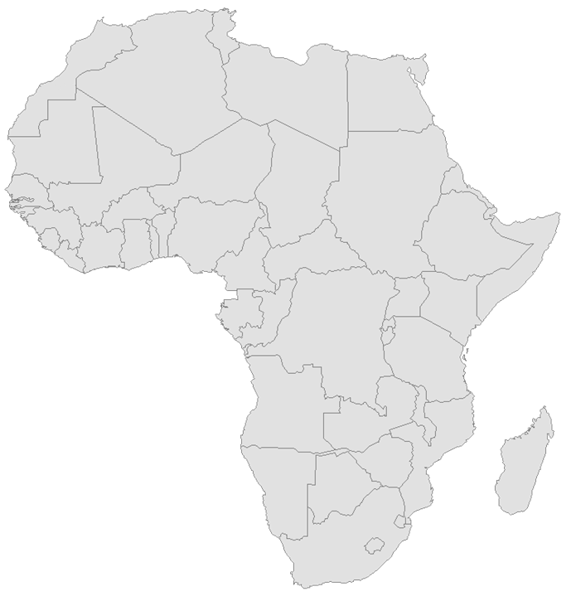
Potential Uses of ICP data 2/3
Country level
UN 1993 System of National Accounts recommends use of PPPs for cross country comparison of GDP & related
Comparing welfare & living standards (poverty analysis) US$1.25 poverty lines Poverty Analysis
Harmonizing economic policies for convergence & regional integration
Fostering intra African trade
Comparative advantage analysis & investment / employment policy decisions to improve competitiveness & business environment
Academia and research groups

Slide 36

Potential Uses of ICP data 3/3
Establishing international poverty threshold (World Bank)
Constructing the Human Development Index (UNDP)
Comparing per capita health expenditures (WHO)
Assessing per capita education expenditures (UNESCO)
Monitoring the welfare of children (UNICEF)
Comparing the relative sizes of economies (AfDB, IMF)
Estimating weighted averages of regional growth rates (AfDB, IMF)
Academia and research groups
International level

Slide 37
Main Lessons Learnt and Recommendations 1/1
Integrating the ICP and CPI data collection of the main household consumption items created synergy and reduced cost
Bringing all stakeholders to work together on some activities had a leverage effect on both AfDB and participating countries
Weak participation of STCs. AfDB to spearhead a process to introduce ICP methodology into their curricula and by encouraging them to conduct some research on ICP issues related to Africa
Countries have yet to comply with the December 2007 Accra Declaration of Heads of NSOs, which recommended the integration of ICP-Africa activities into the usual NSOs activities

Slide 38
The Way Forward 1/2
Undertaking a reduced ICP-Africa in 2015
  Reduce price data collection for the main HH consumption
  survey but full GDP coverage
  Presentation and discussion on the reduced list of product
  Preparatory activities with countries
  Launching workshop in Feb 2014
  Quarterly price data collection starting in March 2014

Slide 39
The Way Forward 2/2
Integration of ICP-CPI Activities
Working in collaboration with the SROs the AfDB is expected to promote the establishment of a legal and regulatory framework for a better integration between the (H)CPI and ICP in the RMCs.
Assessment of the CPI or HCPI systems in each and every country
Establish a regional technical committee
Select a group of 7 countries to pilot the integration of (H)CPI – ICP
Develop specific training modules for STC as part of AfDB capacity building support to countries in the areas of (H)CPI and ICP

Slide 40
Thank You

