Slide 1
Comprehensive Africa Agriculture Development Programme (CAADP)
December 9, 2014
Tunis, Tunisia

Slide 2
What is CAADP?
CAADP is an African framework within which AU Member States plan and implement agriculture-led investment plans and programmes to enhance food and nutrition security, eliminate hunger, reduce poverty and accelerate economic growth.
In 2003, the AU made agriculture one of its core pillars of development through the adoption of the Maputo Declaration.

Slide 3
AU Member states adopted CAADP and agreed to increase public investment in agriculture by a minimum of 10 per cent of national budgets in order to increase annual Agricultural GDP growth by at least 6 per cent.
2014 marks the 10th anniversary since CAADP was adopted and, within a decade, 50 out of 54 countries are using the CAADP framework in their agricultural transformation planning. 2014 is also significant as it was declared the YOA by the AU Heads of State and Government

Slide 4
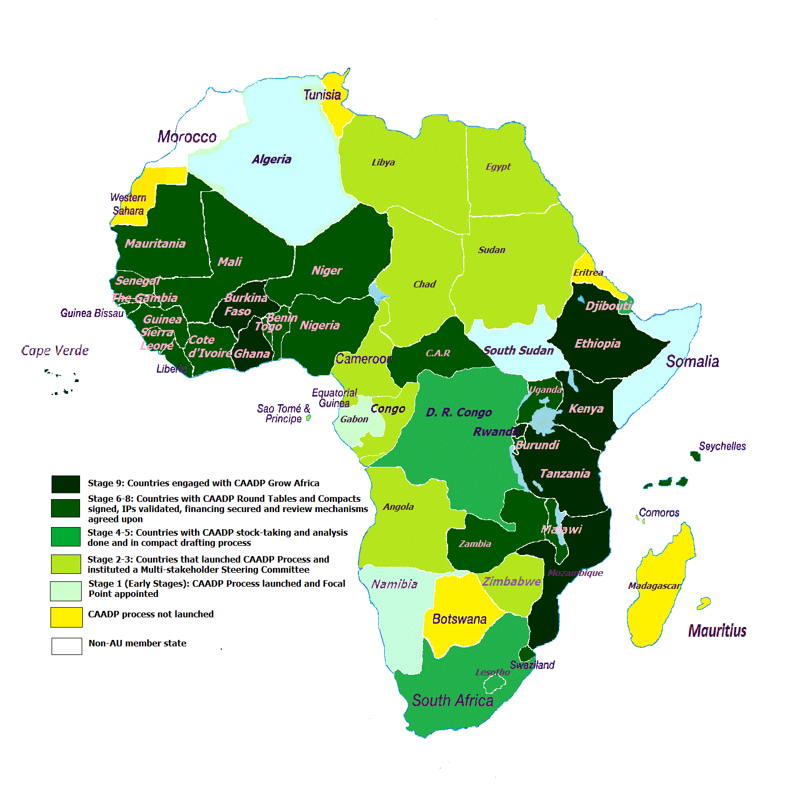

Slide 5
The 2014 African Year of Agriculture and Food Security CAADP @10

Slide 6
Africa’s Paradox and the Outlook
Africa is among the fastest growing regions in the world – agriculture also growing
Africa is the most food insecure continent with a quarter of its population categorized as undernourished
The Outlook:
Africa is at the center of the ‘Mega’ Global Trends agenda: demography, urbanisation, technology, climate change, etc.
Agriculture at the nexus of these Agenda

Slide 7
CAADP 10 Years on…
CAADP as a powerful tool of advocacy asserting the strategic importance of agricultural transformation in Africa
now thanks largely due to the instrumentality of CAADP, it is fashionable to talk of agricultural development as a priority; it wasn’t the case before.
CAADP as African owned and led strategic agenda

Slide 8
Year of Agriculture Milestones
CAADP PP – Stakeholder Consultation (March)
Ministers Conference (May)
24th AU Summit
23rd AU Summit
2012
2013
2014
2015
Validation
Endorsement
AU Summit – Declare 2014 as Year of Agriculture
The Sustaining CAADP Momentum exercise
The CAADP Results Framework
The CAADP Implementation Strategy and Roadmap
The Malabo Declaration

Slide 9
The 2025 3AGTGs
Investment Finance
Accelerated growth (production & Productivity)
Resilience & risk management
Food Security & Nutrition
Markets & regional trade

Slide 10
Malabo Declaration Commitments
Recommitment to the Principles and Values of the CAADP Process
Recommitment to enhance investment finance in Agriculture
Commitment to Ending Hunger by 2025
Commitment to Halving Poverty , by 2025, through inclusive Agricultural Growth and Transformation
Commitment to Boosting Intra-African Trade in Agricultural Commodities & Services
Commitment to Enhancing Resilience of Livelihoods & Production Systems to Climate Variability and Other Shocks
Commitment to Mutual Accountability to Actions and Results

Slide 11
Malabo Declaration Call for Action
AUC and NPCA to develop an Implementation Strategy and Roadmap
Facilitate the translation of the 2025 vision and goals of Africa Agricultural Growth and Transformation into concrete results and impacts
January 2015 – Ordinary Session of the Executive Council for Consideration

Slide 12
The Draft Implementation Strategy

Slide 13
Why the IS&R [1/2]
Malabo – about Implementation, Results and Impact
The commitment to a Results Framework and bi-annual review of progress and performance, i.e. commitment to action and to accountability
In this context, CAADP’s catalytic role should prioritise strengthening and aligning implementation capacity in community, national, regional and continental structures and institutions
Through the CAADP Result Framework, Africa has defined priority results areas representing (i.e. the change at 2025):
Reform of agriculture systems in terms of systemic ability to delivery &
in terms of generating and contributing economic value
Malabo, precise on strengthening systemic capacity to Implement

Slide 14
Why the IS&RM …. [2/2]
IS&R meant to:
guide making of choices in terms of set of actions to (a) delivering expected results and impact, based on (b) strengthened systemic implementation capacity as set in the Malabo Commitments and CAADP Results Framework
Objectives:
Objective 1: to Transform Agriculture and sustained inclusive growth
Objective 2: to Strengthen Systemic Capacity to implement and deliver Results

Slide 15
Why the IS&R [3/3]
The IS&R will stimulate and guide impact on:
Institutional execution capacity linked to a set of factors including organisation effectiveness and efficiency in resource use; management skills; decision making system; learning & adapting
Enabling policy practice (aligned to implementation)
Alliances and partnerships for implementation
The IS&R will also help address challenges such as:
Misalignment in organizational strategies and roles
Discrepancy between continental commitments and national-level follow-up actions
Lack of clarity and coherence in translation of political vision into action and deliverables

Slide 16
Strategic Actions Areas
Objective 2: Strengthened Systemic Capacity to implement and deliver Results
Strengthen capacity for planning
Strengthen policies and institutions
Strengthen leadership, coordination and partnership
Enhance skills, knowledge and agricultural education
Strengthen data and statistics
Institutionalize mutual accountability
Increase public and private financing
Objective 1: Transformed Agriculture and sustained inclusive growth
Increase production and productivity
Enhance markets, trade and value chains
Increase resilience of livelihoods and systems
Strengthen governance of natural resources

Slide 17
Implementation Strategic Action Areas
Agricultural contribution to economic Growth and Inclusive Development
CAADP Principles
CAADP Results Framework - 2025
CAADP Results Framework - 2015
Implementation capacity
Wealth creation; Food Security & Nutrition; Economic Opportunities; Social Safety nets; Resilience
Investment Financing to Agriculture
Zero Hunger
Agricultural Performance (Production; Agro-industry & commerce)
Half Poverty
Production-Productivity; Intra-African trade; functioning agro-markets; Agro-industry; Natural resource management
Implementation arrangements – Partnerships & Alliances
Intra-African Trade in Agric Commodities & Services
CAADP value addition – strengthen systemic capacity to deliver
Social & environmental resilience
Policies; Institutions; Partnerships: Investment; Monitoring and Data-knowledge management
Assessing Progress & Accountability

Slide 18
Implementing the Strategic Action Areas and Roadmap
Guiding Principles
Implementation (committing and using resources) fully a national level responsibility
Clearly defined implementation architecture - (a) implementation entities (mapping of institutions and constituencies implicated); (b) specific responsibilities / systemically accountable for and ( c) implementation linkages and relationships (leverage; interests; catalytic, etc…)
National - Regional value loop
Clarifying action by the countries and hence support actions by continental and regional institutions (synergies, complementarities and subsidiarity)
Accountability /accountable institutions central
Investing in institutions and in People
Leadership and champions

Slide 19
Continental Level: AUC/NPCA
Implementation support
CAADP PP
Ministers Conference
HoSG Summits
Technical Agencies
Development Partners
Technical Partners
NSA
Regional Level: REC
Implementation
Implementation support
Regional Ministers Meetings/ HoSG Summits
Country Level: Secretariat/ASWG
Implementation: Execution (i) Transformation of Agriculture, (ii) Systemic Capacity
Joint Sector Reviews

Slide 20
Roadmap for the Implementation (1/2 )
The Strategic Actions Areas are composed of specific Sub Actions
For each Sub Actions the Roadmap defines Milestones to be achieved within:
Short tem (2015)
Medium term (2016 – 2020)
Long term (2021 – 2025)

Slide 21
Roadmap for the Implementation – Example of SAA 2e (2/2 )
SAA 2e: Strengthen data and statistics for evidence based planning, implementation, monitoring and evaluation and review process
Collect and Manage data
Data analysis
Data sharing
2015
Data Gaps for key indicators
Capacity needs assessed
Indicators benefiting from sharing identified
2016-2020
Data collectors trained in electronic forms
Capacity enhanced
Sharing platforms established
2021-2015
All Data available
Analysis available
Data on key indicators shared

Slide 22
CAADP Results Framework 2015-2025

Slide 23
Why the CAADP Results Framework
Malabo Declaration Commitment on Mutual Accountability for systematic regular review process – Biennal Review
Using the CAADP Results Framework to measure progress towards achieving the Goals
The persistent desire at all levels to see greater results and impacts

Slide 24
Impact to which CAADP contributes
Level 1 – Agriculture’s Contribution to Economic Growth and Inclusive Development
Changes in African agriculture resulting from the implementation of CAADP approach are measured at this level
Level 2 – Agricultural Transformation and Sustained Inclusive Agricultural Growth
This level measures the following Malabo commitments: Commitment 3: Commitment to Ending Hunger in Africa by 2025
Commitment 4: Commitment to Halving Poverty, by the year 2025, through Inclusive Agric Growth & Transformation
Commitment 5: Commitment to Boosting Intra-African Trade in Agricultural commodities and services
Commitment 6: Enhancing Resilience of Livelihoods & Production Systems to Climate Variability and other related risks
2.1 Increased agriculture production and productivity
2.2 Increased intra-African regional trade and better functioning of national & regional markets
2.3 Expanded local agro-industry and value chain development ensuring participation of women and youth
2.4 Increased access to productive safety nets and more nutrition sensitive agriculture investments
2.5 Improved management of natural resources for sustainable agriculture
Added value of CAADP support and interventions to institutional transformation and CAADP operational effectiveness is measured at this level
Level 3 Strengthening Systemic capacity to deliver results
This level measures the following Malabo commitments:
Commitment 1: Recommitment to the Principles and Values of the CAADP Process;
Commitment 2: Recommitment to enhance investment finance in Agriculture; and
Commitment 7: Commitment to Mutual Accountability to Actions and Results
3.1 More effective and inclusive policy design and implementation processes
3.2 More effective and accountable institutions including measuring implementation of their policy and investment commitments
3.3 Strengthened capacity for evidence based planning, implementation & review processes
3.4 Improved multi-sectoral coordination, partnerships and mutual accountability in the agric sector and related sectors
3.5 Increased public and private investments in agriculture
3.6 Increased capacity to generate and use data, information and knowledge

Slide 25
Use of the CAADP Results Framework at country level
The CAADP Results Framework will serve as a guide and tool to:
Examine and align the goals and targets (results and impact) and associated performance indicators in the NAIPs;
Help the country to refine and focus set performance targets of the NAIPs;
Rally unity of purpose around a common national agenda and deliverables; and
Examine and refine, strengthen and align existing national level tools and systems for monitoring, evaluation, and facilitating learning and strengthening accountability.

Slide 26
Use of the CAADP Results Framework at continental and Regional levels
The CAADP Results Framework will:
Provide priority areas, targets and indicators which define “CAADP implementation support” at Level 3 in the Results Framework;
Serve as the central “yardstick” to standardise and benchmark as well as facilitate, guide and compel alignment and harmonisation of strategies and programmes by all players and stakeholders

Slide 27
Result Areas – Level 1 (Impact) | Indicators
1.1. Increased Income | Income per capita, Gini coefficient, national poverty rate, poverty headcount
1.2. Improved Food & Nutrition Security | Hunger index, food aid compared to food supply, stunting index
1.3. Economic opportunities and prosperity – jobs and poverty Alleviation | Job created per annum, numbers of SMEs, Socio-economic growth and development - total factor productivity
1.4. Increased Resilience | Farm, pastoral and fisher households that are resilient to climate and weather related risk, Capacity to withstand shocks Absorptive, Adaptive and Transformative capacity

Slide 28
Result Areas – Level 2 (Outcome) | Indicators
2.1.Increased agricultural production and productivity | Change in Ag. Total Factor productivity , Agriculture GDP Growth, Agriculture Production Index
2.2. Increased intra-African regional trade and better functioning of national & regional markets | share of intra-regional trade in agriculture commodities and services, Per capita Agricultural Imports, Per Capita Agricultural Exports, Agriculture Exports Share in Total Exports, Agriculture Imports Share in Total Imports, Functioning markets, Trade index
2.3. Expanded local agro-industry and value- chain development value chains ensuring participation of women and youth | Volume of sales in SMEs engaged in post-harvest, processing and distribution of food and other agricultural commodities, Number of employees by gender in SMEs
2.4. Increased access to productive Safety nets | Food reserves as share of Total food production, Cash reserves as a share of Agricultural GDP
2.5. Improved management, governance and sustainable use of natural resources for agricultural production | area under Sustainable Land and Water Management, irrigation, implementing voluntary guidelines on responsible governance of tenure of land, forests and fisheries

Slide 29
Result Areas – Level 3 (Outputs) | Indicators
3.1. More effective and inclusive policy design and implementation processes | Existence of a Compact signed by major stakeholders, Existence of a post-Malabo NAIP/NAFSIP, Cumulative number of JSRs implemented, Composition of participants at most-recent JSR
3.2. More effective and accountable institutions | institutionalized mechanisms for mutual accountability , comprehensive and operational M&E system
3.3. Strengthened capacity of evidence-based planning, implementation, and review processes | (FTE) professionals in agricultural policy planning and M&E,
3.4. Improved multi-sectoral coordination, partnerships, and mutual accountability | agriculture-related Public Private Partnerships (PPPs) , joint projects between agriculture and non agriculture sectors , value of investments
3.5 Increased public and private investment in agriculture | public expenditure allocated to agriculture sector, private investment in agriculture and agribusiness
3.6. Increased capacity to generate and use data, information, and knowledge | Index of capacity to generate and use statistical data and information , operational country SAKSS

Slide 30
Linkages
Malabo Declaration,
Implementation Strategy and Roadmap,
CAADP Results Framework

Slide 31
Linkages between Malabo Declaration, IS&R and the CAADP RF
IS&R defines a set of Strategic Action Areas (SAAs) based on national and regional plans to enable results
CAADP Results Framework, main tool for measuring progress of performance in achieving Malabo Declaration commitments and targets and informs review of national and regional plans through learning from results

Slide 32
Malabo Declaration Commitments
CAADP Results
Objectives and Strategic Action Areas
National Plans
Regional Plans

Slide 33
Thank You

