Slide 1
The Trust Fund for Statistical Capacity Building General Information
The trust fund (TFSCB) is a multi-donor trust fund which was launched in 1999, and has provided funding to over 200 projects, in all regions of the world.
The trust fund aims to strengthen the capacity of statistical systems in developing countries, and supports two main types of projects: i) Preparation and/or updating of National Strategies for the Development of Statistics (NSDS); and
ii) Improvement in statistical capacity in key priority areas, such as those highlighted in the Busan Action Plan for Statistics (BAPS) and the post-2015 agenda.

Slide 2
TFSCB – General Information con.
All World Bank member countries are eligible to apply for funding, with priority given to IDA countries. The maximum amount for any one proposal is $500,000 and the duration period covers 2 years. Application windows are generally held twice per year. Funding can also be provided to sub-regional, regional, and international organizations.
In general, the main goal of the TFSCB is to improve statistical capacity in a sustainable manner. The funds provided cannot be used to replace national budgetary resources. Projects should be aligned with Country Partnership Strategies and other international programs, and in line with the PARIS21 overall approach.

Slide 3
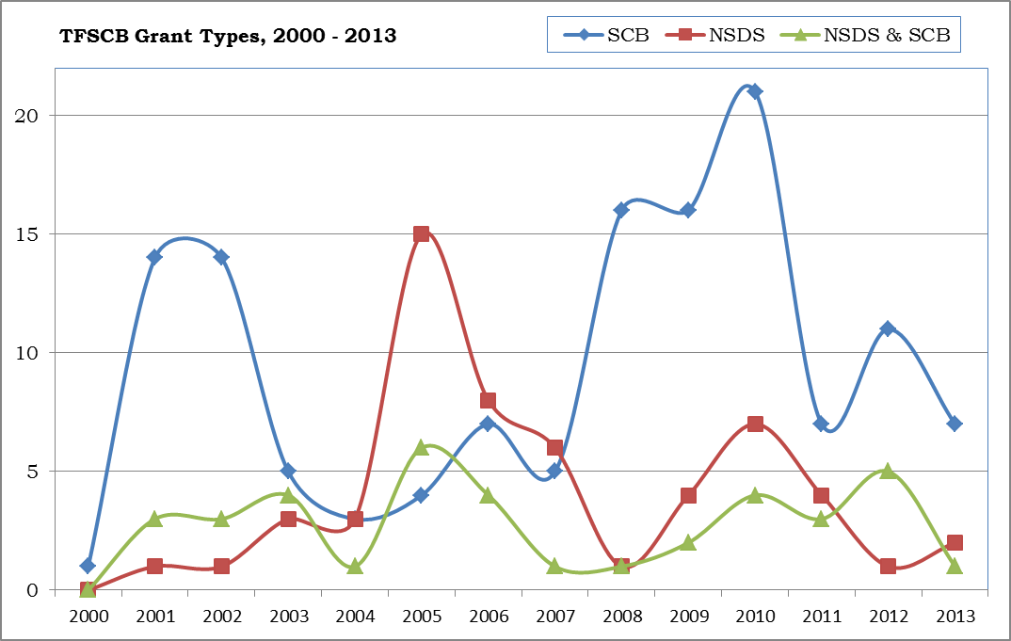
TFSCB – Subject Areas
Key priority areas include gender projects, administrative data sources, Open Data projects, environmental projects (especially the System of Environmental Accounting, or SEEA), and innovative approaches.
Types of Projects:
Statistical Capacity (SCB) – 131
National Strategy (NSDS) – 56
Combination NSDS & SCB - 37

Slide 4
Africa Region and TFSCB
The Africa Region has had a history of the most significant beneficiary region in the TFSCB, as reflected in the table below, in $....
Project Commitments by Region and Type of Project from 2000 – 2013 (millions of US$)
 | SCB Projects | NSDS Projects | Mixed SCB & NSDS Projects | Other Projects | Total | Regional Percentage
Sub-Saharan Africa | $6.1 | $2.2 | $5.3 | $0 | $13.6 | 32%
East Asia and the Pacific | $3.0 | $0.8 | $1.4 | $0 | $5.2 | 12%
Europe and Central Asia | $3.8 | $0.9 | $1.2 | $0 | $5.9 | 14%
Latin America and the Caribbean | $5.0 | $1.3 | $0.7 | $0 | $7.0 | 16%
Middle East and North Africa | $1.8 | $0.2 | $0.5 | $0 | $2.5 | 6%
South Asia | $1.3 | $0.7 | $0.5 | $0 | $2.4 | 6%
Global | $5.0 | $0.1 | $0.0 | $0.9 | $6.1 | 14%
Total | $26.0 | $6.2 | $9.6 | $0.9 | $42.7
Project Type Percentage | 61% | 15% | 22% | 2%

Slide 5
Africa Region and TFSCB
And by number of projects (includes regional projects).

