Slide 1
New and Ongoing Statistical Initiatives of the African Development Bank and its Partners
Sixth Meeting of the Forum on Africa Statistical Development (FASDEV)
Tunis, Tunisia
8 December 2014

Slide 2
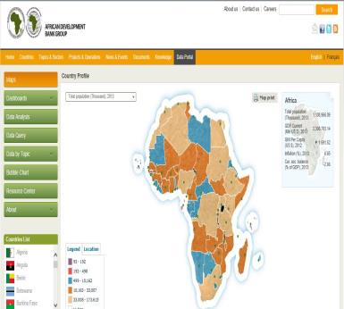
Table of Contents
Introduction
Statistical Development
Statistical Governance and Coordination
Frameworks and Strategies to Harmonize Statistics
Progress in Statistical Development
Statistical Development
Initiatives Developed Under SCB Program
Recent Innovations in Methods of Data Collection and Management

Slide 3
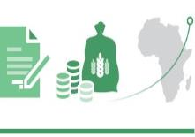
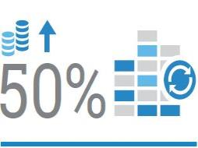
Introduction
Over the past 10 years, statistical development in Africa has emphasized
Developing statistical architecture on the governance and harmonization mechanisms; and
Creating strategic and operational frameworks for coordination of statistical systems in the region
African statistical development and activities are standardized through
United Nations Statistical Commission (UNSC)
Coordination Committee for Statistical Activities (CCSA)
In 2013, MOU was signed between AfDB, other MDBs and the UN for coordination of country-level statistical capacity building, and hence created;
A Global Contact Group
Development of an African Contact Group led by the AfDB (other members are WB, IMF, UNSD & BMGF as observers)
Why ? To operationalize the elements in the MOU
Notes:
African statistical development and activities conform to international standards and norms based on the membership of African countries and institutions of the network of the oversight organs of the United Nations Statistical Commission (UNSC) and the Coordination Committee for Statistical Activities (CCSA) as the highest entity for the global statistical systems.
More recently in 2013, the President of the African Development Bank signed an MOU with other Heads of MDBs and the UN for coordination of country-level statistical capacity building and a Global Contact Group, with the development of an African Contact Group led by the AfDB for the implementation of a concrete program on the MOU.

Slide 4
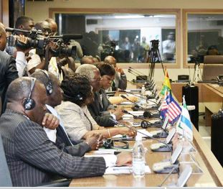
Statistical Development
Political commitment at the highest level
African Charter on Statistics
Adopted in 2009 by the African Heads of State and Government
Underscores the importance of statistics for decision-making at all levels and engages member countries to develop statistics that are consistent with international standards
Has since led to greater use of statistics in policy and decision-making processes
Strategy for the Harmonization of Statistics in Africa (SHaSA)
Adopted by the Heads of State and Government in July 2009
Formulated by pan-African institutions and countries to support the African integration agenda, particularly the Minimum Integration Program (MIP)
Aims to provide harmonized reliable statistics for the design and implementation, as well as monitoring and evaluation of integration and development policies in Africa
Notes:
African Charter on Statistics was adopted in 2009 by the African Heads of State and Government. The Charter underscores the importance of statistics for decision-making at all levels and engages member countries to develop statistics that are consistent with international standards. The signatories to the Charter also committed to scaling up financial support for statistical activities. The Charter led to greater use of statistics in policy and decision-making processes. Advocacy for the endorsement and implementation of the provision of the Charter by member countries is led by the Pan-African institutions, namely the African Development Bank, African Union Commission and the UN Economic Commission for Africa.
Strategy for the Harmonization of Statistics in Africa (SHaSA) was formulated by pan-African institutions and countries to support the African integration agenda, particularly the Minimum Integration Program (MIP). The strategy was adopted by the Heads of State and Government in July 2009 and aims to provide harmonized reliable statistics for the design and implementation as well as monitoring and evaluation of integration and development policies in Africa.

Slide 5
Statistical Governance and Coordination
A number of organs have been set up to promote statistical governance and coordination in Africa
Statistical Commission for Africa (StatCom-Africa)
African Statistical Coordination Committee (ASCC)
African Symposium on Statistical Development (ASSD)
National Data User–Producer Committee
African Contact Group on Enhancing Collaboration to Improve Statistics for the Post 2015 Development Agenda
Their membership comprises of representatives from the relevant institutions in member countries and regional and sub-regional organizations
Notes:
Statistical Commission for Africa (StatCom-Africa) was endorsed by African Ministers of Finance, Planning and Economic Development in 2007 as the apex inter-governmental process for coordinating statistical activities and development issues in Africa. Members of the Commission are heads of National Statistics Offices. The Commission established working groups that seek solutions to data challenges in the various statistical areas.
African Statistical Coordination Committee (ASCC) is one of the working groups of Stat-Com, with the AfDB and UNECA as co-chairs; and, AUC and African Capacity Building Foundation (ACBF) as members. The Committee oversees the coordination and harmonization of statistical development by (i) Reviewing statistical programs in Africa; (ii) Organizing joint statistical programs and expert groups meetings; and (iii) Publishing a joint “African Statistical Yearbook”
African Symposium on Statistical Development (ASSD) is coordinated by Statistics South Africa in collaboration with the AfDB, ECA, and AUC. It promotes the strengthening of capacity of the region’s statistical practitioners to work together to share best practices. The Symposium also helps to create career opportunities in statistics for young people and women.
National Data User–Producer Committee coordinates the national statistical activities to support work on specific sector and thematic areas. The Committee is responsible for ensuring data relevance by ensuring a common understanding of policy issues and the data requirements; setting data priorities, clarifying the objectives for data collection, and agreeing on the best methods for collecting data. It enables data users to routinely specify their needs and data producers to indicate what data are available, how to access them and problems are experienced in data production among others.
African Contact Group on Enhancing Collaboration to Improve Statistics for the Post 2015 Development Agenda, is comprised of the AfDB, World Bank, IMF, United Nations Statistics Division (UNSD), and the Bill & Melinda Gates Foundation (BMGF) as an observer. The Contact Group convened in April 2014 to discuss methods for enhancing collaboration on statistical development activities amongst Multilateral Development Banks (MDGs). The partners agreed to collaborate on (i) influencing political discourse through the revised National Strategy for the Development of Statistics (NSDS); (ii) supporting the production of statistics by expanding the System of National Accounts (SNA) to include integrated household surveys; (iii) strengthening knowledge sharing and innovation through the use of standardized technology; and (iv) increase funding for statistical development activities.

Slide 6
Frameworks and Strategies to Harmonize Statistics
Reference Regional Strategic Framework for Statistical Capacity Building in Africa (RRSF)
Formulated by the African Development Bank, UN Economic Commission for Africa, and the World Bank , with support of RMCs
Provides guidance and appropriate mechanisms for advancing sustainable statistical capacity in Africa by emphasizing country ownership in the preparation of NSDS
National Strategy for the Development of Statistics (NSDS)
Provides a national country-owned instrument for the coordination of country statistical activities
Objective – improve the scope, quantity and quality of official statistics in support of evidence-based policy, planning and decision-making
Strategy for the Harmonization of Statistics in Africa (SHaSA)
Founded by Pan-African institutions & RMCs to support Africa Integration agenda
Aim – provide reliable & comparable statistics for the design, implementation & monitoring and evaluation of regional integration & development programs

Slide 7
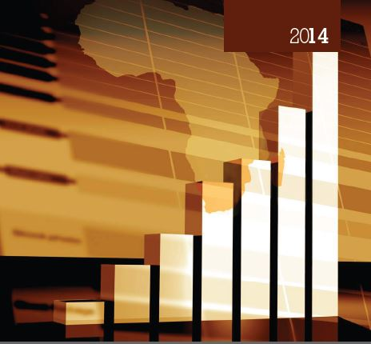
Progress in Statistical Development
These initiatives
Have systematically and steadily improved the scope, content and quality of statistics in African countries
Promoted the production, management and wider and easier access to official data by:
Improving scope, content and quantity, analysis, management, and dissemination of data
Making statistics accessible to all in open data platforms and promoting their extensive use by governments and all stakeholders for decision-making processes
Providing accessibility to the public to promote transparency and good governance by holding governments accountable
Increasing resources for statistics from governments, development partners and other stakeholders

Slide 8
Statistical Development
SCB one of main “vehicles” of statistical development
Implemented by the African Development Bank since 2004 in collaboration with major development partners
Under the program AfDB has committed over US$ 100 million in grants to support:
Strategy, organizational and methods development to promote statistical infrastructure
Adaptation of international statistical standards to conditions in RMCs
Harmonization of data generation and dissemination practices for data comparability across RMCs with the rest of the world
Training of RMC and SRO officials to strengthen statistical capacity

Slide 9
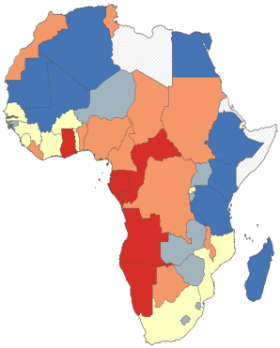
Initiatives Developed under SCB Program
The African Information Highway (AIH)
Launched in 2012
Data Portals/Open Data systems with common IT Platforms installed in all 54 African countries and 16 African sub-regional and regional organizations
One-stop shop to all data necessary for managing and monitoring development results in African countries
Advocacy for Population and Housing Censuses
Undertaken by ASSD
Resulted in the highest participation by RMCs in any round to date, with 50 African countries participating in the 2010 round of World Population and Housing Census by end-2014 compared to 35 in 2000 round
International Comparison Program for Africa (ICP)
Managed by AfDB since 2002 to measure price levels and economic aggregates in real terms across Africa
Capacity-building platform for price statistics, national accounts and related statistics and adopting best practices in economic and social statistics
Civil Registration and Vital Statistics
Implemented by AfDB in collaboration with other Pan Africa institutiions
Notes:
The African Information Highway (AIH) was launched by the AfDB in 2012 to provide an open data platform for increasing access to information to support transparency and accountability: Under the program, Data Portals/Open Data systems with common IT Platforms have been installed in all 54 African countries and 16 African sub-regional and regional organizations.
International Comparison Program for Africa (ICP) is being managed by AfDB since 2002 to measure price levels and economic aggregates in real terms comparable across Africa countries. Due to the initiative, the participation of African countries in the program increased to 50 in the 2011 round against 48 in the 2005 round, 22 in the 1993 and 1 in 1973. Unlike the other regions, the AfDB has adapted the program to also serve as a capacity-building platform for price statistics, national accounts and related statistics and adopting best practices in economic and social statistics.

Slide 10
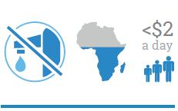
Initiatives Developed under SCB Program (cont.)
Africa Infrastructure Knowledge Program (AIKP)
Adopts a longer-term perspective in providing a framework for generating country-level knowledge on infrastructure on a more sustainable basis
Provides benchmarks for measuring improvements in infrastructure services to ensure that finances are directed where they will have the greatest impact
Labor Statistics: the Bank assists RMCs to improve their labor statistics through:
operational and methodological guidebooks for conducting labor force and household surveys
Assisting countries with the undertaking of labor surveys and labor statistics classifications
Providing training for African sampling statisticians
Improving Data on Food Security, Sustainable Agricultural and Rural Development
Under the Global Strategy for Improving Statistics for Food Security, Sustainable Agriculture & Rural Development, the Action Plan for Africa was formulated by AfDB, UNECA, & the FAO
Rebasing of GDP & reviews
Several countries already assisted with GDP rebasing by AfDB in collaboration with the World Bank and IMF, with 35 countries due to rebase in the near future
Peer review of national accounts
Preparation of Country Statistical Profile (CStP)
diagnostic and programming tool for evaluating the national and sector development strategies
Notes:
Rebasing of GDP: Countries assisted recently under the program by AfDB in collaboration with the World Bank and IMF to rebase their GDP include Burundi, Djibouti, Comoros, Gambia, Ghana, Nigeria, Rwanda, Seychelles, South Africa, Zimbabwe and Zambia. Though countries are required to rebase their GDP most African countries have not been able to do so because of budgetary challenges. Over 35 countries are due for rebasing and requests for support have been received from Egypt, Kenya, and Sudan.
Preparation of Country Statistical Profile (CStP): The CStP serves as a diagnostic and programming tool for evaluating the national and sector development strategies, priorities and programs, and the M&E systems; support from development partners; and, identifies challenges and constraints in the national statistical systems. It proposes national and sector statistical strategies aligned to the national development agenda and programs with the objective of statistics assuming the role of the tool for results measurement and economic management. The CStP serves as an instrument of dialogue between the Government and development partners on coordination of statistical development and activities. The CStP has been prepared for 19 countries and one sub-regional organization – Burundi, Chad, Comoros, ECOWAS, Ethiopia, Gabon, Gambia, Ghana, Guinea Bissau, Lesotho, Kenya, Mauritania, Mauritius, Mozambique, Nigeria, Seychelles, Tanzania, Togo, Zambia.

Slide 11
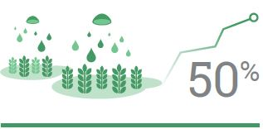
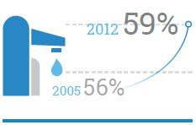
Recent Innovations in Methods of Data Collection and Management
Under the AIH initiative, the AfDB promotes the use of advanced technology through:
Quick surveys using mobile phones, hand held devises and tablets
Implemented on pilot survey of youth unemployment in DRC, Tunisia and a CWIQ survey in Uganda using a combination of telephone calls from call centers and tablets
Weekly data collection of prices for food items
AfDB in collaboration with EU’s Joint Research Center currently undertaken in 40 African countries using its AIH web platform
Data Collection undertaken by national agricultural extension systems
Expand on weekly food price data collection using mobile phones and tablets technology in multiple locations using extension officers
Notes:
Quick surveys using mobile phones, hand held devises and tablets implemented on pilot basis for real time interview analysis in Tunisia, the Democratic Republic of Congo, and Uganda on youth unemployment using CATI. This will be implemented progressively in other African countries. Other initiatives being implemented by the Bank in selected countries on pilot basis will be extended to other countries

Slide 12
Recent Innovations in Methods of Data Collection and Management (cont.)
Data Dissemination to Farmers
Providing weekly market food price data to farmers in distant markets through cell phone
Creation of Farmers’ Registries
Pilot phase initiated in Zambia with records on over 10,000 farmers collected & to be initiated in Tunisia and expanded progressively to other countries.
Digital Farm Mapping
Provide maps of all farms or agricultural land in participating countries
Overall will provide ideal frames for Agriculture. Related surveys
Notes:
Data Dissemination to Farmers through cell phone by providing weekly market food price data to farmers in distant markets to improve decision-making in the production and marketing of their produce;
Creation of Farmers’ Registries in African countries for providing key information on farmers and their activities. The pilot phase has been initiated in Zambia (with records on over 10,000 farmers collected) and Tunisia, and will be extended to Uganda, Rwanda and Senegal in the coming weeks;
Digital Farm Mapping launched by AfDB to provide maps of all farms or agricultural land in participating countries with complete information on GPS coordinates of the farm, soil type, crops farmed, input use, yield, average rainfall for each piece of land for all countries.

Slide 13
THANK YOU

