Slide 1
Status of civil registration systems in SA and the use of civil registration based vital statistics
Presentation prepared for the Third Conference of African Ministers Responsible for Civil Registration and Vital Statistics
Côte d’Ivoire: 9–13 January, 2015

Slide 2
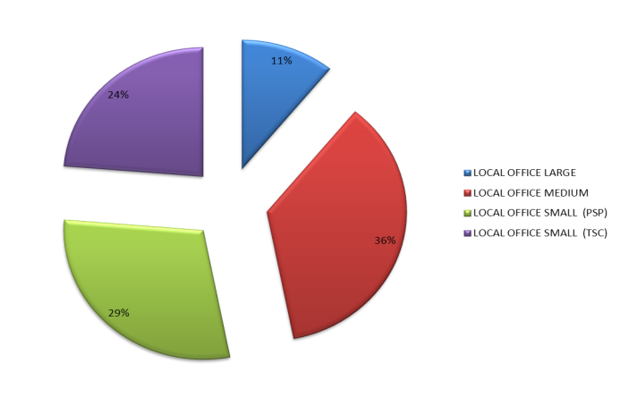
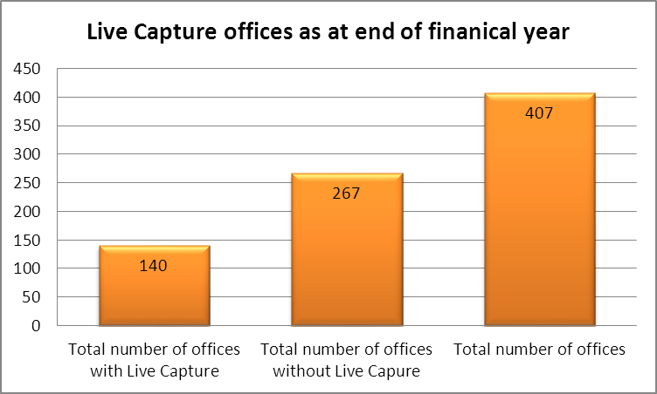
Current Footprint status
Offices are categorised by type of office:
Local office Large – serving about 400 000 pop per annum
Local office Medium – 160 000 pop
Local office Small – 40 000 pop
Province | LOCAL OFFICE LARGE | LOCAL OFFICE MEDIUM | LOCAL OFFICE SMALL (PSP) | LOCAL OFFICE SMALL (TSC) | TOTAL
EC | 6 | 24 | 23 | 6 | 59
FS | 3 | 9 | 11 | 7 | 30
GP | 8 | 23 | 6 | 24 | 61
KZN | 8 | 18 | 32 | 18 | 76
LP | 5 | 19 | 21 | 12 | 57
MP | 3 | 21 | 19 | 15 | 58
NC | 3 | 7 | 5 | 3 | 18
NW | 3 | 13 | 2 | 4 | 22
WC | 5 | 12 | 0 | 9 | 26
TOTAL | 44 | 146 | 119 | 98 | 407

Slide 3
Rural / Urban division of current offices
 | LOCAL OFFICE LARGE |  | LOCAL OFFICE MEDIUM |  | LOCAL OFFICE SMALL (PSP) |  | LOCAL OFFICE SMALL (TSC) |  | Grand Total
PROVINCE | RURAL | URBAN | RURAL | URBAN | RURAL | URBAN | RURAL | URBAN
EC | 0 | 6 | 15 | 9 | 22 | 1 | 6 |  | 59
FS | 0 | 3 | 3 | 6 | 11 | 0 | 5 | 2 | 30
GAUTENG | 0 | 8 | 2 | 21 |  | 6 | 2 | 22 | 61
KZN | 1 | 7 | 6 | 12 | 29 | 3 | 16 | 2 | 76
LP | 0 | 5 | 13 | 6 | 19 | 2 | 12 |  | 57
MP | 0 | 3 | 11 | 10 | 18 | 1 | 15 |  | 58
NC | 0 | 3 | 6 | 1 | 4 | 1 | 1 | 2 | 18
NW | 0 | 3 | 8 | 5 | 2 | 0 | 4 |  | 22
WC | 0 | 5 | 5 | 7 |  | 0 | 8 | 1 | 26
Grand Total | 1 | 43 | 69 | 77 | 105 | 14 | 69 | 29 | 407

Slide 4
Birth registration: online health facilities 2009/10
Financial Year | Hospitals to be connected in terms of the Strategic Plan | Number of Health Facilities connected and Operational | Total Health Facilities Connected | Number of Health Facilities where manual collection is conducted | Total Health Facilities where births are registered
2009/10 | No target set | 50 | 128 | 127 | 255
2010/11 | 120 | 44 | 172 | 114 | 286
2011/12 | 126 | 84 | 256 | 88 | 344
2012/13 | 80 | 89 | 345 | 77 | 422
2013/14 | 40 | 44 | 389 | 69 | 458
2014/15 | 0 | 0 | 389 | 69 | 458
Year of health facility connectivity | Health facilities currently online ( cumulative) | Rural | Urban | Nr connected during the financial year.
2009/2010 | 128 | 36 | 14 | 50
2010/2011 | 172 | 20 | 24 | 44
2011/2012 | 256 | 37 | 47 | 84
2012/2013 | 345 | 48 | 41 | 89
2013/2014 | 389 | 23 | 21 | 44

Slide 5
COMPARISON LIVE BIRTHS DoH AGAINST DHA BIRTH REGISTRATIONS

Slide 6
Birth registrations by status of
registration
2012
241 677
late
registrations
1 in 5
births registered during 2012 were registered late
926 726
current
registrations
1 168 403
total registrations

Slide 7
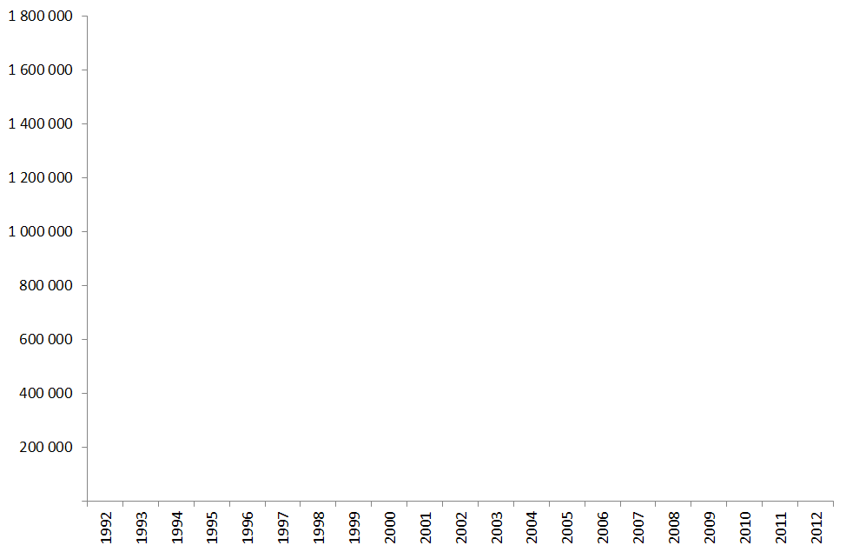
Number of birth registrations, 1992-2012
Total registration
Late registration
Current registration
In 1998, 78% of registrations were late
In 2012, this has dropped to 21%

Slide 8
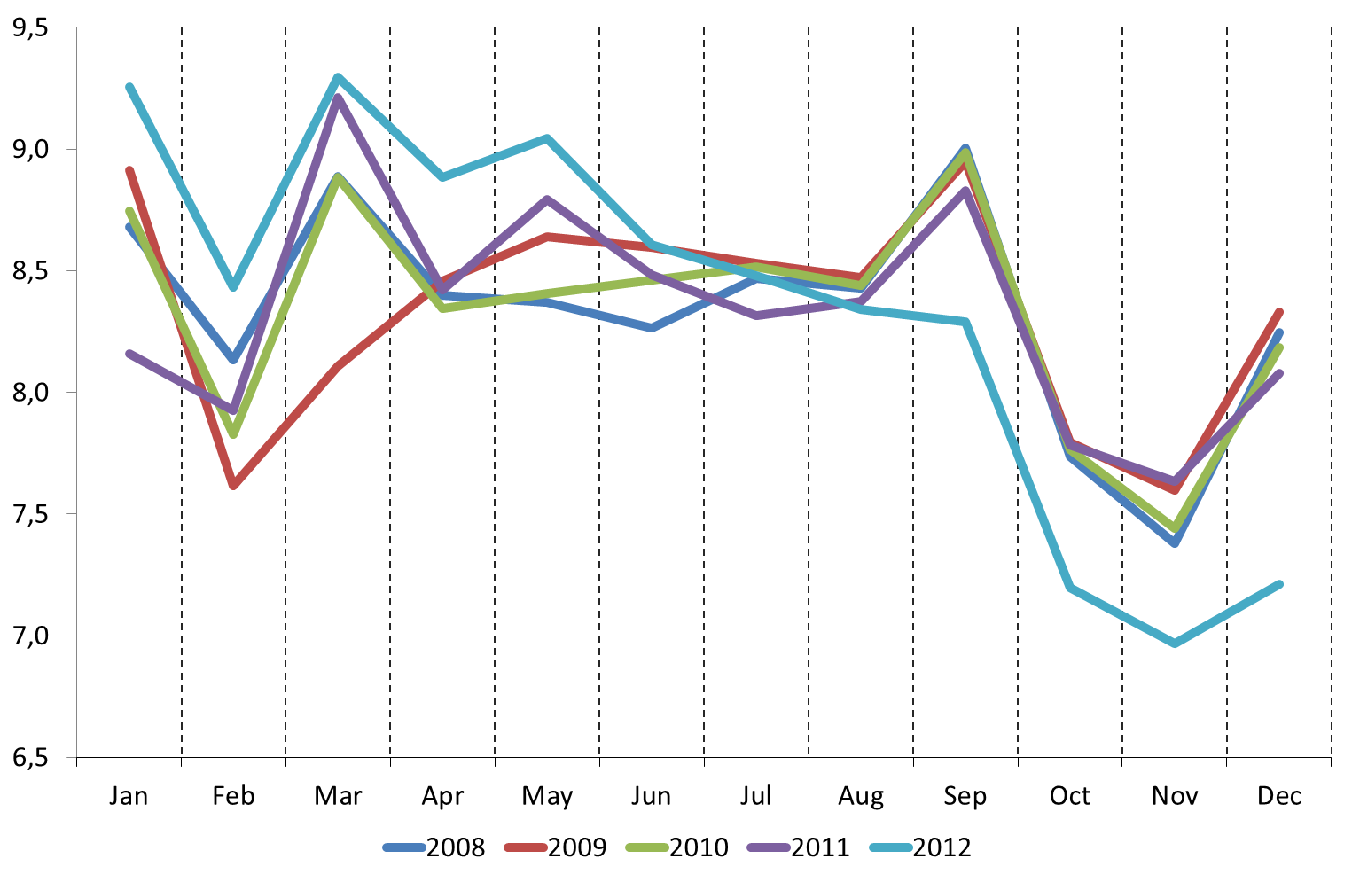
Percentage of births by month (2008-2012)

Slide 9
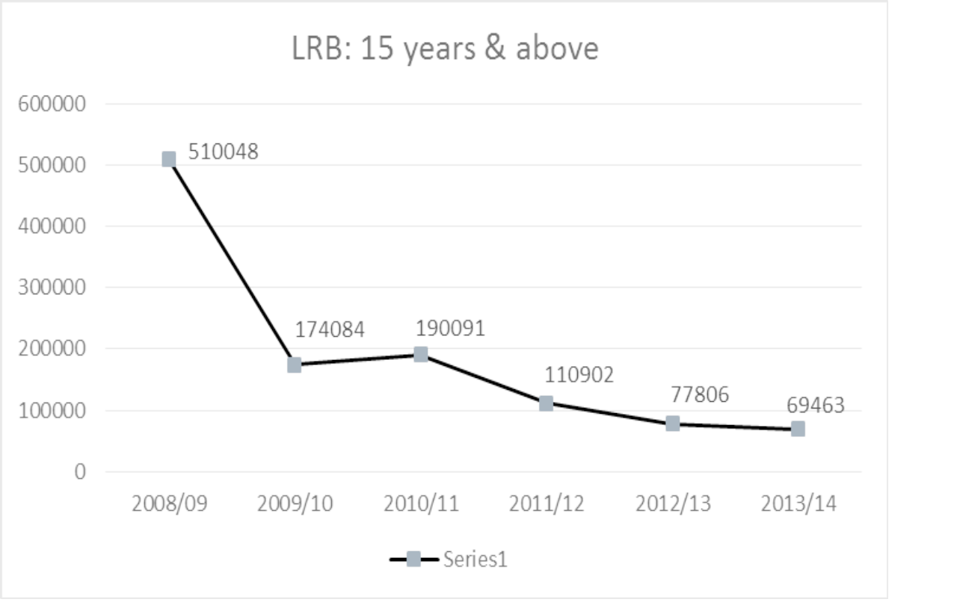
Declining LRB applications
The above decline in LRB applications is attributed to outreach programmes & campaigns

Slide 10
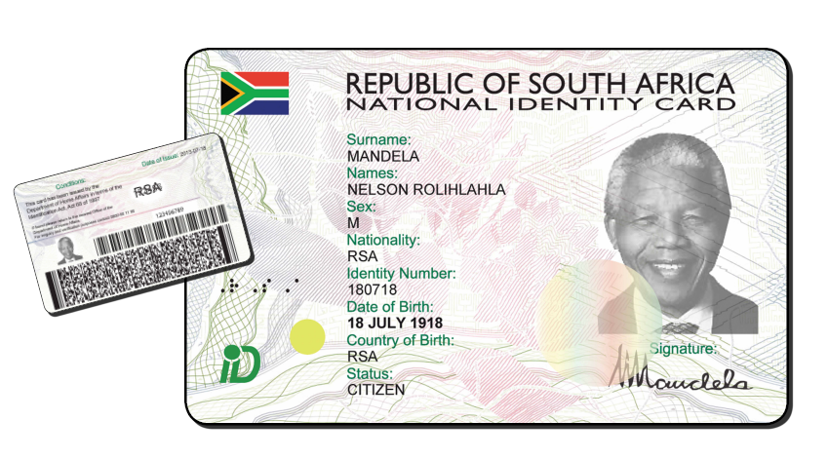
South Africa’s Identity documents life cycle
Reference Book (Apartheid era identity)
1960- 1986
Turnaround time unknown
Green Barcoded ID Book
1986-2013
Turnaround time 54 working days
Smart ID Card
2013- beyond
Secure has the option for additional Government services on the chip
Turnaround time 10-15 working days

Slide 11
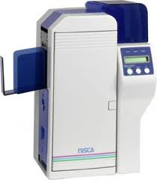
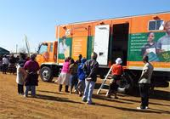
Smart ID Card/ Passport Process
Government Printing Works
Citizens
1
8
3
2
Track n trace
NPR & HANIS (National Identification System once modernized)
4
5
Front Offices
6
7
sms notification
Couriering to front offices

Slide 12
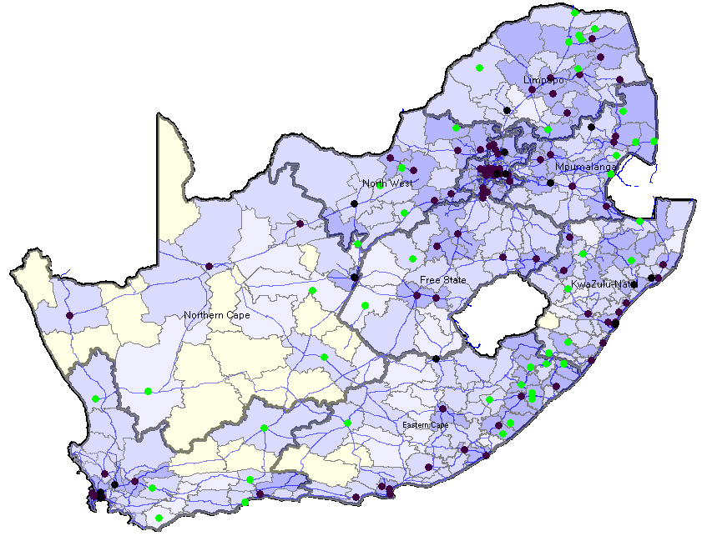
140 Offices envisaged to be operational with live capture 2014/15)

Slide 13
Incentives for birth registration and ID
Social grants
Registration of children at school
Voter registration
Registration at tertiary
Social services
Banks

Slide 14
94%
Death registration of adults is
complete
77%
of deaths were registered within the 3 Days of death as stipulated within the legislation in 2013 it was 74.9% in 2012
Statistics compiled in accordance with WHO standards
General improvements noted in the quality of data

Slide 15
In 2013, 458 933 deaths occurred in South Africa

Slide 16
Decline in recorded deaths
continues

Slide 17
HANIS Production Transactions on Banks
Period | ABIL | ABSA | BIDVEST | FNB | NED | SBSA | Total
1 April to 30 April 2014 | 343808 | 169081 | 9254 | 209529 | 111531 | 2120 | 845323
1 May to 25 May 2014 | 213106 | 92717 | 5581 | 124306 | 73907 | 839 | 510456
26 May to 29 June 2014 | 278174 | 150397 | 7963 | 190790 | 137174 | 1168 | 765666
30 June to 27 July 2014 | 191047 | 124815 | 6594 | 176278 | 137963 | 549 | 637246
28 July to 31 August 2014 | 210488 | 196642 | 7812 | 230340 | 184930 | 591 | 830803
1 Sep to 30 Sep 2014 | 262019 | 173720 | 7653 | 191015 | 222054 | 526 | 856987
1 Oct to 30 Oct 2014 | 161929 | 179702 | 8343 | 197033 | 205406 | 505 | 752918
1 Nov to 24 Nov 2014 | 121968 | 113209 | 5923 | 141257 | 161419 | 370 | 538223
1 Dec to 31 Dec 2014 | 177858 | 151689 | 8695 | 296201 | 225451 | 278 | 851477
1 Jan to 31 Jan 2015 | 164091 | 202268 | 6033 | 336953 | 282973 | 233 | 992551
TOTAL |  |  |  |  |  |  | 7581650

Slide 18
Importance of death/stillbirths registration for vital statistics
Based on data from the death registration system at the Department of Home Affairs.
Derive information on the number of deaths/stillbirths (and their causes) registered each year:
Age and sex of deceased, geographic information, causes of death (natural vs unnatural), etc
It is used as a source of statistical information on mortality and causes of death:
Evaluating, monitoring and improving the health of the population
MDGs – CRVS used to derive the following indicators in the SA 2013 MDG report (Under five mortality rate, infant mortality rate and maternal mortality ratio)
Informing decisions on health policy and strategy
Comparing health across different regions
Notes:
The births and death registration Act, 1992 states that in the case of a death due to natural causes, any person who was present at the time of death, or who became aware thereof, or who has charge of the burial concerned, shall give, as soon as practicable, notice of death.
The Act states that If there is any doubt whether the death was due to natural causes, such a death has to be reported to a police officer. After an investigation as to the circumstances of a death due to other than natural causes, in terms of section 3 of the Inquests Act, 1959 (Act 58 of 1959), the medical practitioner concerned shall, as soon as he is satisfied that the corpse concerned is no longer required for the purposes of an examination, issue a prescribed certificate to that effect.
The Department of Home Affairs uses form DHA-1663 (Notice of death/stillbirth) which is a revised version of the BI-1663 introduced in 1998 to register all deaths and stillbirths. The DOH is responsible for the confirmation of occurrences of death and still births and to indicate the cause of death on the death notification form. The DOH is guided by the National Health Act of 2003.

Slide 19
Importance of birth registration for vital statistics
Based on data from the birth registration system at the Department of Home Affairs.
Derive information on the number of births registered each year:
Date of birth
Sex of child
Particulars of parents
Geographic information
Information on births is used as :
Measure of fertility
denominators for the rates from the census and survey data to produce rates on mortality
Notes:
The Births and death Registration Act states that a child must be registered within 30 days of birth. The Department of Home Affairs uses form DHA-24 to register babies aged 30 days and less and form DHA-24/LRB (late registration of birth) for persons aged 31 days and above. All births registered from 31 days and older must comply with the prescribed requirements for late registration of birth. The application for this registration should include road to health (clinic) card; letter from the hospital where the child was born; a letter from the first school attended by the child; where applicable and an affidavit prescribed for the late registration of a birth. No registration of birth shall be done of a person who dies before notice of his birth has been given.
Notice of the birth must be given by one of the parents or, if neither parent is available to do so, the person having legal guardianship of the child. The birth of a child outside the country where at least one parent is a South African citizen can be registered at any South African Mission abroad. Documentary proof in the form of a birth certificate of the foreign country must accompany the Notice of Birth.
The Act further states that no registration of birth can be done of a person who dies before notice of his or her birth is given.

Slide 20
Importance of marriage registration for vital statistics
Based on data from the marriage registration systems at the Department of Home Affairs.
Civil marriages
Customary marriages
Civil unions
Derive information on the following:
Age at marriage and age differences between spouses
Marital status at the time of marriages
Geographic information on marriages
Trends in registrations
It is used as a source of statistical information on family formation and their characteristcs

Slide 21
Important Announcement
With effect from 01 June 2015 everyone travelling with children under 18 years to and from South Africa will be required to produce unabridged birth certificates for those children.

