Slide 1
Remittances Trends in Africa
Presented By : David Ndegwa
Addis Ababa, Ethiopia. 26 October 2017.

Slide 2
Contents
Introduction
Main Trends
Cost of Sending
Challenges

Slide 3
Introduction
IMF defines remittances as "household income from foreign economies arising mainly from the temporary or permanent movement of people to those economies. Remittances include cash and non-cash items that flow through formal channels, such as via electronic wire, or through informal channels, such as money or goods carried across borders…".

Slide 4
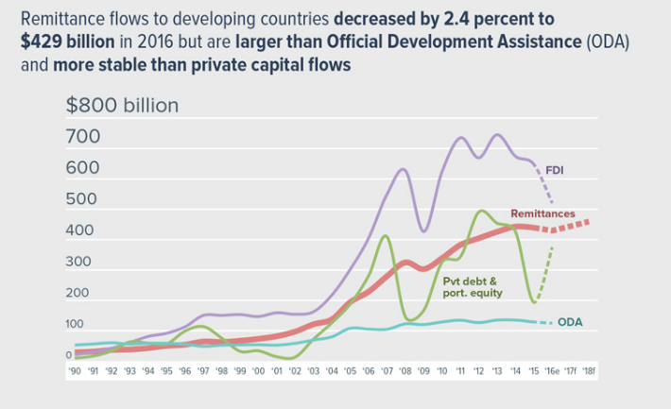
Main Trends: Remittances still larger than ODA in 2016
Decrease from 2015 estimates of about $441 billion to developing countries, nearly three times the amount of ODA.
Source: World Bank

Slide 5
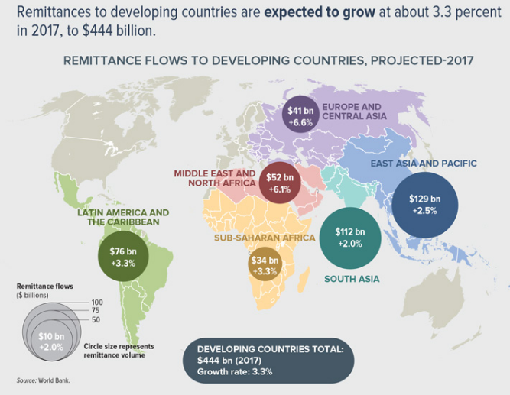
Remittances to developing countries expected to grow
Source: World Bank

Slide 6
Remittances in absolute figures and as a share of GDP (2015)
Source: Hein de Haas

Slide 7
Remittances as percentage of GDP for selected countries (those where its higher than 4% of GDP) in 2015
Source: World Bank

Slide 8
Cost of sending
According to WB report the global average cost of sending $200 at 7.45 percent in the first quarter of 2017 higher than the SDG goal of 3 per cent.
Higher in Sub-Saharan Africa at 9.8 per cent
According the WB Cutting prices by at least 5 percentage points can save up to $16 billion a year.
The Send Money Africa (SMA) data base by the AU’s African Institute for Remittances tracks cost of sending to Africa and within on quarterly basis
Their latest estimate was for Q4 2016 (12th – 16th December 2016) at 9.05 per cent
Challenge of lowering cost remains but promising new tools (apps) such as Xoom by PayPal are fast and cheaper
Just yesterday new free open source software Mojaloop application was launched-developed under the Bill and Melinda Gates’s Foundation Level One Project to provide interoperability between financial institutions and payment service providers
Other numerous startups leveraging smartphone apps such as Mpesa and others have opened doors for service providers to tap into the lucrative market (SMA has lengthy glossary of different types of services)

Slide 9
Remittances Challenges remain
Insufficient data quality and capacity for analysis
Many unofficial transfers not reflected in data
High cost of transfer persist
Inadequate competition keeping cost high
Inadequate regulation to increase competition for lowering costs

