Slide 1
Geospatial Database Create Geodatabase Practical Session
GIS for Spatial Planning
Training for Ministry of Transport
Mozambique
Maputo, Mozambique
2-13 July 2018
GeoInformation Systmes Section (GISS)

Slide 2
Identifying features
When you want to view attribute values for a feature, use the Identify tool that can be accessed from the Tools toolbar. Here are the steps:
In ArcMap open Maputo1.mxd
Click the Identify tool on the Tools toolbar. Alternatively, you can access Identify by right-clicking and selecting Identify from the context menu:
Within the data frame
In a result listed on the Find dialog box
On a record in the Table window

Slide 3
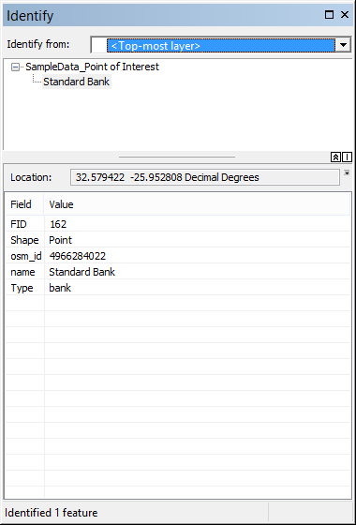
Identifying features
2. Click on a location in your data frame to identify the features at the location.
The attributes are presented in the Identify window.

Slide 4
Identifying features
Alternatively, you can create a box to identify a group of features. Click on a location in your data frame, then drag to create a box. You can also hold down the SHIFT key while clicking on the map to identify multiple features.

Slide 5
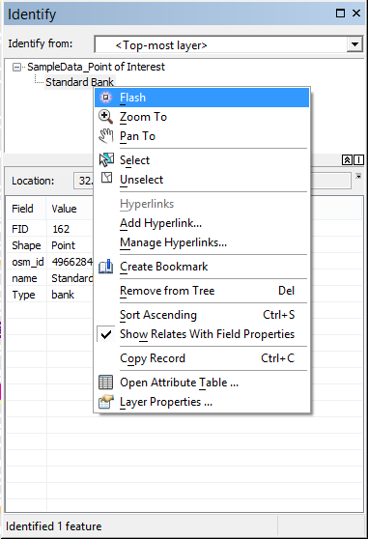
Identifying features
Working with results in the Identify window
Right-click a feature to open a context menu to zoom to the feature and perform other operations (flash, pan, etc.).

Slide 6
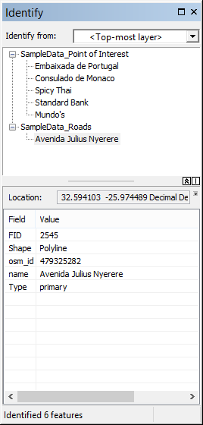
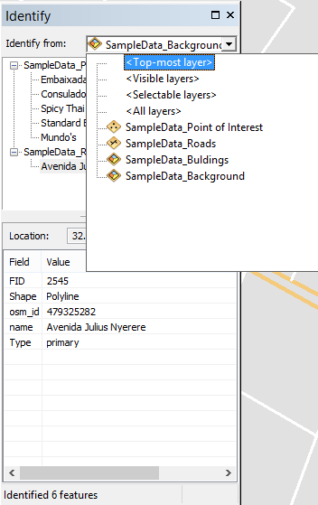
Identifying features
Choosing which layers to identify

Slide 7
Identifying features
Topmost layer—Identifies the attributes of the feature or features from the layer that is highest in the table of contents drawing order and currently visible.
Visible layers—Identifies the attributes of the features that are currently visible in your map.
Selectable layers—Identifies the attributes of the features belonging to selectable layers. You can manage the list of selectable layers in the table of contents List by Selection view.
All layers—Identify displays feature attributes for all map layers in the data frame regardless of whether they are in the display.
A layer—Select a specific layer in your map. If you choose a particular layer, its features are identifiable even if the layer is currently turned off in the table of contents or currently not being drawn because of the scale of the map.

Slide 8
Setting HTML pop-up properties for feature layers
Setting the properties of an HTML pop-up display
You use the Layer Properties dialog box to define HTML pop-up properties for a layer. Follow these steps:
Right-click the layer to open the Layer Properties dialog box and click the HTML Popup tab.
Check the Show content for this layer using the HTML Popup tool check box.
Choose the option for the type of HTML display you would like to use. You have three options as shown here:

Slide 9
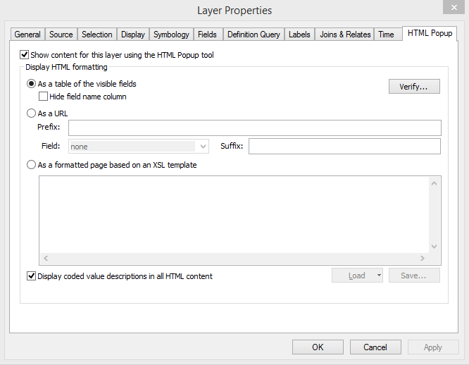
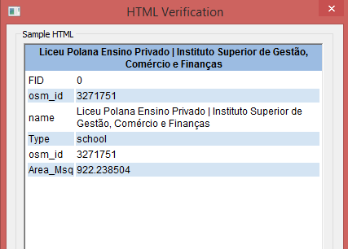
Setting HTML pop-up properties for feature layers
5. To verify that your HTML content will display as you want it to, click the Verify button.

Slide 10
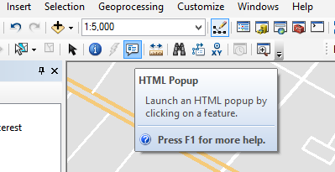
Setting HTML pop-up properties for feature layers
Types of HTML content you can display
As a table of the visible fields
Click the HTML Popup tool on the tool bar.

Slide 11
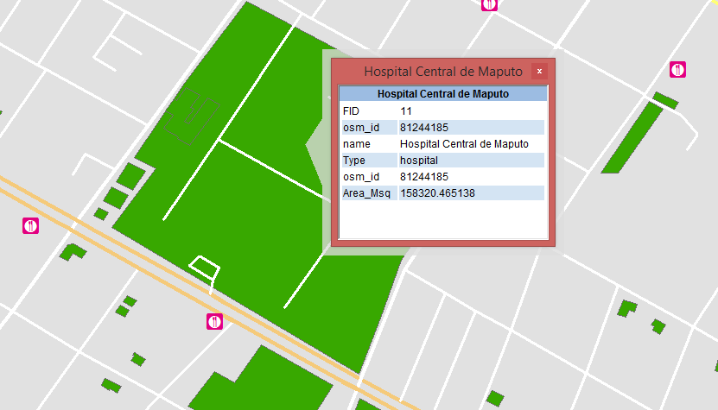
Setting HTML pop-up properties for feature layers
Types of HTML content you can display
As a table of the visible fields
Click on a building feature.
The default HTML pop-up window for a feature layer has an HTML table containing the names and values of the layer's attributes (below).

Slide 12
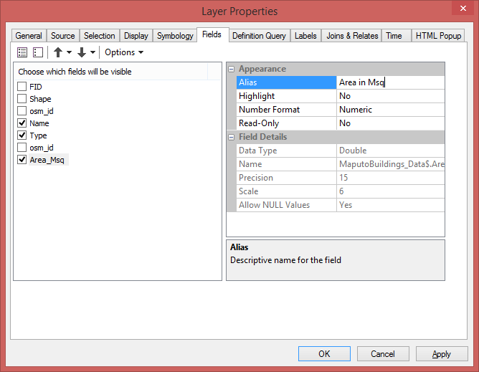
Setting HTML pop-up properties for feature layers
Types of HTML content you can display
As a table of the visible fields
You can set your field visibility, the order in which fields appear, field alias names, and other properties on the Fields tab of the Layer Properties dialog box.

Slide 13
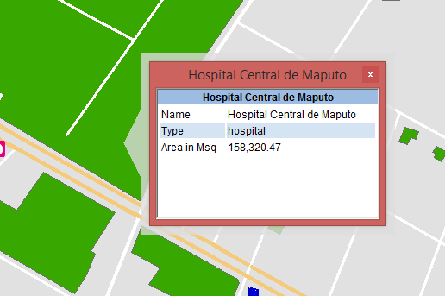
Setting HTML pop-up properties for feature layers
Types of HTML content you can display
As a table of the visible fields
This display also includes three visible fields—Name, Type and Area in Msq—which are displayed using their field aliases.

Slide 14
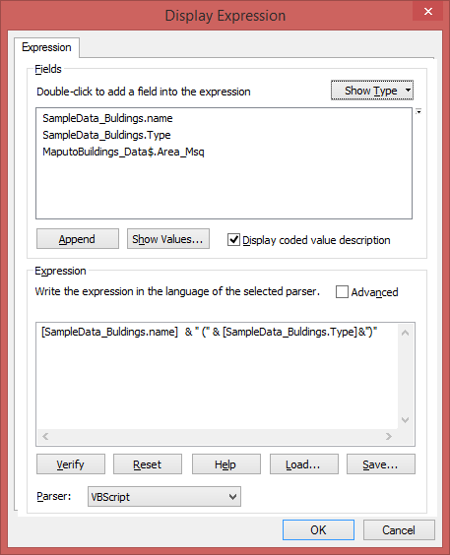
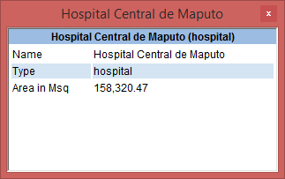
Setting HTML pop-up properties for feature layers
Types of HTML content you can display
As a table of the visible fields
Use the Display tab on your Layer Properties dialog box to build the display expression. Click the Expression button to display the Display Expression dialog box and create a display expression.

Slide 15
Setting HTML pop-up properties for feature layers
Types of HTML content you can display
As a table of the visible fields
Displaying images from file paths.
You can do this by using the HTML image tag:
<img src='D:\Exercise Data\Piri-piri_Restaurant.jpg' width='250' />
<img src='D:\Exercise Data\Galaxy_Restaurant.jpg' width='250' />

Slide 16
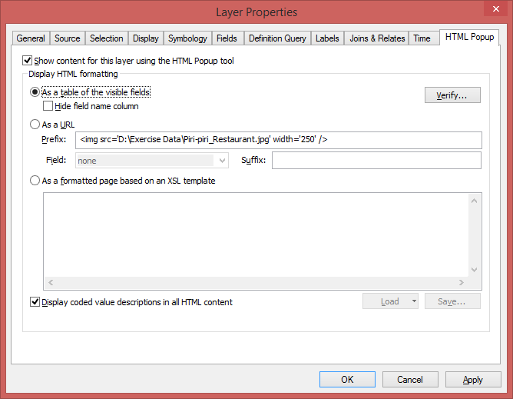
Setting HTML pop-up properties for feature layers
Types of HTML content you can display
As a table of the visible fields

Slide 17
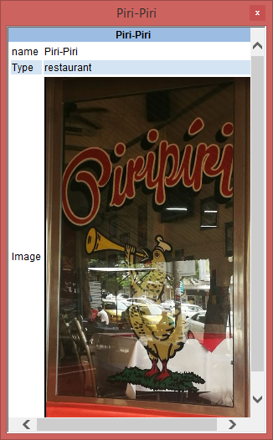
Setting HTML pop-up properties for feature layers
Types of HTML content you can display
As a table of the visible fields
Search and then click on
Piri-Piri & Galaxy restaurants

Slide 18
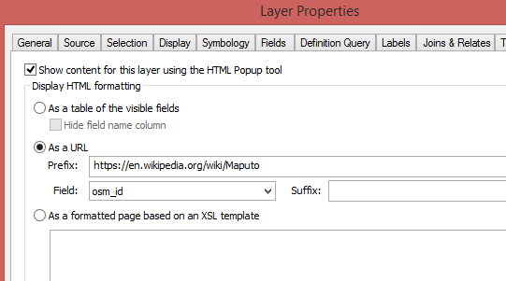
Setting HTML pop-up properties for feature layers
Types of HTML content you can display
As a URL
Right click on SampleData_Background layer then select Properties.
https://en.wikipedia.org/wiki/Maputo

Slide 19
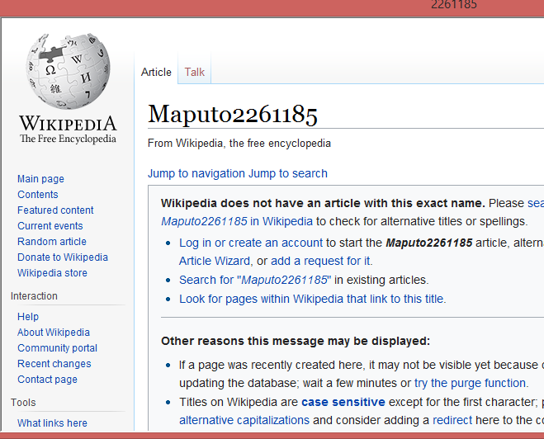
Setting HTML pop-up properties for feature layers
Types of HTML content you can display
As a URL

Slide 20
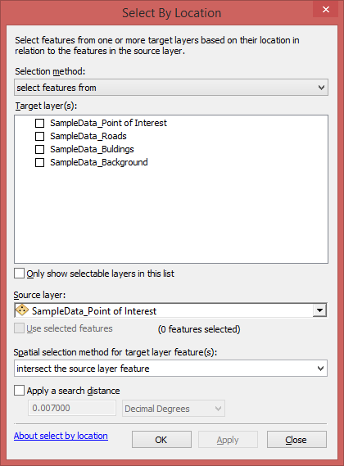
Selecting features
Using Select By Location
Steps for using Select By Location
Click Selection > Select By Location to open the Select by Location dialog box.

Slide 21
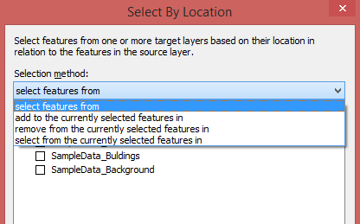
Selecting features
Using Select By Location
Steps for using Select By Location
2. Choose the type of selection that you want to make. Click the drop-down arrow to see your choices.

Slide 22
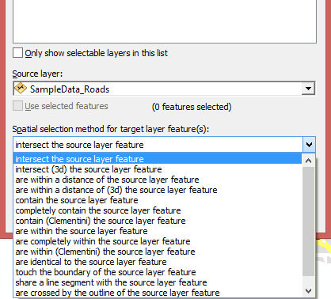
Selecting features
Using Select By Location
Steps for using Select By Location
3. Identify the target layer(s) from which features will be selected and check them on
4. Choose the spatial relationship rule that will be used for selection.

Slide 23
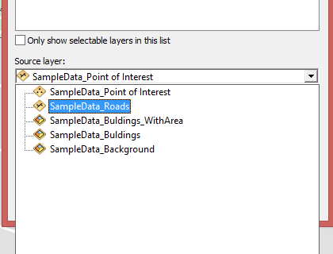
Selecting features
Using Select By Location
Steps for using Select By Location
5. Specify the source layer that will be used to select features from the target layer.

Slide 24
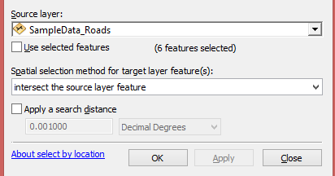
Selecting features
Using Select By Location
Steps for using Select By Location
6. To complete your Select by Location specification, you can optionally specify if you want to
Use selected features in the source layer to identify the features to select.
Use a buffer distance in your search (buffer distances are only used with some selection options).

Slide 25
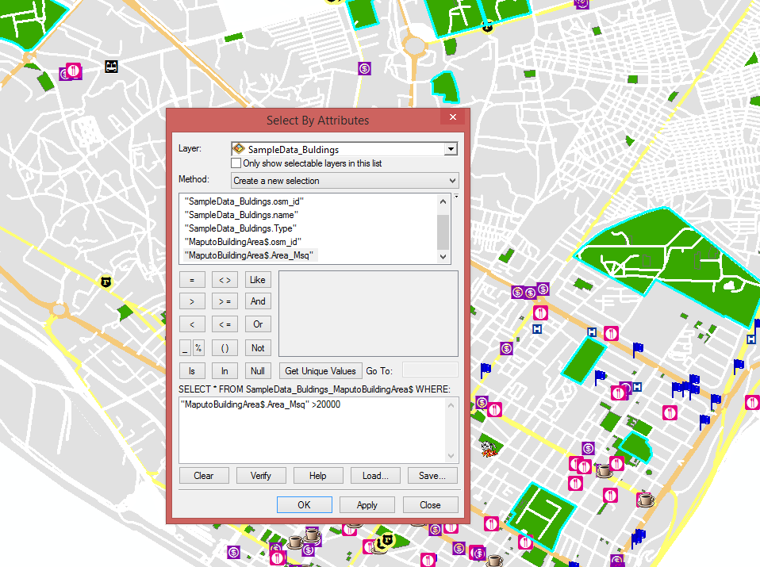
Selecting features
Using Select By Attributes
Select By Attributes allows you to provide a SQL query expression that is used to select features that match the selection criteria.
Steps for using Select By Attributes
1. Click Selection > Select By Attributes to open the Select By Attributes dialog box

Slide 26
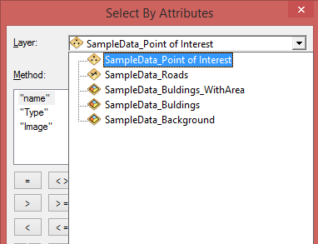
Selecting features
Using Select By Attributes
Steps for using Select By Attributes
2. Choose the layer to perform the selection against.

Slide 27
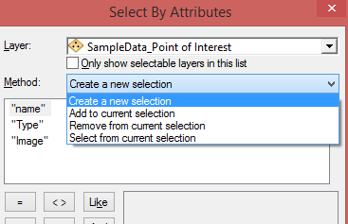
Selecting features
Using Select By Attributes
Steps for using Select By Attributes
3. Specify the selection method.

Slide 28
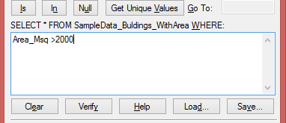
Selecting features
Using Select By Attributes
Steps for using Select By Attributes
4. Enter a query expression using one of the following methods:
Create a query using the expression building tools.
Type a query into the selection window.
Load a query saved to disk.

Slide 29
Selecting features
Using Select By Attributes
Steps for using Select By Attributes
5. Validate your query expression by clicking Verify.
6. Click OK or Apply to execute your selection expression and work with the selection results.
7. Optionally, you can save your query expression for later reuse before closing this dialog box.

Slide 30
THANK YOU!

