Slide 1
Geospatial Metadata, Standards and Infrastructure
GIS for Spatial Planning
Training for Ministry of Transport
Mozambique
Maputo, Mozambique
2-13 July 2018
GeoInformation Systmes Section (GISS)

Slide 2
Module 2: Geospatial Metadata, Standards and Infrastructure

Slide 3
What is metadata?

Slide 4
What is metadata?
Data about data.

Slide 5
What is metadata?
Data about data.
Description
Item
Map documents
Layers
Geodatabase datasets
Non-spatial table
etc.

Slide 6
What is metadata?
A set of data that describes and gives information about other data (item).

Slide 7
What is metadata?
In an item's metadata you can record:
How accurate the item is
Restrictions associated with using and sharing
Important processes
Etc.

Slide 8
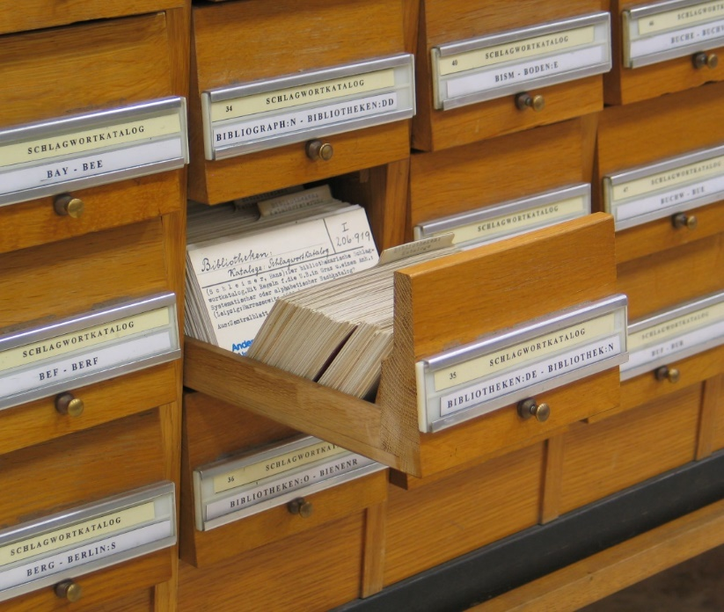
Use of metadata?
Finding data
Using data
Re-using data

Slide 9
Essential metadata vocabulary
Metadata elements:
An individual piece of information in an item's metadata.
Metadata standard:
A document identifying content that should be provided to describe geospatial resources such as maps, map services, vector data, imagery, and relevant nonspatial resources.
Standards are typically created or ratified by national or international standards bodies.

Slide 10
Essential metadata vocabulary
Metadata profile:
A document that modifies a metadata standard.
A profile may reduce the overall number of metadata elements that were originally included in a standard.
Metadata style:
The metadata configuration used in ArcGIS.
The appearance of metadata when you view it in ArcGIS.

Slide 11
Essential metadata vocabulary
Stand-alone metadata:
An XML file containing geospatial metadata that is not associated with an ArcGIS item. Some items, such as atlases and globes, can't be described in ArcGIS.
Metadata catalog:
A searchable online collection of metadata describing geospatial resources.

Slide 12
Metadata styles and standards
A metadata style configures ArcGIS to create the metadata you want.
ArcGIS provides the default Item Description metadata style which lets you see and edit a simple set of metadata properties for an item.

Slide 13
Metadata styles and standards
Default Item Description metadata style is designed to facilitate providing information that is used by ArcGIS.
It is straightforward and effective, suitable for anyone who doesn't need to adhere to specific metadata standards.

Slide 14
Metadata styles and standards
Several metadata styles are provided with the current version of ArcGIS for Desktop to support different metadata standards:
ISO 19139 Metadata Implementation Specification : Geographic information — Metadata — XML schema implementation
ISO 19139 Metadata Implementation Specification GML3.2: identical to the one above, except the exported files use the GML 3.2 namespace
North American Profile of ISO 19115 2003: This style lets you view and edit a complete metadata document that complies with North American Profile of ISO 19115:2003

Slide 15
Metadata styles and standards
INSPIRE Metadata Directive: This style lets you view and edit a complete ISO 19139 metadata document that adheres to the INSPIRE Implementing Rules.
FGDC CSDGM Metadata: This style lets you view and edit metadata following the FGDC Content Standard for Digital Geospatial Metadata (CSDGM) guidelines.

Slide 16
Viewing metadata
Most ArcGIS items can have metadata, including tools, toolboxes, folders, geodatabases, text files, and file types such as Word documents.
Once created, metadata is copied, moved, and deleted along with the item when it is managed with ArcGIS.

Slide 17
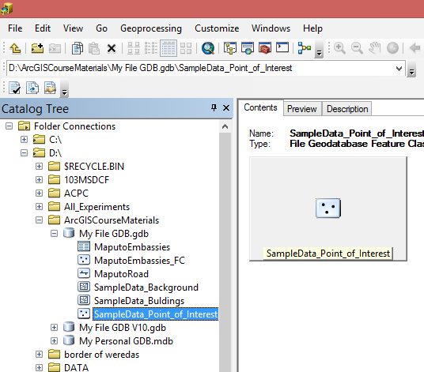
Viewing metadata
An ArcGIS item's metadata can be viewed in the Description tab.

Slide 18
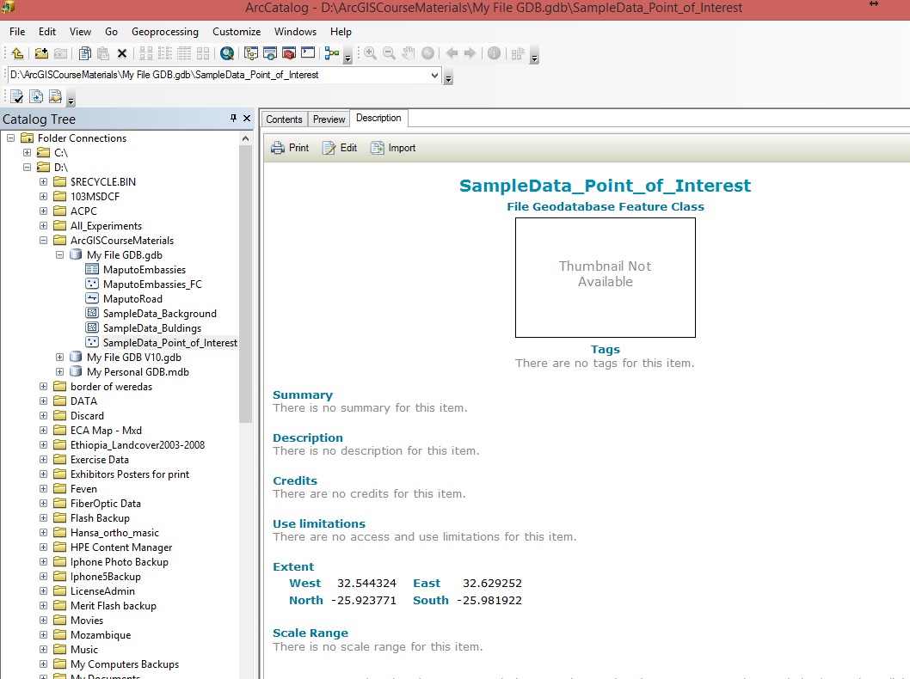

Slide 19
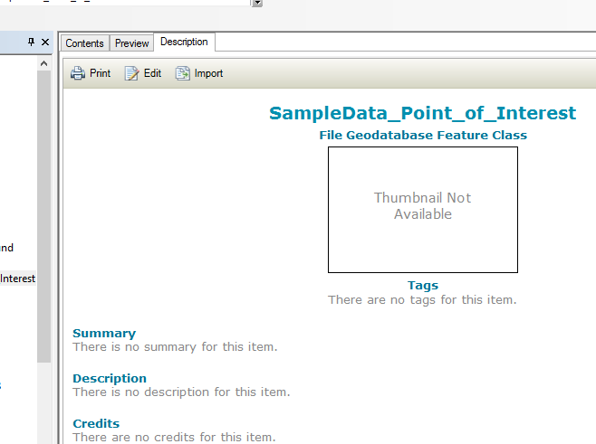
Viewing metadata
After viewing an item's metadata, you can start editing it if you have permission to do so—you'll see the Edit button in the Description tab.

Slide 20
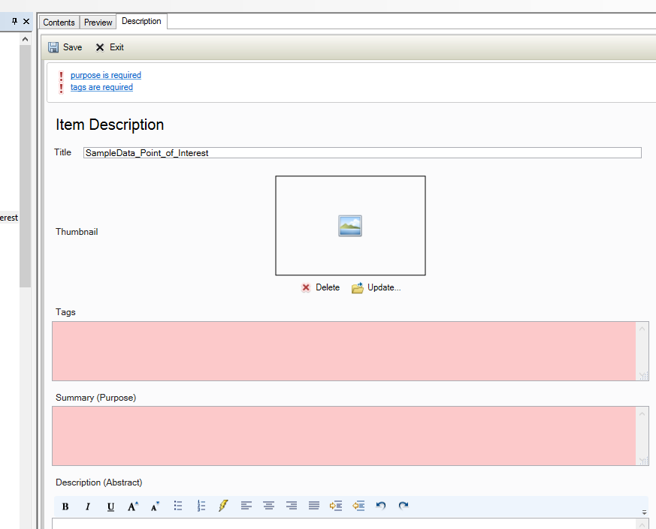
Viewing metadata
Default Item Description metadata style

Slide 21
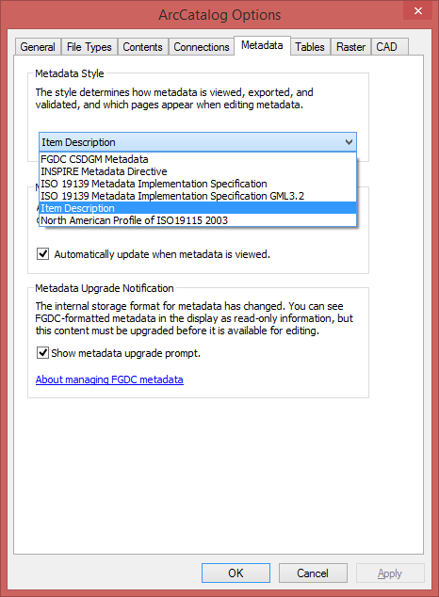
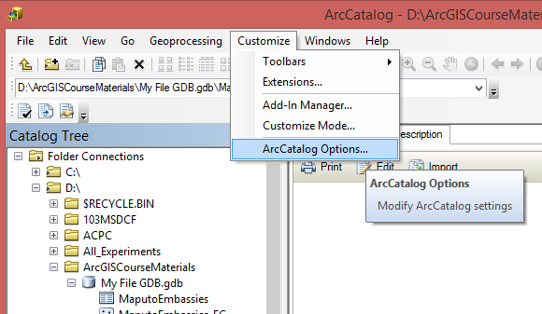
Choosing a metadata style

Slide 22
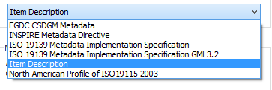
Choosing a metadata style

Slide 23
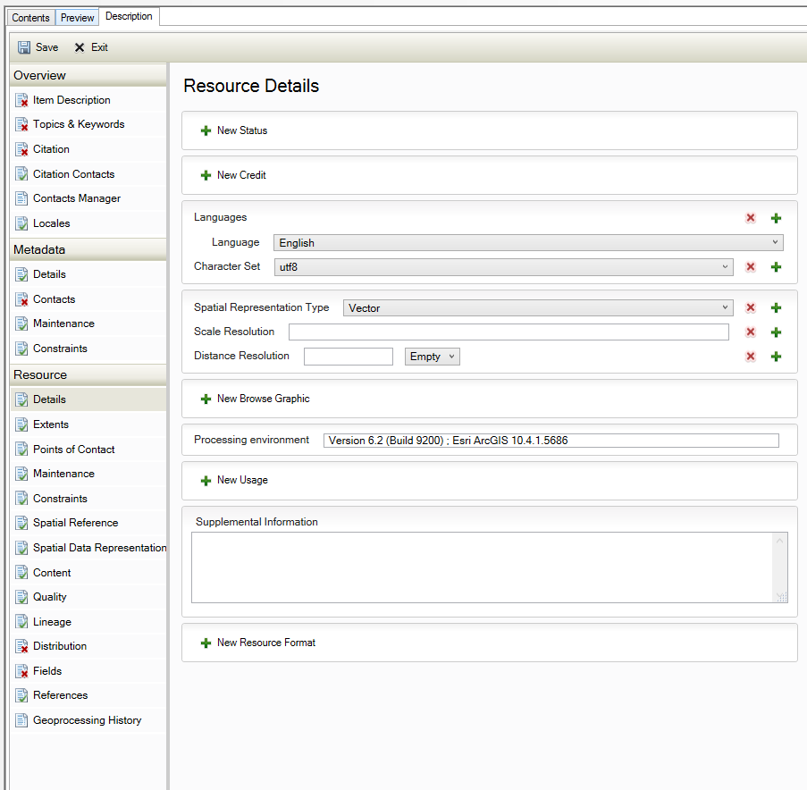
Choosing a metadata style
ISO 19139 Metadata Implementation Specification

Slide 24
Choosing a metadata style
Elements are classified as mandatory, recommended or optional.
Mandatory elements have to be filled in.
Recommended element implies a strong recommendation.
Optional element is everything else. Some of these elements will be of substantial interest to give a good description of a dataset.

Slide 25
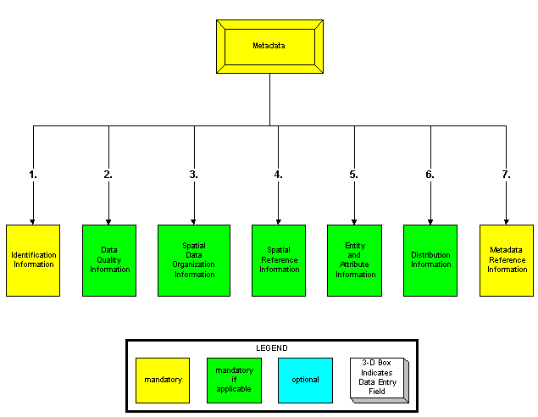
Creating and editing metadata
Example of FGDC metadata standard

Slide 26
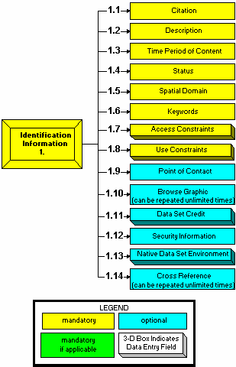
Creating and editing metadata
Example of FGDC metadata standard

Slide 27
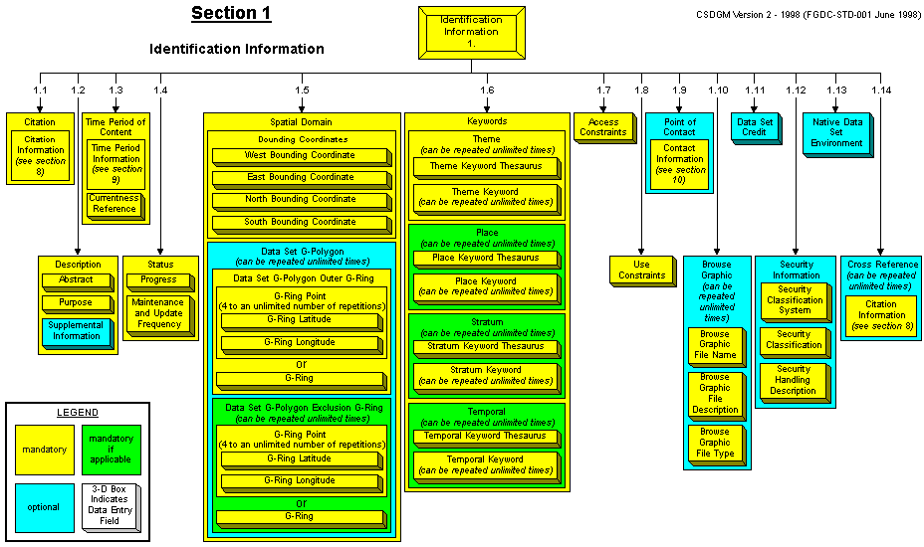
Creating and editing metadata

Slide 28
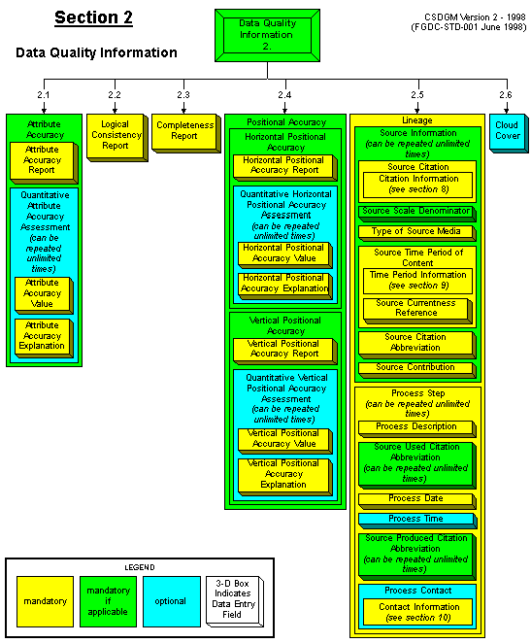

Slide 29
Creating and editing metadata

Slide 30
Creating and editing metadata

Slide 32
Creating and editing metadata

Slide 33
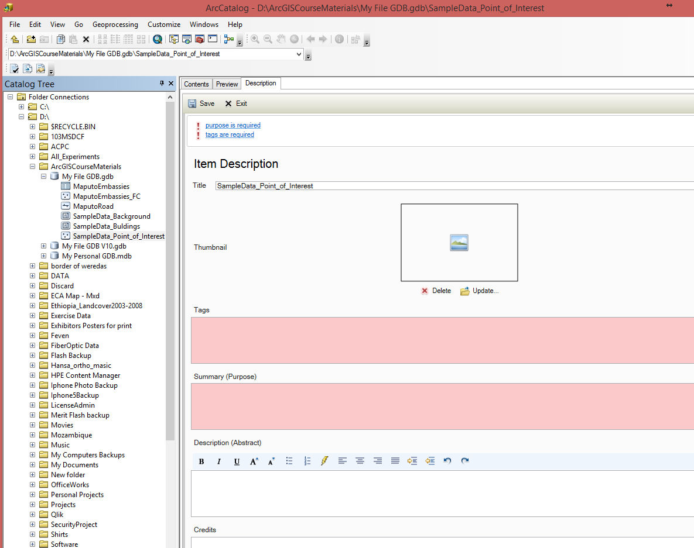

Slide 36
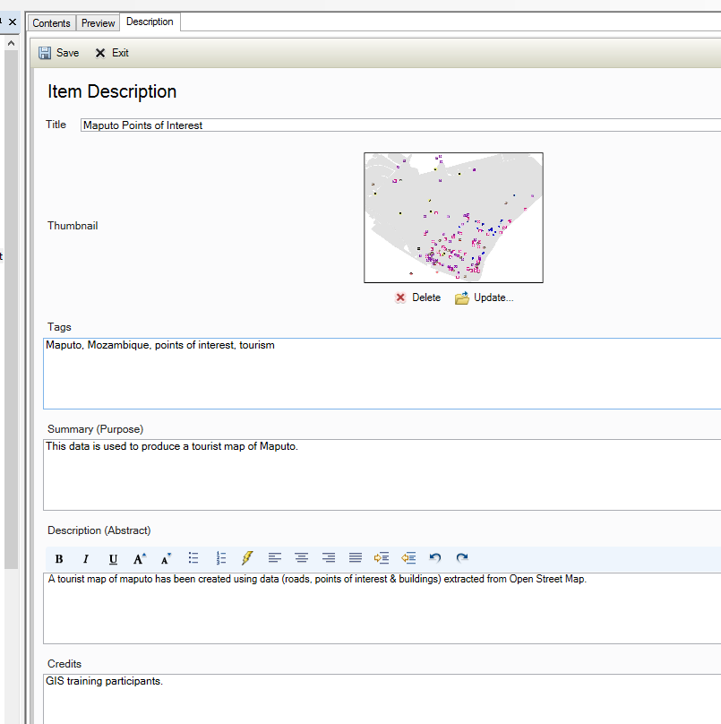

Slide 37
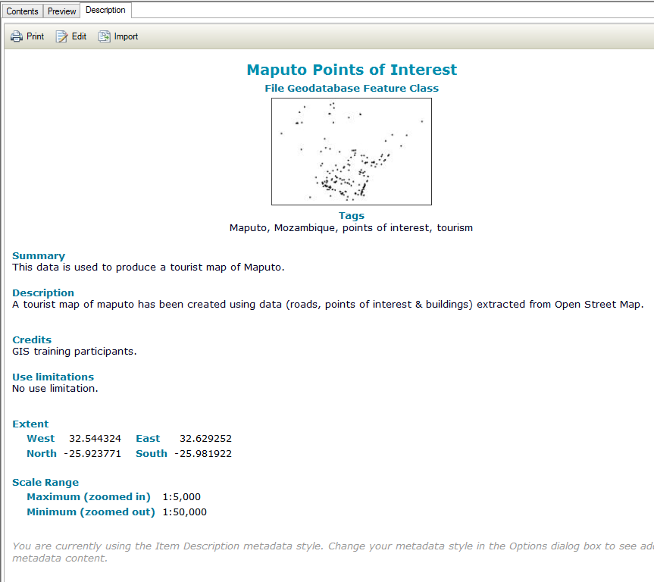

Slide 38
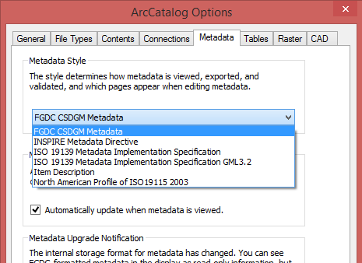
Creating standard-compliant metadata

Slide 39
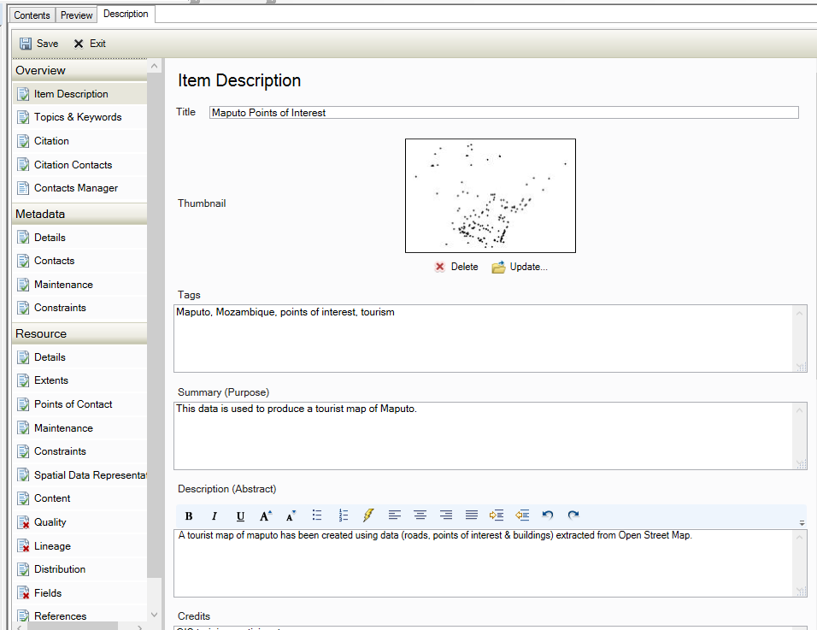
Creating standard-compliant metadata

Slide 40
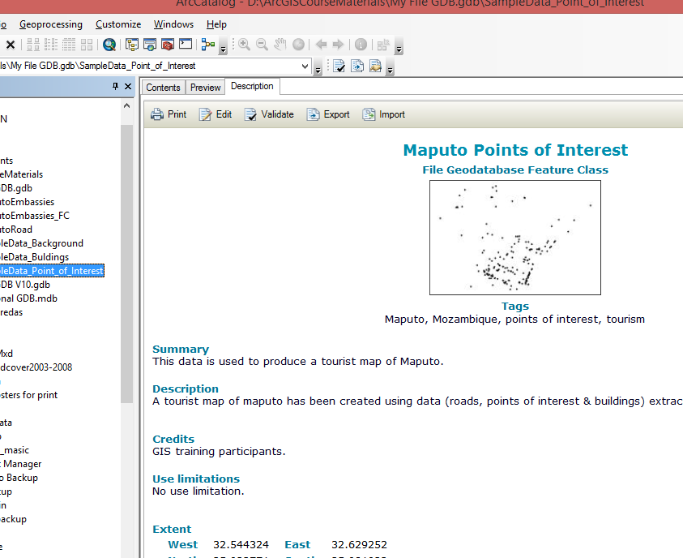
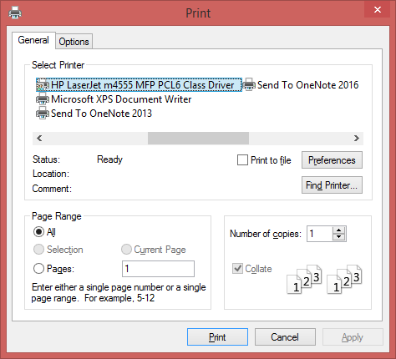
Printing metadata

Slide 41
THANK YOU!

