Slide 1
Geospatial Metadata, Standards and Infrastructure Practical Session
GIS for Spatial Planning
Training for Ministry of Transport
Mozambique
Maputo, Mozambique
2-13 July 2018
GeoInformation Systmes Section (GISS)

Slide 2
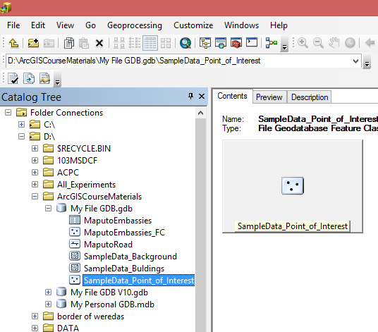
Viewing metadata
An ArcGIS item's metadata can be viewed in the Description tab.
In ArcCatalog click on SampleData_Point_of_Interest feature class in Catalog Tree > Select the Description tab.

Slide 3
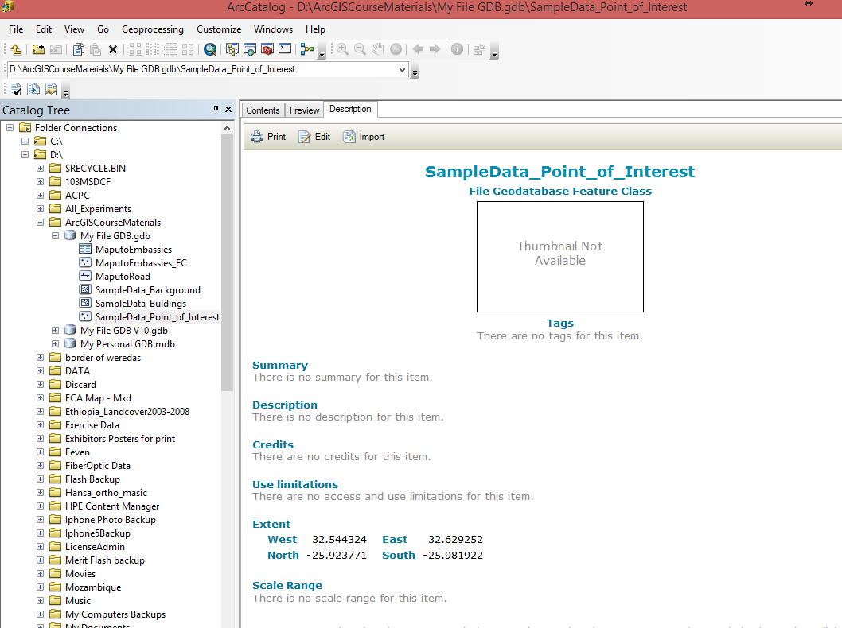

Slide 4
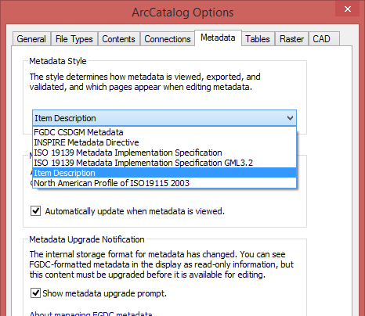
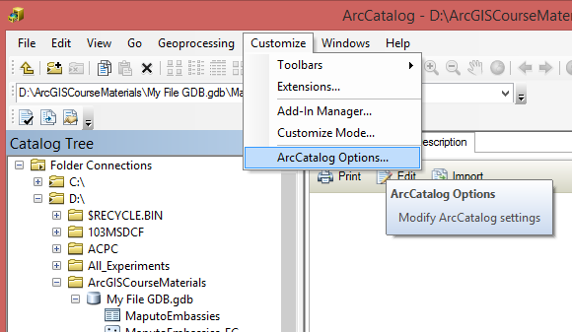
Choosing a metadata style
Select Item Description for a Metadata Style.

Slide 5
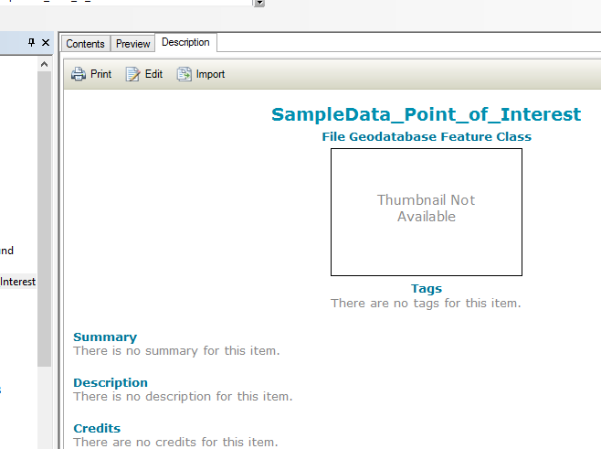
Editing metadata
After viewing an item's metadata, you can start editing it if you have permission to do so—you'll see the Edit button in the Description tab.
Click Edit.

Slide 6
Editing metadata

Slide 7
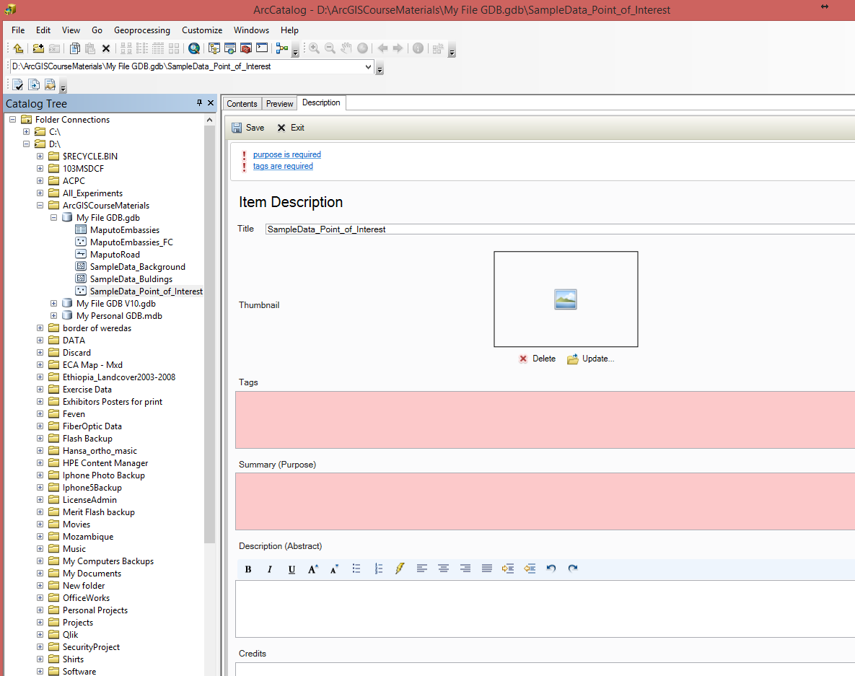
Fill in all information.

Slide 8
Editing metadata
Adding thumbnail image.
Click on Update button.
Browse to D:\Exercise Data\POI_thumbnail.jpg
Click Open.

Slide 9
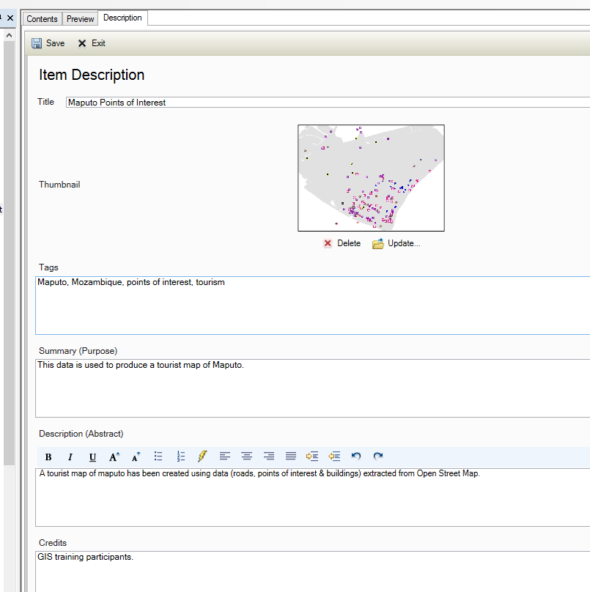
Click Save.

Slide 10
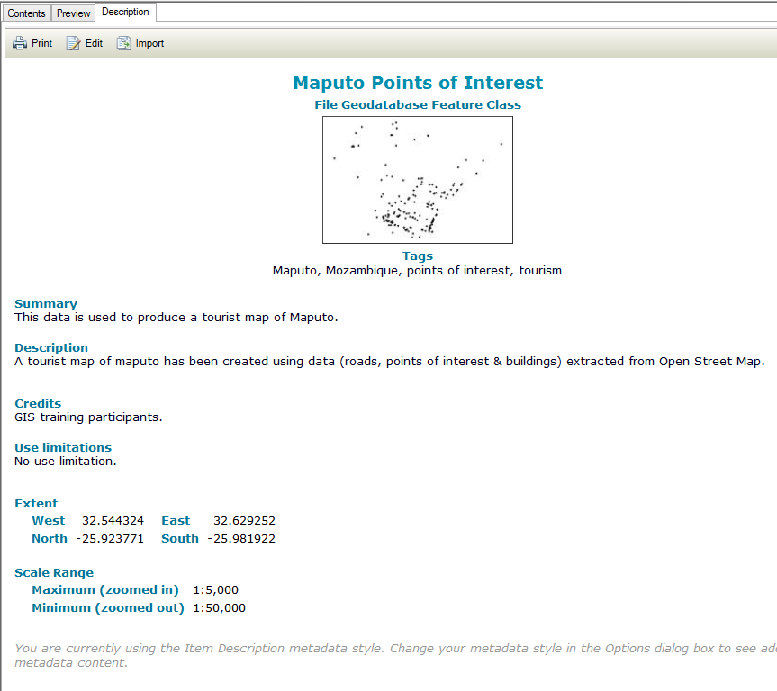

Slide 11
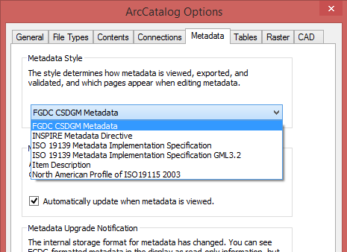
Creating standard-compliant metadata

Slide 12
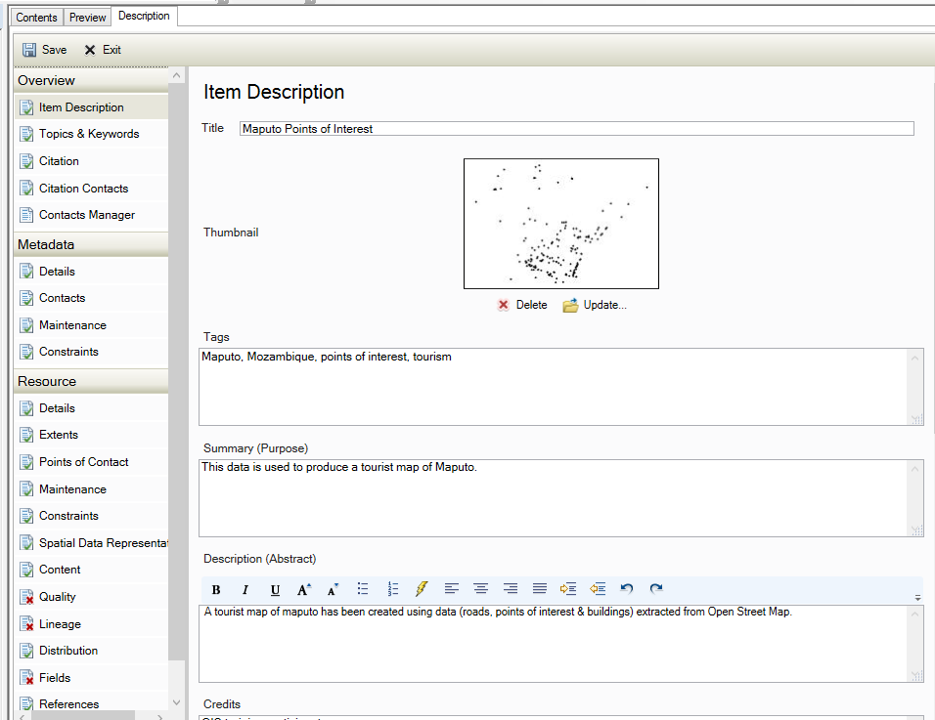
Creating standard-compliant metadata

Slide 13
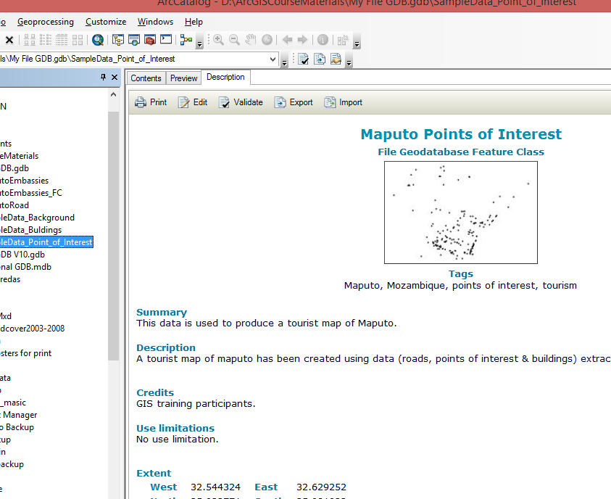
Exporting metadata
Click on Export button.

Slide 14
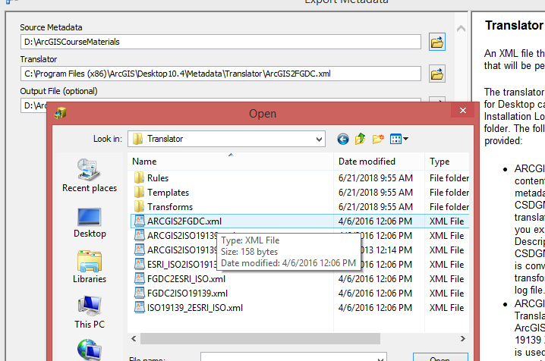
Exporting metadata
Select Translator file which is provided with ArcGIS for Desktop can be found in the <ArcGIS Installation Location>\Metadata\Translator folder.
Select Output File location.
Click OK.

Slide 15
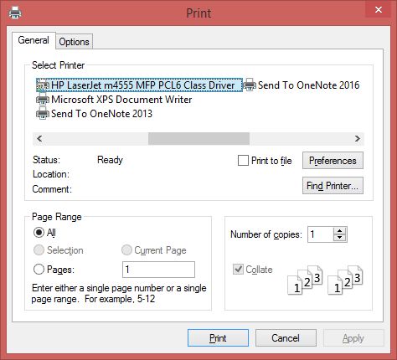
Printing metadata

Slide 16
THANK YOU!

