Slide 1
Geospatial Database Create Geodatabase Practical Session
GIS for Spatial Planning
Training for Ministry of Transport
Mozambique
Maputo, Mozambique
2-13 July 2018
GeoInformation Systmes Section (GISS)

Slide 2
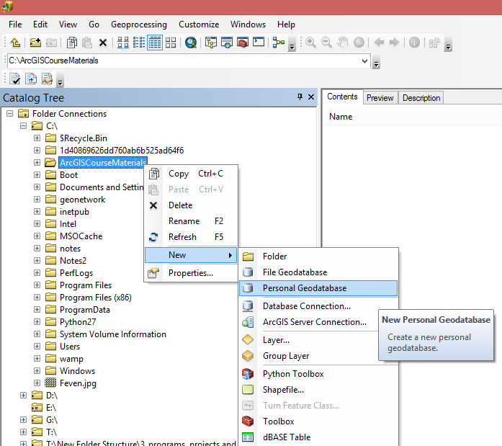
Create a Personal Geodatabase
To create a personal geodatabase that corresponds to the same release as the ArcGIS for Desktop client you are using, follow these steps:
In ArcCatalog, right-click the file folder in the Catalog tree where you want to create the new personal geodatabase.
Point to New.
Click Personal Geodatabase.
Type a new name (My Personal GDB) for this personal geodatabase and press Enter.

Slide 3
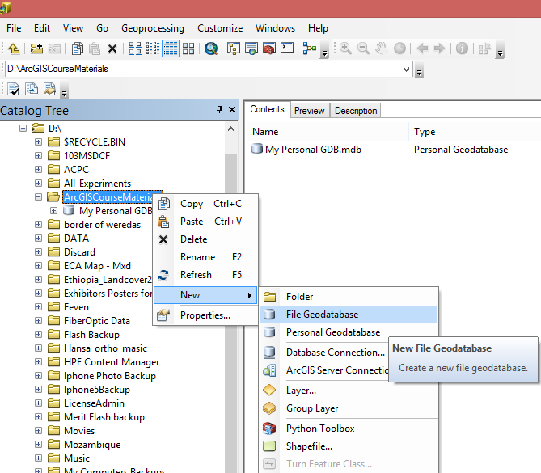
Create a Personal Geodatabase
There are two ways to create a file geodatabase; from a folder connection or using the Create File GDB tool.
Create a File Geodatabase: from a folder connection
In ArcCatalog, right-click the file folder in the Catalog tree where you want to create the new file geodatabase.
Point to New.
Click File Geodatabase.
Type a new name (My Personal GDB) for this personal geodatabase and press Enter.

Slide 4
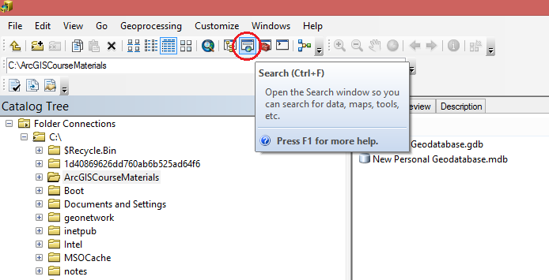
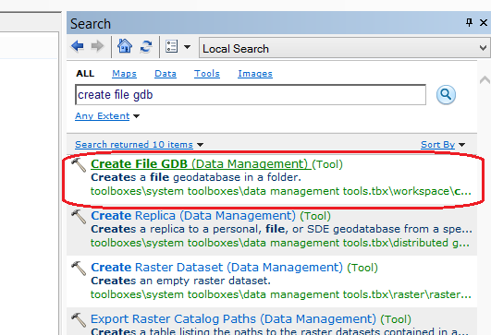
Create a Personal Geodatabase
Create a File Geodatabase: using the Create File GDB tool
1. Open the Create File GDB in ArcGIS for Desktop

Slide 5
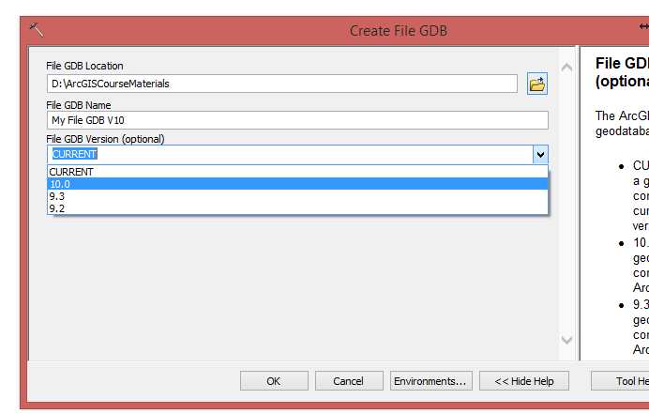
Create a Personal Geodatabase
This allows you to create a file geodatabase that corresponds to an older release of ArcGIS.
Create a File Geodatabase: from a folder connection
Open the Create File GDB in ArcGIS for Desktop
Specify the folder location where you want the file geodatabase created.
Type a name (My File GDB V10) for the geodatabase.
Choose which ArcGIS version you want the file geodatabase to be.
Click OK to run the tool.

Slide 6
Create an Enterprise Geodatabase
You can create enterprise geodatabase in a Microsoft SQL Server using the Create Enterprise Geodatabase geoprocessing tool.
Requirements
You have SQL Server installed and the instance configured
You perform the role of both the database administrator and geodatabase administrator and, therefore, know the password for both logins
You need an ArcGIS Server keycodes file to authorize your geodatabase

Slide 7
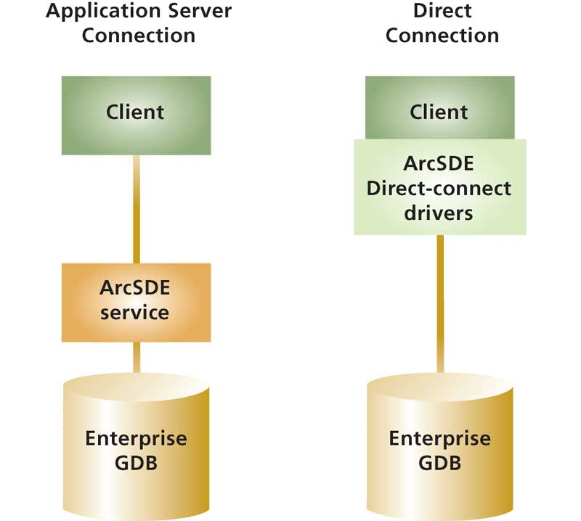
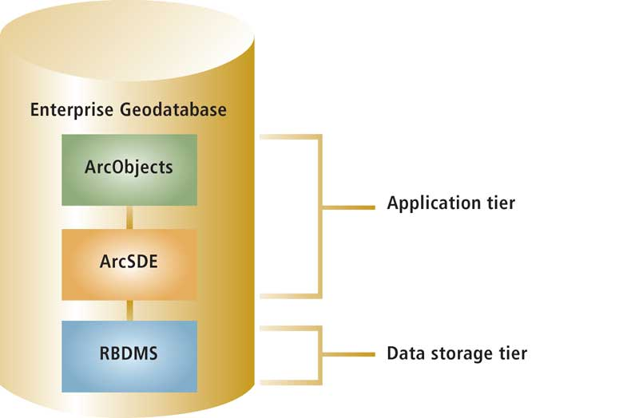
Create an Enterprise Geodatabase

Slide 8
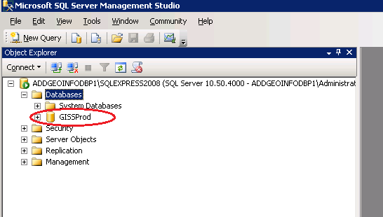
Create an Enterprise Geodatabase
SQL Server instance has been created: 10.201.2.116/SQLEXPRESS2008
SQL database has been created: GISSProd

Slide 9
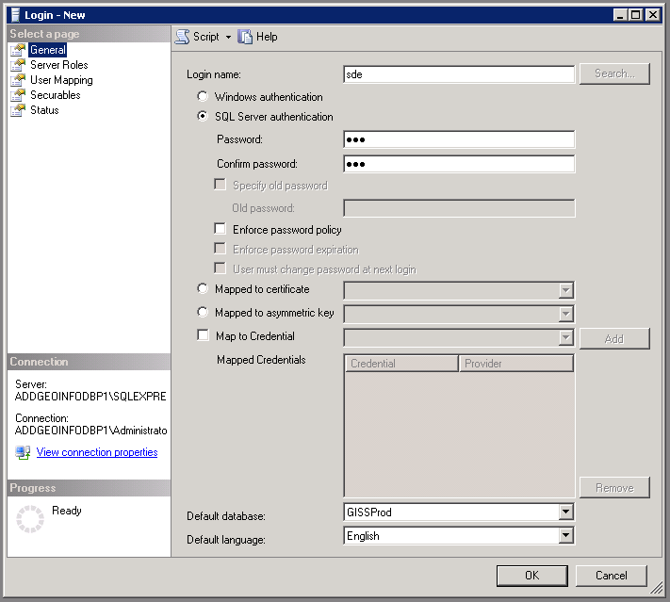
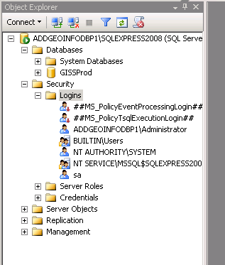
Create an Enterprise Geodatabase
A new User (Login) has been created in SQL Server:
Username: sde
Password: sde

Slide 10
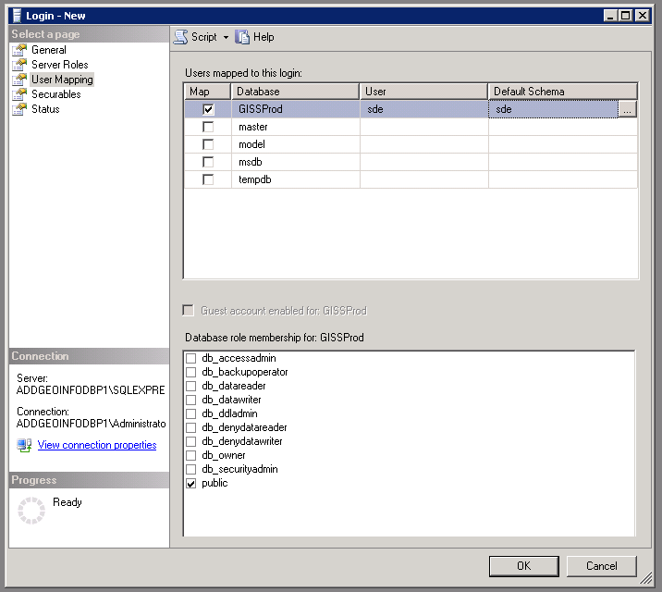
Create an Enterprise Geodatabase
New user has been mapped to the new database & schema has been defined
Schema name: sde (because it should be the same with the user)
- sde user has been mapped to the GISSProd database.

Slide 11
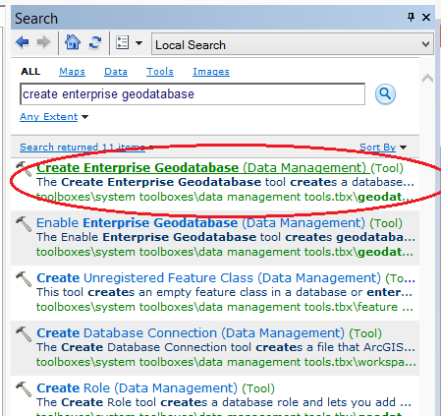
Create an Enterprise Geodatabase
An enterprise geodatabase has been created using the Create Enterprise Geodatabase tool .

Slide 12
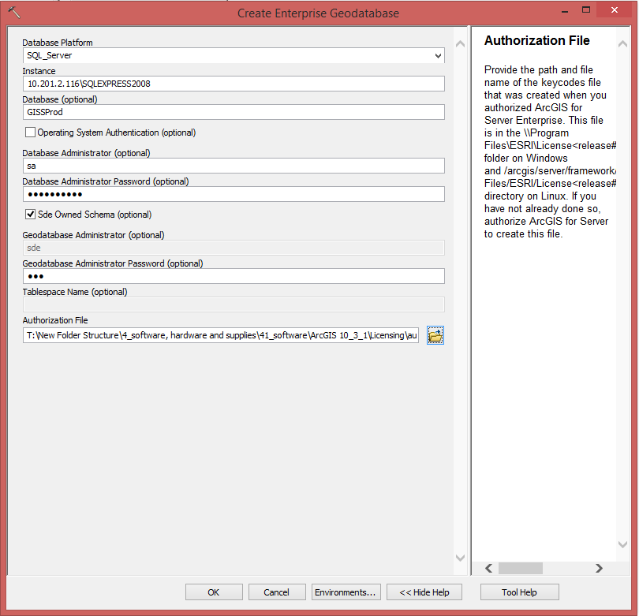
Create an Enterprise Geodatabase
An enterprise geodatabase has been created using the Create Enterprise Geodatabase tool .
A path to the keycodes file that was created when you authorized ArcGIS for Server Enterprise is required.

Slide 13
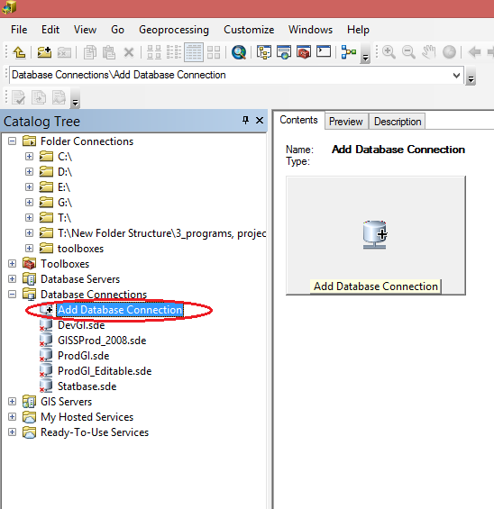
Create an Enterprise Geodatabase
Connecting to the enterprise geodatabase from ArcGIS Desktop
In ArcCatalog tree, expand ‘Database Connections’ and double-click ‘Add Database Connections ‘

Slide 14
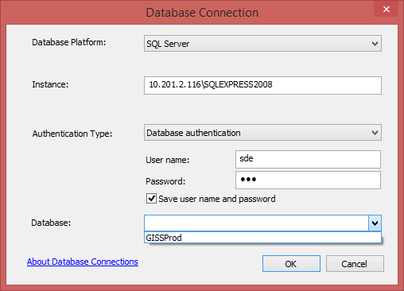
Create an Enterprise Geodatabase
Connecting to the enterprise geodatabase from ArcGIS Desktop
2. Enter the following parameters
Instance: 10.201.2.116\SQLEXPRESS2008
Authentication Type: Database authentication
User name: sde
Password: sde
Database: GISSProd
Then click OK.
3. Type a new name (MyEnterpriseGDB) to the new enterprise geodatabase connection.

Slide 15
THANK YOU!

