Slide 1
Using Model Builder in ArcGIS
GIS for Spatial Planning
Training for Ministry of Transport,
Mozambique
Maputo, Mozambique
2-13 July 2018
Aster Denekew Yilma
African Centre for Statistics

Slide 2
Content
What is ModelBuilder
Creating a Model in ModelBuilder
Validating model
Running model
Generating model report

Slide 3
What is ModelBuilder?
ModelBuilder is an application we use to create, edit and mange models
We create models in ArcGIS using ModelBuilder to automate process
It is a tool for building workflows / models that use sequence of geoprocessing tools
Notes:
It is a tool for building workflows / models that use sequence of geoprocessing tools to automate a process in order to generate new datasets

Slide 4
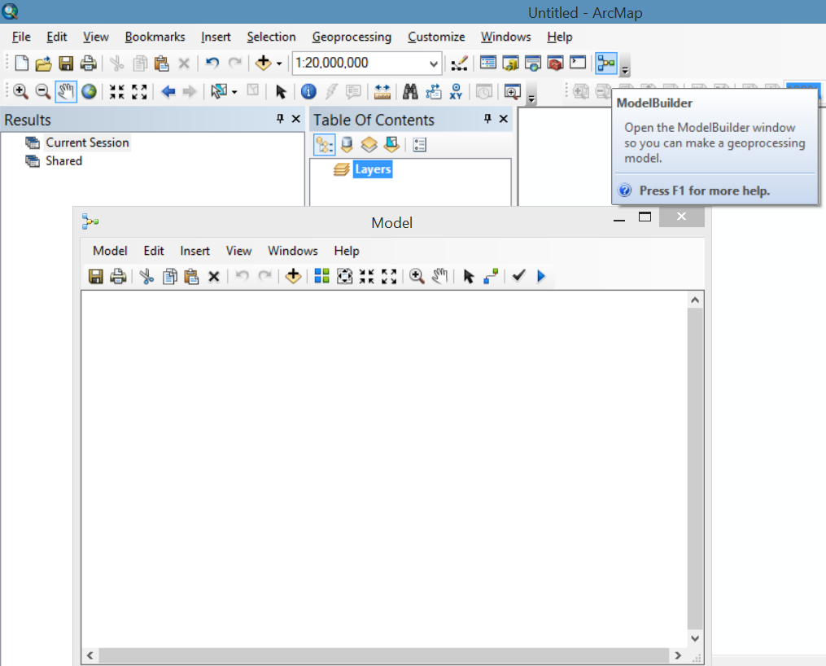
Creating Models in ArcGIS
Creating a new model:
Click the ModelBuilder button on the ArcMap Standard toolbar
This opens the ModelBuilder window for editing
the model is open for editing, you can add tools using the Search window; add data elements

Slide 5
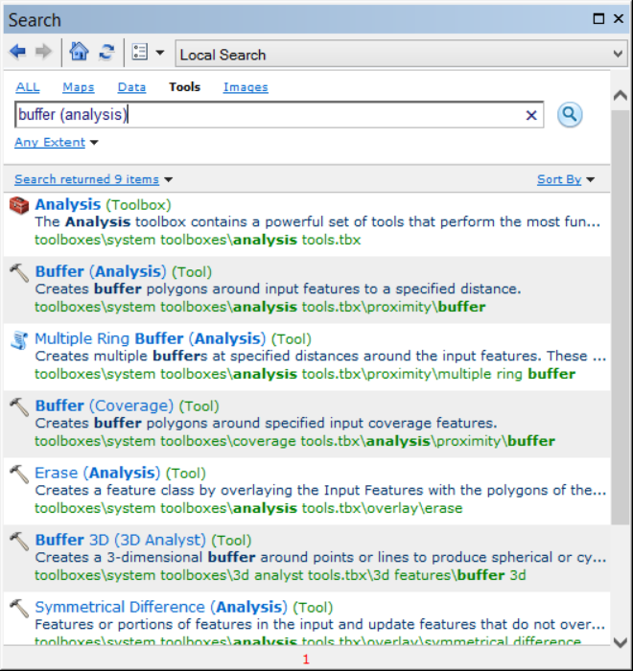
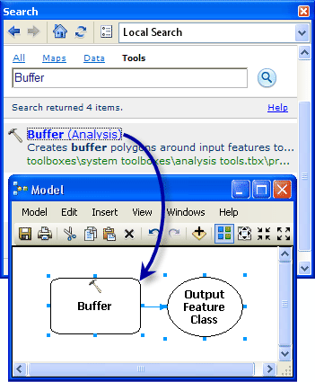
Creating Models in ArcGIS
Adding tools and data to a model:
In ArcMap, click Geoprocessing > Search For Tools.
Notes:
This opens a Search window
On the Search window, type Buffer, then click the Search button to search.
The Buffer tool is listed along with other search items
Drag the search item Buffer (Analysis) in to the ModelBuilder canvas

Slide 6
Creating Models in ArcGIS
Right click on the Buffer tool
Create input features
(Make variable -> From Parameter -> Input features )
Input feature added

Slide 7
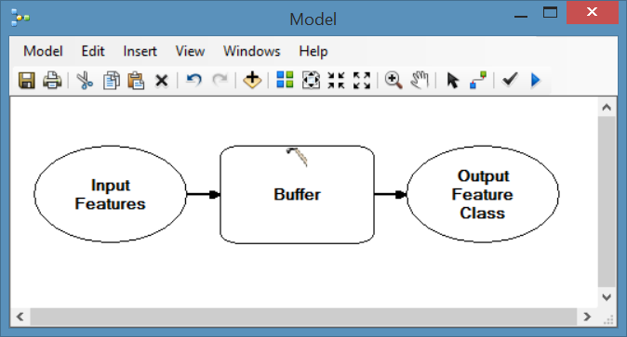
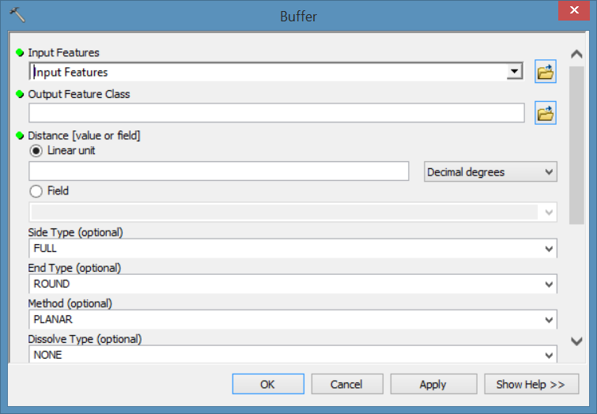
Creating Models in ArcGIS
“Not Ready-To-Run”
Double click each building block to define parameters
Notes:
When you initially drag a tool into a ModelBuilder window, the process is in a not-ready-to-run state (the tool is white), because the required parameter values have not been specified.

Slide 8
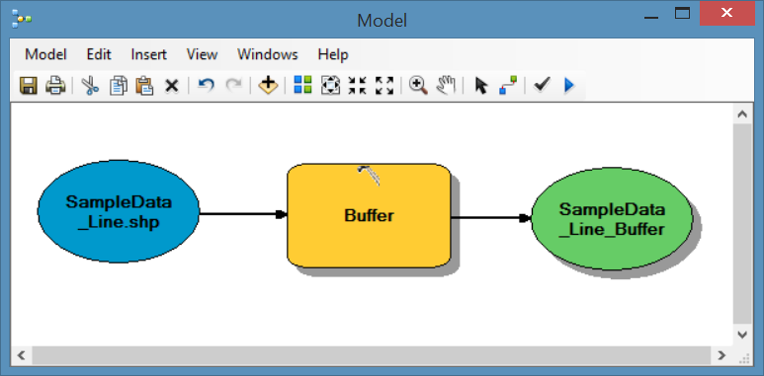
Creating Models in ArcGIS
“Ready-to-run”
Notes:
A process is ready-to-run when the tool has all required parameter values.

Slide 9
Creating Models in ArcGIS
The first geoprocessing applies a new projection to an input feature class to create a new output feature class
The output feature, projected feature class, becomes input feature for the next geoprocessing (clip)
Notes:
The Output Feature class will contain all the attributes of the Input Features

Slide 10
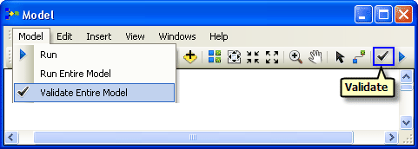
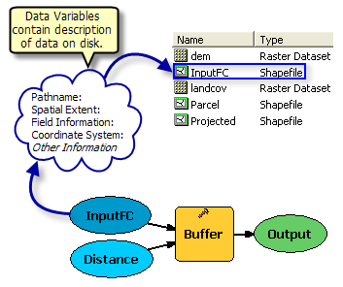
Validating the Model
Validate the model: data elements and parameter values are valid
Data variables reference data on disk, not the actual data
Notes:
Data variables reference data on disk and only contain descriptive information about the data on disk, not the actual data. Validating a model refreshes this descriptive information then checks this description against each tool parameter to ensure it is still valid.

Slide 11
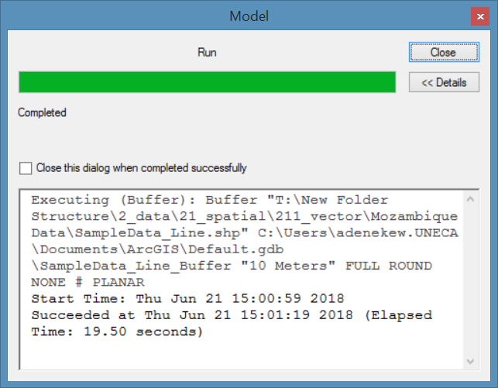
Running the Model

Slide 12
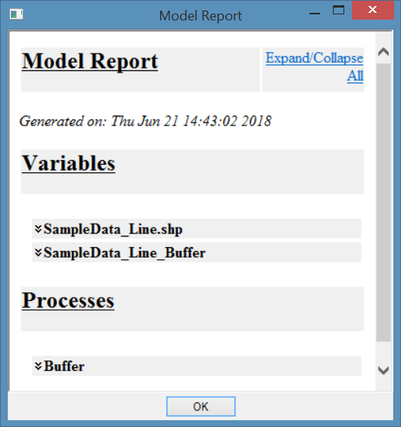
Generating Model Report
Generate model report:
Warning message if there is problem in the model
View or save model

Slide 13
THANK YOU!

