Slide 1
Surface Operations Examples
GIS for Spatial Planning
Training for Ministry of Transport
Mozambique
Maputo, Mozambique
2-13 July 2018
Geoinformation and Sectoral Statistics Section

Slide 2
Content
Creating contour lines form Surface Raster (DEM/DTM)
Creating Slope from Surface Raster (DEM)
Creating Aspect from Surface Raster (DEM)
Creating Hillshade`
Using the Raster Calculator

Slide 3
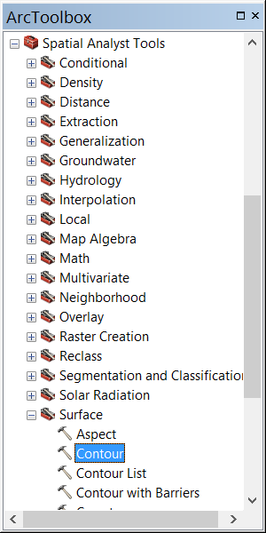
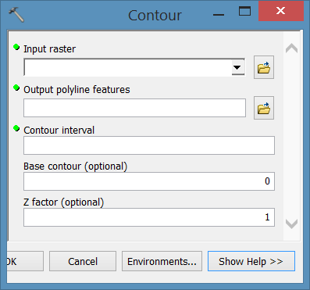
Creating Contours from Raster Surface
To create contour lines from raster surface (e.g. DEM), use Contour (Spatial Analysis) tool, Surface toolset
Notes:
Select input surface raster
Select the folder where you will save the output polyline features (contour), including name
Base contour is the base contour value, where contours are generated above and below this value. The default is 0

Slide 4
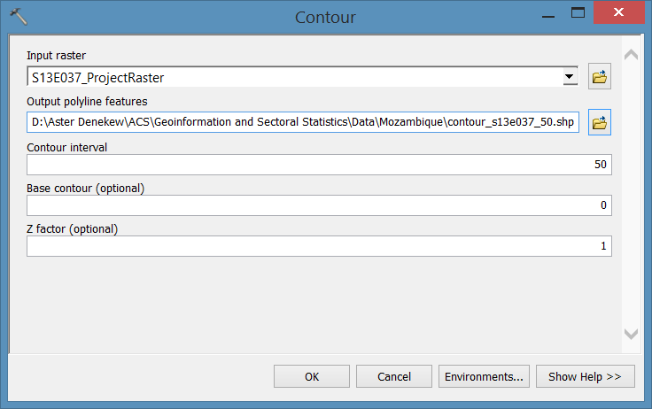
Creating Contours from Raster Surface

Slide 5
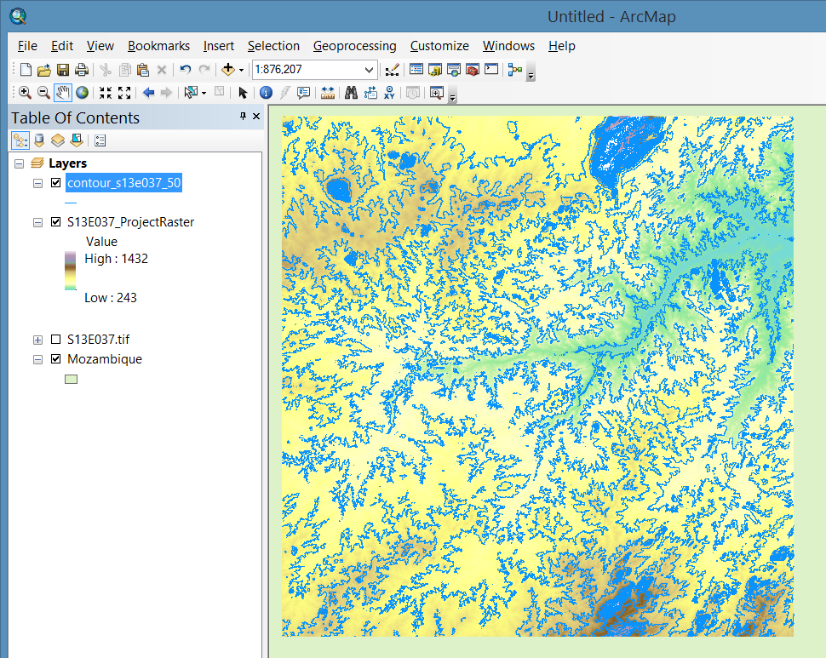
Creating Contours from Raster Surface

Slide 6
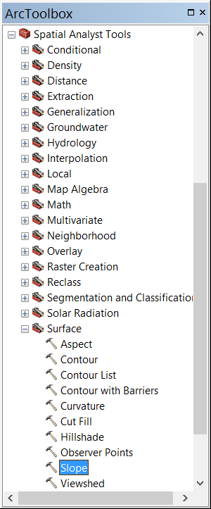
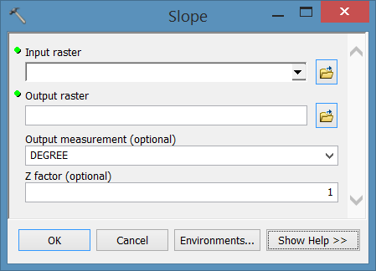
Creating Slope from Raster Surface
To create slope from raster surface (e.g. DEM), use Slope (Spatial Analysis) tool, Surface toolset
Notes:
Select input surface raster
Select the folder where you will save the output raster (slope), including name of raster output
Select the output measurement (Degree or Percent rise ) for the slope measurement unit
Z factor adjusts the units of measure for z units; if the x,y units in the input raster is different from z units. Z factor is 1 if they have same units.

Slide 7
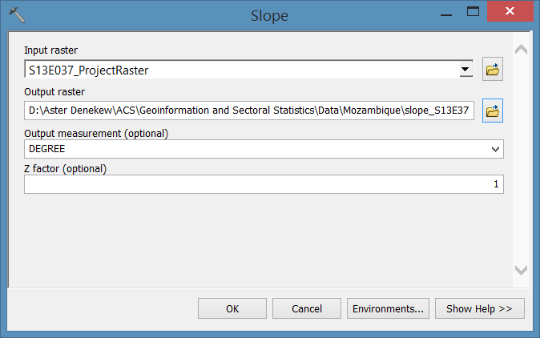
Creating Slope from Raster Surface

Slide 8
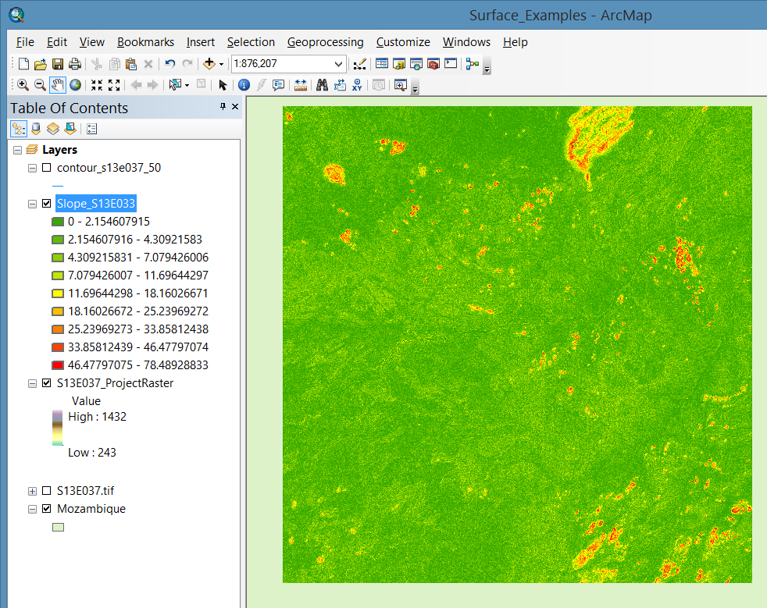
Creating Slope from Raster Surface

Slide 9
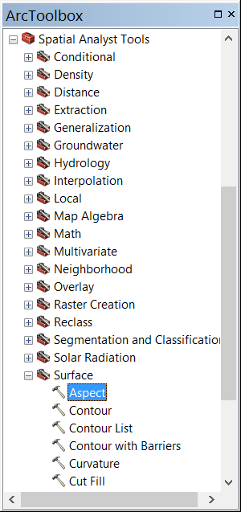
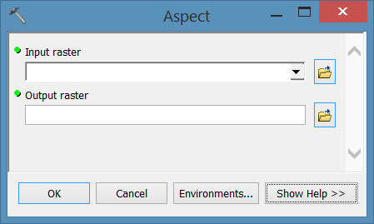
Creating Aspect from Raster Surface
To create slope from raster surface (e.g. DEM), use Aspect (Spatial Analysis) tool, Surface toolset
Notes:
Select input surface raster
Select the folder where you will save the output raster (Aspect), including name of raster output
Cells in the input raster that are flat—with zero slope—are assigned an aspect of -1.
Aspect is expressed in positive degrees from 0 to 359.9, measured clockwise from north

Slide 10
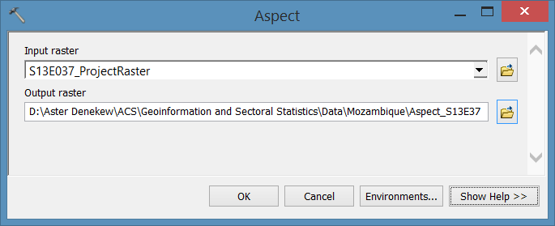
Creating Aspect from Raster Surface

Slide 11
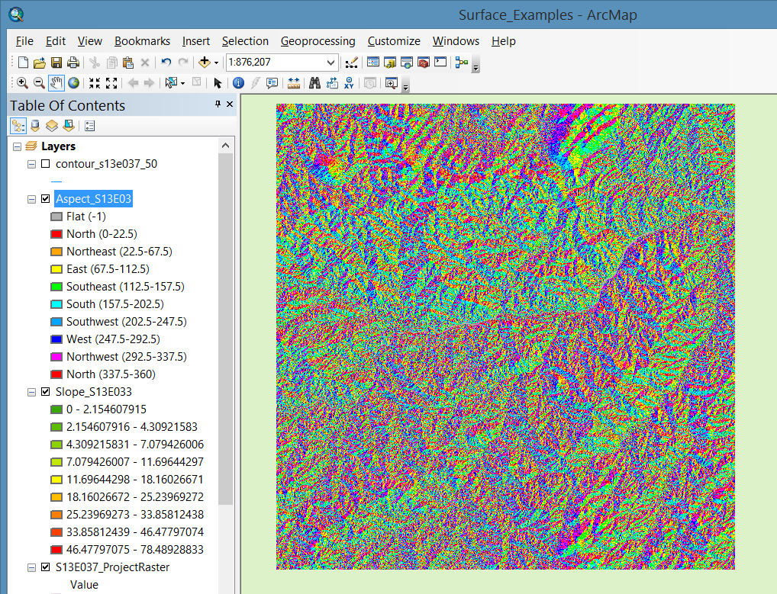
Creating Aspect from Raster Surface

Slide 12
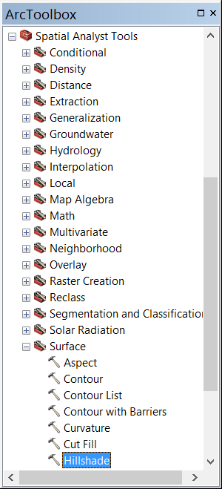
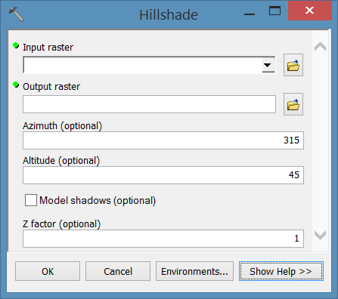
Creating Hillshade from Raster Surface
To create hillshade from raster surface (e.g. DEM), use Hillshade (Spatial Analysis) tool, Surface toolset

Slide 13
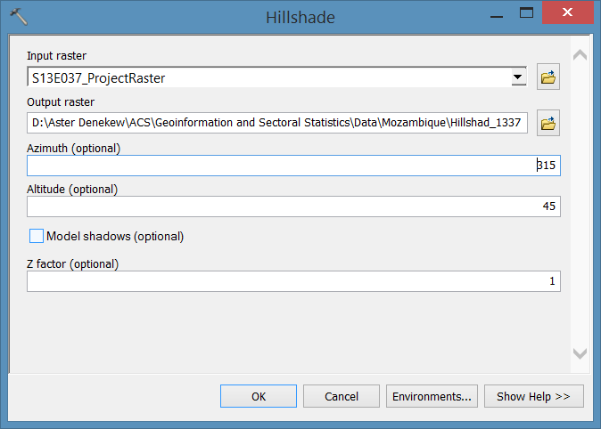
Creating Hillshade
Notes:
If Model shadows are not checked the effects of shadows are not considered. The output raster only considers local illumination angles
If checked, the output shaded raster considers both local illumination angles and shadows

Slide 14
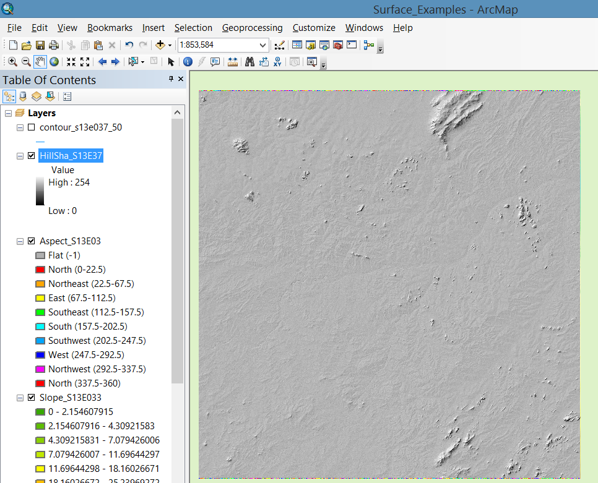
Creating Hillshade
You can change the color in Symbology
Check the hill shade effect to change the display, Z value

Slide 15
THANK YOU!

