Slide 1
Spatial Analysis & Modeling
GIS for Spatial Planning
Training for Ministry of Transport
Mozambique
Maputo, Mozambique
2-13 July 2018
Geoinformation and Sectoral Statistics Section

Slide 2
Content
Spatial Analysis and Modeling Concepts
Surface Models
Surface Modeling Operations

Slide 3
Spatial Analysis & Modeling Concepts
Spatial analysis is the technique to analyze data in terms of location
Find out patterns, identify relationships among features, plan efficient routes, perform site selection, model or predict values based on discrete sample observations, etc.
Relationships: proximity, overlap, intersection, visibility, accessibility, etc.
Detect patterns: hotspots, outliers, clusters, change over time

Slide 4
Spatial Analysis & Modeling Concepts
Predict values: given a set of measured points across an area you can determine the estimated values in unmeasured locations
Using spatial analysis, you can combine information from many independent sources and derive a new set of information by applying a large, rich, and sophisticated set of spatial operators or geo-processing tools

Slide 5
Spatial Analysis & Modeling Concepts
Why Spatial modeling: finding relationships among geographic features to understand and address any particular problem
Spatial modeling allows you to derive new data from values of existing data layers and to predict what might happen and where
Modeling often involve developing specialized workflows through programming, creating scripts and automated workflows, lets you efficiently query and process large amounts of data and implement more complex algorithms.

Slide 6
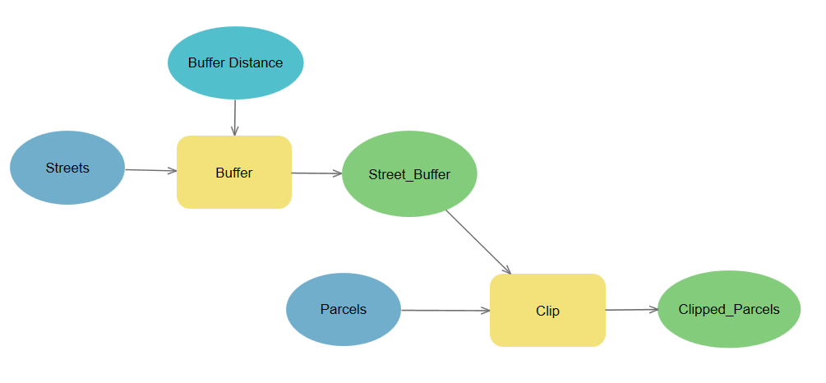
Spatial Analysis & Modeling Concepts
Models help you understand, describe, and predict how things work in the real world
Spatial modeling, modeling spatial problems, involve two types of models:
Representation models – represent the objects in the landscape
Process models – simulate the processes in the landscape

Slide 7
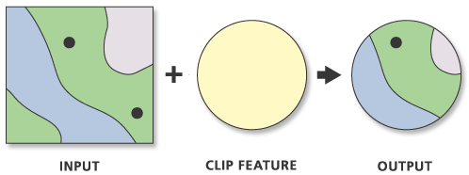
Spatial Analysis & Modeling Concepts
Spatial Analysis
Raster model
Vector model

Slide 8
Spatial Analysis & Modeling Concepts
Using an elevation surface, for example, you can derive information and identify features that were not readily apparent in the original surface,
contours, angle of slope, steepest downslope direction (aspect), shaded relief (hillshade), and visible areas (viewsheds)
model the flow of water across Earth’s surface, deriving runoff characteristics, understanding drainage systems, and creating watersheds

Slide 9
Surface Models
Surface Models: DSM, DEM, DTM
Digital Surface Model (DSM) surface model which captures the natural and built features on the Earth’s surface
DSM is generated using LiDAR system, which sends pulses of light to the ground and when the pulse of light bounces off/back its target and returns to the sensor, it gives the range (a variable distance) to the Earth
LiDAR delivers a massive point cloud filled of varying elevation values (Height can come from the top of buildings, tree canopy, power lines, other built and natural features)
DSM is useful in 3D modeling for telecommunications, urban planning and aviation (objects extrude from the earth, particularly useful in these application to identify obstructions)

Slide 10
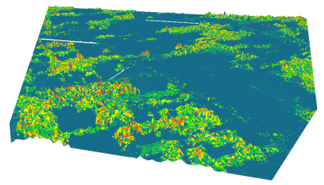
Surface Models
DSM

Slide 11
Surface Models
Digital Elevation Model (DEM) is a digital model or 3D representation of a terrain’s surface, created from DEM is bare-earth raster grid, which filters out vegetation and man made features terrain elevation data
DEM is bare-earth raster grid, which filters out vegetation and man made features
non-ground points such as bridges and roads, built (power lines, buildings and towers), and natural (trees and other vegetation types) are not included in DEM
Digital Elevation Model (DEM) is frequently used and simplest form of digital representation of topography

Slide 12
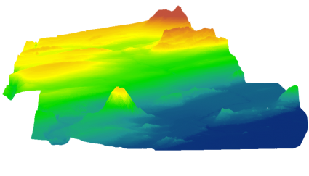
Surface Models
DEM is used to determine terrain attributes such as elevation, slope and aspect
Terrain features such as drainage basins and watersheds, drainage networks and channel can be identified from DEMs.
Widely used in hydrologic modeling, and geologic analysis, soil mapping

Slide 13
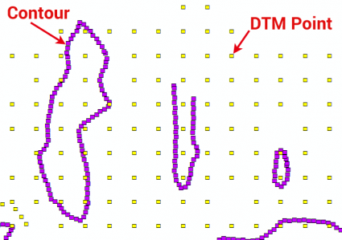
Surface Models
A Digital Terrain Model (DTM) is a vector data set composed of regularly spaced points and natural features such as ridges and breaklines.
DTMs are typically created through stereo photogrammetry
From these regularly-space and contour lines, you can interpolate a DTM into a DEM

Slide 14
Surface Modeling Operations
Surface modeling operations include:
Contour
Slope
Aspect
Hillshade
Viewshed
Visibility
Cut Fill
Interpolation

Slide 15
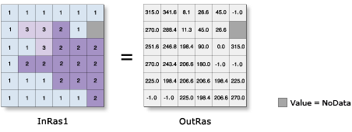
Surface Modeling Operations
Aspect (Spatial Analyst)
Derives aspect from a raster surface. The aspect identifies the downslope direction of the maximum rate of change in value from each cell to its neighbors.
Aspect can be thought of as the slope direction. The values of the output raster will be the compass direction of the aspect.
Aspect is expressed in positive degrees from 0 to 359.9, measured clockwise from north.

Slide 16
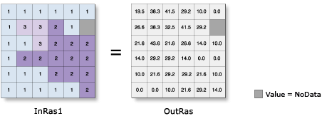
Surface Modeling Operations
Slope (Spatial Analyst)
Identifies the slope (gradient, or rate of maximum change in z-value) from each cell of a raster surface.

Slide 17
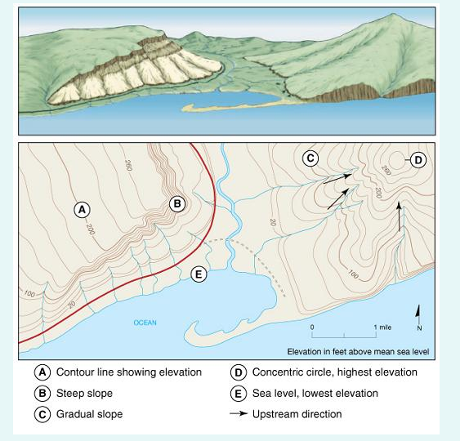
Surface Modeling Operations
Contour (Spatial Analyst)
Contours represent points having equal heights/ elevations with respect to a particular datum such as Mean Sea Level (MSL)
Topographic maps, shape of a landscape represented with contour lines
A way to describe three-dimensional landscapes in two dimensions
Notes:
When contour lines are close together, elevation is changing rapidly over an area, meaning the slope is steep, cliff
When contour lines are far apart, elevation is changing gradually, meaning the slope is gentle
Contour lines also form concentric circles, indicationg hill or mountain

Slide 18
Surface Modeling Operations
Contour (Spatial Analyst)
Contour tool: Creates a line feature class of contours (isolines) from a raster surface.
A base contour is used; e.g. to create contours every 10 meters, starting at 5 meters
5 is the base contour, and 10 is the contour interval. values to be contoured 5, 15, 25, 35, 45, …

Slide 19
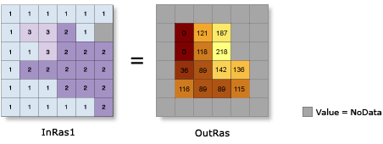
Surface Modeling Operations
Hillshade (Spatial Analyst)
Hillshade tool: Creates a shaded relief from a surface raster by considering the illumination source angle and shadows.
The hillshade raster has an integer value of 0 to 255, o representing

Slide 20
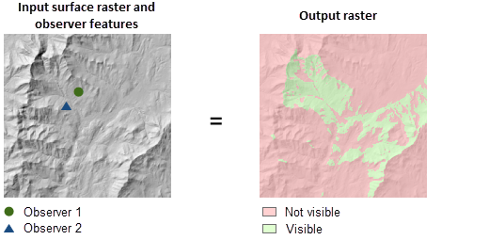
Surface Modeling Operations
Viewshed (Spatial Analyst)
Determines the raster surface locations visible to a set of observer features
Useful in application like telecommunication

Slide 21
Surface Modeling Operations
Spatial interpolation is used to take known values and interpolate them into a surface, deriving new estimated surface values
Elevation points interpolated to generate DEM
Contour lines interpolated to generate DEM
Using interpolation methods, users can create surfaces from sampled locations without having to visit every location of a study area, saving time and effort.

Slide 22
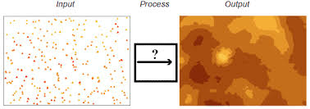
Surface Modeling Operations
Interpolation(Spatial Analyst)
Interpolation is creating a surface based on a sample of values with the domain
Different techniques for interpolation:
IDW (Inverse Distance Weighting)
Kriging
Natural Neighbor
Spline

Slide 23
Surface Modeling Operations
IDW: Interpolates a raster surface from points using an inverse distance weighted (IDW) technique
Values for nearby points tend to be more similar
IDW weights the value of each point by its distance to the cell being analyzed and averages the values
It assumes that unknown value is influenced more by nearby points than far away points

Slide 24
Surface Modeling Operations
Spline: Interpolates a raster surface from points using a two-dimensional minimum curvature spline technique.
It fits a curve through the sample data and assigns values to other locations based on their location on the curve
Regularized Method: results in a smoother surface that smoother areas of abruptly changing values
Tension Method: results in a rougher surface that more closely adheres to abrupt changes in sample points

Slide 25
Surface Modeling Operations
Kriging Method: Interpolates a raster surface from points using kriging.
Like IDW interpolation, Kriging forms weights from surrounding measured values to predict values at unmeasured locations.
IDW uses a simple algorithm based on distance
Kriging weights come from a semi-variogram that is developed by looking at the spatial structure of the data
Predictions are made for locations in the study area based on the semi-variogram and the spatial arrangement of measured values that are nearby
Semi-variograms measure the strength of statistical correlation as a function of distance; they quantify spatial autocorrelation
Kriging associates probability with each prediction

Slide 26
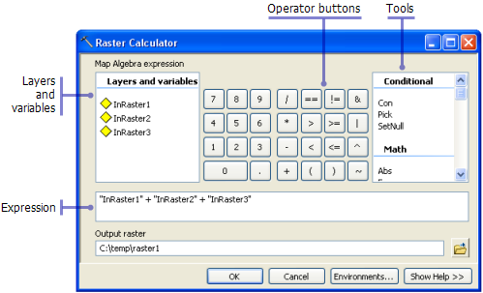
Surface Modeling Operations
Raster Calculator (Spatial Analyst)
Builds and executes a single Map Algebra expression using Python syntax in a calculator-like interface.

Slide 27
THANK YOU!
denekewa@Un.org

