Slide 1
Geospatial Data models
GIS for Spatial Planning
Training for Ministry of Transport
Mozambique
Maputo, Mozambique
2-13 July 2018
Geoinformation and Sectoral Statistics Section

Slide 2
Content
Data Model Concepts
Types of Data Models: Vector Vs. Raster
Scale and resolution
Spatial relationships and spatial operations

Slide 3
Data Model Concepts
Data represent a simplified view of the real world
Physical entities or phenomena are approximated by data in GIS
  Spatial location, extent of the physical entities, non-spatial properties
Entity is represented by spatial feature or spatial object
Essential characteristics are also defined for each entity
Objects are abstractions in a spatial database
Spatial objects are the objects in a spatial database representing real-world entities with associated attributes
Notes:
Rivers, represented by lines, lakes represented by polygons
Lines and polygons are spatial objects in the spatial database
Spatial objects has location information, non-spatial attributes to describe or represent the spatial entity/physical entity or phenomena

Slide 4
Data Model Concepts
Spatial data model is means of representing and manipulating spatially-referenced information
Notes:
The image in the left is an aerial photo of a certain area; the right side is representation of features (lake, or reservoir ) ; it is a representation of the real world entities, in the spatial database

Slide 5
Data Model Concepts
Data model is the objects in a spatial database plus the relationships among them
Coordinates are used to define the spatial location and extent of geographic objects
Attribute/non-spatial data are linked with coordinate data to define each spatial object in the spatial database
Most conceptualizations or models view the world as set of layers
Each layer organizes the spatial and attribute data for a given set of cartographic/spatial objects
  E.g. Lake, river, road, etc.
Thematic layers in GIS databases

Slide 6
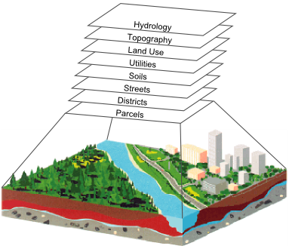
Data Model Concepts
Notes:
Overlaying these different layers gives the picture of the real world

Slide 7
Data Model Concepts
Attribute data are categorized as nominal, ordinal, or interval/ratio
Nominal attributes: variables that provide descriptive information about an object
  E.g. Color, vegetation type, city name, owner of parcel, soil type etc.
Nominal attributes can also be images, film clips, audio, or other descriptive information
  E.g. Images of buildings or surroundings in real estate management database

Slide 8
Data Model Concepts
Ordinal attributes: variables that imply rank order or scale by their values
Ordinal attribute may be descriptive
  E.g. small, medium, large,
  Low, moderate, high,
  ranging from 1 to 5 (soil erosion level ), etc.
Interval/ratio attributes are used for numeric items where both order and absolute difference in magnitudes are reflected in the number
  Real number on a linear scale
  E.g. area, length, weight, height, depth, value, etc. are represented by interval/ration variables
Notes:
Area of parcel, in sq. meters; length of river; height of building; depth of lake; etc.

Slide 9
Data Model Concepts
Spatial objects are represented in two most common spatial data models
Spatial data models begin with conceptualization, how you will represent the real world phenomena or entities
  E.g. a road can be represented as lines; river as line or polygon; city and towns as point or polygon, etc.
  The road to include the road type (e.g.: highway, street, etc. or gravel, paved/ asphalted, etc.); width of road,
Notes:
We start conceptualizing how the road is represented; how the river is represented, etc.

Slide 10
Data Model Concepts
There are two main data models or conceptualizations used for spatial data: Vector data model and Raster data model
Vector data model use discrete objects such as point, lines and polygons to represent the geometry of the real-world entities, discrete entities
    E.g. a road, river, city and towns, lakes or wetlands, farm land, etc.
Raster data model represents continuous phenomena that may change continuously across a region
    E.g. Elevation, rainfall, temperature, soil moisture, etc.
Raster model uses grid cells for representing continuous phenomena
Notes:
Vector data layers consist of representations of objects, usually called features in a form of points, lines or polygons, which are represented and stored in x, y, z coordinates
Example: Elevation can be measured everywhere, and we get different values of elevation

Slide 11
Data Model Concepts
Notes:
This is example of vector and raster model representations
Vector model use points, lines, and polygons
Raster model use grid cells

Slide 12
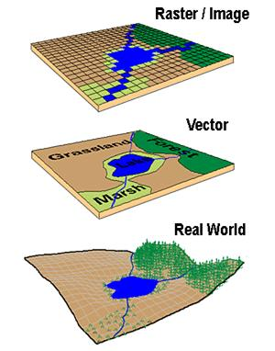
Data Model Concepts
Raster vs. Vector Data Model

Slide 13
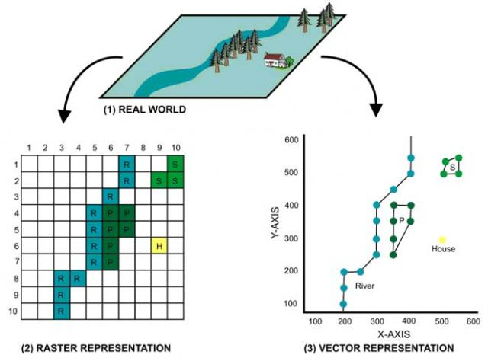
Data Model Concepts

Slide 14
Data Model Concepts
Vector data model and Raster data model can represent same phenomena
    E.g. Elevation represented as surface (continuous field) using raster grid or as lines representing contours of equal elevation (discrete objects), or as points of height (Z values).
Data can be converted from one conceptual view to another
    E.g. raster data layer can be derived from contour lines, point cloud
Selection of raster or vector model depends on the application or type of operations to be performed
    E.g. Elevation represented as surface (continuous field) in raster - to easily determine slope, or
    as discrete contours if printed maps of topography
Notes:
Topographic height measured as Z values; x, y representing location of point.

Slide 15
Vector Data Model
There are three basic types of vector objects: points, lines and polygons
Vector data model uses sets of coordinates and associated attribute data to define discrete objects
Point objects in spatial database represent location of entities considered to have no dimension
Simplest type of spatial objects
    E.g. wells, sampling points, poles, telephone towers, etc.
Line objects are used to represent linear features using ordered set of coordinate pairs
    E.g. infrastructure networks (transport networks: highways, railroads, etc.) ; utility networks: (gas, electric, telephone, water, etc. ); airline networks: hubs and routes, etc.); natural networks such as river channels
Notes:
We use several points to approximate linear features

Slide 16
Vector Data Model
Polygon objects in spatial database represent entities which covers an area
    E.g. lakes, Buildings, parcels, etc.
Boundaries may be defined by natural phenomena (e.g. lake), or by man made features (e.g census tracts, neighborhoods)
    E.g. Land cover data: forest, wetlands, urban areas, etc.
    Soil data – soil types

Slide 17
Raster Data Model
Raster Data Model defines the world as a regular set of cells in a uniform grid pattern
Cells are square and evenly spaced in the x and y directions
Each cell represent attribute values and cell location of phenomena or entities
Cell dimension specifies the length and width of the cell in surface units
Raster data models represent continuous phenomena or spatial features
    E.g. Elevation/DEM, bathymetry, precipitation, slope, etc.
Raster data model may also be used to represent discrete data
    E.g. Land cover: forest, wetlands, urban areas
Rasters are digital aerial photographs, imagery from satellites, digital pictures, or even scanned maps

Slide 18
TIN Data Model
Triangulated Irregular Network (TIN) is data model commonly used to represent terrain heights
x, y, and z locations, used as measured points in TIN
Result in TIN composed of nodes, lines and triangulated faces
TIN used for digital elevation models (DEM) or digital terrain models (DTM)
Very efficient way of representing topography

Slide 19
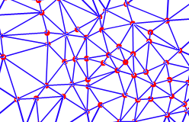
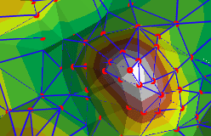
TIN Data Model
Notes:
The edges of TINS form non-overlapping facets

Slide 20
Scale and Resolution
Scale is the relationship between distance on a map and the corresponding distance on the earth
The ratio of distance on a map, to actual ground distance
Expressed in a ratio: e.g. 1:100,000; 1:1,000
  1:100,000 means one unit of distance on the map represents 100,000 of the same units of distance on the earth; i.e. 1 cm on the map equals 100,000 cm (1 km) on the ground
  Large scale maps show more detail; Small scale maps show less detail, but cover large parts of the earth
  Smaller denominator, larger scale or small map-to-ground ratio, small scale

Slide 21
Scale and Resolution
GIS data is stored in a very different way than paper map data, map scale is different
Paper maps have fixed map scale
GIS maps don’t have fixed map scale
You can zoom in until the screen displays a square meter or less, or zoom out until the screen displays the entire earth
This means that geographic data in a GIS doesn't really have a defined 'map scale'

Slide 22
Scale and Resolution
Resolution is the size of the smallest feature that can be represented in a surface
Ground resolution, spatial resolution
Spatial resolution of an image is an indication of the size of a pixel in terms of ground dimensions.
A spatial resolution of 30 meters means that one pixel represents an area 30 meters by 30 meters on the ground
High resolution: features more closely resemble real-world features; small objects can be detected
Low resolution: features simplified or not shown at all; only large features are visible
Notes:
Compare what an astronaut onboard the space shuttle sees of the Earth to what you can see from an airplane. The astronaut might see your whole province or country in one glance, but couldn't distinguish individual houses. Flying over a city or town, you would be able to see individual buildings and cars, but you would be viewing a much smaller area than the astronaut

Slide 23
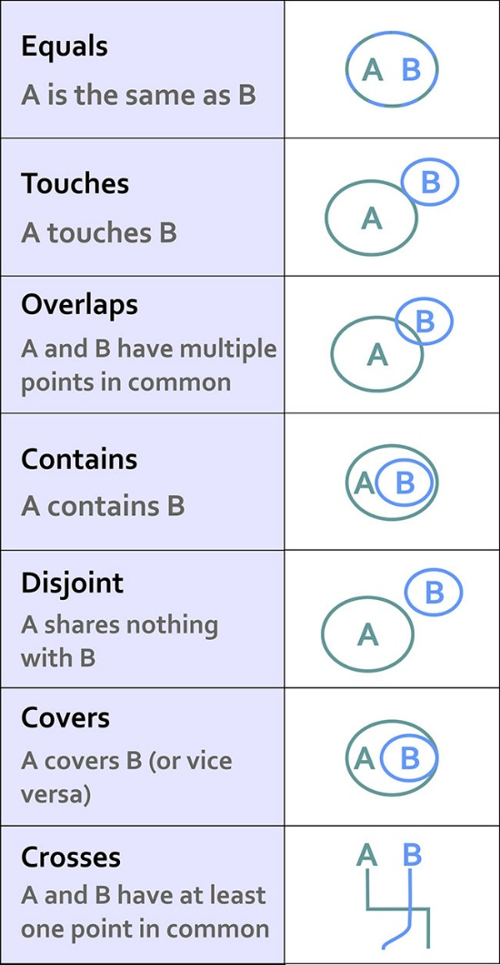
Spatial relationships
Spatial relationships between features
  Do they overlap?
  Is one contained by the other?
  Does one cross the other?
Geometries can be spatially related in different ways

Slide 24
Spatial Operations
Spatial operations use geometry functions to take spatial data as input, analyze the data, then produce output data that is the derivative of the analysis performed on the input data
E.g. Buffer, clip, intersection, union, dissolve, merge, etc.

Slide 25
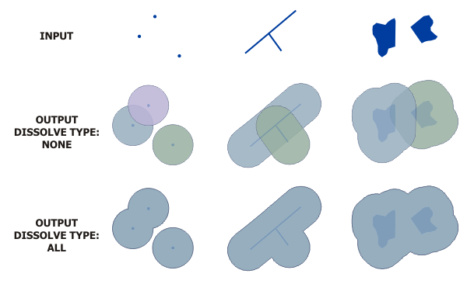
Spatial Operations
Buffer (Analysis)
Creates buffer polygons around input features to a specified distance

Slide 26
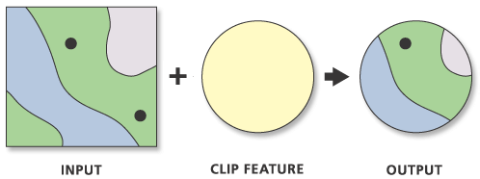
Spatial Operations
Clip (Analysis)
Clip: Extracts input features that overlay the clip features
Creating a new feature class: Area of Interest (AOI), or study area
The Output Feature Class will contain all the attributes of the Input Features

Slide 27
Spatial Operations
Clip (Data Management )
Cuts out a portion of a raster dataset, mosaic dataset, or image service layer.
Allows you to extract a portion of a raster dataset based on a template extent
The clipped area is specified either by a rectangular envelope using minimum and maximum x- and y-coordinates or by using an output extent file

Slide 28
Spatial Operations
Intersect (Analysis)
Computes a geometric intersection of the input features.
Features or portions of features which overlap in all layers and/or feature classes will be written to the output feature class.
Input Features must be simple features: point, multipoint, line, or polygon

Slide 29
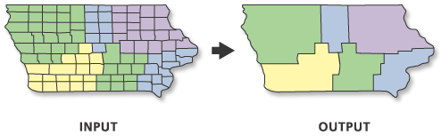
Spatial Operations
Dissolve (Data Management)
Aggregates features based on specified attributes

Slide 30
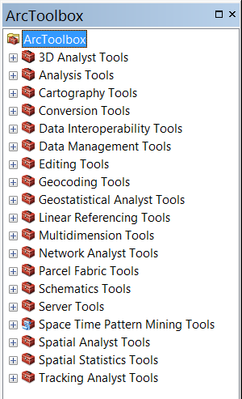
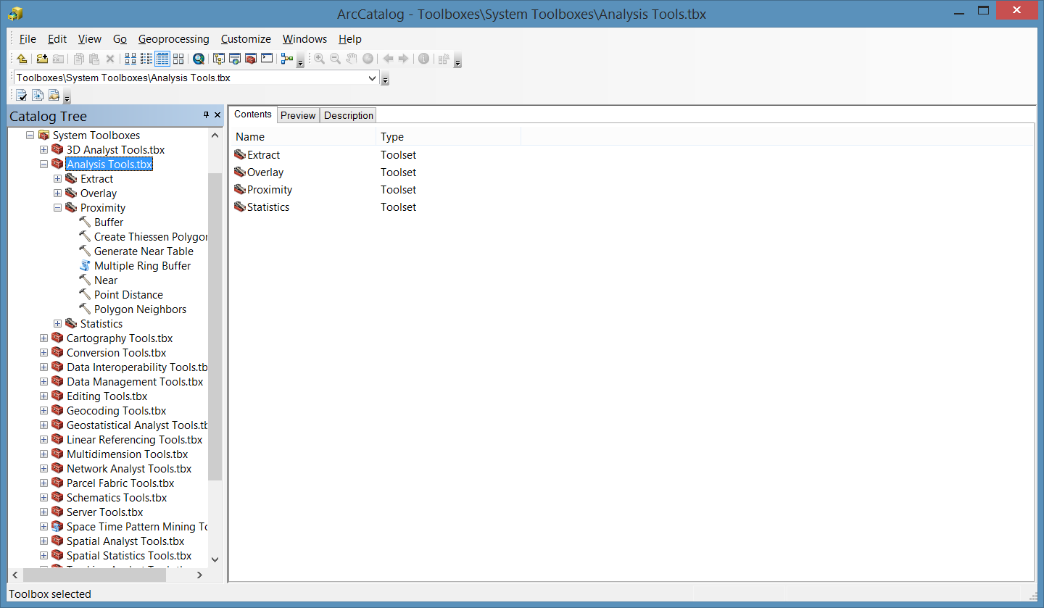
Spatial Operations
Accessing the Tools (ArcToolbox)
Open the Catalog Window > Expand Toolboxes > SystemToolboxes >Expand Analysis Tools or Data Management Tool
Open ArcToolbox
Notes:
You can access it in the same way from the ArcCatalog Window, from the Toolboxes

Slide 31
Spatial Operations
Notes:
You can access it in the same way from the ArcCatalog Window, from the Toolboxes

Slide 32



THANK YOU!
denekewa@Un.org

