Slide 1
Geospatial Data Use and sharing Concepts
GIS for Spatial Planning
Training for Ministry of Transport
Mozambique
Maputo, Mozambique
2-13 July 2018
Geoinformation and Sectoral Statistics Section

Slide 2
Data Sharing Concepts
The volume of data is challenge with geographic information systems
With the increasing data acquisition methods in modern technologies: remote sensing and GPS
large and valuable datasets are available
Datasets are available in many institutions / organization
Others duplicate the effort to create the datasets that already exist
with out knowing the existence of the datasets or
with lack of access and data sharing mechanisms
Notes:
The volume of data is challenge with geographic information systems, this challenge comes with the increasing data acquisition methods in modern technologies such as remote sensing / satelitel technology and Global Navigation Systems one of them being GPS

Slide 3
Data Sharing Concepts
Organizations understood the problems related with geospatial data/information such as:
duplication of efforts,
non-standardized approaches,
lack of awareness,
Geo-information providers have realized that satisfying geo-information needs goes beyond the capacity of single organizations
In recent years, technological developments have facilitated access to geo-information and made it easier to exploit it effectively
Notes:
At the same time, organization understood the problem: duplication of efforts, which wastes scarce resources, both financial and human; different organiations use different standards or don’t used standardized data and methods, which also creates problem of data sharing.. There is also lack of awareness among the decision makers or users in general about the concept of data sharing, and lack of willingness to share data
the need for

Slide 4
Data Sharing Concepts
Organizations were seeking for mechanisms that enable them to work together to share their data and resources and to provide efficient information services to the users
Brought different data sharing initiatives
Globally recognized concept/initiative of spatial data infrastructure (SDI)
Notes:
spatial data infrastructure (SDI) is global initiative which has now more than 20 years existence

Slide 5
Spatial Data Infrastructure
Spatial Data Infrastructure (SDI) evolved since early ninties: got recognition when development of national geospatial data infrastructure in Canada has received acceptance from the public, private sector and the user community,
The first international conference on “Emerging Global Geospatial Data Infrastructure” held in Bonn in September, 1996 to share ideas in building global geospatial data infrastructure among the international communities
Global Geospatial Data Infrastructure (GSDI) Association has members from Governments, Private, Academia, user community
GSDI conference held almost every year which gathers the geospatial community from all around the world.
Notes:
Global Geospatial Data Infrastructure (GSDI) Association has members from all over the world

Slide 6
Spatial Data Infrastructure
Spatial Data Infrastructure (Geospatial Data Infrastructure ) is the technology, policies, standards, human resources, and related mechanisms necessary to facilitate sharing, access to, and responsible use of geospatial data

Slide 7
Spatial Data Infrastructure
Currently, SDI is being implemented at different levels: national, regional and global levels – to facilitate the discovery, and access to geospatial data and services
National Spatial Data Infrastructure (NSDI) encompasses the policies and technology used and the institutional arrangement within a nation to produce, manage, and share geospatial information

Slide 8
Spatial Data Infrastructure
Geopspatial Metadata
Metadata is data about data.
Geospatial metadata: the information that describes geospatial data, geospatial Web services, or other geospatial resources.
Metadata provides the user information about the data such as content, source, quality, condition for use, lineage (history of use and changes) and other relevant characteristics
Notes:
Metadata is one of the components of SDI.

Slide 9
Spatial Data Infrastructure
Used for evaluating the fitness of the datasets:
Who collected the data? Is the source of data a recognized authority?
What were the methods used to acquire the data?
For what purpose were the data collected/intended?
What time period does the data represent?
Completeness of the data, etc.

Slide 10
Spatial Data Infrastructure
Clearinghouses
Clearinghouse is a “system of software and institutions to facilitate the discovery, evaluation and downloading of digital geospatial data”.
A clearinghouse consists of a number of servers that contain information about available digital geospatial data, the metadata
Notes:
Clearinghouse is also another important component of SDI
Users discover if dataset is available, and evaluate the usefulness of the data by looking at the metadata, and access the datasets based on the data access rules

Slide 11
Spatial Data Infrastructure
Geospatial Web Services
Geospatial Web services provide access to spatial data and GIS functionalities through the Internet
Web services are based on simple and proprietary standards, that makes data exchange possible, regardless of location, processing platforms, operating systems, or languages; lowering the cost of data sharing
Makes it for users to integrate them with their own systems and applications with out the need to install special type of GIS software
Notes:
You don’t need to have a special GIS software, processing platform; you can access a geospatial web service located in a server remotely in another organization, or in different country,

Slide 12
Spatial Data Infrastructure
Geoportals
A Web portal is a Web site that functions as an entry point to the World Wide Web
A geoportal is a web portal specifically for geospatial information; a gateway to a collection of online geospatial information resources
A single point of access to geospatial data, geospatial web services, and other geospatial resources
Facilitate geospatial information sharing between providers, and the users
Notes:
Geoportals are also part of a spatial data infrastructure. They are a means to share available geospatial data, and geospatial resources.

Slide 13
Spatial Data Infrastructure
Geospatial data/information providers publish the metadata to the geoportal.
Users can browse or search through geoportals to find relevant geospatial resources.
Once they find and evaluate their applicability, users can download the online data, or connect to and use Web services, or
Contact the content provider for offline data or document delivery

Slide 14
Spatial Data Infrastructure
As the broker between the data provider and the user, geoportals are serving as the face of SDI
Because geoportals help to realize the objectives of SDI to facilitate collaboration, they have been developed as a major part of SDI
A very good example of Geospatial portal is INSPIRE – European SDI

Slide 15
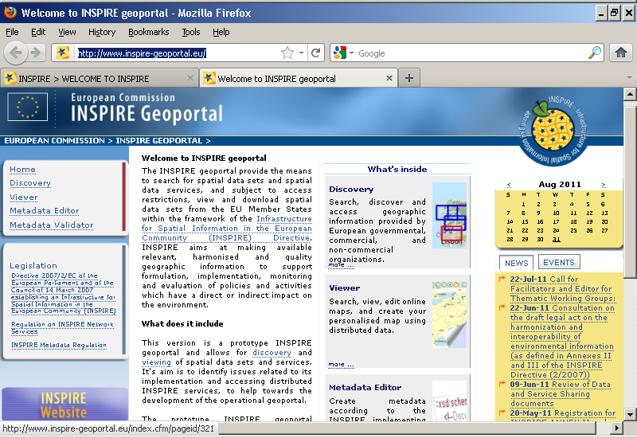
Spatial Data Infrastructure
Notes:
Look at the INSPIRe Geoportal for yourself
The geoportal provides the directive, the available data through links to the different participating members, and other relevant links

Slide 16
Spatial Data Infrastructure
Spatial Data Infrastructure Initiatives in Africa
UNECA has been promoting SDI both at national and regional levels
It has mainly been doing awareness raising and support the efforts of countries in realizing their national SDI
A number of African countries have been making efforts to mainstream geospatial information in their national development strategies through the development of NSDI and geospatial and space programmes
Other programs in open data initiatives are ongoing
Mozambique is one of the countries in the effort to realize open data initiatives; the open data portal (mozambique.opendataforafrica.org/ )

Slide 17
THANK YOU!
denekewa@Un.org

