Slide 1
Fundamentals of GIS
GIS for Spatial Planning
Training for Ministry of Transport
Mozambique
Maputo, Mozambique
2-13 July 2018
Geoinformation and Sectoral Statistics

Slide 2
Understanding GIS
A geographic information system (GIS) is a system designed to capture, store, manipulate, analyze, manage, and present spatial or geographic data.
GIS is a system that integrates hardware, software, and data for capturing, managing, analyzing, and displaying all forms of geographically referenced information
specific data types, data access methods and spatial data analysis methods, visualization of results
GIS gives better picture and understanding of the real-world
Organizations use GIS to solve problems and improve processes; spatial planning
Notes:
Visualization of results makes it unique: Results can be visualized and communicated in different formats, such as maps, and graphs
When we add a spatial or geographic component to our analysis, we have a better picture and understanding of the real-world

Slide 3
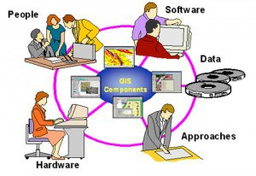
Components of GIS
GIS integrates the five key components
GIS software and hardware
Data
People
Policy and procedures / methods of implementation

Slide 4
Components of GIS
Software and Hardware:
Hardware: Computer and associated hardware used for data capturing and dissemination: GPS, digitizers, Scanners, Printers, plotters
requirement of GIS software
Software: provides the functions and tools needed to store, analyze, and display geographic information
Several GIS software are available
Free and Open source: QGIS, ILWIS, GRASS GIS, SAGA GIS, MapWindow, etc.
Proprietary software: ArcGIS (ESRI ), GeoMedia, MapInfo, SuperGIS, IDRISI, etc.
Decision is based on the institution requirement
Size of data handled; Cost of the software; Functionalities provided, etc.
day-to-day operating procedures and costs; staffing requirements and costs;
Maintenance costs; application development and cost
user training and costs; etc.

Slide 5
Components of GIS
Data: is important part of a GIS
The most expensive component of a GIS.
due to the high costs of data acquisition, especially using remotely sensing earth observation satellites.
Building the database also takes a lot of time, and large amount of money.
Implementing a Geospatial database requires planning and choosing the right information base for the particular application of an organization/business.
Notes:
Data is not only important part of a GIS but also the most expensive component of a GIS
This is due to the generally high costs of data acquisition, especially using remotely sensing earth observation satellites

Slide 6
Components of GIS
The people: transform the geographic/(geo)spatial data in a form usable by every one, the geospatial information.
GIS is an interdisciplinary field that requires varied backgrounds of expertise (the people) depending on the applications in use
Policies and Institutional frameworks: also important for a functional GIS.
The interest and willingness of decision makers to exploit GIS technology, and
The organizational setup for collecting spatial data, analyzing, and using the results for planning and implementation
Notes:
People enter, manipulate, analyze and transform the data into information usable by every one.
Besides the technical components, policies and institutional frameworks are important for a functional GIS
not only the necessary investments in hardware and software, but also in the retraining and/or hiring of personnel to utilize the new technology in the proper organizational context
new tools can only be used effectively if they are properly integrated into the entire business strategy and operation

Slide 7
Functionalities of GIS
GIS Data input, storage and retrieval
Data manipulation and analysis
Data output/display or visualization
Database management
Notes:
Data created or imported into the GIS and stored in files or databases
Data manipulation including conversion of formats, from one data format into another; integration of the different data types and formats, etc.
Analysis of the data to find new information and trends; several anlysis techniques and tools are available in GIS systems
The most important feature of GIS is the display/ visualization. It is the visualization of the data which makes it unique from other information systems. Maps and graphic displays are associated with the data
GIS uses special types of databases to handle the data and the location information; manging the database is one important functions

Slide 8
Geospatial Data
Spatial /Geospatial data is raw data distinguished by the presence of a geographic link; connected to a known place on the earth
Represent objects or phenomena with specific location in space
Geospatial data is geographically/spatially referenced in some consistent manner, such as by means of latitude and longitude, a national coordinate system, postal codes, or electoral area
Geographic information/Geo-information is a specific type of information resulting form interpretation of spatial data/geospatial data

Slide 9
Geospatial Data
Two important components of geospatial data: geographic position and attributes or properties
Geographic position specifies the location of a feature or phenomenon by using a coordinate system (x, y, z)
Attributes /non spatial data refer to the various properties of the phenomenon or feature
GIS software use database management systems to handle attribute or non-spatial data
Provides the link between the geographic position/spatial data and attribute/non-spatial data
Notes:
suitable to visualize the data as a table and the spatial component of the features as maps on the screen

Slide 10
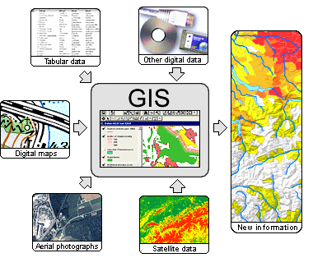
Geospatial Data Sources
GIS handles different data from different sources to produce new information
Geospatial data acquired using different sources
Common data sources:
Paper maps,
Existing digital data
Aerial photographs
GPS (Global Positioning Systems)
Surveying instruments, e.g. Total Station
Imageries from Remote-sensing satellites/ Earth observation satellites and
Laser Scanners, usually mounted in Aircrafts
Drones and UAVs

Slide 11
Geospatial Data Sources
Earth observation data: most commonly used data sources
Earth observation is gathering of information about the planet earth
Earth observation satellites are satellites specifically designed to observe Earth from space
Data from Earth observation satellites/ Remote sensing satellites are processed into images: remote sensing images, satellite imageries or satellite data

Slide 12
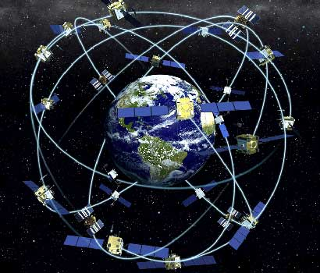
Geospatial Data Sources
Data collected using GPS can be imported in to a GIS system
Global Positioning Systems (GPS) used for data collection and capture
GPS is a space-based satellite navigation system that provides location and time information
GPS is one of the Global Navigation Satellite Systems (GNSS);
Other GNSS include: GLONASS (Russia), Galileo(Europe), Beidou (China)
Notes:
Global Navigation Satellite System (GNSS) refers to a constellation of satellites providing signals from space that transmit positioning and timing data to GNSS receivers. The receivers then use this data to determine location.

Slide 13
Geospatial Data Sources
Existing digital data are available in different formats
Features extracted from satellite images using image processing techniques, already existing in different databases
Most GIS databases created with data converted from paper maps/ Arial photo
Digital maps, datasets and image data are available in the Internet, in different data portals
Notes:
We can make use of such resources with little or no cost

Slide 14
Applications of GIS
80% of all data are related to a geographical position
Nearly every problem has some component of location information
GIS technology is used by a variety of professionals for a broad range of applications
Users: Government offices, research organizations & academia, International/UN agencies, etc. for decisions support, planning, research, etc.
Notes:
GIS is a useful tool for nearly every field of knowledge. GIS benefits organizations of all sizes and in almost every industry.

Slide 15
Applications of GIS
Examples of applications:
Water Resource Management
Land degradation, Land use and Land cover change
Disaster Risk Management
Climate Change Mitigation and Adaptation
Food Security and Poverty Reduction
Health and Telemedicine
Land Administration/Cadastre,
Socio-Economic mapping,
Utility Management,
Transport
Media (e.g. TV: for Reporting, Marketing, Advertising, etc.)
Notes:
Water resource management: assessment of water resources; watersheds and basin level management
Health sector benefit in mapping vulnerability and prevalence, in malaria, disease outbreak, identify risk areas, etc.
To decide where best to build new schools based on population density and proximity to health facilities
Utility companies use maps to keep an accurate and up-to-date record of their infrastructure for maintenance and planning purposes

Slide 16
THANK YOU!

