Slide 1
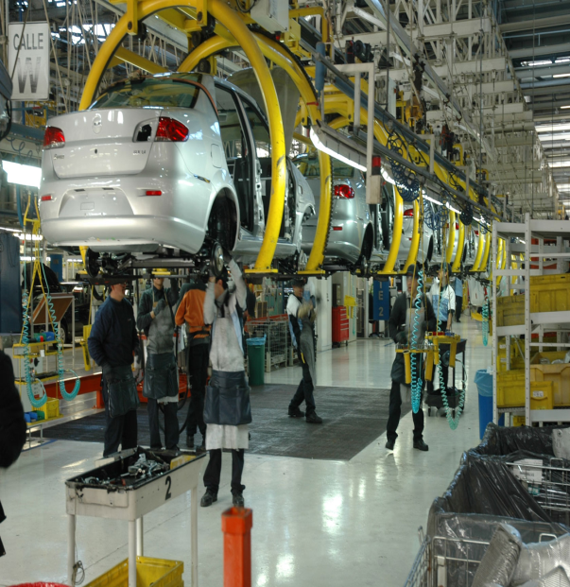
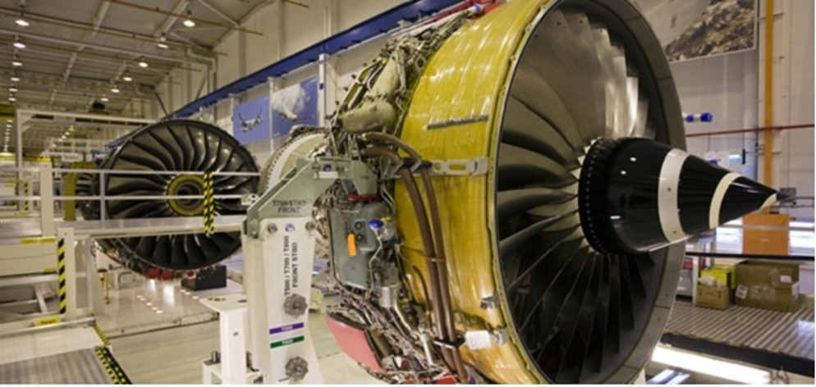
Production transformation strategies The case of mexico
Héctor M. Nuñez
Centro de investigación y docencia Económicas (CIDE)
ECA-OECD-ECLAC Policy Dialogue on
“Africa and Latin America at a Cross-roads: addressing structural global landscape”

Slide 2
Outline
Background
Structure of the Mexican Economy
Institutional framework
Concluding Remarks
& Policy Recommendations

Slide 3
Social & Environmental Background
GDP per capita increased 94% in the last 20 years
Yet in Mexico prevails a high degree of inequality. Gini of 0.5 in 2000 to 0.48 in 2012
52% of the population is in asset poverty and 19% is in food poverty
An increase in GHG emissions over 57% during the last 20 years and per capita over 20% (14th world largest polluter, 1.5% of global GHG)
It is highly vulnerable to climate change (hurricanes, prolonged droughts)
Mexico has a great challenge in social and environmental issues
Notes:
Esta diapositiva presenta las características socioambientales del país. Esto puede dar la información para enfatizar en la necesidad de un desarrollo económico inclusivo con mejoras en salarios, así como un desarrollo que promueva la sustentabilidad de las actividades económicas del país.
10% de la población con mayores ingresos se lleva un 40% del total de los ingresos mientras que el 10% más pobre se lleva menos del 2%.

Slide 4
Economic Background
Economic liberalization in 1994
Oil export depending, but manufactures dominate exports
FDI and exporting based economy
The budget for science decreased from 2000 to 2008, afterwards it recovered.
Low expenditure in R&D (% of GDP)
Public 0.25%
Private 0.18%
Specialized in low and middle technology goods

Slide 5
Exports (%GPD)

Slide 6
Value Added of Manufacturing Sector (% GPD)

Slide 7
Exports & Imports Shares (%)

Slide 8
Exports of high-tech manufacturing goods (% Manufacturing GPD)

Slide 9
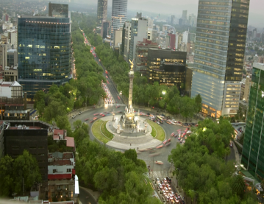
Structure of the Mexican Economy
GDP during the last 20 years: Annual growth 4.7%
Manufacturing Sector GDP: Annual growth 4.6%,
Services Sector GDP: 6.1%
Current VA: 30% manufacturing and 30% services
37% of employment in the services, 29% in commercial and 23% in manufacturing
Annual Employment growth 3.8%
Annual Real Wages Growth 1.2%

Slide 10
GDP & GDP growth (Constants prices 2008)

Slide 11
Shares: Value Added; Employment; Wages

Slide 12
Sectorial labor productivity1998-2013
Notes:
The labor force has moved to sectors with lower productivity like commercial or services, instead of moving to the most productive sectors like manufacturing
Los trabajadores se han desplazado principalmente al sector comercio y de servicios. Dichos sectores son de baja productividad.

Slide 13
Change Labor Productivity 1998-2013 = 0.93%

Slide 14
Manufacturing Sector Structure (% Manufacturing VA)
Notes:
The most dynamic and important sector in the economy
Labor productivity has increased
The transportation sub-sector reports the highest productivity increase, a high employment share, & a structural change

Slide 15
Balance of Trade Manufacturing Sector
Notes:
Automotive reports surplus

Slide 16
Within Manufacturing sector productivity 1998-2013
Notes:
Aquí se tomo el sector manufacturero de forma aislada para conocer su dinámica interna. El subsector mas importante en aumento de productividad fue el de transportes donde esta la industria automotriz y la aeroespacial. También la industria alimentaria es importante.

Slide 17
Institutional Framework
Industrial policies have been adapted to boost exports and FDI through high interest rates and wage growth controlled
1940-1982: ISI
80s: Debt Crisis & Transition
1990-2013: Liberalization pro manufacturing & exports
2014-…: New reforms “to allow economic development in strategic sectors, aimed to eliminate market failures that currently avoid small and medium firms to reach their full potential in different regions of country”

Slide 18
Trade Liberalization
Trade liberalization and export promotion:
11 Free Trade Agreements with 46 countries ( FTAs ).
33 Agreements for the Promotion and Reciprocal Protection of Investments.
9 agreements limited scope (Economic Complementation Agreements and Partial Scope Agreements ) within the framework of the Latin American Integration Association (ALADI ).
Programs to encourage exports: IMMEX , ALTEX , DRAW BACK. Reduced tariffs for inputs imported or Tax return programs
Structural Reforms: Energy, Labor, Education, Telecommunications, Antitrust, Financial, Fiscal, Justice, Electoral, Transparency
Notes:
Objetivo de las reformas es: elevar la productividad de nuestro país, lo que detonará el crecimiento y el desarrollo económico de México; fortalecer y ampliar los derechos para que formen parte de la realidad cotidiana de los mexicanos; y afianzar nuestro régimen democrático y de libertades, lo que nos permitirá transitar de una democracia electoral a una democracia que brinde resultados concretos (SE).
El Plan Nacional de Desarrollo 2013-2018 propone una política moderna de fomento económico en sectores estratégicos, orientada a eliminar fallas de mercado que impiden a las pequeñas y medianas empresas que operan en los sectores de minería, agricultura y turismo, entre otros, alcanzar su máximo potencial en las diferentes regiones de país.
IMMEX: El Programa de Industria Manufacturera, Maquiladora y de Servicios de Exportación (IMMEX) es un instrumento de fomento a las exportaciones, mediante el cual se permite a los productores de mercancías destinadas a la exportación o empresas que prestan servicios destinados a la exportación, importar temporalmente diversos bienes (materias primas, insumos, componentes, envases y empaques, así como maquinaria y equipo) para ser utilizados en la elaboración de productos de exportación, sin cubrir el pago del impuesto general de importación, del impuesto al valor agregado y de las cuotas compensatorias, en su casoPROSEC: Programas de Promoción Sectorial
DRAW BACK: se reintegra al exportador el valor de los impuestos causados por la importación y posterior exportación de: a) materias primas, partes y componentes, empaques y envases, combustibles, lubricantes y otros materiales incorporados al producto exportado; b) por la importación de mercancías que se retornan al extranjero en el mismo estado en que fueron importadas; y c) mercancías importadas para su reparación o alteració
ALTEX: El Registro de Empresas Altamente Exportadoras (ALTEX) permite a personas físicas y morales la devolución del Impuesto al Valor Agregado (IVA), que tengan a su favor por la exportación de mercancías, la posibilidad de obtener esos saldos en un plazo máximo de 20 días hábiles

Slide 19
Science and Technology Policy
70’s: National Council for Science and Technology, it started the intervention in technological development.
80’s & 90’s: Liberalization implied Intellectual Property advances
XXI century: policy for the promotion of innovation by linking the private sector with academic and research centers aiming:
To promote innovation by individuals or companies by reducing the risk involved in investing in R&D
To be more inclusive in the innovation process, even though this promotion is benefiting more complex sectors
But it is an innovation policy of first generation that includes tax incentives, subsidies, grants, support for SMEs, among others
While it should be focused in sectors that are exposed to higher learning processes and higher technological change because they need more support to take advantage of these changes
Thus, innovation policies respond to a horizontal treatment

Slide 20
Expenditure on R&D (%GDP) & Share of Public and Private Expenditure on R&D in Mexico
Notes:
Porcentaje del gasto en I&D respecto al PIB: comparativo AL. puede server para mostar que tanto Mexico esta invirtiendo en Investigacion y desarrollo y que tanta participación tiene el gobierno.

Slide 21
Sectoral concentration of fiscal INCENTIVES 2005-2008 (Million MXN$)
 | 2005 |  | 2006 |  | 2007 |  | 2008
Sector | Amount | % | Amount | % | Amount | % | Amount | %
Automotive | 1548.1 | 51.70 | 1251.8 | 31.29 | 1662.4 | 36.94 | 1420.5 | 31.57
Food and bevarage | 301.9 | 10.10 | 414.7 | 10.37 | 640.9 | 14.24 | 517.8 | 11.51
Basic pharmaceutical | 237 | 7.90 | 368.9 | 9.22 | 497.8 | 11.06 | 336.2 | 7.47
Electrical / electronic equipment | 218.3 | 7.70 | 420.8 | 10.52 | 218.8 | 4.86 | 210.9 | 4.69
Total | 2305.3 | 77.00 | 2456.2 | 61.40 | 3019.9 | 67.10 | 2485.4 | 55.24
Notes:
En esta grafica se pierde los valores de los paises latinomaeircanos por la gran cantidad de patentes chinas, por eso recomiendo usar la anteriror.

Slide 22
Incentive Program for Research, Technological Development and Innovation (PEI) (Million MXN$)
Subsector | Total Investment (MXN$) | Number of proyects | Public Investment $ %
Professional and technical services | 3,828.2 | 547 | 1,915.8 | 50.0
Transport equipment | 3,230.1 | 212 | 1,034.7 | 32.0
Not available | 2,968.0 | 406 | 1,374.1 | 46.3
Chemical industry | 2,715.1 | 384 | 1,065.1 | 39.2
Food Industry | 2,060.7 | 242 | 861.4 | 41.8
Metal products | 1,055.8 | 122 | 533.1 | 50.5
Machinery and equipment | 809.1 | 128 | 419.4 | 51.8
Other manufacturing | 530.3 | 80 | 248.1 | 46.8
Paper Industry | 527.5 | 41 | 169.9 | 32.2
Forest acts and services Agro | 500.9 | 58 | 213.2 | 42.6
Basic metal industries | 465.0 | 59 | 223.9 | 48.1
Computer and Communication Eq | 443.1 | 58 | 227.6 | 51.4
Nonmetallic Mineral Prods | 359.1 | 64 | 162.7 | 45.3
Metallic and non-metallic mining | 343.2 | 33 | 147.6 | 43.0
Industry Plastic and rubber | 311.1 | 61 | 157.7 | 50.7
Livestock and aquaculture | 304.6 | 49 | 151.3 | 49.7
Accessories and appliances | 254.1 | 74 | 150.9 | 59.4
Medical and related serv | 251.6 | 25 | 130.7 | 51.9
Air transport | 219.7 | 10 | 26.2 | 11.9
Total of 19 subsectors | 21,177.3 | 2,653 | 9,213.3 | 43.5
Participation% of the total (71) | 91.7 | 89.8 | 90.5
Total (71 subsectors) | 23,099.4 | 2,953 | 10,177.0 | 44.1

Slide 23
Concluding Remarks
The model of the last 20 years has discouraged the development of technologies in the country and increased the labor movement to more traditional sectors such as commercial and services
The development of the domestic industry is highly depended on FDI flows, which may create uncertainty and economic vulnerability
Structural reforms are sold as the catalyst for growth in the medium term, however job insecurity in the country is a weak point
Specialization should not be linked to the prevailing allocation of resources of the country

Slide 24
POLICY recommendations
There must be a clear policy to increase the transfer of technology from public research to industry
It is possible to achieve a faster growth through more sophisticated exports
Review of the policies approach aiming to support local and sustainable development as cornerstones
Policies more oriented to promote knowledge sharing and inter-sectoral technological spill; which may give priority to more dynamic sectors that are unable to absorb the risk of investing in R&D
Patterns of specialization and diversification that lead to learning and improvement in production processes
Industrial policy should take a holistic view: productive capacities accompanied by policies of innovation and human capital formation

