Slide 1
The impact of alcohol related road crashes
Global Overview and Perspectives
Addis Ababa
8 July 2015
Brett Bivans
IARD

Slide 2
Road Traffic Crashes: A Global Epidemic (1)
Worldwide 1.2 million people die each year in road traffic crashes
20-50 million people injured annually
In 2012, Road crashes was the 9th leading cause of death in the world
Road injury is forecast to be the 7th leading cause of death globally by 2030
Road traffic crashes are the leading cause of death for people aged 15 – 29 worldwide

Slide 3
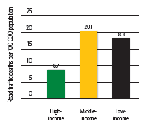
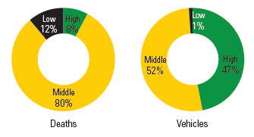
Road Traffic Crashes: A Global Epidemic (2)
92% of road traffic deaths occur in low and middle income countries

Slide 4
Road Traffic Crashes: A Global Epidemic (3)
Estimated cost - $518 billion annually
$65 billion in low/middle income countries
Costs estimated at 1% - 1.5% GNP (low/middle income countries)
Alcohol a factor in 33%-69% of fatal crashes (low/middle income countries)
In many low and middle income countries data on alcohol-related road traffic deaths is unavailable or unreliable
Differences between countries:
Legal limit for drinking and driving
Definition of what constitutes drinking and driving

Slide 5
Characteristics of Drink Driving and Crashes
Crash risk increases with increasing alcohol consumption
Single vehicle crashes
Run-off-road single vehicle crashes
High speed crashes (especially rural)
Hit roadside object crashes
High proportion of nighttime crashes
High proportion of weekend crashes

Slide 6
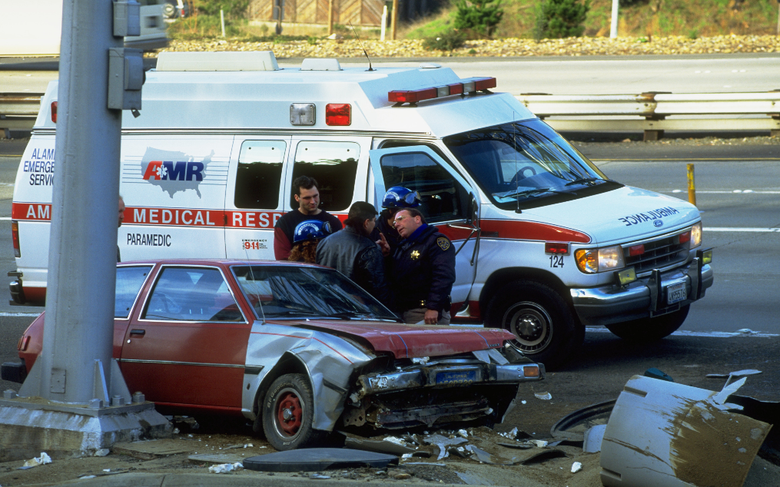
Alcohol Effects on Driving
There is an impact on:
reaction times
driver vigilance
driver visual acuity
steering efficiency
risk of complications in injury rehabilitation

Slide 7
Demographic Characteristics of Drink Drivers
Males, 18-24 years old
From low socio-economic groups
Single or divorced
In blue collar occupations
Low education and literacy levels
Low self-esteem
Notes:
In terms of demographic characteristics, a consistent picture of drink-drivers emerges across a number of studies

Slide 8
Solutions
Highly motorized countries have been able to reduce drink driving
Examples include Australia, and more recently France
Successful programs cannot always be translated unchanged to other countries because:
Cultural beliefs differ from country to country
Traffic mix is often very different
Style and quality of road networks can differ
Education levels vary and communication modes differ.
But key principles of successful programs can be applied

Slide 9
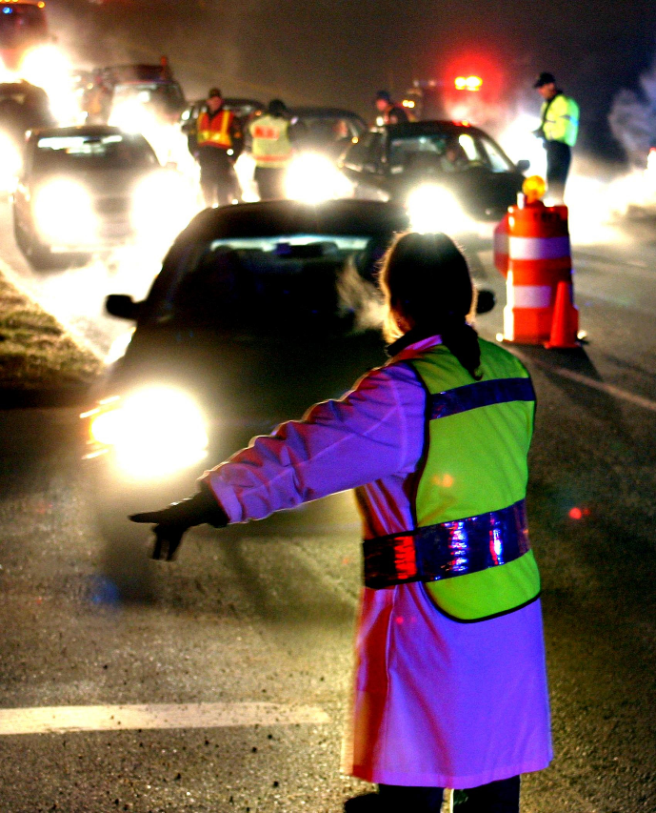
Key Principles of Successful Programs
Strong political commitment to prevent drink driving
Clearly defined legislation for BAC level and penalties for offences
Implementing “good practice”
Strong and well publicized enforcement campaigns
Public education to change attitudes toward drinking and driving
Strict and swift enforced penalties for offenders

Slide 10
Global Actions on Harmful Drinking Initiatives
Projects in six countries
China, Colombia, Mexico, Nigeria, Russia and Vietnam
Focus on:
Capacity Building
Local Projects
Public education and awareness campaigns, enhanced enforcement campaigns, mass media
Evaluation

Slide 11
Shoom Shufair Campaign – Ethiopia
Shoom Shufair is an example of how private sector can help reduce drinking and driving.
Project goals:
Raise awareness around not drink-driving
Increased intention to use designated driver (shoom shufair)
Partnerships & collaboration to address the issue

Slide 12
Partnerships for Shooom Shufair
Broad range of partners involved in the project:
Government (Federal Roads Transport Authority)
Private Sector
Hospitality Industry (Radisson Blu)
Vehicle Rentals/Tour Operators
Insurance (Nyala Insurance)
Media (AfroFM)

Slide 13
Summary
Alcohol impairs driving performance
Alcohol involved crashes are a high proportion of all severe crashes in many countries
Young, inexperienced males are most at risk
Typical alcohol involved crash types are known
There are some key principles of successful programs and ‘good practice’ interventions proven to reduce alcohol related crashes

