Slide 1
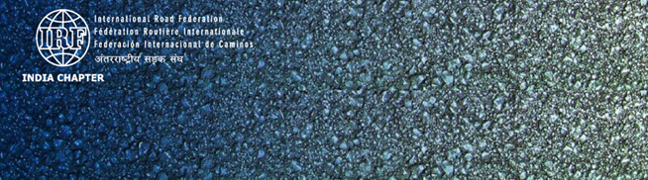
Road Crash Database: RADaR as a Viable Option for Developing World
Dr. P K Sikdar
Advisor IRF (India Chapter)
President ICT Pvt. Ltd.
3rd African Road Safety Conference: Midterm Review of the African Road Safety Action Plan
9-10 July 2015 Ethiopia, Addis Ababa

Slide 2
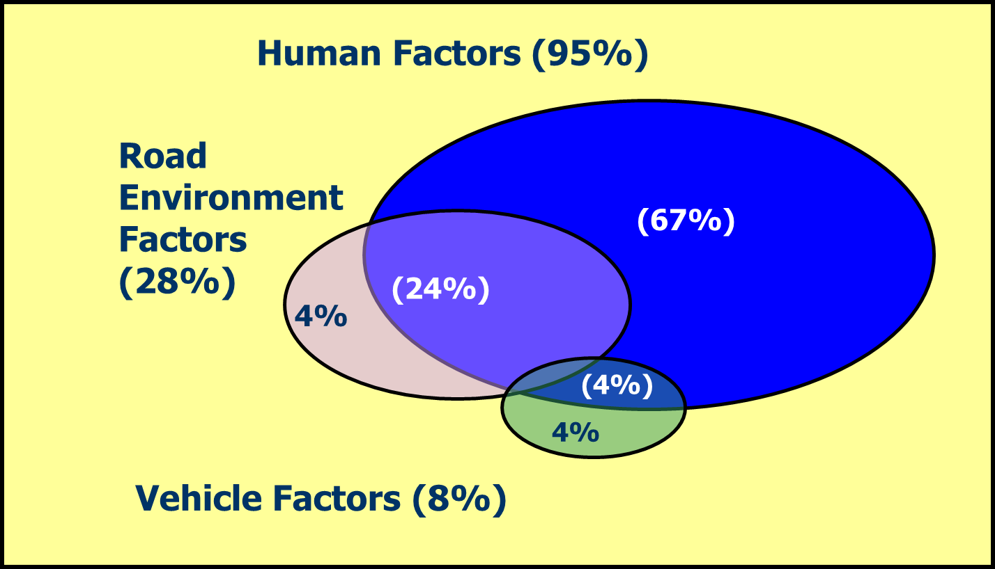
Road Transport System
A safe road transport system includes safe road infrastructure, safe road users and safe vehicles.
If any of these fail to perform, road crash/accidents tend to occur.

Slide 3
Safe Road Transport System - Institutions
Ministry of Education
Road Transport Authority
Police, NGOs
Safe Road User
Road Transport Authority
Safe Roads
Safe Vehicle
Emergency Care
Road Authorities
Health Department

Slide 4
Why do crashes/ accidents occur?
We know the general reason, but don’t know the specifics
Understanding ‘where, how and why’ is the key to design effective solutions to reduce crashes/ accidents

Slide 5
Do we know?
How many accidents are caused due to poor road condition?
Was visibility a problem on the accident location?
Type of vehicles involved in most number of accidents on a specific road type?
Location of the accidents?
Type of road users involved in most number of accidents on a specific road type?
Vehicle condition at the time of accident?

Slide 6
Do we know?
Which are the problem areas? Junctions, Straight roads or curves?
When do most accidents happen? Day or night time?
How many fatalities occurred by hitting roadside objects?
What type of accidents are common? Read-end, Head-on or side swipe?
What are the major accident type on urban road/ rural road?................................

Slide 7
Road Safety
Management System
  Commonly adopted approach is based on ad-hoc interventions alone
What is needed - a data-led intervention - focused on results

Slide 8
Data-led Solutions
A robust road crash/ accident database is inescapable necessity for all countries as we are all serious and determined to reduce road crashes/accidents and improving the quality of life of the citizens…
Good Data
Effective Solutions
Reduced Accidents
Improved Economy
Effective Governance

Slide 9
RADaR
(Road Accident Data Recorder)
International Road Federation

Slide 10
RADaR Apps to meet the Requirements of UN Decade of Action for Road Safety 2011-2020
Pillar-1: Road Safety Management
Strengthen institutional capacity to further national road safety efforts.
(It is possible when we know the nature of the road safety problems through the most logical and complete crash data)
Pillar-2: Safer Roads & Mobility
Improve the safety of road networks for the benefit of all road users, especially VRUs.
(It is possible to identify and locate the infrastructure safety problems, and to correct the infrastructure)

Slide 11
RADaR Apps – A Revolution in Scientific Road Crash/Accident Data Collection
Technology has brought about level playing field worldwide (Grab the opportunity and leap frog)
What you cannot measure, you cannot manage
(If you cannot measure road safety of the network, you cannot manage road safety….)

Slide 12
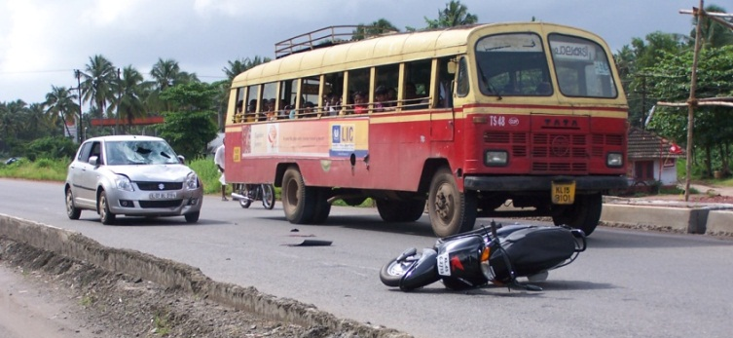
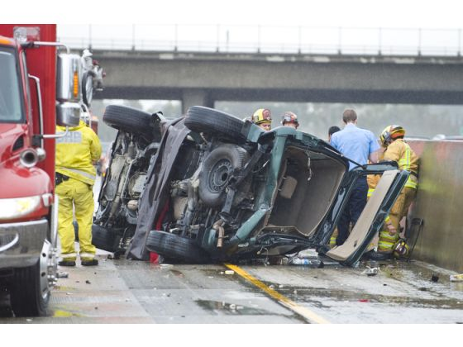
Why RADaR ?
An End to End solution for road crash/accident data recording and reporting is provided by RADaR
To identify the factors contributing to road crashes/accidents
Driver behaviour or fault
Roadway design or control
Poor roadway maintenance
Vehicle failure
Etc

Slide 13
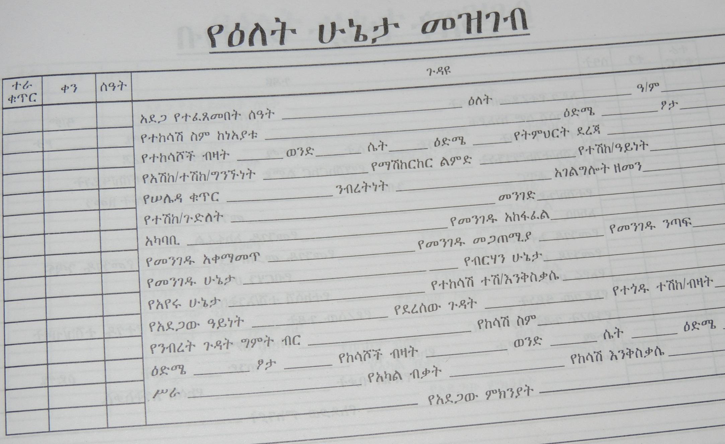
Crash/Accident Data Collection Format Used in Addis Ababa

Slide 14
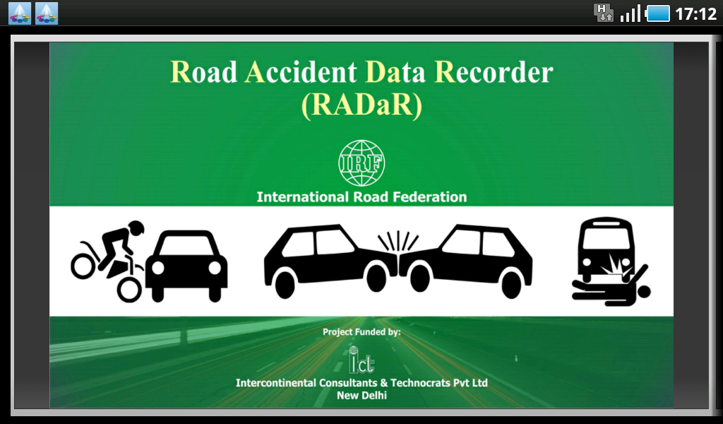
What is RADaR ?
Road Accident Data Recorder (RADaR) is an innovative and scientific data collection and reporting system designed as an application for Android tablet with connectivity to web-based database server

Slide 15
Features of RADaR
A quick and easy automated tool to collect comprehensive road crash data
User friendly software application loaded on to tablet computer working on ANDROID operating system
GPS/GPRS facility to record exact crash location in global coordinate system, use Google map and to transmit data to web-based central server
Drop-down menus of RADaR application enable easy recording of data using touch screen mode
Facility to take photographs of road crash scene, and to record crash site on Google network map
Pictorial Menu-driven recording of road layout of crash site and collision diagram plotted on layout for scientific investigations

Slide 16


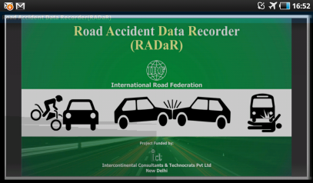
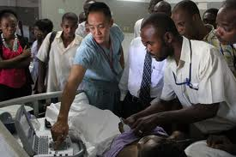


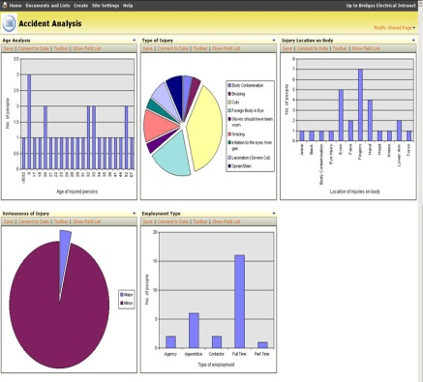
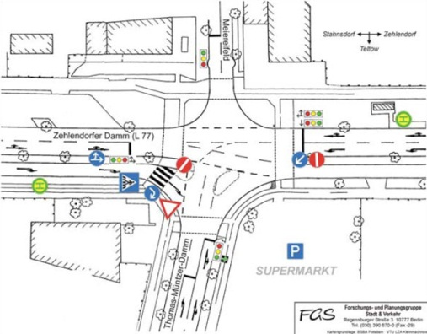
How RADaR Works ?
Enforcement Personnel
Web-Based Server
RADaR Application
Resuscitation
Centres
RADaR Reporting Tool
Motor Insurance
Adjudication
Black Spot Improvement

Slide 17
Integration of RADaR with ‘Vehicle Registration’ and ‘Driver Licensing’ Databases
RADaR has capability to draw the data for vehicle registration and driver license information from link to National Databases
All required information at one platform

Slide 18
Implementation of RADaR Application
(Road safety needs a systematic reform for data)
RADaR license is for each Police Station, and they will use the Android tablets for collection of road accident/crash data
Accident/crash data collected at the accident site/scene and later at other locations (e.g. hospital, etc.) will then be transmitted to the central server directly
Contd..

Slide 19
Implementation of RADaR Application
(Road safety needs a systematic reform for data)
The web-based central server is provided, managed and maintained by the supplier of RADaR Application.
Access to data is through secured userID and Password, – from a Police Station, Sub-city to the highest level of the Commission or country as a whole.
The GSM/GPRS network facility shall be arranged and made available by the implementing agency, viz. Police Department, Road Authority, etc.
All users at different levels of hierarchy can use RADaR reporting tool
RADaR started with Android-2.2, and now it is adopted to Android-4.4 and higher versions

Slide 20
Hierarchical Access to Web-based Central Accident Database

Slide 21
Recording of Data in
RADaR

Slide 22
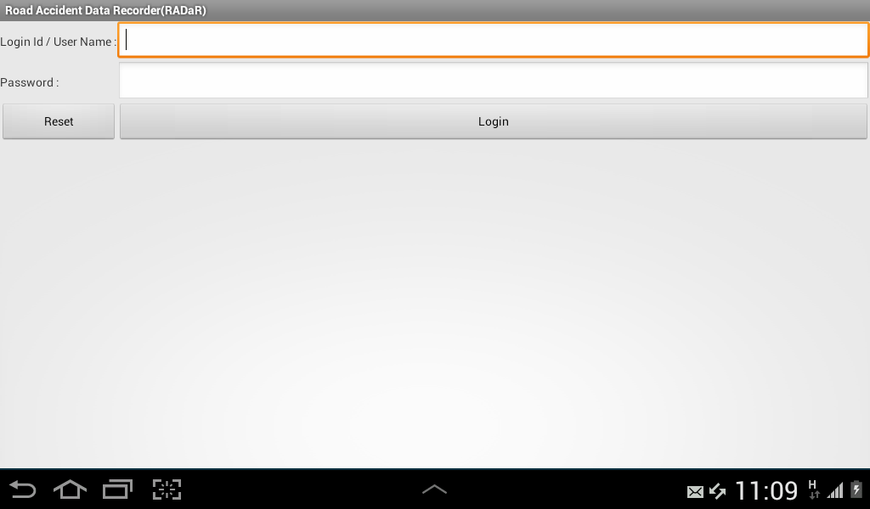
Unique user ID and Password for each Police Station and User

Slide 23
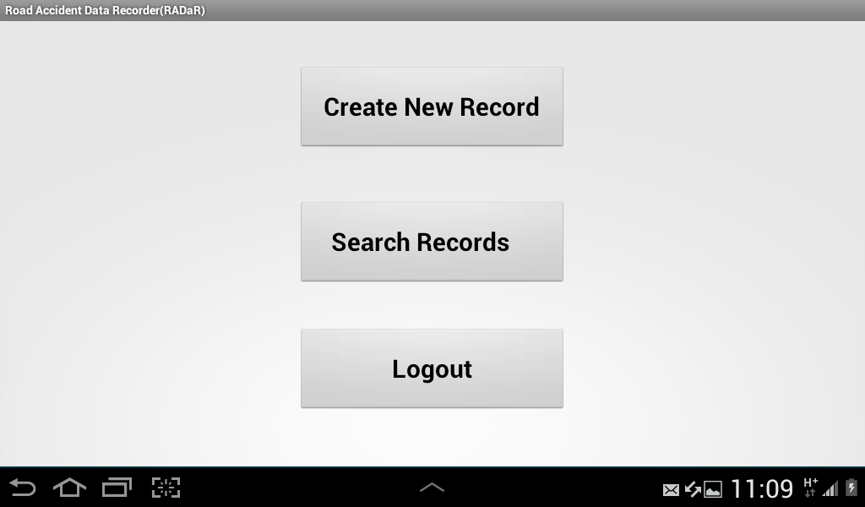
Opening Menu of RADaR –
three options

Slide 24
Categorization of Crash/Accidents Features
Classification for Timing of Accident
  Type of Area and Time of Day
  Month of Year
Classification for Location of Accident
  Location Type
  Location
Classification for Vehicle
  Number of Vehicles Involved
  Type of Impacting Vehicles
  Vehicle Type
  Vehicle Defect
  Vehicle Maneuvers
  Age of Vehicle
Classification for Road
  Road Character
  Road Type
  Road Layout
  Road Width
  Road Works
  Surface Condition
  Horizontal Geometry
  Vertical Geometry
  Type of Junction Control
  Surface Type
Classification for Pedestrian/Passenger
  Pedestrian/Passenger under Influence
  Pedestrian/Passenger Position
  Pedestrian/Passenger Action
  Age of Pedestrian/Passenger
Classification for Driver
  Driver Under Influence
  Safety Devices
  Sex of Driver
  Type of Driving License
  Educational Qualification
  Possible Driver Error
  Nature of Traffic Violations
  Hit and Run
Classification for Victim
  Type of Victim
  Age of Victim(including Driver)
  Number of Fatalities
Other Classification
  Weather Condition
  Light Condition
  Type of Collision

Slide 25
Data recorded through menu-driven touch screen
Accident identification
Information on persons involved, site layout, collision type and road characteristics
Information on vehicles/passengers/pedestrians involved in accident
Location on Google map, GPS coordinates of accident location and photographs of accident scene
Recording collision diagram on layout of accident site layout; also saving data in tablet memory or send to web-based server
Facility to search previous data or export data

Slide 26
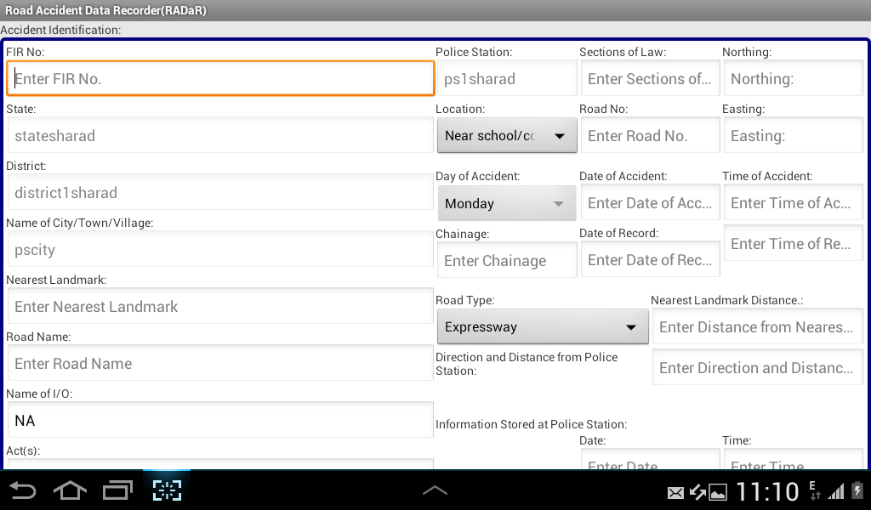
Data Fields of the First Page, viz, Accident ID, Police Station ID, Section of Law applicable, Date and time of Accident, Road Type GPS co-ordinates, etc.

Slide 27
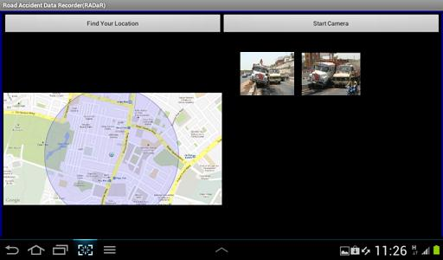
Facility to record the exact crash site with GPS co-ordinates and to click photos of the accident scene. In addition, accident location can be marked on Google map

Slide 28
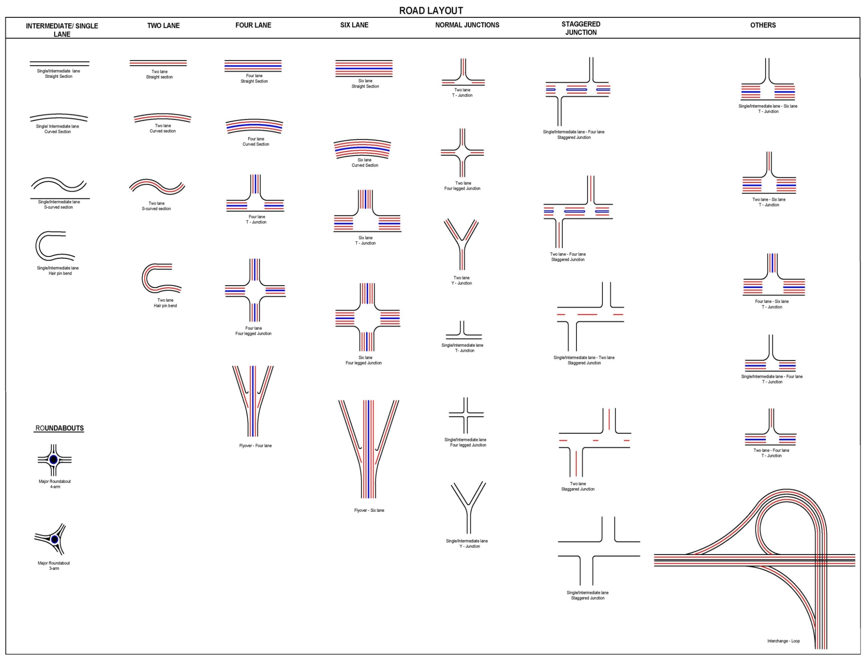

Slide 29
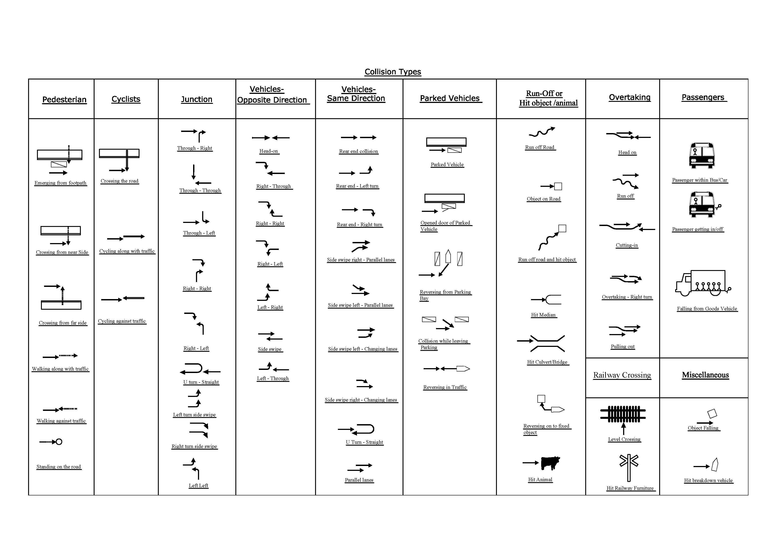

Slide 30
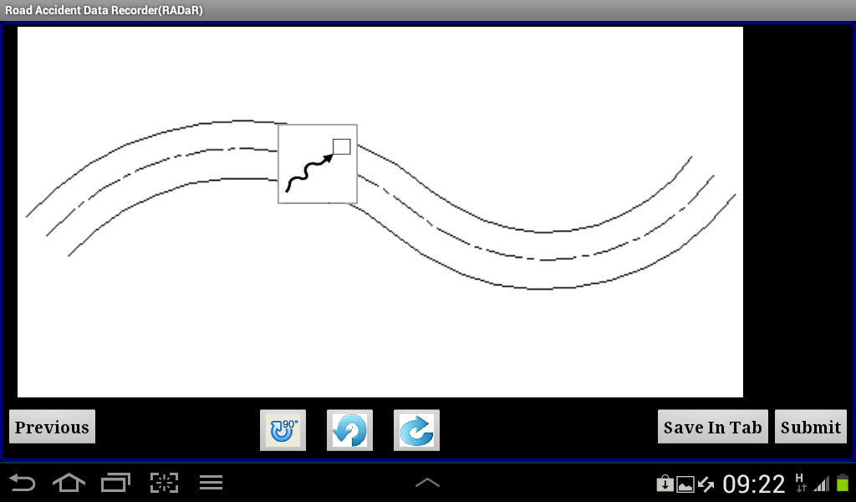

Facility to draw collision diagram on accident site layout and then submit the data to sever or to save in the tablet

Slide 31
RADaR Application through
Web-based Server
User-1
User-2
CloudServer
User-n
User-3
User-4

Slide 32
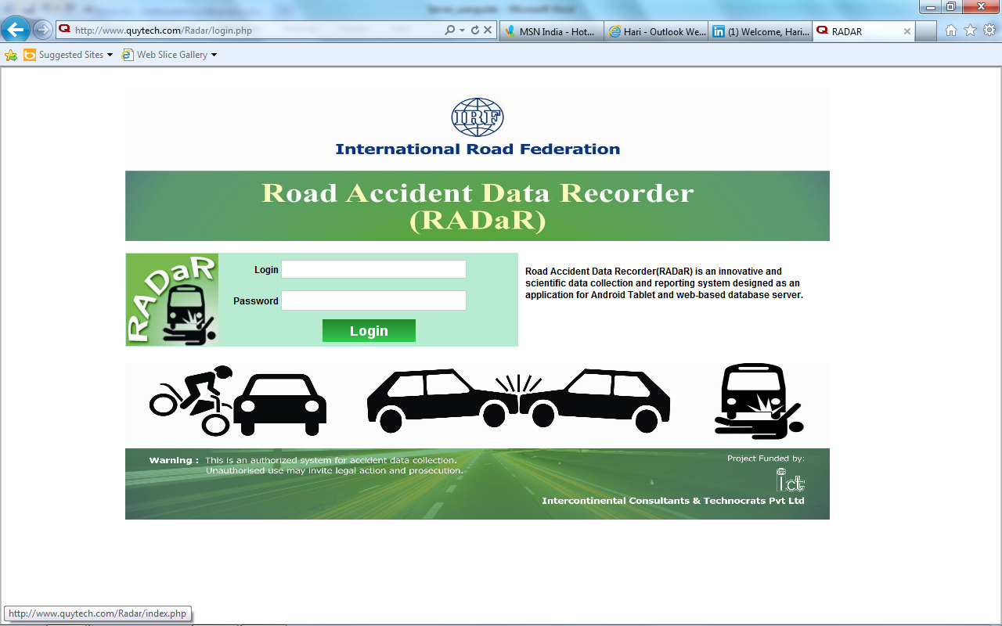
Access to the Database

Slide 33
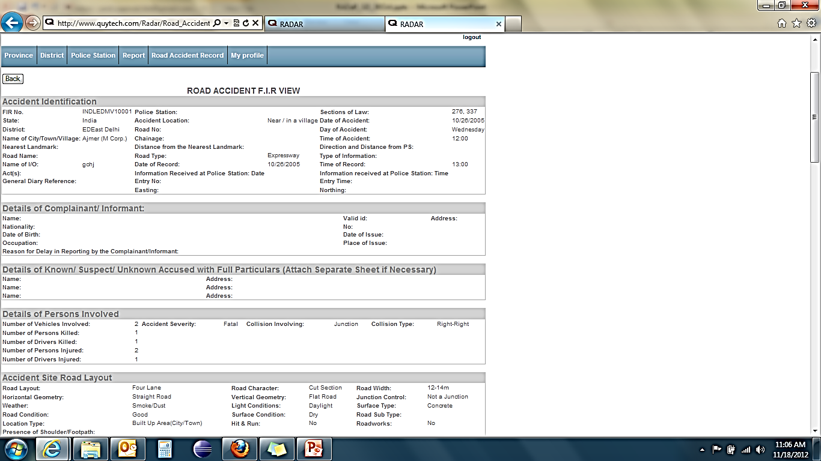
View of Accident Record

Slide 34
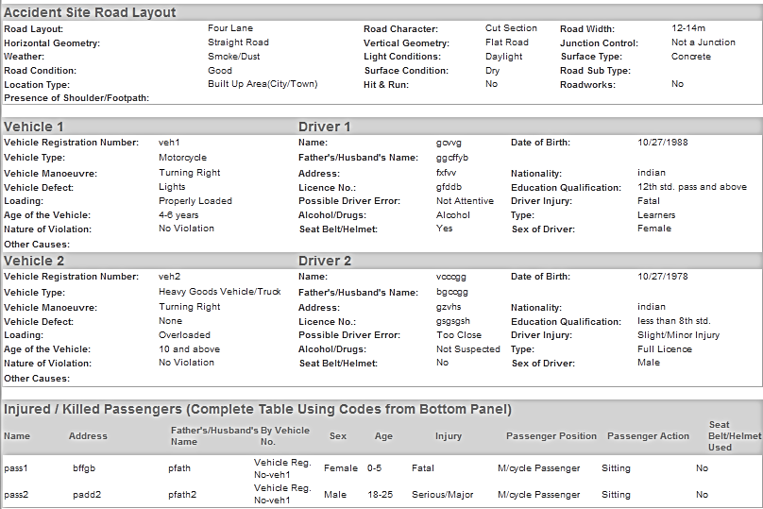
View of Accident Record

Slide 35
RADaR Reporting Tool (RADMS)
Data can be reported at city level/district level/state level/country level as desired
  Data analysis at city/district level will help in identifying blackspots, settling the accident claims faster etc.
  State level data may be useful for insurance companies/ Govt. authorities/health officials to plan accordingly.
  State level/country level data may be useful to analyze the human behavior; further research can be done to identify the pattern of accidents with the causes linked to those; related to different age groups, etc.

Slide 36
RADaR Reporting Tables
Accidents Classified According to Month of Year
Accidents Classified According to Type of Area and Time of the Day
Accidents Classified According to Road Type
Accidents Classified According to Number of Fatalities
Accidents Classified According to Number of Vehicles Involved
Accidents Classified According to Type of Collision
Accidents Classified According to Presence of Road Works
Accidents Classified According to Weather Condition
Accidents Classified According to Location Type
Accidents Classified According to Age Profile of the Victim
(including Driver)
Accidents Classified According to Use of Alcohol/Safety Devices/
Driving License
Accidents Classified According to Type of Victim
Accidents Classified According to Nature of Traffic Violations
Accidents Classified According to Load Condition of Involved Vehicles
Fatal Accidents Classified According to Type of Impacting Vehicles

Slide 37
RADaR Reporting Tables
Major Injury Accidents Classified According to Type of Impacting Vehicles
Minor Injury Accidents Classified According to Type of Impacting Vehicles
Accidents Classified According to Road Character
Accidents Classified According to Road Layout
Accidents Classified According to Road Width
Accidents Classified According to Horizontal Geometry
Accidents Classified According to Vertical Geometry
Accidents Classified According to Type of Junction Control
Accidents Classified According to Light Condition
Accidents Classified According to Surface Type
Accidents Classified According to Hit and Run
Accidents Classified According to Road Condition
Accidents Classified According to Surface Condition
Accidents Classified According to Vehicle Type
Accidents Classified According to Vehicle Maneuvers

Slide 38
RADaR Reporting Tables
Accidents Classified According to Sex of Driver
Accidents Classified According to Vehicle Defect
Accidents Classified According to Type of Driving License
Accidents Classified According to Seat Belt/Helmet use by Driver
Accidents Classified According to Educational Qualification of Driver
Accidents Classified According to Driver Under influence
Accidents Classified According to Passenger Position
Accidents Classified According to Pedestrian/Passenger under Influence
Accidents Classified According to Possible Driver Error
Accidents Classified According to Age of Pedestrian/Passenger
Accidents Classified According to Passenger Action
Accidents Classified According to Pedestrian Location
Accidents Classified According to Pedestrian Action
Accidents Classified According to Location
Accidents Classified According to Age of Vehicles

Slide 39
RADaR Database (Delhi)
A database of 50 accidents created for the development and testing of the RADaR Application developments.

Slide 40
RADaR Test Data, Delhi
State | Province | District | Police Station | No. of Records
INDIA | Delhi | East Delhi | Mayur Vihar | 7
 |  |  | Ashok Nagar | 7
 |  |  | Vasundhara Encl | 6
 |  | North Delhi | Sadar Bazar | 6
 |  |  | Sabzi Mandi | 6
 |  |  | Chandni Chowk | 6
 |  | South Delhi | Hauz Khas | 6
 |  |  | Vasant Kunj | 6
webuser |  |  |  | Total = 50
webuserin | webuserdl | edwebuser | mvwebuser
 |  |  | anwebuser
 |  |  | vewebuser
 |  | ndwebuser | sbwebuser
 |  |  | smwebuser
 |  |  | ccwebuser
 |  | webusersd | webuserhk
 |  |  | vkwebuser

Slide 41
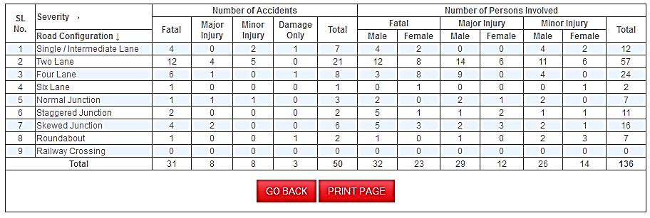
Examples of RADaR Reporting tool’s
Analysis Tables
Province Level Table
Table 19: Accidents Classified According to Road Layout
Note:- Table using 50 test records.

Slide 42
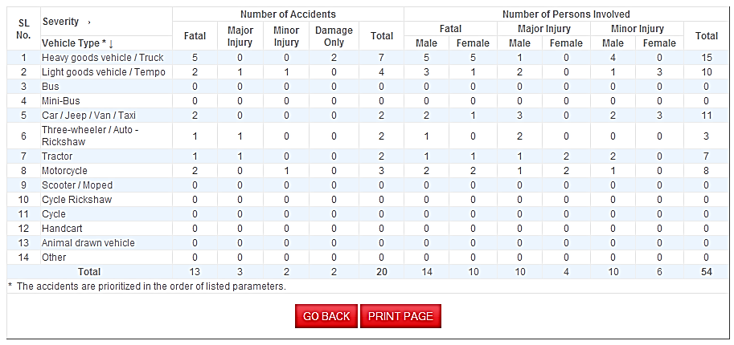
Examples of RADaR Reporting tool’s
Analysis Tables
District Level Table
Table 29: Accidents Classified According to Vehicle Type
Note:- Table using 50 test records.

Slide 43
Vehicle Involved in Fatal Injury Accident

Slide 44
Number of Accidents by Severity & Vehicle Type

Slide 45
Number of Accidents in Day/Night Condition & Severity

Slide 46
Pilot Study of RADaR
Pilot study of RADaR in two Cities.
Delhi (India)
Addis Ababa (Ethiopia)

Slide 47
RADaR Pilot Study
in
Delhi

Slide 48
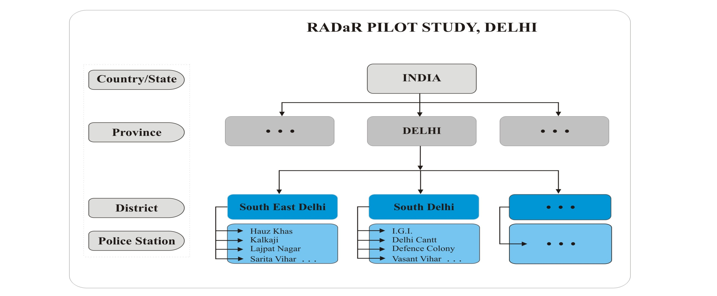
RADaR Pilot Study in Delhi

Slide 49
Districts and Police Stations of Pilot Study in Delhi
RADaR Pilot Study, Delhi
State/Country | Province | District | Police Station
India | Delhi | South East Delhi | Hauz Khas
 |  |  | Kalkaji
 |  |  | Lajpat Nagar
 |  |  | Sarita Vihar
 |  | South Delhi | I.G.I.A.
 |  |  | Defence Colony
 |  |  | Vasant Vihar
 |  |  | Delhi Cantt
User ID & Password created for each level of hierarchy
Start of Pilot Study in Delhi – September 24, 2012

Slide 50
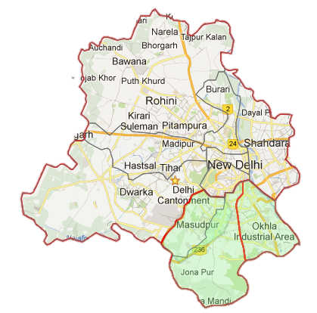
Two Pilot Districts
Delhi Map
14 Districts

Slide 51
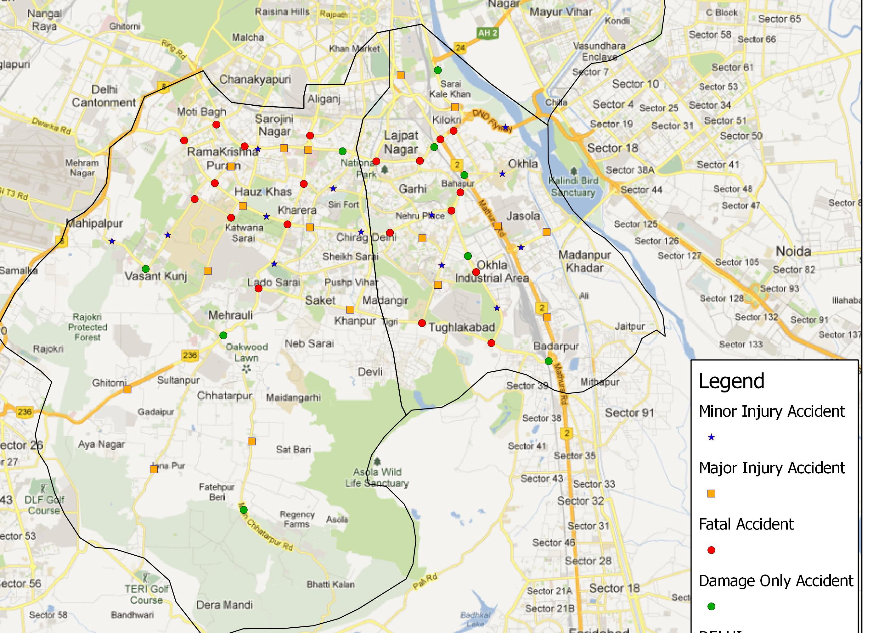
South-East Delhi
South Delhi
The RADaR collected data when attached to a geo-referenced map, the location of each accident is plotted as shown automatically

Slide 52
RADaR Pilot Study
in
Addis Ababa

Slide 53
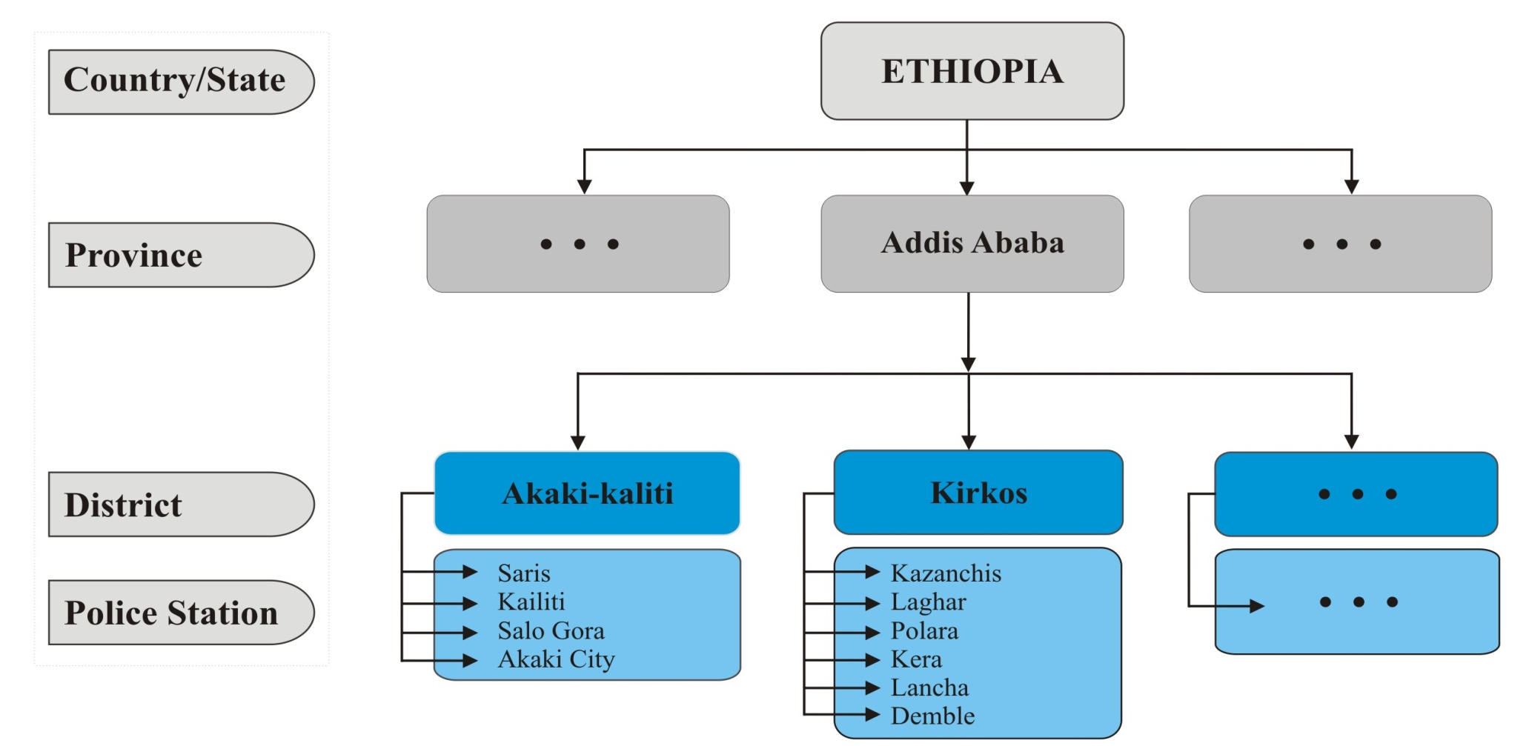
RADaR Pilot Study in Addis Ababa

Slide 54
Country/State | Province | Districts | Police Stations
Ethiopia | Addis Ababa | Bole Sub City HPO | Gerji
 |  |  | C.M.C.
 |  |  | Bulbula
 |  |  | Gora
 |  |  | Karamara
 |  |  | Air Lines
 |  | Addis Ketema Sub City HPO | Merkato
 |  |  | Mesalemiya
 |  |  | Auto Bus
 |  |  | Hifoyeta
 |  | Kolfe Keraniyo Sub City HPO | Kolfe
 |  |  | Ayer Tena
 |  |  | Asko
 |  |  | Karagora
 |  |  | Keraqore
 |  |  | Keraniyo
 |  |  | Betel
 |  | Nifas Silk Lafto Sub City HPO | Mekanisa
 |  |  | Saris
 |  |  | Lafto
 |  |  | Gofa Kera
 |  |  | Lebu
 |  |  | Kore
 |  | Arada Sub City HPO | Jan Meda
 |  |  | 4 Kilo
 |  |  | Piassa
 |  |  | Ras Desta

Slide 55
Country/State | Province | Districts | Police Stations
Ethiopia | Addis Ababa | Lideta Sub City HPO | Teklehaimanot
 |  |  | Abnet
 |  |  | Balcha
 |  |  | Torhayloch
 |  | Gulele Sub City HPO | Paster
 |  |  | Kechene
 |  |  | Adisu Gebeya
 |  |  | Menen
 |  |  | Shiro
 |  | Yeka Sub City HPO | Kotebe
 |  |  | Lamberat
 |  |  | Aware
 |  |  | Ferensay
 |  |  | Meri
 |  | Kirkos Sub City HPO | Kasanchis
 |  |  | Dembel
 |  |  | Lancha
 |  |  | Kera
 |  |  | Popularay
 |  |  | Leghar
 |  | Akaki Sub City HPO | Kali
 |  |  | Akaki
 |  |  | Salo Gora
 |  |  | Saris

Slide 56
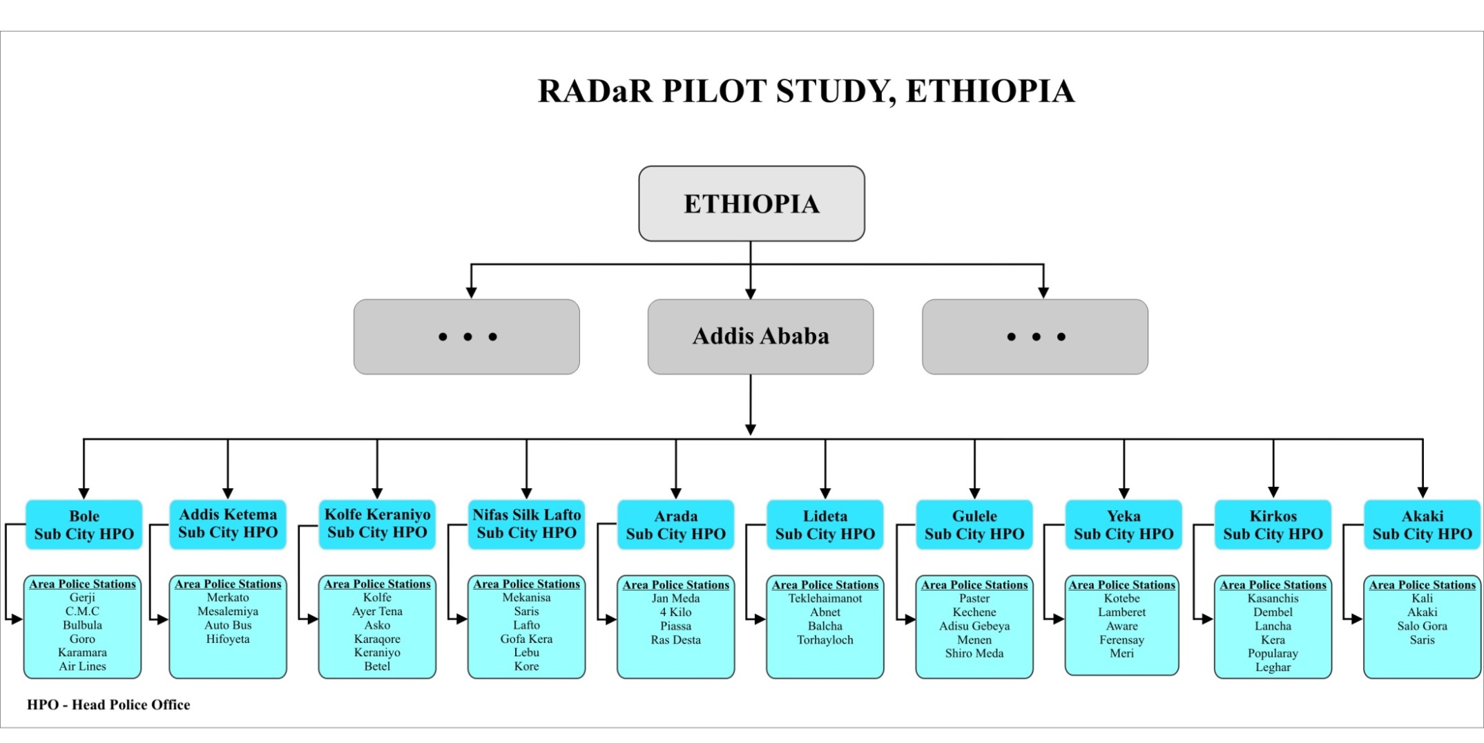

Slide 57
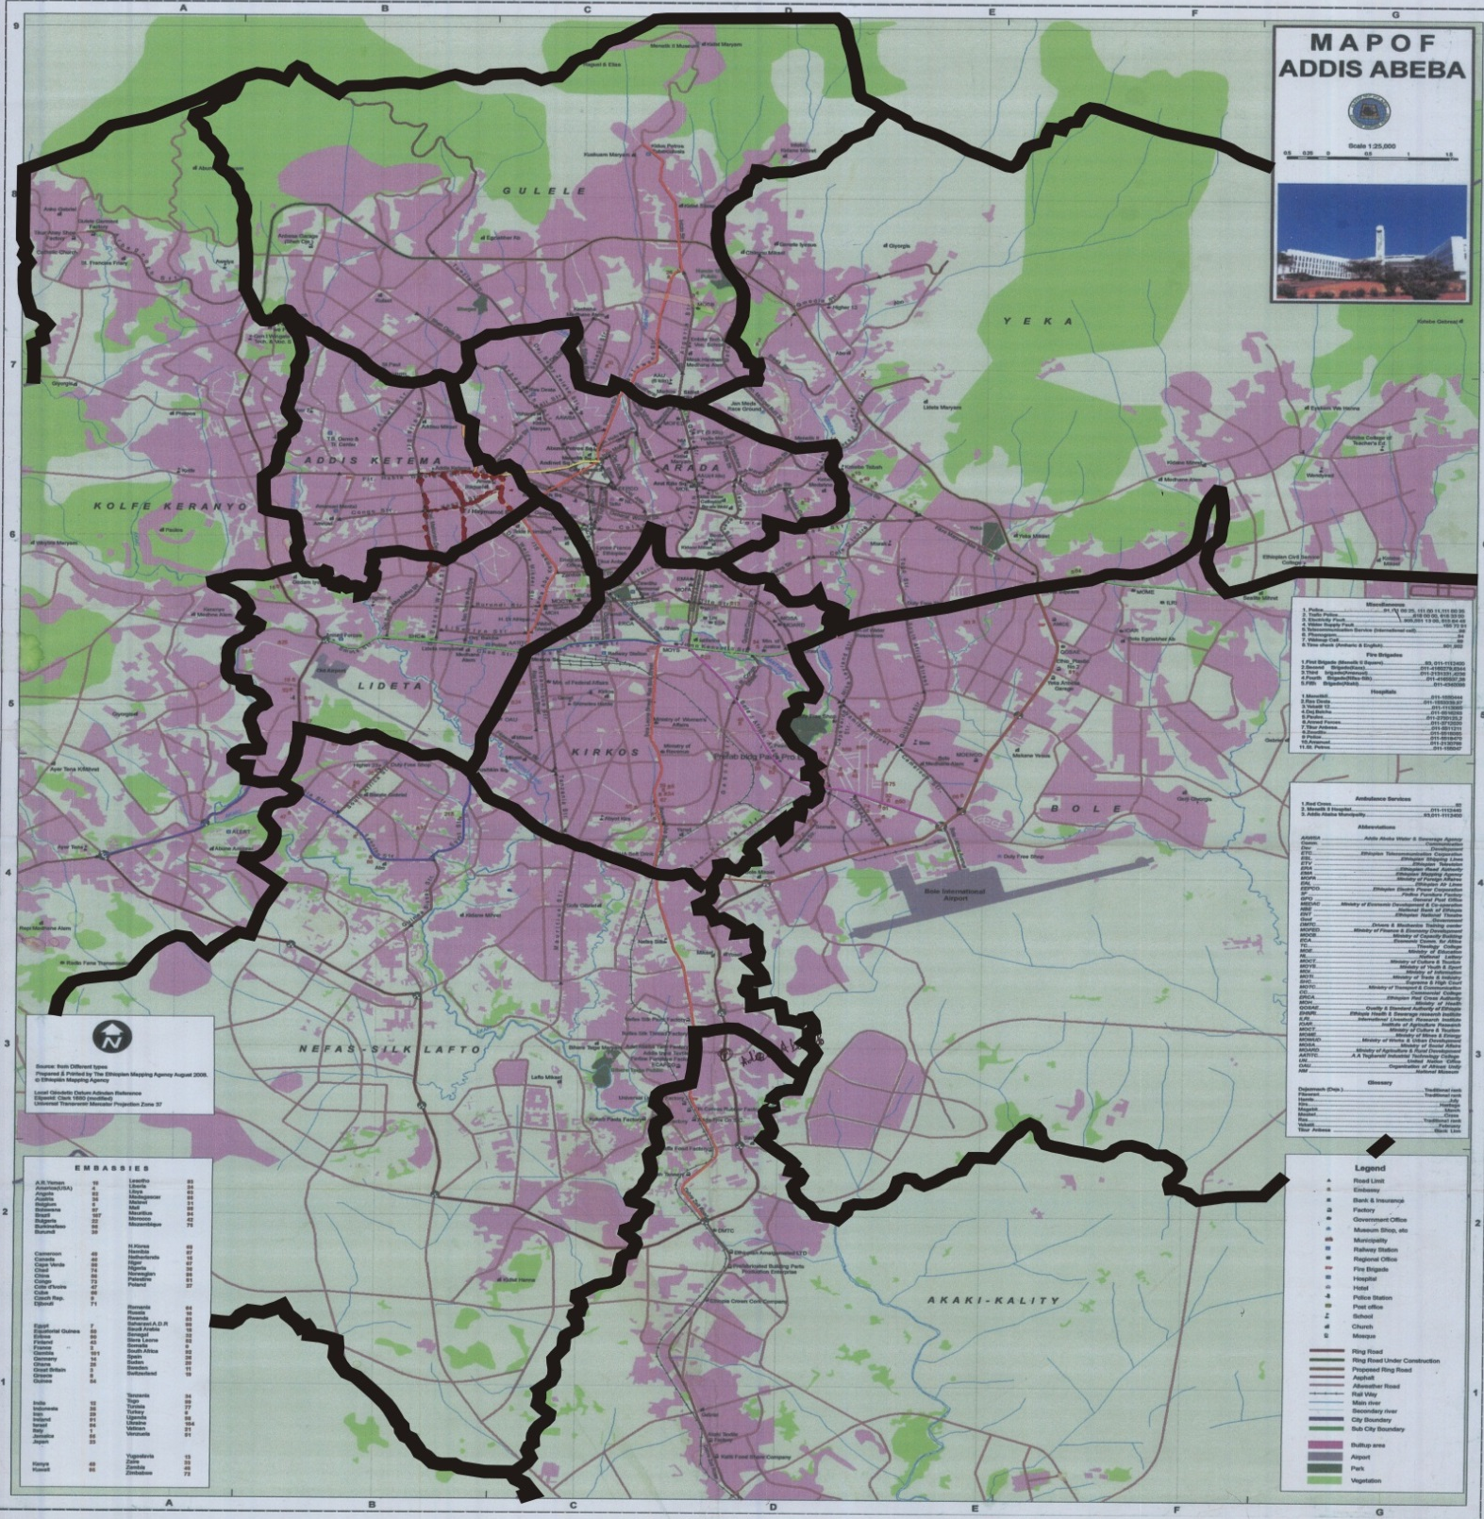
06
05
07
08
01
09
10
04
02
03

Slide 58
CODING FOR THE ACCIDENT DATA
FOR EASY REFERENCE
Unique Identification of Each Accident Record
AA= Addis Ababa Province
03 = Police Station 03
ETAA0503YYNNNN
YY=Year
ET=Ethiopia
05 = District 05
NNNN= Serial No. of Accident
Example: ETAA0503150056

Slide 59
EASE OF IMPLEMENTING RADaR APPLICATION
RADaR system is designed in such a way that the implementing Ministry/Road Authority would not need any major infrastructure for its implementation.
The data gets collected at web-server provided by IRF under the license of the RADaR. The implementing agency does not have to create server/data centre or even the manpower to manage and maintain all these infrastructures, which is not so easy to do in developing world.
The implementing agency can simply have the RADaR licenses, get the Traffic Police personnel trained for a few days in the operation of the RADaR application using the tablet, and then it can be implemented within a few days.

Slide 60
EASE OF IMPLEMENTING RADaR APPLICATION
The implementing agency will select and buy the tablets (of brand/make of their choice), having the provision of SIM Card and/or internet enabled (WiFi), in which the RADaR application will be operating.
The minimum specification of tablet for operating RADaR application is given to the implementing agency by IRF; Implementing Agency is required to procure tablets of their choice, and it can be implemented in minimum time after the decision is made for its implementation.
Crash data can be easily shared among all the concerned Departments/Agencies for performing their roles in reducing road crashes/accidents (to save lives and disabilities)

Slide 61
Thanks !!
For any information relating to RADaR, please contact at the email address given below.
pksikdar@indiairf.com
pksikdar@ictonline.com

