Slide 1
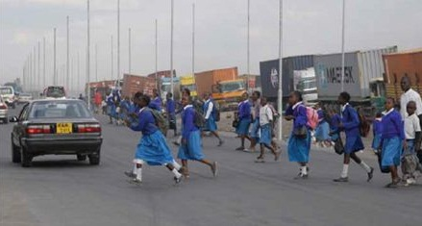
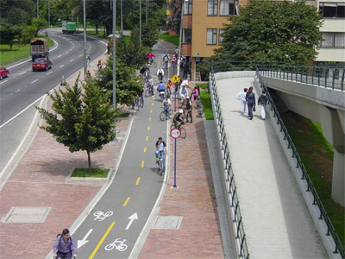
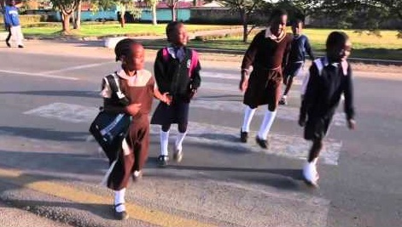
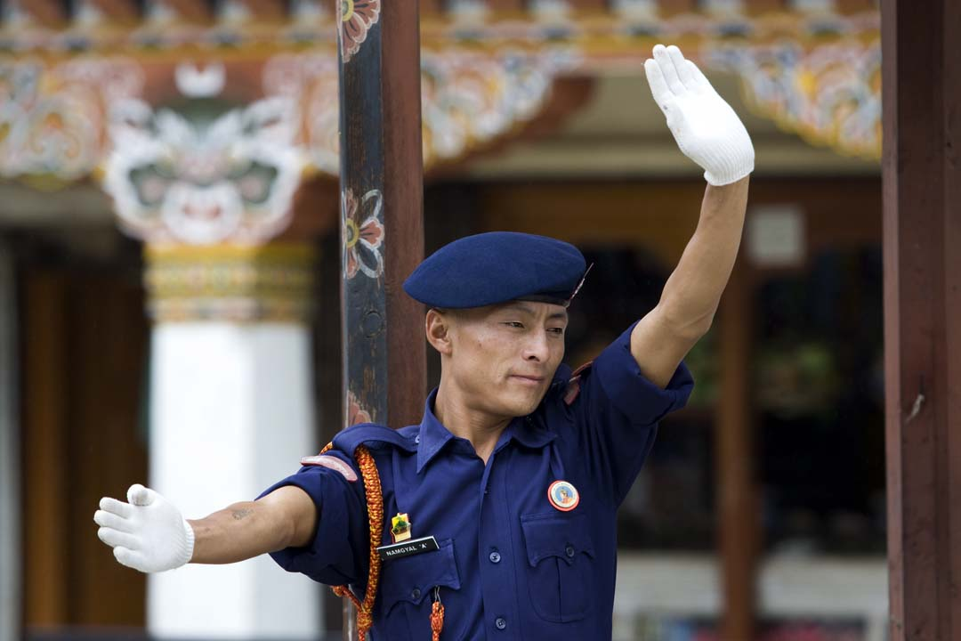
World Bank Support to Road Safety in Africa
Tawia Addo-Ashong
Senior Transport Specialist
Transport & ICT Global Practice
The World Bank
taddoashong@worldbank.org
3rd African Road Safety Conference
Addis Ababa, Ethiopia, July 9-10, 2015

Slide 2
SSATP
an international partnership of 40 African countries, Regional Economic Communities (RECs), African institutions (African Union Commission-AUC, United Nations Economic Commission for Africa-UNECA), public and private sector organizations and international development agencies, with the mission to facilitate policy development and related capacity building in Africa's transport sector.
enable AUC and UNECA to encourage countries to achieve the goals of the UN Decade of Action for Road Safety and Africa Road Safety Plan of Action 2011-2020;
promote effective policy and strategy formulation and implementation at country level;
stimulate good practice in Road Safety Management (Pillar one of the UN Decade of action) by promoting systematic implementation of the Africa Plan of Action; and
better integration of road safety policy and pillar-based interventions in locally and externally funded road developments
Notes:
1. Research
The GRSF will strengthen the evidence base that aligns road safety to the Bank’s twin goals of reducing poverty and boosting shared prosperity. While relatively strong estimates exist regarding the aggregate economic burden caused by road traffic injuries (RTI) and fatalities, very little evidence and analysis exists to show how the poorest members of low and middle income countries are directly affected by the crisis.
GRSF will work with the Transport and ICT Global Practice, the Road Safety Thematic Group and other MDBs to develop a long-term research strategy for road safety. Through a needs assessment they will identify research gaps and establish a process for calls for proposal for road safety research. GRSF will also establish linkages with DEC, ensure that work that is being undertaken is complementary and seek opportunities for closer collaboration between the two units.
Some of the possible areas for support under the GRSF research theme are:
Quantitatively measuring the socio-economic impact of road traffic crashes specifically on the low-income households in 1-3 low income countries.
Quantify how many lives are saved by implementing both infrastructure and non-infrastructure related interventions, strengthening the justification for investing in road safety.
Provide continued support to the Road Traffic Injury Research Network, this network consisting of junior and senior researchers in LICs and MICs, provides an opportunity to build local capacity in road safety research.
Look into the incidences of fatality and injury for school children and create a manual for designing school zone safety areas which could be implemented on all schools which exist along project roads.
Expected outcomes
Clear linkages established between poor road safety and poverty
Quantification of lives saved by implementing non-infrastructure related interventions
Building local research capacity
Research on designs for making areas around schools safer
Understanding barriers on key issues such as legal and institutional frameworks, emergency response, child and community road safety education, urban and rural road use behaviour and enforcement.
2. Improved Data Management
Poor road safety crash data is an ongoing challenge to developing effective and sustainable road safety outcomes. Countries lack capacity to collect, manage and analyse the data required for developing and prioritizing and informing evidence based road safety interventions.
GRSF has linked countries to the resources of the International Traffic Safety Data and Analysis Group (IRTAD) of the OECD in order to assist the creation of national crash database systems. To build in-country capacity to manage crash data, IRTAD twins the client country with a country partner where road safety data management systems are well-established and functioning. DFID funds will be used to work with individual LIC to set up or improve data management systems.
Expected outcomes
4 LICs with improved national crash database systems
National staff able to produce, analyse and deliver required crash statistics for monitoring and determining effectiveness of counter measure performance
Effective institutional linkages between police, hospitals and key Ministries including Transport, Health and Education for data collection, planning, communication, monitoring and evaluation
3. Institution and Capacity Building
The GRSF works with client countries to assist in the development of sustainable and action-oriented agencies that are capable of coordinating activity across the multiple sectors engaged in the various strands of road safety. In order to adequately design investment strategies and Safe System approaches in projects to achieve this, the GSRF undertakes country assessments of road safety institutional capacity. The capacity reviews ensure that funds (through World Bank, other development banks, or country budgets) create plans that are targeted for maximum results in a manner that scales up capacity creates long- term sustainability and ensures effectiveness of agencies.
The GRSF will continue to work with LICs to develop strategies where none exist and strengthen strategies to allow for more effective road safety outcomes. Evidence has shown that successful strategies are not static and need to be continuously monitored and updated, with adjustments to interventions based on real-time evaluation of existing data. This is in line with the strategies developed by successful nations who have over a period of time achieved significant and sustained reductions in fatalities and injury. GRSF will provide technical assistance to 2 LIC countries to develop the institutional capacity to implement a performance based management system to collect and analyse their road safety data, and design evidence based interventions that achieve the set goals.
GRSF will also support safe corridor demonstration projects in LICs – the targeting of one or more high risk corridors with a series of well-organised multi-sectoral activities to strengthen the road safety management capacity and delivery of participating agencies.
Expected outcomes
Improved policy level coordination and capacity of different stakeholders to plan and implement multi-sectoral interventions for effective road safety outcomes
Improved capacity of lead road safety agencies to plan, test, implement, monitor and refine road safety management strategies
Development of national road safety plans/strategies to address road safety challenges in LICs
Infrastructure Safety
Safe road infrastructure is critical to the sustainable development agenda of the developing world. This remains a central pillar of the GRSF and World Bank’s strategy for the transport sector throughout the UN Decade of Action. Partnering with the International Road Assessment Program (iRAP), the GRSF has built local capacity to improve the safety of road infrastructure through the assessment and redesign of high-risk road sections. To date GRSF has funded the inspection and survey of over 36,000 km of high risk roads in LMICs and has identified infrastructure safety improvements meeting the needs of all categories of road users.
In the second half of the UN Decade, the GRSF will continue to work with iRAP to diagnose and remedy high-risk roads and to build capacity for safe road management systems through training and country-specific support. The use of systematic road safety audits will also be implemented, with recommendations and improvements incorporated into the design, final construction drawings and works.
Expected Outcomes:
8,000km of high risk highways/urban networks surveyed and star rated across 4 LICs
Development of safe infrastructure investment plans and road designs
6 Road safety audits and associated training carried out.
Improved capacity for Road Agencies in LICs to understand and undertake road safety audits and to deliver safe designs
Partnerships
GRSF recognizes the value of other institutions working in the area of road safety. GRSF will continue to develop existing partnerships with IRTAD, IRF, and GRSP and actively seek new opportunities to partner with other country, regional and international organizations (e.g. The World Road Association). The private sector, academia and civil society groups with a shared interest and strong road safety culture will also be encouraged into partnership.
GRSF will scale up and align its work with Regional Development Banks (RDBs). It will also continue to participate in the Multilateral Bank (MDB) Road Safety initiative and will proactively look for opportunities to use its resources to leverage additional funding from other MDBs working on the ground in LICs.
Expected outcomes
Strong partnerships for training, capacity building, and advocacy established with other road safety public, private and civil society organization’s
Common agenda, messaging, results monitoring and coordination of road safety activities across RDBs and MDBs
Economic Commission for Europe, Geneva. Statistics of Road Traffic Accidents in Europe and North America. Aug 2011.

Slide 3
Support from SSATP
“The Urgency of Acting Now”
SSATP will provide support for
Building Capacity and development of a robust monitoring process for the Decade of Action
Development and review of existing road safety policies and strategies
Creation and strengthening of road safety lead agencies
Mainstreaming road safety in infrastructure investments

Slide 4
Support from GRSF
GRSF Objectives
Strengthening global, regional and country capacity to support sustainable reductions in road deaths and injuries in Low and Middle Income Countries (LMICs)
Scaling up global road safety funding, coordination and advocacy mechanisms, and
Mainstreaming road safety components into all World Bank funded road infrastructure projects
Notes:
1. Research
The GRSF will strengthen the evidence base that aligns road safety to the Bank’s twin goals of reducing poverty and boosting shared prosperity. While relatively strong estimates exist regarding the aggregate economic burden caused by road traffic injuries (RTI) and fatalities, very little evidence and analysis exists to show how the poorest members of low and middle income countries are directly affected by the crisis.
GRSF will work with the Transport and ICT Global Practice, the Road Safety Thematic Group and other MDBs to develop a long-term research strategy for road safety. Through a needs assessment they will identify research gaps and establish a process for calls for proposal for road safety research. GRSF will also establish linkages with DEC, ensure that work that is being undertaken is complementary and seek opportunities for closer collaboration between the two units.
Some of the possible areas for support under the GRSF research theme are:
Quantitatively measuring the socio-economic impact of road traffic crashes specifically on the low-income households in 1-3 low income countries.
Quantify how many lives are saved by implementing both infrastructure and non-infrastructure related interventions, strengthening the justification for investing in road safety.
Provide continued support to the Road Traffic Injury Research Network, this network consisting of junior and senior researchers in LICs and MICs, provides an opportunity to build local capacity in road safety research.
Look into the incidences of fatality and injury for school children and create a manual for designing school zone safety areas which could be implemented on all schools which exist along project roads.
Expected outcomes
Clear linkages established between poor road safety and poverty
Quantification of lives saved by implementing non-infrastructure related interventions
Building local research capacity
Research on designs for making areas around schools safer
Understanding barriers on key issues such as legal and institutional frameworks, emergency response, child and community road safety education, urban and rural road use behaviour and enforcement.
2. Improved Data Management
Poor road safety crash data is an ongoing challenge to developing effective and sustainable road safety outcomes. Countries lack capacity to collect, manage and analyse the data required for developing and prioritizing and informing evidence based road safety interventions.
GRSF has linked countries to the resources of the International Traffic Safety Data and Analysis Group (IRTAD) of the OECD in order to assist the creation of national crash database systems. To build in-country capacity to manage crash data, IRTAD twins the client country with a country partner where road safety data management systems are well-established and functioning. DFID funds will be used to work with individual LIC to set up or improve data management systems.
Expected outcomes
4 LICs with improved national crash database systems
National staff able to produce, analyse and deliver required crash statistics for monitoring and determining effectiveness of counter measure performance
Effective institutional linkages between police, hospitals and key Ministries including Transport, Health and Education for data collection, planning, communication, monitoring and evaluation
3. Institution and Capacity Building
The GRSF works with client countries to assist in the development of sustainable and action-oriented agencies that are capable of coordinating activity across the multiple sectors engaged in the various strands of road safety. In order to adequately design investment strategies and Safe System approaches in projects to achieve this, the GSRF undertakes country assessments of road safety institutional capacity. The capacity reviews ensure that funds (through World Bank, other development banks, or country budgets) create plans that are targeted for maximum results in a manner that scales up capacity creates long- term sustainability and ensures effectiveness of agencies.
The GRSF will continue to work with LICs to develop strategies where none exist and strengthen strategies to allow for more effective road safety outcomes. Evidence has shown that successful strategies are not static and need to be continuously monitored and updated, with adjustments to interventions based on real-time evaluation of existing data. This is in line with the strategies developed by successful nations who have over a period of time achieved significant and sustained reductions in fatalities and injury. GRSF will provide technical assistance to 2 LIC countries to develop the institutional capacity to implement a performance based management system to collect and analyse their road safety data, and design evidence based interventions that achieve the set goals.
GRSF will also support safe corridor demonstration projects in LICs – the targeting of one or more high risk corridors with a series of well-organised multi-sectoral activities to strengthen the road safety management capacity and delivery of participating agencies.
Expected outcomes
Improved policy level coordination and capacity of different stakeholders to plan and implement multi-sectoral interventions for effective road safety outcomes
Improved capacity of lead road safety agencies to plan, test, implement, monitor and refine road safety management strategies
Development of national road safety plans/strategies to address road safety challenges in LICs
Infrastructure Safety
Safe road infrastructure is critical to the sustainable development agenda of the developing world. This remains a central pillar of the GRSF and World Bank’s strategy for the transport sector throughout the UN Decade of Action. Partnering with the International Road Assessment Program (iRAP), the GRSF has built local capacity to improve the safety of road infrastructure through the assessment and redesign of high-risk road sections. To date GRSF has funded the inspection and survey of over 36,000 km of high risk roads in LMICs and has identified infrastructure safety improvements meeting the needs of all categories of road users.
In the second half of the UN Decade, the GRSF will continue to work with iRAP to diagnose and remedy high-risk roads and to build capacity for safe road management systems through training and country-specific support. The use of systematic road safety audits will also be implemented, with recommendations and improvements incorporated into the design, final construction drawings and works.
Expected Outcomes:
8,000km of high risk highways/urban networks surveyed and star rated across 4 LICs
Development of safe infrastructure investment plans and road designs
6 Road safety audits and associated training carried out.
Improved capacity for Road Agencies in LICs to understand and undertake road safety audits and to deliver safe designs
Partnerships
GRSF recognizes the value of other institutions working in the area of road safety. GRSF will continue to develop existing partnerships with IRTAD, IRF, and GRSP and actively seek new opportunities to partner with other country, regional and international organizations (e.g. The World Road Association). The private sector, academia and civil society groups with a shared interest and strong road safety culture will also be encouraged into partnership.
GRSF will scale up and align its work with Regional Development Banks (RDBs). It will also continue to participate in the Multilateral Bank (MDB) Road Safety initiative and will proactively look for opportunities to use its resources to leverage additional funding from other MDBs working on the ground in LICs.
Expected outcomes
Strong partnerships for training, capacity building, and advocacy established with other road safety public, private and civil society organization’s
Common agenda, messaging, results monitoring and coordination of road safety activities across RDBs and MDBs
Economic Commission for Europe, Geneva. Statistics of Road Traffic Accidents in Europe and North America. Aug 2011.

Slide 5
Support from GRSF
GRSF will provide funding support for :
capacity reviews
development and monitoring of national plans/strategies
improving data management
mainstreaming safety into infrastructure development and management
workshops and training
research
Notes:
1. Research
The GRSF will strengthen the evidence base that aligns road safety to the Bank’s twin goals of reducing poverty and boosting shared prosperity. While relatively strong estimates exist regarding the aggregate economic burden caused by road traffic injuries (RTI) and fatalities, very little evidence and analysis exists to show how the poorest members of low and middle income countries are directly affected by the crisis.
GRSF will work with the Transport and ICT Global Practice, the Road Safety Thematic Group and other MDBs to develop a long-term research strategy for road safety. Through a needs assessment they will identify research gaps and establish a process for calls for proposal for road safety research. GRSF will also establish linkages with DEC, ensure that work that is being undertaken is complementary and seek opportunities for closer collaboration between the two units.
Some of the possible areas for support under the GRSF research theme are:
Quantitatively measuring the socio-economic impact of road traffic crashes specifically on the low-income households in 1-3 low income countries.
Quantify how many lives are saved by implementing both infrastructure and non-infrastructure related interventions, strengthening the justification for investing in road safety.
Provide continued support to the Road Traffic Injury Research Network, this network consisting of junior and senior researchers in LICs and MICs, provides an opportunity to build local capacity in road safety research.
Look into the incidences of fatality and injury for school children and create a manual for designing school zone safety areas which could be implemented on all schools which exist along project roads.
Expected outcomes
Clear linkages established between poor road safety and poverty
Quantification of lives saved by implementing non-infrastructure related interventions
Building local research capacity
Research on designs for making areas around schools safer
Understanding barriers on key issues such as legal and institutional frameworks, emergency response, child and community road safety education, urban and rural road use behaviour and enforcement.
2. Improved Data Management
Poor road safety crash data is an ongoing challenge to developing effective and sustainable road safety outcomes. Countries lack capacity to collect, manage and analyse the data required for developing and prioritizing and informing evidence based road safety interventions.
GRSF has linked countries to the resources of the International Traffic Safety Data and Analysis Group (IRTAD) of the OECD in order to assist the creation of national crash database systems. To build in-country capacity to manage crash data, IRTAD twins the client country with a country partner where road safety data management systems are well-established and functioning. DFID funds will be used to work with individual LIC to set up or improve data management systems.
Expected outcomes
4 LICs with improved national crash database systems
National staff able to produce, analyse and deliver required crash statistics for monitoring and determining effectiveness of counter measure performance
Effective institutional linkages between police, hospitals and key Ministries including Transport, Health and Education for data collection, planning, communication, monitoring and evaluation
3. Institution and Capacity Building
The GRSF works with client countries to assist in the development of sustainable and action-oriented agencies that are capable of coordinating activity across the multiple sectors engaged in the various strands of road safety. In order to adequately design investment strategies and Safe System approaches in projects to achieve this, the GSRF undertakes country assessments of road safety institutional capacity. The capacity reviews ensure that funds (through World Bank, other development banks, or country budgets) create plans that are targeted for maximum results in a manner that scales up capacity creates long- term sustainability and ensures effectiveness of agencies.
The GRSF will continue to work with LICs to develop strategies where none exist and strengthen strategies to allow for more effective road safety outcomes. Evidence has shown that successful strategies are not static and need to be continuously monitored and updated, with adjustments to interventions based on real-time evaluation of existing data. This is in line with the strategies developed by successful nations who have over a period of time achieved significant and sustained reductions in fatalities and injury. GRSF will provide technical assistance to 2 LIC countries to develop the institutional capacity to implement a performance based management system to collect and analyse their road safety data, and design evidence based interventions that achieve the set goals.
GRSF will also support safe corridor demonstration projects in LICs – the targeting of one or more high risk corridors with a series of well-organised multi-sectoral activities to strengthen the road safety management capacity and delivery of participating agencies.
Expected outcomes
Improved policy level coordination and capacity of different stakeholders to plan and implement multi-sectoral interventions for effective road safety outcomes
Improved capacity of lead road safety agencies to plan, test, implement, monitor and refine road safety management strategies
Development of national road safety plans/strategies to address road safety challenges in LICs
Infrastructure Safety
Safe road infrastructure is critical to the sustainable development agenda of the developing world. This remains a central pillar of the GRSF and World Bank’s strategy for the transport sector throughout the UN Decade of Action. Partnering with the International Road Assessment Program (iRAP), the GRSF has built local capacity to improve the safety of road infrastructure through the assessment and redesign of high-risk road sections. To date GRSF has funded the inspection and survey of over 36,000 km of high risk roads in LMICs and has identified infrastructure safety improvements meeting the needs of all categories of road users.
In the second half of the UN Decade, the GRSF will continue to work with iRAP to diagnose and remedy high-risk roads and to build capacity for safe road management systems through training and country-specific support. The use of systematic road safety audits will also be implemented, with recommendations and improvements incorporated into the design, final construction drawings and works.
Expected Outcomes:
8,000km of high risk highways/urban networks surveyed and star rated across 4 LICs
Development of safe infrastructure investment plans and road designs
6 Road safety audits and associated training carried out.
Improved capacity for Road Agencies in LICs to understand and undertake road safety audits and to deliver safe designs
Partnerships
GRSF recognizes the value of other institutions working in the area of road safety. GRSF will continue to develop existing partnerships with IRTAD, IRF, and GRSP and actively seek new opportunities to partner with other country, regional and international organizations (e.g. The World Road Association). The private sector, academia and civil society groups with a shared interest and strong road safety culture will also be encouraged into partnership.
GRSF will scale up and align its work with Regional Development Banks (RDBs). It will also continue to participate in the Multilateral Bank (MDB) Road Safety initiative and will proactively look for opportunities to use its resources to leverage additional funding from other MDBs working on the ground in LICs.
Expected outcomes
Strong partnerships for training, capacity building, and advocacy established with other road safety public, private and civil society organization’s
Common agenda, messaging, results monitoring and coordination of road safety activities across RDBs and MDBs
Economic Commission for Europe, Geneva. Statistics of Road Traffic Accidents in Europe and North America. Aug 2011.

Slide 6
Support from Transport & ICT Global Practice
Safe, clean and affordable transport for all
delivered operations totaling US$1.1 billion
60% of transport portfolio goes towards road infrastructure investment
Commitment to ensure road safety is integrated in every road project
Creation of a Global Solutions Group focusing on Road Safety
Support to Brasilia conference
- supporting WHO travel fund
- supporting travel under projects
- chairing/leading sessions( with partners)
- pre/side events (African ministers, Insurance, police)

Slide 7
Second Global High-Level Conference on Road Safety in Brazil, Brasilia, November 18-19, 2015
This Second Conference follows the First Global Ministerial Conference on Road Safety, held in Russia in 2009, to accelerate the momentum around achieving the Decade target of stabilizing road deaths.
It is a unique moment for member states to bring a new impetus to the Decade of Action at its mid-point – a time to reaffirm commitments and propose new strategies for the next five years, in light of the scenario that should emerge from discussions on the new Sustainable Development Goals.
Conference will bring together over 1,500 participants from 150 countries, among them Ministers of Health, Cities, Transport, and Interior; senior officials from United Nations agencies; representatives of civil society; and business leaders.
Status: Invitations

Slide 8
Second Global High-Level Conference on Road Safety in Brazil, Brasilia, November 18-19, 2015
Invitations to Countries
1. Invitations to all countries: Save the Date sent in 2014.
2. 2015 – March: Formal invitations sent to ministries of countries
involved (signed by 5 Ministers); The receipt of Invitations is being monitored through the Ministry of External Relations
3. JUNE – sent invitation again to all MoH (Brazil and WHO)
JULY / 2015: It will be sent a new notice, informing password for
registration on the website
AUGUST / 2015: meeting with all embassies, conducted by the Brazilian
Government, will be organized in Brasilia to mobilize participation.
September / 2015: a new reminder will be sent to all countries regarding the
event and registrations.

Slide 9
Second Global High-Level Conference on Road Safety in Brazil, Brasilia, November 18-19, 2015
Total 1.500
• 1000 - International guests
600 - 4 per Country - Government officials
200 NGOs
50 - Academic Institutions and researchers
100 - Private Sector
50 - United Nations
• 500 - Participants from Brazil
400 - State/Government representatives (Government, Ministries, Parliament, Mayors)
50 - NGOs
30 - Private Sector
20 - Universities and Academic Research Institutions

Slide 10
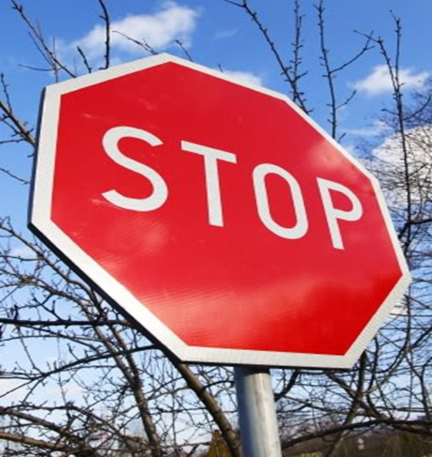
Contact:
Tawia Addo-Ashong: taddoashong@worldbank.org
Justin Runji: jrunji@worldbank.org
Marc Shotten: mshotten@worldbank.org
Dipan Bose: dbose@worldbank.org
Thank You
Notes:
Most of traffic accidents are preventable, and let us collectively stop traffic accident being a killer !

