Slide 1
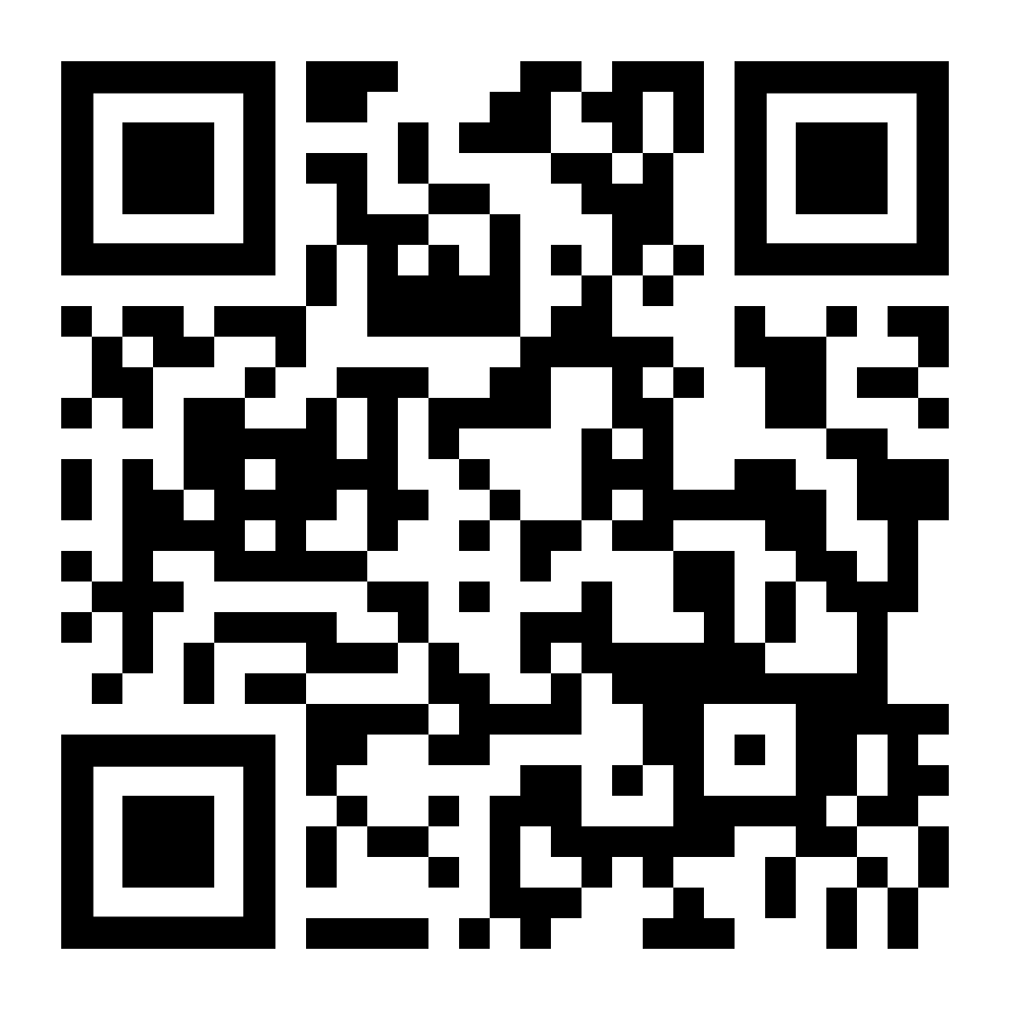
Special Session of the Regional Coordination Mechanism for Africa MONDAY, FEBRUARY 24, 2020 Victoria Falls, Zimbabwe Online Evaluation Questionnaire: https://www.research.net/r/SS-RCM
You can also scan the QR code

