Slide 1
Institutions and Policies for Inclusive Green Economy in Africa Expert Group Meeting on Enabling Measures for an Inclusive Green Economy in Africa
23-24 September 2014
Addis Ababa

Slide 2
Presentation Outline
Introduction
Role of institutions and policies in advancing inclusive green economy
Trends and gaps in institutions and policies in support of inclusive green economy
Challenges and opportunities
Conclusions and recommendations

Slide 3
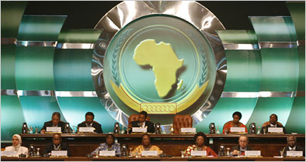
1. Introduction
View of institutions and policies for Inclusive Green Economy (IGE)
Relevance of the issue

Slide 4
2. Role of institutions and policies in advancing inclusive green economy
High Level Leadership and Commitment
The Africa Consensus Statement to Rio+20
The Outcome document of Rio+20, June 2012
The Africa RIM for the Rio+20 follow up processes (November 2012)
The subregional and Africa reports on Sustainable Development Goals (SDGs)
The 7th AU-ECA Joint Annual Meetings (2014)

Slide 5
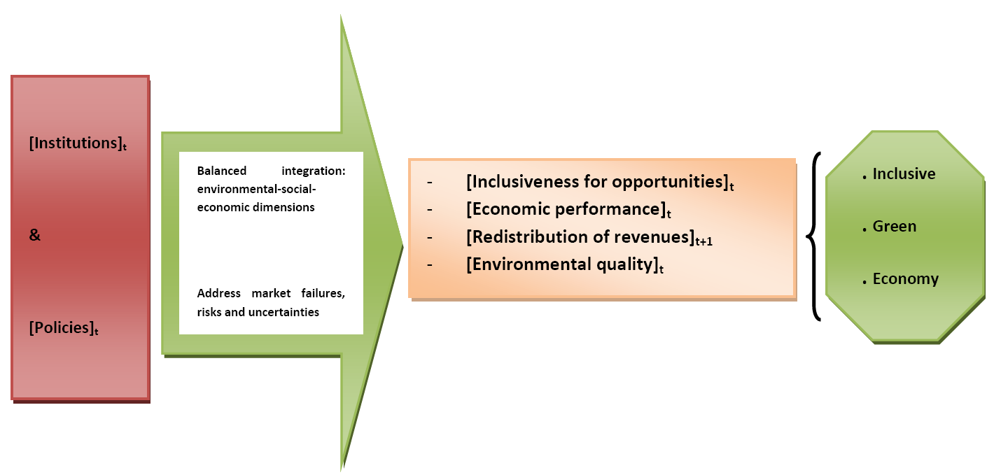
Pivotal role through: Stabilization, Production, Redistribution

Slide 6
3. Trends and gaps in institutions and policies in support of inclusive green economy
At all levels and increasingly: Institutional, strategic and policy frameworks
Provide countries with the opportunity for IGE
Step-wise approach
Tailored to regional/national/local specificities, priorities and strategic interest

Slide 7
AT THE REGIONAL LEVEL
The African Union (AU) and its Organs: Programmes and instruments of the AUC and the NEPAD
Key initiatives: Lagos Plan of Action for economic development (1980); Abuja Treaty (1991), NEPAD (2001)
More recently, the 5th Special Session of the AMCEN launched AGEP:
Organizations: AUC, AfDB, UNEP, ECA, ILO and the NEPAD Planning and Coordinating Agency (NPCA)
Its main objective: facilitated, coordinated and consolidated support

Slide 8
The African Development Bank (AfDB)
high-impact, well focused integrated support to Africa’s development
Green Growth Strategy
Substantial investment for national IGE initiatives through its 10-year strategy (2013 – 2022)
Africa50 Fund to finance infrastructure projects, of up to USD 100 billion.

Slide 9
The Economic Commission for Africa of UN (ECA)
Specifically mandated by the WSSD, the UN GA and Rio+20: Its own work programme and assist African States
ECA has responded to this mandate:
Various sectoral committees on SD, e.g.: ACSD
Key meetings, e.g.: RIMs
Programmes in specific areas such as climate change, water, etc.
“Vision 2063” (jointly with AU, AfDB)
MDGs and Post-2015 Development Agenda

Slide 10
The repositioning of the ECA and the subsequent review have led to internal reorganization and better programmatic linkages
A GENR Section has been established
Main objective of GENRS: Contribute to the body of knowledge and enhance understanding on the implications of the IGE paradigm for Africa’s transformational agenda

Slide 11
AT THE SUBREGIONAL LEVEL
RECs: SADC, ECOWAS, EAC, COMESA, AMU, the Community of Sahelo-Saharan States, ECCAS, and IGAD
Over the years, various programmes in place
E.g.: ECCAS General Secretariat: Natural resources economy and ST, establishment of a Green Economy System, including a Green Economy Fund

Slide 12
AT THE NATIONAL LEVEL
Countries are increasingly adopting various policies, strategies and plans addressing IGE and SD:
LT national visions, national development plans, NSSDs, PRSPs, and sectoral strategies in the agriculture, environment and natural resources sectors, etc.
IGE: Ethiopia, Mozambique, Rwanda, South Africa
Other selected examples of countries: Botswana, Kenya, Mali, Senegal, Sierra Leone, Uganda, Zambia, etc.

Slide 13
AT THE LOCAL LEVEL
IGE policies, at the level of cities and rural communities, in areas such as sustainable land use, building standards, green cities, public transportation, infrastructure and energy efficiency, sustainable agriculture and rural livelihoods are critical to the transition
Ample opportunities for collaboration and consultation, including with traditional institutions

Slide 14
AT THE GLOBAL LEVEL
The UN High-Level Political Forum on SD: The main UN platform on SD
The Economic and Social Council (ECOSOC) is the UN central platform for reflection, debate, and innovative thinking on SD
The UN Partnership for Action on a Green Economy (UN PAGE)
UNIDO, UNEP, ILO and UNITAR
IGE services to governments
The Green Growth Knowledge Platform (GGKP), 2012
A global network of international organizations and experts
Identifies and addresses major knowledge gaps in IGE theory and practice

Slide 15
REMAINING GAPS
Ineffective strategic and co-ordinated action
Social ministries are little involved
Few references are made to small businesses or informal sector actors
Coordinating bodies: Dormant or not functioning optimally
Finance ministries or departments: Not often playing a central role in the IGE strategy process
Critical for the full integration of IGE in main national development frameworks
E.g.: Setting IGE fiscal priorities for national expenditure and revenue generation
Few countries have developed an integrated set of indicators

Slide 16
4. Challenges and opportunities
Challenges and constraints
Implementation: Generally weak and less effective; e.g.: Environmental Performance Index (EPI)
Coordination : Difficulty of inter-departmental and inter-agency coordination- e.g.: AU
Funding: A perennial problem at all levels
Inadequate commitment: Makes consensus difficult to attain on a number of issues at the subregional level
Insufficient capacity at all levels: inadequate human resources and institutional capacity

Slide 17
Opportunities and supporting factors
The political environment and ownership of development is improving; NEPAD
Growing recognition of the role of I&P for IGE; e.g.: The Africa Consensus Statement to Rio+20
The institutional and policy frameworks provided by the regional and subregional organizations; e.g.: Climdev project (AfDB-AU-ECA)
Existing SD and IGE frameworks, including the upcoming SDGs

Slide 18
5. Conclusions and recommendations
Conclusions: Improving institutions and their ability to enable the right frameworks is critical so that all actors can deliver on their shared responsibility and ensure better coordination and policy implementation for inclusive green economy.

Slide 19
Recommendations:
I&P should aim at:
Scaling up for a strong high-level leadership, policy dialogue, and a synergistic approach, including through specific arrangements with the private sector
Increasing IGE technical dialogue
Focusing on ahead planning for building urban, rural and industrial systems
Ensuring that the AU and ECA work together
Implementing innovative policies and mechanisms for financing
Implementing M&E systems

