Slide 1
Economic Instruments
Expert Group Meeting on Enabling Measures for Inclusive Green Economy in Africa
23 and 24 September 2014,
UNCC, Addis Ababa, Ethiopia

Slide 2
Outline
Introduction
Role of economic instruments in fostering an inclusive green economy
Trends and gaps in the use of economic instruments
Challenges and opportunities
Conclusion and Recommendations

Slide 3
Introduction
Transitioning to an inclusive green economy (IGE) entails the stimulation and support of green investments in and across various sectors of an economy.
Stimulating green investments further requires strong and coherent signals to economic agents …that encourage shifts in production, consumption, and investment behaviours.
Sonigo et al (2012) identifies four main categories of policy tools that can be used to encourage green behaviour: (i) regulatory (ii) information (iii) Behavioural (iv) Economic instruments - comprise a variety of policy approaches such as taxes, incentives, subsidies, penalties or grants for green enterprises that influence decisions of economic agents through their impact on market signals.

Slide 4
Role of economic instruments in fostering an inclusive green economy
Creating the right incentives for an inclusive green economy
  addressing externalities, market failure and “getting the price right”/internalizing costs
  Promotes behavioral change and efficiency
  Fiscal measures – generates financial resources/revenues (part could go to targeted social investments/social protection programmes), induce investments, promote Green Public Procurement (GPP). GPP for example, accelerates market transformation for green solutions, encourages eco-innovations
  The incentive structure creates other opportunities…with positive spill-over effects to other sectors

Slide 5
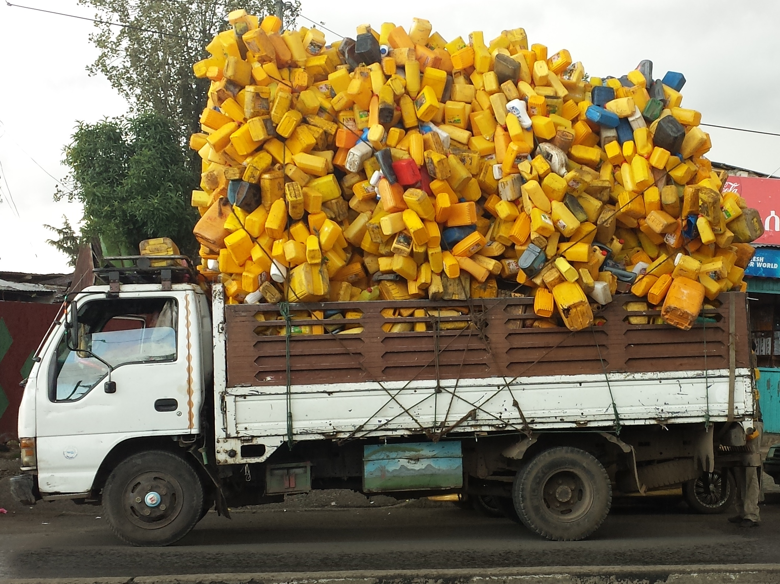

Slide 6
Trends and gaps in the use of economic instruments
Economic instruments have been applied to address a wide range of issues in support of green economy policies in many countries. So many initiatives are also emerging across Africa.
Economic Instruments in the energy sector - stimulating investments in renewable energy to address Africa’s energy challenge. E.g. Renewable Energy Feed-in Tariffs (REFITs), Low interest bank loans and capital subsidies for solar energy in Tunisia
Economic Instruments in the industrial sector – creating incentives, curbing emissions and raising revenues. E.g. Green tax initiatives in South Africa
Economic Instruments in the transport sector. E.g. Environmental levy on motor vehicles in Uganda
Economic Instruments in Ecosystems E.g. Forest certification in Congo basin

Slide 7
Challenges and opportunities
Challenges
  Understanding the structure of the problem and the policy context
  Finding the right balance - growth, environmental and distributional concerns
  Capacity
  Business-as-usual inertia and vested interests

Slide 8
Challenges and opportunities
Opportunities
Green Economy – emerging concept, emerging policy choices
Evolving landscape of environmental governance
Trends in green investments and multilateral financing mechanisms
Structural transformation and transition of African economies
Knowledge management and strategic frameworks

Slide 9
Conclusion
Policy has a role in supporting and encouraging green behaviour. Green behaviour is a shared responsibility of individual citizens, public authorities and industry.
As a policy tool, EIs provide a critical set of instruments for building green economies by creating incentives for behavioural change, stimulate and support green investments and redress social impacts.
The inherent incentive structure of EIs can support shifts of investments towards clean and efficient technologies, natural capital and social infrastructure such as education, skills training, health care and social protection systems - providing opportunities for a faster and more inclusive transition to a green economy.
The effectiveness and efficiency of EIs as policy measures, however, depend on the existing institutional, legal, social and economic systems. The application of economic instruments may not be an effective policy tool in addressing every problem. Choosing an effective policy package that fits in with the institutional capabilities and existing policy frameworks remain a difficult challenge

Slide 10
Recommendations
Focus on the broader policy framework
The choice of instruments should incorporate realistic assessments of institutional frameworks and capabilities
Analyse policy choices and trade-offs
Effectiveness of the instrument to achieve the specific policy objectives must remain paramount
Impact and distributional concerns
Recognize and address vested interests

Slide 11
Thank you

