Slide 1
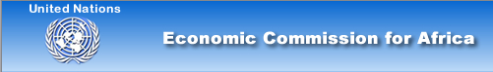

High-level Workshop on PPP Implementation in the Energy Sector in Africa
Co-operation between Africa and Korea
in Generation and Transmission Project
July 2011
Korea Electric Power Corporation
Notes:
Good afternoon, ladies and gentlemen.
My name is ㅇㅇㅇ. ㅇㅇㅇ of KEPCO.
On behalf of KEPCO, I would like to thank you all for taking the time to attend today's presentation.

Slide 2
CONTENTS
INTRODUCTION :
OVERVIEW OF KEPCO
Ⅰ
FAR BEYOND THE BOUNDARY :
KEPCO’S OVERSEAS BUSINESS
Ⅱ
CO-OPERATION IN AFRICA
Generation and Transmission Project
Ⅲ
Notes:
To introduce KEPCO’s overall business and potential cooperation opportunities , I structured my presentation into fourtparts.
First, I will briefly talk about the Overview of KEPCO to give you general information about KEPCO.
Second, I will go on to introduce KEPCO’s Transmission and Distribution
Thirdly I will explain KEPCO’s overseas business.
Lastly I will close my presentation with KEPCO 2020 vision.

Slide 3
INTRODUCTION :
OVERVIEW OF KEPCO
Ⅰ
Notes:
Let me start with the company overview.

Slide 4
Profile of KEPCO
USD 67.6 billion Largest Company in Korea in terms of Assets
USD 35.6 billion Power Retail Revenue in 2010
51.1% Government Shareholding
19,710 Employees
As of Jan, 2011
$1 = 1,100 won
A1, A Long-term Credit Rating by Moody’s, S&P
306th Fortune Global ranking
493th Financial Times Global ranking
NYSE Listed on the New York Stock Exchange since 1994
Notes:
In Asset wide KEPCO is the largest company in Korea. above Samsung Electronics, LG, Hyundai Motors.
KEPCO is government owned company with government share is over 50%.
KEPCO’s credit rating is highest in Korea and the same as Korean Government rate.
Also KEPCO has been listed on the New your Stock Exchange since 1994.

Slide 5
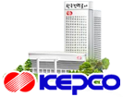
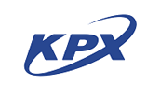

Structure of the Korean Electric Market
Government
Regulation
6 Generation
Companies
Community
Energy Supplier
Korea Power
Exchange
Customers
Market
Operation
Transmission,
Distribution &
Retail
IPPs & others
Notes:
In this slide, we can see how each player in the Korean electric market influences each other.
Generation companies transact with KEPCO through KPX, an independent electricity transaction authority. KEPCO supplies electricity to customers by means of its T&D system and retail network.

Slide 6
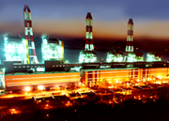
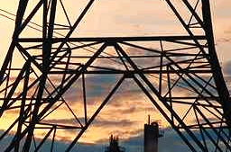
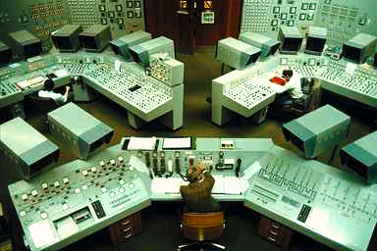
KEPCO’s Position & Facilities
92%
100%
100%
Generation
Transmission
Distribution & Retail
Total Capacity :
76,078MW (100%)
KEPCO & Subsidiaries : 65,560MW (86%)
IPPs & Others :
10,518MW (14%)
Line Length :
30,676 c-km
Substation Capacity :
256,318 MVA
731 Substations
Line Length :
428,259 c-km
Transformers :
101,692 MVA
No. of Customers :
19,229,000 households
Notes:
KEPCO is a highly integrated utility company, from generation, transmission, distribution and retail services.
KEPCO and its generation subsidiaries account for 92%
of the total generation market share in Korea, while T&D and retail operations are solely maintained by KEPCO.

Slide 7
Generation Source Mix
Optimization of Generation Mix
Power Generation
Hydro
7.3%
Green
2.3%
Hydro
1.4%
Green
0.8%
Coal
31.8%
Coal
40.9%
Nuclear
23.3%
Nuclear
31.3%
Gas
25.5%
Oil
9.8%
Gas
20.3%
Oil
5.3%
Capacity : 76,078MW
Generation : 474,660GWh
Notes:
Generation source mix by fuel type
On the view of Installed Capacity side, coal is biggest followed by gas and nuclear.
On the view of power generation side, coal is 41%, nuclear is 31%.
Coal and Nuclear are in charge of base load and they are operated annually without interruption.
원자력발전소 점검주기 :
18개월 : 핵연료 교체 및 터빈설비 등 점검
5년 : 터빈 발전기 완전 분해 점검
10년 : 원자로 내부의 하부 검사
화력발전 점검주기
- A 급 (정밀점검) : 고압터빈 완전분해
- B 급 (보통점검) : 저압터빈 완전분해
주기 및 순환 : 24개월, A→B→B→A(6년)

Slide 8
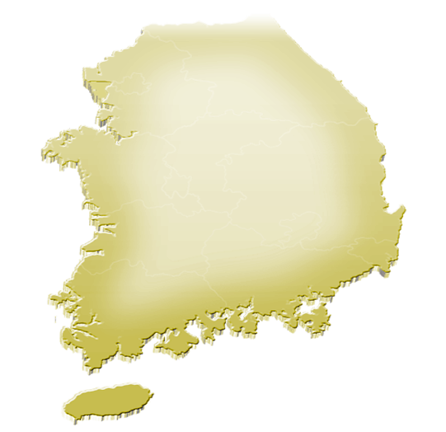


Transmission System Network
Sin-Dukheun
Yangju
Uijeongbu
Sin-Gapyung
Yangyang P/P
Seo-Incheon C/C
Sungdong
Migum
Characteristics
Seo-Incheon
Youngdeungpo
Chungbu
Sin-Yangje
Dong-Seoul
Incheon T/P, C/C
Sin-Bupyung
Youngseo
Sin-Sungnam
Donghae
765kV
Sin-Incheon
Seo-seoul
Gonjiam
Sin-Taebaek
Youngheung T/P
Sin-Sihung
Sin-Youngin
Highest voltage
Pyungtaek T/P, C/C
Sin-Ansan
Dangjin T/P
Hwasung
Sin-suwon
Uljin N/P
Ansan
Sin-Ansung
Sin-Jecheon
Sin-Youngju
Taean T/P
Sin-Dangjin
Sin-seosan
Sin-Jincheon
345kV
Sin-onyang
Chungwon
Sunsan
Cheongsong P/P
Main transmission system
Boryeong T/P, C/C
Seo-Daegu
Sin-Youngil
Chungyang
Sinkaedong
Sin-Okcheon
Buk-Daegu
ShinPohang
154kV
Gunsan
Daegu
Sin-Kyeongsan
Ulju
Wolseong N/P
Sin-Ulsan
Ulsan TP, C/C
Connected to major
consuming areas
Sin-Gimje
Sin-Namwon
Muju P/P
Sincheong P/P
Goryeong
Sin-Onsan
Bukbusan
Kori N/P
Sin-Yangsan
Youngwang N/P
Euiryong
Pusan C/C
Nam-Pusan
HVDC Connects
the main land
to Jeju Island (100km)
Sin-Gimhae
Sin-Gwangju
Sin-Masan
Hadong T/P
Samcheonpo T/P
Sin-Gosung
Gwangyang
Gwangyang Steel
Sin-Hwasun
Gwangyang C/C
Transmission Capacity
Sin-Gangjin
Yeosu N/P
(Unit: c-km/ substations)
Haenam C/S
765kV : 835 / 5
154KV < 345KV < 765KV
Jeju T/P
345kV : 8,580 / 88
Hanrim CC
154kV : 20,777 / 628
Namjeju
Notes:
This is transmission system network map in Korea.
Orange color lines are765kV, blue lines are 345kV system and gray colors are 154kV system.
Most of 345kV and 154kV systems are looped to prevent power interruption at any case.

Slide 9






Electricity Consumption / Tariff
Annual Electricity Consumption per Capita
[ Unit : kWh/capita ]
12,917
8,833
7,818
7,512
5,607
Korea
Japan
U.S.A
U.K
France
[Year : 2009]
Comparison of Electricity Tariff
[ Unit : US$/kWh ]
`
0.16
0.15
0.11
0.07
0.09
Korea
Japan
U.S.A
U.K
France
[Year : 2009]
Notes:
전력사용량과 전기요금 비교
한국의 1인당 연간 전력사용량은 이미 일본, 영국, 프랑스를 넘어서 OECD국가의 최상위에 위치하고 있음
전기요금을 비교하면 kWh 당 0.07달러로 일본, 미국, 영국, 프랑스보다 저렴함
석유, 가스, 우라늄 등의 천연자원이 전혀 없고 석탄을 대부분 수입해야 하는 현실을 감안하면
한국의 전기요금은 무척 경쟁력이 있음
이는 연료를 제외한 건설, 운영 면에서 효율을 극대화하여 비용을 최소화한 것에 기인함

Slide 10




Operational Capabilities : T & D Loss
Transmission & Distribution Loss
[unit : %]
29.3
11.8
5.62
3.99
4.01
3.99
‘61
‘70
‘90
‘07
‘08
‘10
Comparison among countries
[unit : %, Year:2008]
6.8
6.8
6.8
6.8
5.8
6.0
5.2
4.58
3.99
Japan
Taiwan
France
U.S.A
Germany
Italy
U.K.
China
Korea
Notes:
KEPCO’s Most notable Operation capability is T&D loss.
In 1961 T&D loss rate was almost 30%. With active efforts on Loss Prevention, we reached 3.99% in last year.
By comparison with other countries, we can see the competitiveness of KEPCO.
전기요금 체계 : 100kWh 단위 6단계 11.7배 차이(최저 5센트, 최대 60센트)
연체이자 : 2%. 납기일 = 검침일+20일, 해지: 납기 2개월 지연시

Slide 11
KEPCO’s Effort to Reduce Loss Rate
Technical Loss
Transmission & Distribution Voltage Upgrading
Use of Low Loss Materials
Voltage unification
  Distribution voltage : 3.3, 5.7, 6.6, 11.4, 22.9kV → 22.9kV
  Low voltage : 100, 110, 220V → 220V
Non Technical Loss
Introduction of AMR (Automatic Meter Reading System)
Devising of Contract Violation Detection Program
Improvement of Service Wire and Watt-Meter Cover
Reorganization of the Pilferage Detecting Teams
Notes:
Power factor improvement to above 0.9
41% of Distribution loss is from Tr.(target : no load loss) G11→G9 grade iron core(Amorphous Tr from 1995 : decrease 25~30% of No load loss)
Construct distribution facilities impossible or difficult to steal electricity from Pilferage.
Easily check pilferage and wrong-connected wires without opening the cover or breaking seals

Slide 12
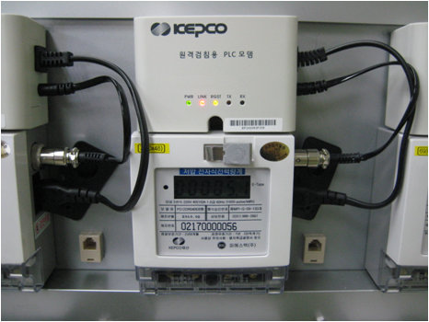
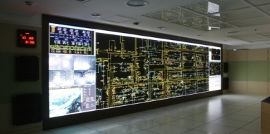
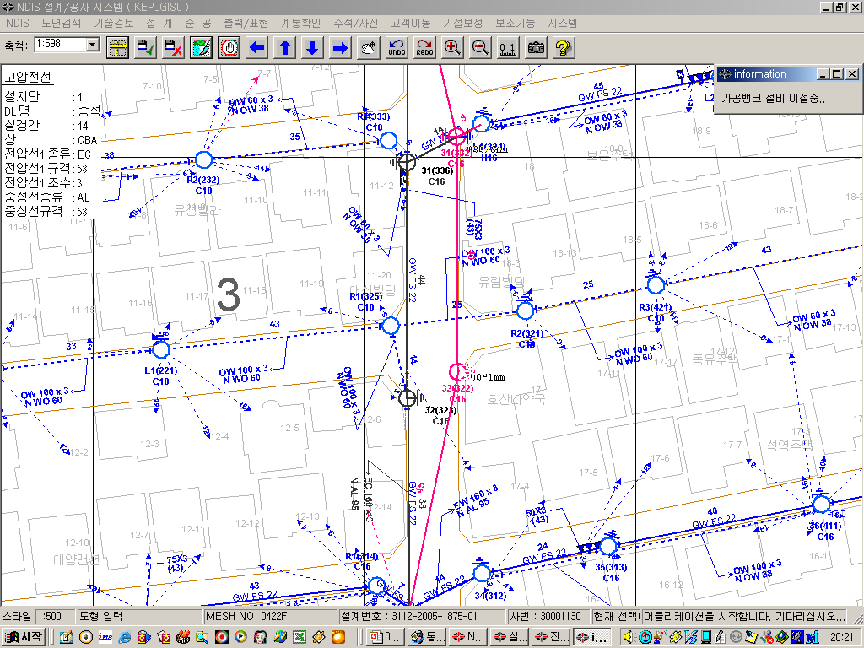
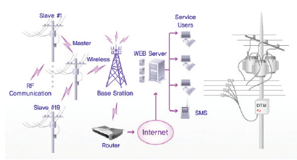
KEPCO’s Power IT Solutions
SCADA/DMS
Utility developed Solution
Continuous upgrade with practical feedback
Nation-wide system
Loss reduction/ load balancing
AMI
Advanced BPL technology
Anti-pilferage function
Upgrade toward Smart-Grid
GIS
DTMS
Real-time transformer monitoring
Power quality analysis
DIS
Based on GIS
Distribution data management
Design / Planning / Work order management
Network Analysis
Notes:
SCADA: Supervisory Control And Data Acquisition / DMS : Distribution Management System
-KEPCO에서 직접 개발한 솔루션이며 2003년에 전국확대 되어 현재까지 지속적으로 발전되고 있음
200개 지점을 묶어 43개 DCC 운영중
AMI: Advanced Metering Infrastructure(고압 18만호는 2002년 완료)
KEPCO는 BPL(Broadband Power Line)을 이용한 AMI사업에 강점이 있으며, 현재 500,000호 사업이 진행 중
도전방지기능 및 MDMS(Meter Data Management System), DR(Demand Response) 등 Smart Grid에 적합한 시스템으로 발전 중
DTMS: Distribution Transformer Management System
실시간 배전용 변압기 감시시스템으로 효과적인 부하관리와 전기품질 감시 시스템 임
DIS: Distribution Information System
GIS 기반의 배전분야 종합 정보 시스템
KEPCO는 이 시스템을 통하여 배전공사 설계, 계획, 작업관리 등을 처리하고 있음

Slide 13
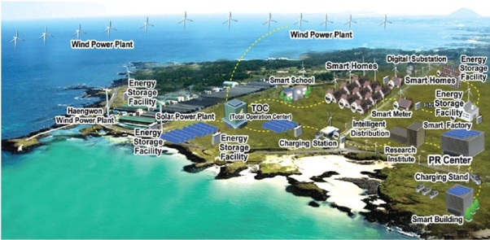
Smart Grid Test Bed
Goal
:
To Develop Smart Grid into the Business Model and the
Export-Oriented Industry
Period
: Dec, 2009 ~ May, 2013 (42 months)
Location
: Jeju Island (World first SG test bed)
Scale
: 5 sub-projects, 2 substations, 5 distribution lines, 6,000 households
5 subprojects of Smart Grid
Smart
Power Grid
Construction of real-time operation and monitoring for smart T&D system
Smart
Place
Integrated management of electric power through demand response
(by Two-way Information Exchange between Consumers and Suppliers)
Smart
Transport
Construction of charging infra and control center for next-generation transportation (EVs)
Smart
Renewable
Connection of renewables to the grid and construction of micro-grid operation platform
Smart
Elec. Service
Development of various tariffs and service models for the future power service infra
Notes:
KEPCO has been constructing Smart Grid Test Bed to be a Smart Grid global leading company since 2009.
KEPCO is testing all-inclusive technologies of Smart Grid and verifying their possibilities of commercialization.
Recently, KEPCO opened the Smart Grid PR center and four(4) experience hall in the Jeju island.
KEPCO expects to operate network more efficiently and eco-friendly through Smart Grid.
This project consists of 5 sub-projects including Power Grid
한국 주도로 만든 스마트그리드 국제기구인 '이스간(ISGAN·국제 스마트그리드 액션 네트워크)'이 ‘11. 6월 한국에 공식 설립됨. 국제에너지기구(IEA)의 공식기구인 이스간의 발족을 한국이 주도함에 따라 향후 스마트그리드 분야에서 한국이 국제표준 작업을 주도하게 될 것

Slide 14
FAR BEYOND THE BOUNDARY :
KEPCO’S OVERSEAS BUSINESS
Ⅱ

Slide 15
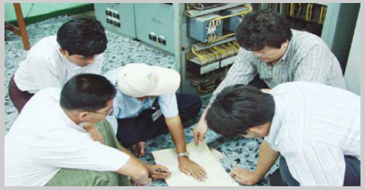
Overseas Business field
Power Generation
Financing
Fuel Supply
Development of IPP Project
- BOT, BOO, BOOT, M&A, ROMM
O&M, Technical Consulting
KEPCO
Project Developer
EPC
O&M
Resources Development
Coal, Gas & Uranium Development
Transmission & Distribution
Technical Consulting / Training
Equity Investment, BOT
EPC (Engineering, Procurement, Construction)
Notes:
해외사업 분야
한전은 1995년부터 해외사업을 시작하였음
발전분야로서 IPP사업을 추진하고 있음
IPP 사업 개발에서 한전은 EPC, O&M, financing, 연료공급을 통합하는 리딩 역할을 하고 있음
송배전 분야로서는 컨설팅, BOT 및 EPC를 추진하고 있음

Slide 16
Overseas Projects Map
`
Canada
Kazakhstan
China
Cree East (Uranium)
Water Berry (Uranium)
Denison (Uranium)
Substation EPC
Transmission EPC
Gansu : BOO, 98.8MW
Neimenggu : BOO,628/495MW
Shanxi : BOO, 4,432/1,558MW
T&D Consulting
Egypt
Dominica
T&D Consulting
Distribution EPC
Jordan
Al Qatrana BOO, 373MW
Bangladesh
Saudi Arabia
T&D Consulting
Plant BOO, 1,204MW
T&D Consulting
Cambodia
WAPP
T&D Consulting
Mexico
UAE
T&D Consulting
Plant BOO, 433MW
Nuclear EPC 5,500MW
Shuweihat BOO 1,600MW
Indonesia
Niger
Adaro energy(Coal)
Bayan Resources(Coal)
Imouraren((Uranium)
Pakistan
Nigeria
T&D Consulting
June. 2011
Australia
Egbin Plant
Repair/ M&A
Philippines
Cockatoo(Coal)
Moolarben(Coal)
Bylong(Coal)
Ownaview(Coal)
: In operation(6,806MW)
: Under construction(11,463MW)
Malaya O&M
Ilijan : BOT, 1,200 MW
Naga : M&A, 448MW
Cebu : BOO, 200MW
`
: Resource Development
Notes:
This is a map demonstrating KEPCO’s overseas projects.
Since its entry into the power business in the mid 1990’s, KEPCO has become one of the leading independent power producers in the Philippines.
Meanwhile, to implement high-technology, KEPCO is engaged in China’s rapidly growing generation market.
In addition, we are moving forward with plans for T&D technical
consulting services in Myanmar, Mongolia, Indonesia, Egypt and Paraguay. Also, we are participating in the resource
development project to obtain coal and uranium in Australia and Canada. Self-Sufficiency Increased(28%)
설비용량 : 6,806, 지분용량 : 2,589
건설용량 : 11,463, 지분용량 : 2,184(사우디: 40% 482MW, UAE : 20% 314MW)

Slide 17
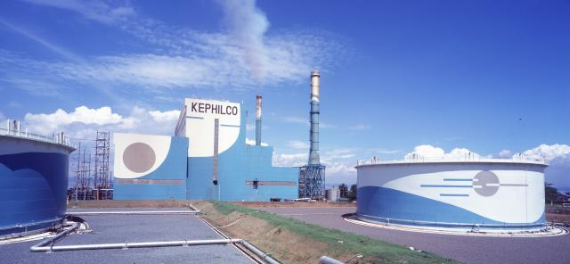

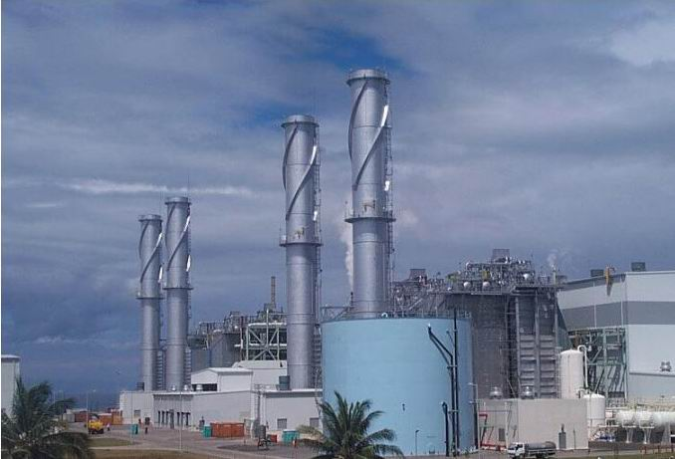
Project highlights: Generation(1)
Malaya Project: Philippines
Host entity: NPC
Project type: ROMM (15 years)
Capacity: 650MW
Fuel: B.C Oil
Shareholding: 100%
Ilijan Project: Philippines
Host entity: NPC
Project type: BOT (23 years)
Capacity: 1,200MW (600×2 Blocks)
Fuel: Natural Gas
Shareholding: 51%
Notes:
To give you a clearer picture about KEPCO’s overseas business, I will give a rundown on each overseas project where we made good use of our expertise acquired from domestic projects over three decades of building and operating thermal, nuclear power plants and of T&D operation.
Our overseas project began in the Philippines. It was in the mid 1990s.
The first overseas project for KEPCO was Malaya ROMM, which is considered to be a successful business model in the Philippines.
Upon completion of the 3 year rehabilitation, once old and derated power plant transformed into one of the most efficiently performing power plants in the country and Malaya plant is being benchmarked by other generation companies.
Following Malaya project, KEPCO won a build-own-transfer contract for the 1,200MW Ilijan gas combined-cycle power plant in 1996.
KEPCO raised capital of about 5 million dollars through project financing secured against future income, which was possible thanks to the recognition of its profitability.
After three years of construction, the Ilijan power plant began its operation in 2002. KEPCO’s experience in the Philippines has become an opportunity for KEPCO to demonstrate its technology to the world and this made KEPCO one of the major generation companies responsible for about 12% of the country's total power production.

Slide 18
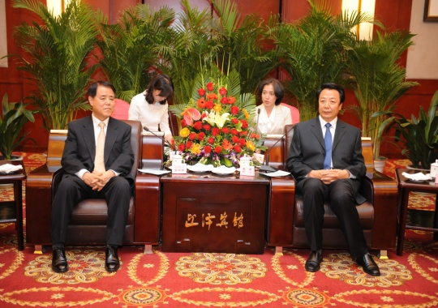
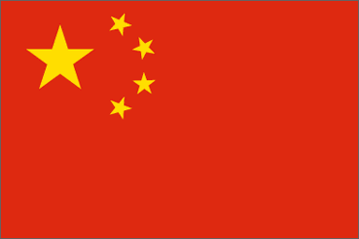
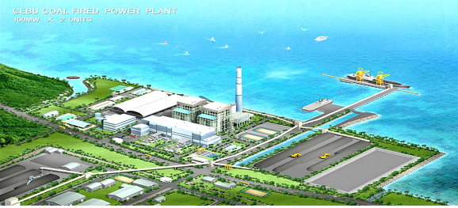
Project highlights: Generation(2)
Shanxi Joint Venture Project: China
Host Entity: SIEG (Shanxi International Energy Group)
Project Type
Shareholding: 34%
- Joint Venture(SIEG-KEPCO-Deutsche Bank-
Japan consortium)for 50 years
- Total Generation Capacity : 13,439MW
- Development of 9 Coal Mines
Cebu Project: Philippines
Host entity: KEPCO SPC POWER CORPORATION
Project type: BOO (25 years)
Capacity: 200MW
Fuel: Coal
Shareholding: 60%
Notes:
Another Asian country that KEPCO is concentrating on is China.
From 2007 KEPCO has been operating 4,000MW coal fire power plant. And still under construction about 10,000MW of new power plant.

Slide 19
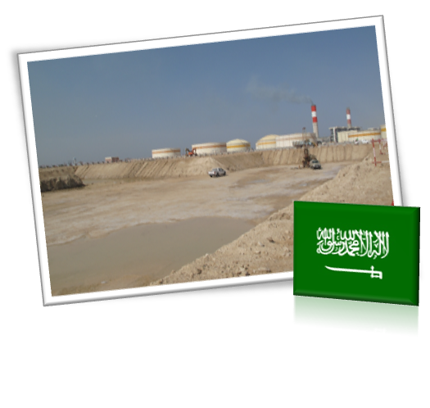
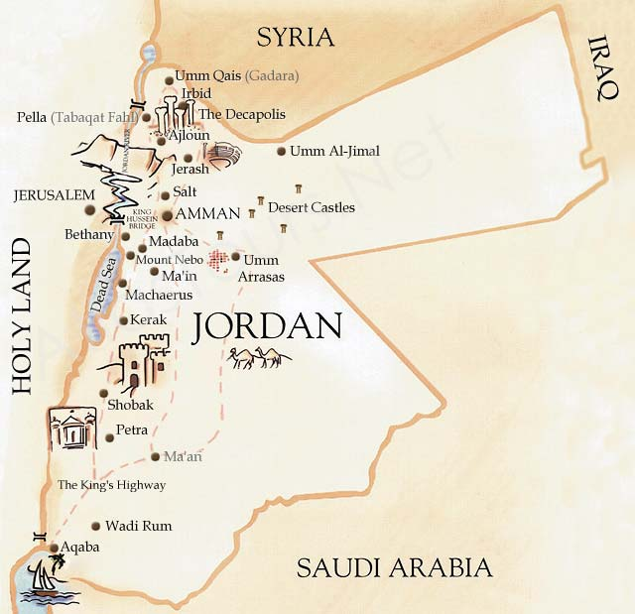

Project highlights: Generation(3)
Rabigh Project: Saudi Arabia
Host entity: Saudi Electric Company
Project type: BOO (20 years)
Capacity: 1,204MW
Fuel: Oil
Shareholding: 40%
Al Qatrana Power Project: Jordan
Host Entity: Ministry of Energy & Mineral Resources
Project type: BOO (25 years)
Capacity: 373MW Class (near Amman)
Fuel: Natural Gas
Shareholding: 80%
Notes:
We are expanding our Middle East market beyond Lebanon. The Rabigh project in Saudi Arabia and Al Qatrana project in Jordan positioned KEPCO as a competitive IPP which rivals global companies in an international bidding.
We expect that the two projects will give us a bridgehead in our march into the Middle East market.

Slide 20
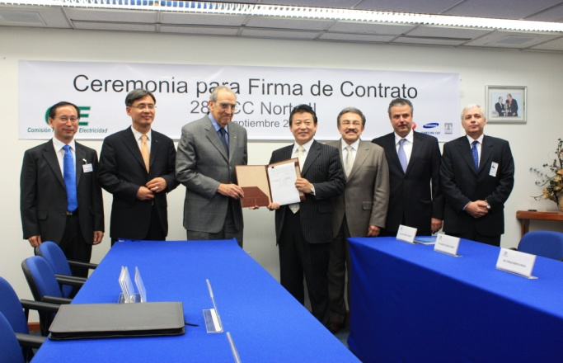

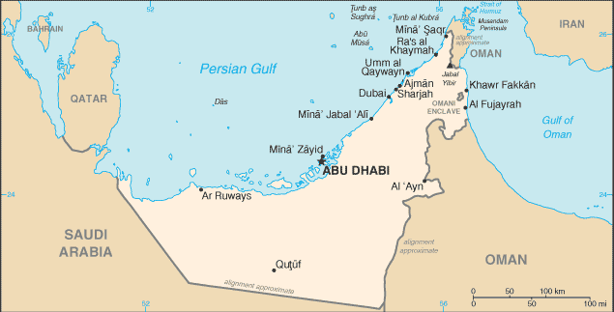

Project highlights: Generation(4)
Norte Ⅱ Project: Mexico
Host entity: Commission Federel Electricity
Project type: BOO (25 years)
Capacity: 433MW
Fuel: Natural Gas
Shareholding: 56%
UAE Shuweihat S3 : UAE
Host entity: Abu Dhabi Water & Electricity Authority
Project type: BOO (25 years)
Capacity: 1,600MW
Fuel: Natural Gas
Shareholding: 19.6%

Slide 21
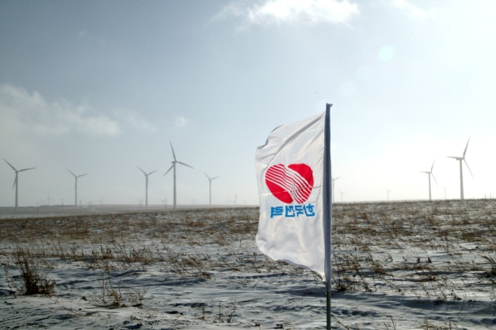
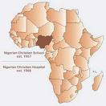

Project highlights: Generation(5)
Gansu, Neimenggu Wind Power: China
Host entity: Datang Corp.
Project type: BOO (20 years)
Capacity: Gansu 98.8MW / Neimenggu 627.5MW
Fuel: Wind
Shareholding: 40%
Buying Egbin Power Plant : Nigeria
Host entity: BPE
Project type: Buying, O&M
Consortium : ERL(70%), KEPCO(30%)
Capacity: 1,320MW
Shareholding: 51%(June 2011)
Notes:
Let me turn to wind power project. KEPCO is operating wind power plants in Gansu and Neimenggu Provinces in China. KEPCO was the first foreign company to enter the new and renewable energy market and is the largest foreign wind power developer in China.
Besides revenues from plant operation, we expect additional profits from Certified Emission Reductions.

Slide 22
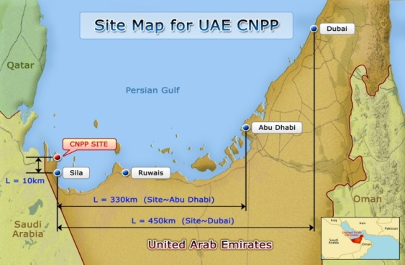
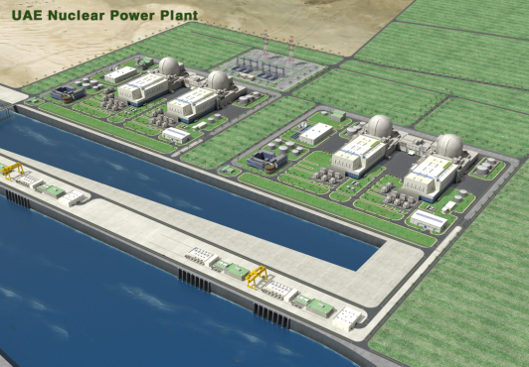



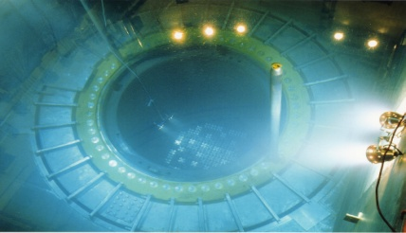
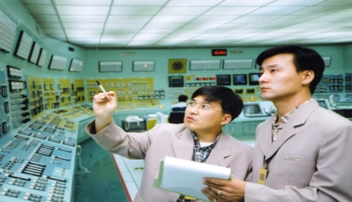
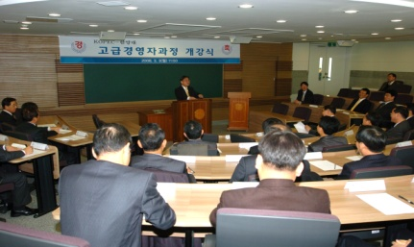
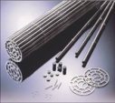
Project highlights: Nuclear Power Project
UAE NPP Project
Project Capacity: 5,600MW
Host entity: UAE ENEC
Contract Type: International Open Tendering
Completion: 1 May 2017 (Unit #1)
Key Terms of the Contract
APR1400 4units
Nuclear Fuel
Supply
(For 3 years
after completion)
Operational
Support
Education &
Training Support
Contract Amount
U$18.6bn
Notes:
In Dec 27, 2009, KEPCO was awarded the UAE nuclear power project in an international competitive bidding.
Emirate Nuclear Energy Corporation contracted KEPCO to build four units of 1400MW nuclear power plant and the first unit will be completed no later than May 1, 2017.
KEPCO is the main contractor and therefore in charge of the whole UAE nuclear program.
The KEPCO Team includes KEPCO subsidiaries, Hyundai, Samsung, Doosan Heavy Industries, Westinghouse of the US, and Toshiba of Japan.
KEPCO has developed its nuclear plant construction technology by continuously building nuclear power plants over the last three decades.
The selection of KEPCO in the competitive international tendering proves that KEPCO has excellent nuclear operational capability, plant infrastructure construction, price competitiveness and project execution capacity.
수은 100억달러 10년거치 18년 상환 대출 예정

Slide 23
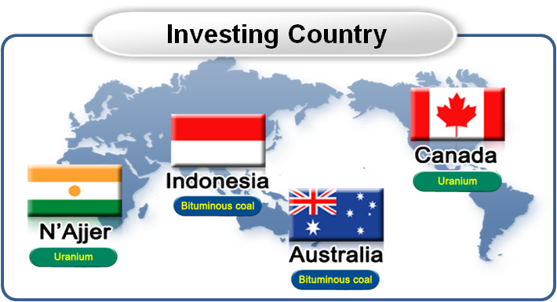







Energy Development Business
Self-Sufficiency Increase
Fuel(Coal& Uranium) Self-Sufficiency Average
28%
17%
7%
2008
2009
2010
  Procure 1,650mt of thermal coal in 2010
Coal Procurement
[Unit:mt]
1,650
Australia Bylong Coal mine(100%) (950mt/y)
200
250
300
Indonesia PT. Bayan Resources(20%) (700mt/y)
‘07
‘08
‘09
‘10
  Discovered high grade uranium
Mine | Country | Ave. Grade
Mcarthur River | Canada | 19.5%
Ranger | Australia | 0.10%
Husab | Namibia | 0.05%
Waterbury | Canada | 10.0%
Canada Waterbury Lake uranium exploration project
Discovered 22% high grade uranium
Development will begin after exploration for
confirming economic reserves

Slide 24
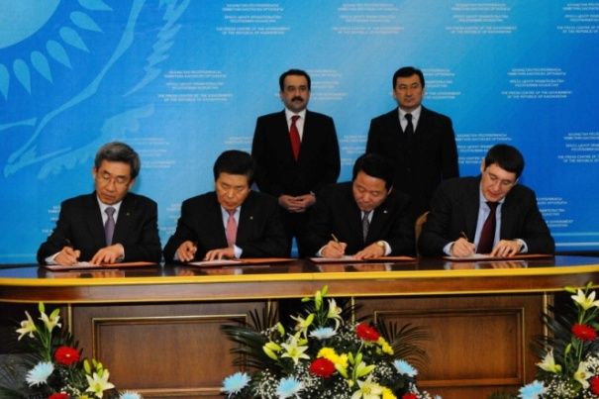

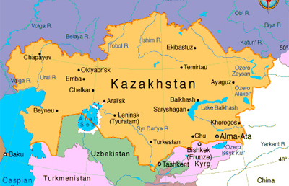
Project highlights: Transmission EPC
Substation : Kazakhstan
Host entity: Kazakhstan Electricity Grid Operation Company
Project type: EPC
Work scope: Rehabilitation of 500kV, 230kV 17 substations
Contract amount : U$ 100 millions
Project Period: Feb 2011 ~ Nov 2013
Transmission : Kazakhstan
Host entity: Kazakhstan Electricity Grid Operation Company
Project type: EPC
Work scope: Construction of 220kV transmission lines(327km)
Contract amount : U$ 46 millions
Project Period: Mar 2011 ~ Oct 2012
Bylong

Slide 25
CO-OPERATION IN AFRICA
Generation and Transmission Project
Ⅲ

Slide 26
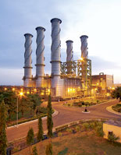
Buying Power Plant in Nigeria
Feature of Egbin Power Plant
Position
○ The largest power plant in the West Africa
○ Accounts for 30~40% of the national supply
Location: 60km east of Lagos
Installed Capacity: 1,320MW(220MW X 6 Units)
Available Capacity: 860MW (August 2010)
○ No. 1 Unit: Turbine rotor out of order
○ No. 4 Unit: Reduced by 20MW
○ No. 6 Unit: Turbine rotor and boiler out of order
Fuel: Natural Gas
Generator: Hitachi
Boiler: Single Drum Radial Type
Turbine: TCDF Reheat
Commercial operation: 1985

Slide 27
Buying Power Plant in Nigeria
3
Structure of Governance
Sahara Group
KEPCO(30%)
ERL(70%)
Guarantee
Lender (local bank)
KERNL
51%
Nigeria Gov.
51%
Egbin Power Plant
49%
Time Schedule
2007 May : Incorporation of Joint Venture Company KERNL
2007 May : Contract signing Between KERNL ↔
Bureau of Public Enterprises(BPE)
2007 August : TSA between KEPCO↔KERNL
2008~2009 : Interruption due to change in privatization policy
2010 May : Resumption of buying power plant
2011 July : Signing of PPA, GSA
Notes:
20 Oct 2010 , The Bureau of Public Enterprises has resumed discussions with the Korean Electric Power Corporation with a view to concluding the deal for the sale of 51 per cent Federal Government‘s stake in the country’s biggest power plant, the Egbin power station, to KEPCO.
The BPE had earlier announced the sale of the plant to KEPCO in 2007, but unresolved labour issues and the change of government stalled the conclusion of the deal.
KEPCO was to pay $280m for 51 per cent stake in the plant and that the company had paid initial 10 per cent of the fee as an indication of the acceptance of the offer. However, the suspension of the liberalization of the power sector by late President Umaru Yar‘Ardua and some unresolved labor issues prevented the conclusion of the deal.
BPE had since resumed discussions with KEPCO and that discussions were at an advance stage to finally hand over the power company to the firm. BPE and the Federal Government were addressing some of the issues hindering the transfer of the power station to KEPCO.
The company was sold to them (KEPCO) in 2007, but the necessary agreements could not be signed for the transfer of Egbin to the firm for some reasons but the outstanding issues are being addressed and very soon we believe that the deal will be concluded.
The Egbin power plant is the biggest power station in the country with an installed capacity of 1,320 megawatts of electricity.
The Federal Government recently inaugurated the power sector road map and one of the key issues in the document is government‘s plan to sell at least 51 per cent stake in most of the electricity companies, otherwise known as successor companies.
It is expected that by 2011, most of the 11 distribution companies would have been sold, while some of the three thermal power stations would also have gone to the highest bidders.
Chairman, Presidential Taskforce on Power, Prof. Barth Nnaji, had said that some of the successor companies of PHCN might be on offer by the end of the year.
The BPE had already invited bids for management contracts for the Transmission Company of Nigeria, but the sale of 51 per cent of government‘s stake in electricity distribution and generation companies could commence in December.

Slide 28
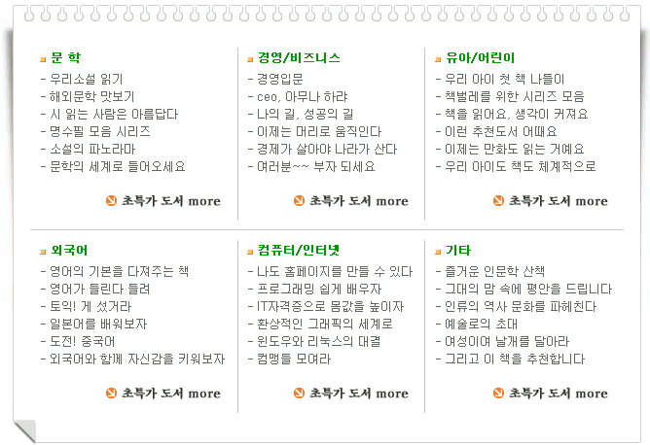
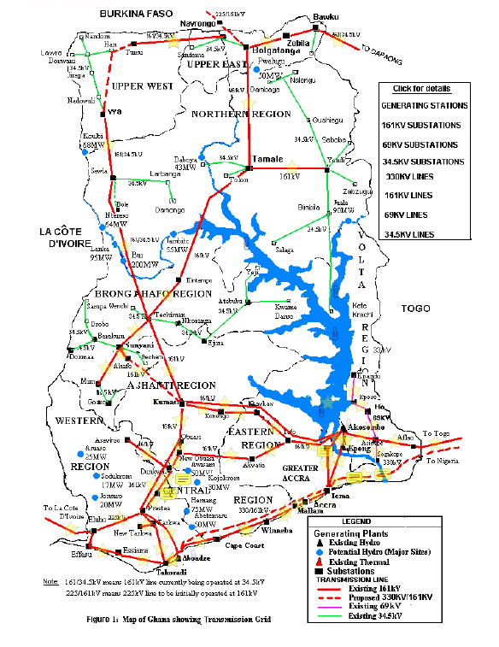


Transmission EPC Project in Ghana
Background
Power interconnection projects in the West Africa sub-regions
Starts from Nigeria (Benin and Togo), through Aboadze in the southern Ghana, passes through northern Han, connecting to the neighboring countries Burkina Faso and Mali.
Map of the project
Nouakchott
ourossogui
MAURITANIE
Dakar
Kaolack
mbour
SENEGAL
Banjul
tambacounda
kayes
GAMBIE
MALI
manantali
NIGER
GUINE
BISSAU
sambangalou
kita
Bamako
ségou
san
Niamey
Bissau
Wulessedougou
BURKINA FASO
TCHAD
Boké
GUINEE
Siguiri
koutiala
Ouagadougou
birnin kebbi
Mamou
kangaré
sikasso
bougouni
bobo-dioulasso
bawku
kano
Conakry
Kankan
odiénné
Han
bolgatanga
dapaong
kaduna
banfora
wa
shirono
gombé
Freetown
ferké
yendi
BENIN
kainji
jos
CÔTE
D'IVOIRE
sawla
T
O
G
O
SIERRALEONE
laboa
bole
tamale
jebba
Voinjama
Nzo
bouaké 2
tanda
oshogbo
NIGERIA
man
kossou
GHANA
nangbeto
ajaokuta
Gbanga
techiman
kpeve
kétou
ayede
Monrovia
buyo
kumassi
ho
bohicon
ikeja
LIBERIA
taabo
akossombo
avakpa
egbin
benin
onitsha
enugu
bushanan
soubré
tafo
téma
Lagos
sapele
abobo
dunkwa
Lomé
Cotonou
prestea
Accra
ughelli
san-pédro
Abidjan
aboadze
aladja
Abaafam
CAMEROUN
ATLANTIC OCEAN - OCEAN ATLANTIQUE

Slide 29
Transmission EPC Project in Ghana
Project Scope
  Transmission Line: 330kV T/L 175km (Aboadze ~ Prestea)
  Substations: 330kV Prestea substation
Financing Terms of EDC
  Loan Amount : U$ 67 Million
  Interest Rate : 0.1% per annum
  Repayment Period: 35 years (including 15 years grace period)
  Method of Repayment: Semi-annual equal installments
  Interest Payment: every 6 months for the unpaid principal

Slide 30
Transmission EPC Project in Ghana
Financing Structure (EDCF)
Ghana Government
(MOFA)
③ Loan Request
Korean Government
(MOFA/MOF)
⑤ Loan Arrangement
② Approval on
Project with EDCF
⑧ Letter of Guarantee
④ Approval on the Loan
MOF of GHANA
(Borrower)
⑥ Loan Agreement
Lender
(K-EXIM Bank)
⑩ Repayment
① Project Identification
assisted by Samsung
⑨ Disbursement
GRIDCO
(Executing Agency)
⑦ EPC Contract
Samsung/KEPCO
Consortium
(EPC Contractor)
Abb.
MOFA : Ministry of Foreign Affairs
MOF : Ministry of Finance
K-EXIM : Export Import Bank of Korea

Slide 31
Transmission EPC Project in Ghana
Time Schedule
  2009 August : Start Pre Feasibility Study
  2010 February : Finalize F/S Report
  February : Loan Request for EDCF
  June : Mission Dispatch & Pledge for EDCF
  2011 February : Loan Agreement (Ghana – Korea Government)
  August : Bid for Consultant
  September : Bid for EPC
  December : EPC Contract and start implementation
  2014 March : Commissioning & complete implementation

Slide 32
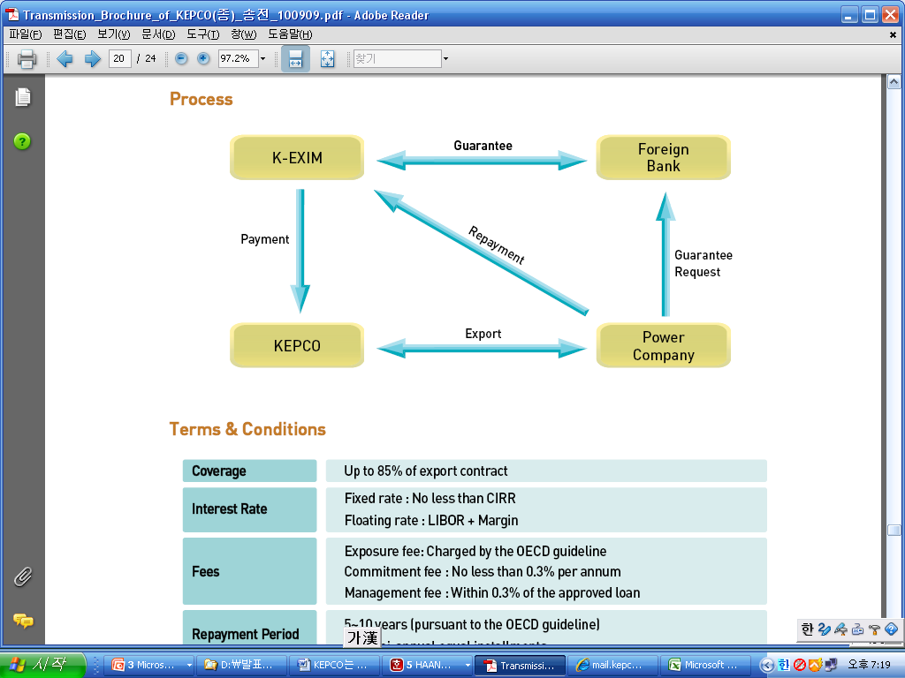
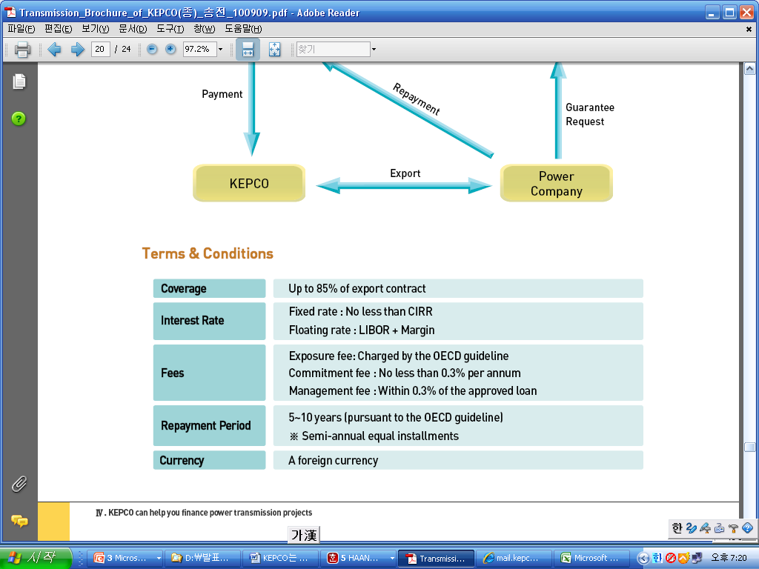
Financing for Transmission EPC Project
Direct Loan

Slide 33
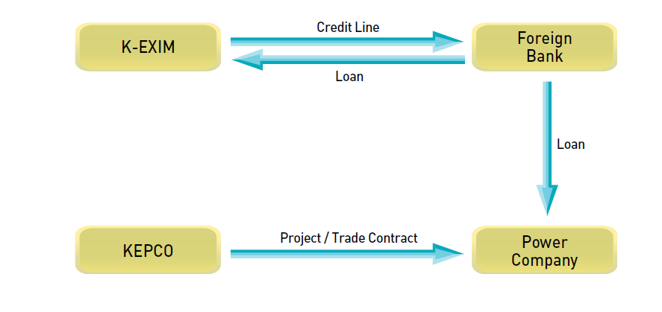
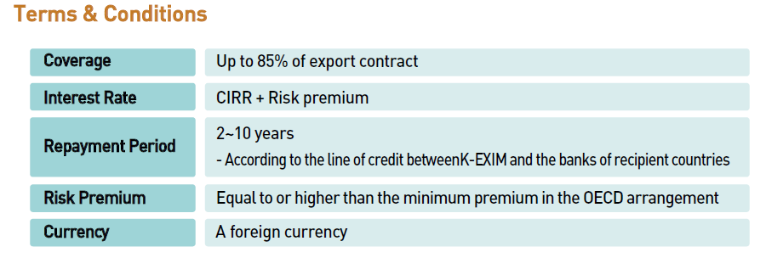
Financing for Transmission EPC Project
Inter Bank Export Loan

Slide 34
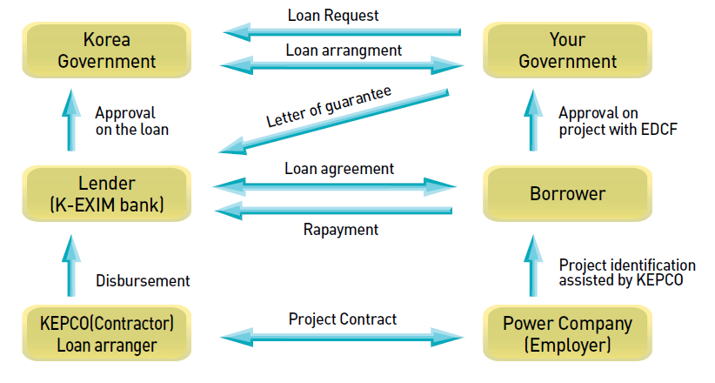
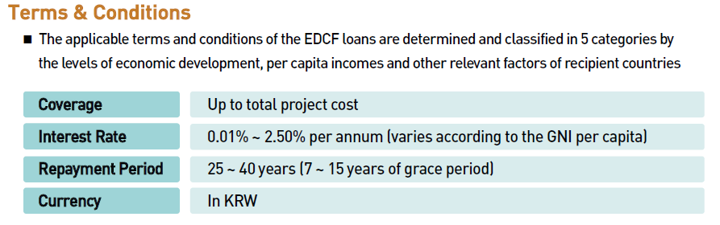
Financing for Transmission EPC Project
Export-Import Bank of Korea : EDCF

Slide 35
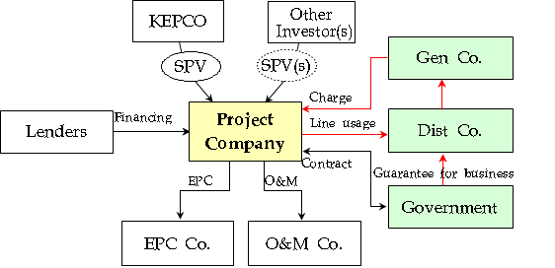
Transmission BOOT of Latin American Countries
Introducing Countries
  Chile
  Peru
  Guatemala
BOOT Scheme
Notes:
전통적 송변전 BOT 사업
송변전설비 건설 후 일정기간 운영하면서 송전용량에 따라 송전비용 (Wheeling charge 또는 Tolling fee)을 받아 투자비 회수
조류변동에 따라 송전량 예측 힘들어 리스크 높음
신개념 송변전 BOT 사업
사업기간 동안 연간 송전선로 사용료 (AnnualCannon )를 받아 투자비 회수
조류에 상관없이 일정액이 회수되어 리스크 적음

Slide 36
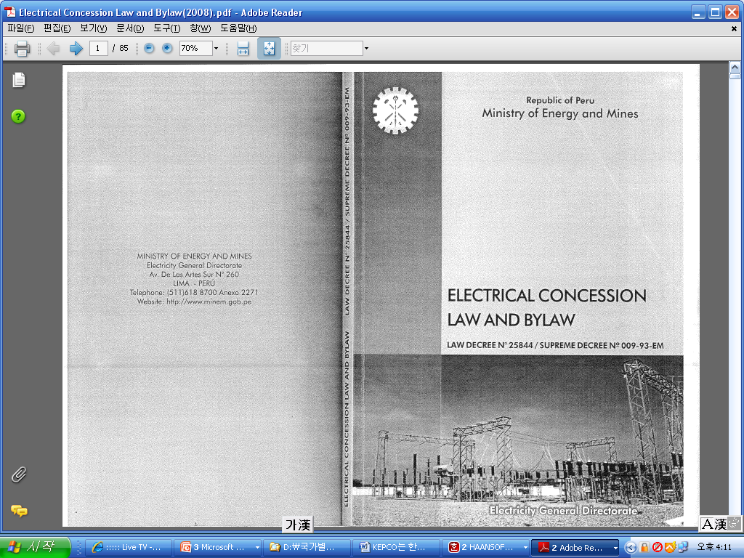
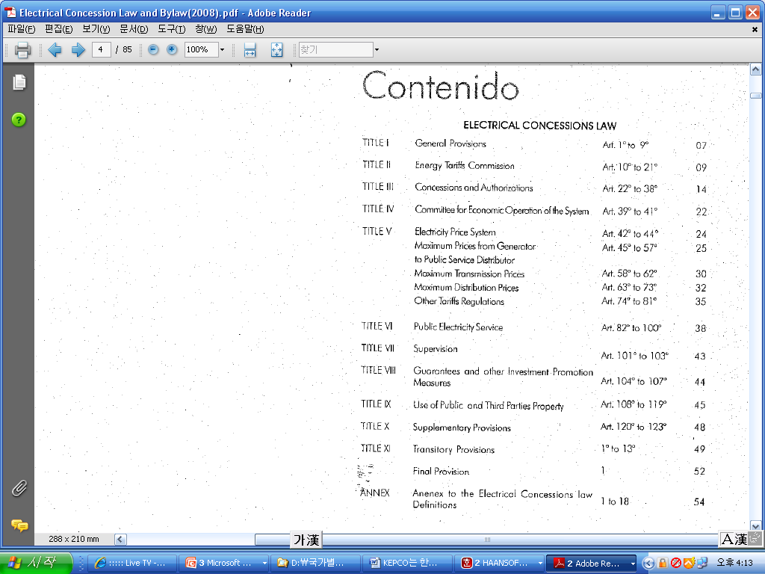
Transmission BOOT of Latin American Countries
Electrical Concession Law of PERU

Slide 37
KEPCO wishes for
Further Opportunities of
Mutual Benefit.
Thank You!
Notes:
Indeed, we wish for further opportunities in order to ensure
maximum mutual benefit.
Thank you again for your attention during my presentation.

