Slide 1

SDGs & MAPS support in SSA
New York
17 July 2018
Mansour Ndiaye
Cluster Leader, Sustainable Development, UNDP Africa
Notes:
In this session, we wanted to focus on what UNDP could bring into the discussion on the revision of the Social Policy Framework for Africa, as an organization which we believe has the expertise to address developmental issues in a cross-sectoral and holistic way.

Slide 2
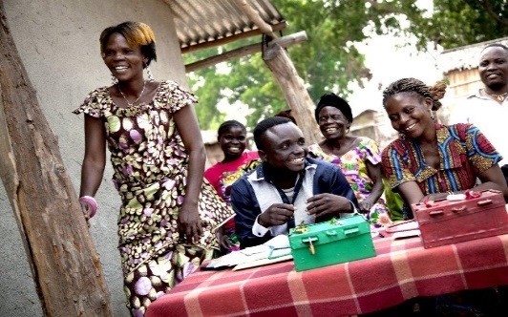

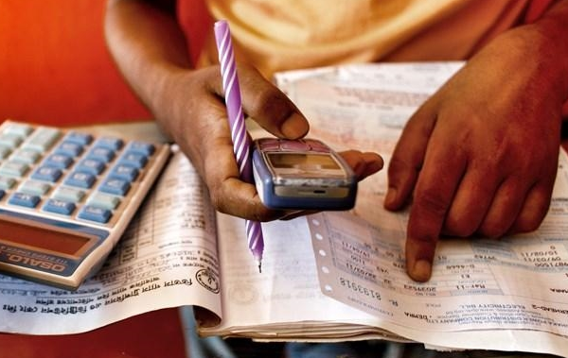
WHAT IS MAPS?
MAINSTREAMING
ACCELERATION
POLICY SUPPORT
Landing the SDG agenda at the national and local levels: integration into national and sub-national plans for development; and into budget allocations
Will need to be linked to the new UNDAF Guidelines
Focus on priority areas defined by respective countries
Support an integrated approach, including synergies and trade-offs
Bottlenecks assessment, financing and partnerships, and measurement
Support – skills and experience - from respective UN agencies to countries, which should be made available at a low cost in a timely manner

Slide 3


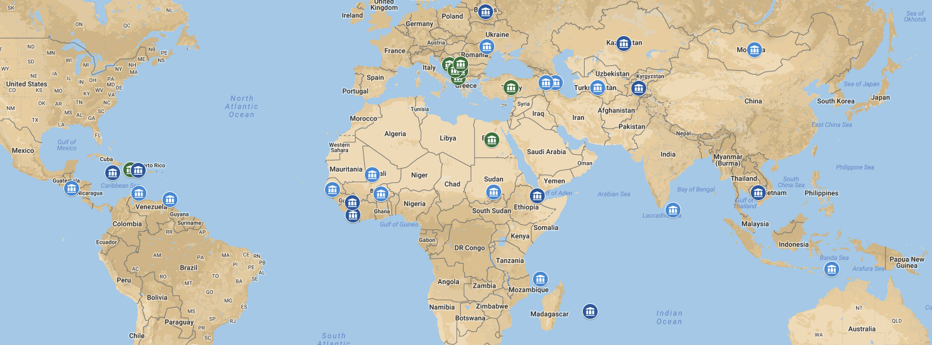
MAPS missions (2016-2018)
2016 MAPS Missions
2017 - 2018 MAPS Missions
Sudan (8-12 Oct)
Mali (18-22 Sept)
Armenia (24 July - 1 Aug)
Gambia (24-28 July)
​Comoros (24-28 July)
Moldova (​17-21 July)
Angola (12-16 March)
2018 Africa MAPS Pipeline
Sudan (11-15 Dec)
Tajikistan (5-9 Dec)
Djibouti (27 Nov - 1 Dec)
Guinea (21-25 Nov)
Kazakhstan (21-25 Nov)
Belarus (Nov 27-Dec 1)
Dominican Republic (27 Nov-4 Dec)
Mongolia (20-24 Nov)
Turkmenistan (20-24 Nov)
Burkina Faso (6-10 Nov)
Madagascar (23-28 April)
Madagascar (23-27 April)​
El Salvador​ (26-30 June)
Azerbaijan (30 May - 3 June)​
Sri Lanka (22-26 May)
Aruba (15-19 May​)
Timor Leste (18-27 April)
​Trinidad & Tobago (17-26 April)
Cameroon
Tanzania
Guinea Bissau
Mauritius (14-18 Nov)
Jamaica (24-28 Oct )
Cambodia (3-7 Oct)
Liberia (8-12 Aug)​​)

Slide 4
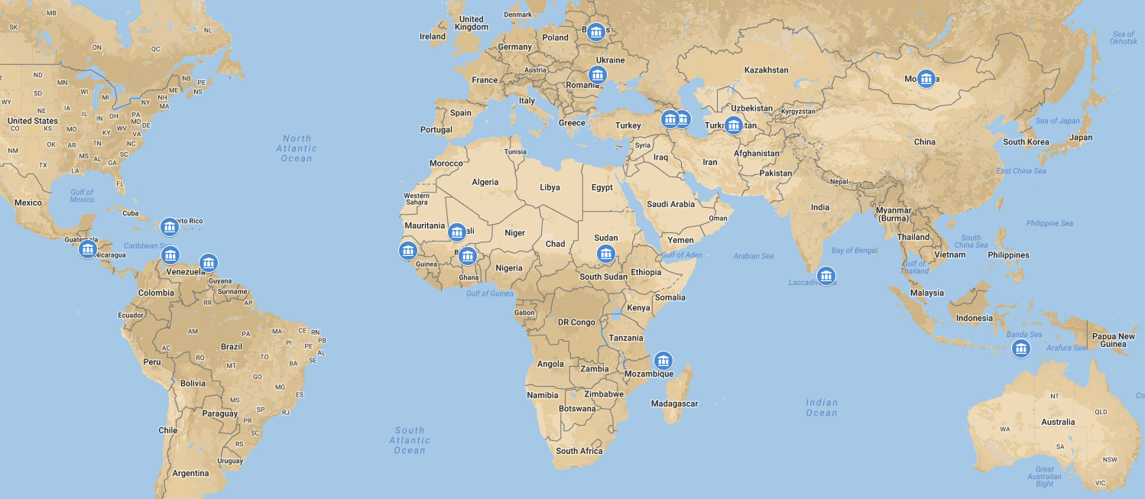
MAPS missions: inter-agency participation
Belarus
WHO
World Bank
UNFPA
UNICEF
ILO
DESA
Moldova
UNFPA
World Bank
Turkmenistan
UNICEF
World Bank
WHO
Dominican Republic
UNICEF
UN Women
UNFPA
FAO
WHO/PAHO
Mali
ILO
FAO
WFP
UNEP
UNICEF
UNESCO
Mongolia
UNICEF
UNFPA
ADB
El Salvador
UNICEF
UNFPA
WFP
UNHCR
Armenia
FAO
UNICEF
Azerbaijan
ILO
UNICEF
Sudan
UNICEF
WFP
ILO
DESA
OECD
Trinidad & Tobago
ILO
ECLAC
FAO
PAHO
Aruba
ECLAC
The Gambia
ECA
UN Women
ILO
Burkina Faso
WFP
FAO
UNEP
UNESCO
IOM
UNIDO
UN Habitat
Sri Lanka
ESCAP
UNFPA
Comoros
ECA
Timor Leste
UNICEF
UN Women
WFP
(consultations)
Notes:
Let us concentrate a bit on the concept of integration which our main focus in this session
The question here is….if sustainable development is our ultimate objective, how do achieve that? How do we do sustainable development? And to answer that question, we have to understand that the SDGs are indivisible and integrated in nature. As we see here, sustainable development brings together the economy, the social, the environment, governance.
Because of this feature,, we believe that we should simultaneously focus on all these to get the whole picture and try understand how policies in these different areas interact.
Because at some point, trade-offs but also potential synergies across areas will come up and we need to take this into consideration when we do sustainable development, and this is also why the concept of integration becomes relevant in the context of the Social Policy Framework for Africa.

Slide 5
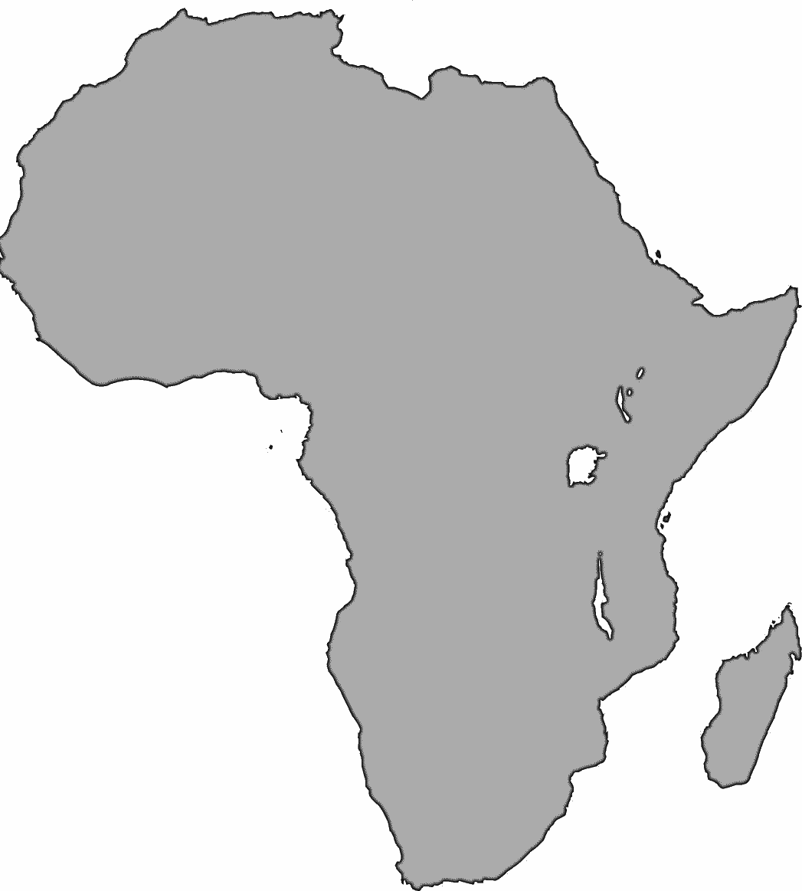
RSCA SDG country support
Advocacy and engagement
Mainstreaming
Financing
Follow-up and review
Data and statistics
Notes:
As I say, we have Agenda 2030 and the SDGs, which are built around 3 key principles.:
Universality: implies that goals are relevant to all countries, not only to developing countries, but also to developed countries, and the necessity for countries to contextualize or land the SDGs in their own national reality and processes (so we are not talking here about uniformity)
- Integration, and this is mainly what we will focus on in the next hour or so: means that we have a sustainable development agenda, covering 3 dimensions: the social, the economy and the environment, which are somehow interlinked and so require an integrated approach, working across sectors, to maximize synergies and minimize trade-offs.
Leaving no one behind, which is particularly relevant today, to ensure that the most vulnerable categories of the population are reached and benefit from the development gains. And this implies for countries the work on their capacity to use disaggregated data to monitor progress and evaluate results.

Slide 6
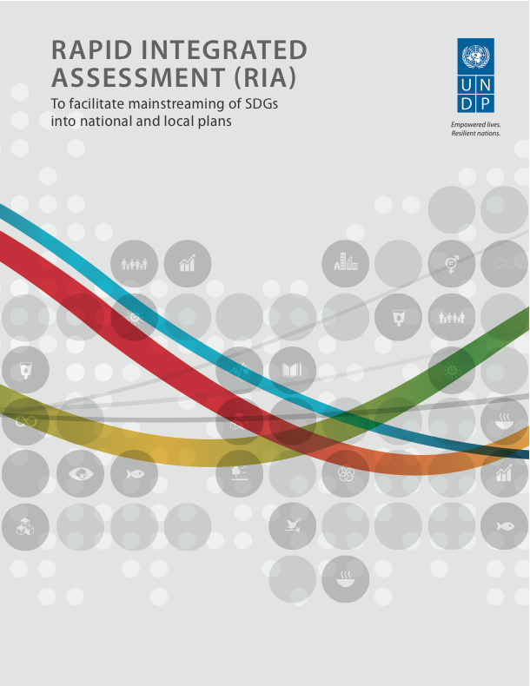
Alignment
Sound alignment on traditional socioeconomic goals
Gaps on Planet
Consistent shortfalls in gender equality and inclusion
Little attention to sustainable consumption and production
Oceans have been left out
Some emphasis on economic growth above inclusion
Missing opportunities for intersectoral linkages
Strong disparities between countries (cf. Angola)
Figure 1: RIA analysis, Côte d’Ivoire, 23 May 2018
Notes:
Let us concentrate a bit on the concept of integration which our main focus in this session
The question here is….if sustainable development is our ultimate objective, how do achieve that? How do we do sustainable development? And to answer that question, we have to understand that the SDGs are indivisible and integrated in nature. As we see here, sustainable development brings together the economy, the social, the environment, governance.
Because of this feature,, we believe that we should simultaneously focus on all these to get the whole picture and try understand how policies in these different areas interact.
Because at some point, trade-offs but also potential synergies across areas will come up and we need to take this into consideration when we do sustainable development, and this is also why the concept of integration becomes relevant in the context of the Social Policy Framework for Africa.

Slide 7
ACCELERATION
  Not all goals can be pursued equally and at the same time
  Pursuit of catalytic actions with impacts across multiple SDG targets
Inspiring cross -sectoral collaboration, breaking down silos
Identifying and investing in ‘accelerators’ – intervention areas that can yield multiple dividends (women and girls’ empowerment, energy access, water access)
Identifying the bottlenecks
Adapting innovative acceleration solutions across countries
Notes:
It is not easy to talk about Acceleration. Demand is high from countries for assistance in prioritizing specific entry points, and many organizations are working on different tools and approaches. The UNDG is now in the process of preparing an online Acceleration Platform.
This platform will inventory tools that will contribute to identifying bottlenecks and accelerating SDG achievement. The principles of integration, reaching the last mile, risk-informed development and universality provides a guiding framework for this Toolkit, and the Toolkit will not only look at the UN agencies’ tools but those from other international organizations and think tanks.

Slide 8
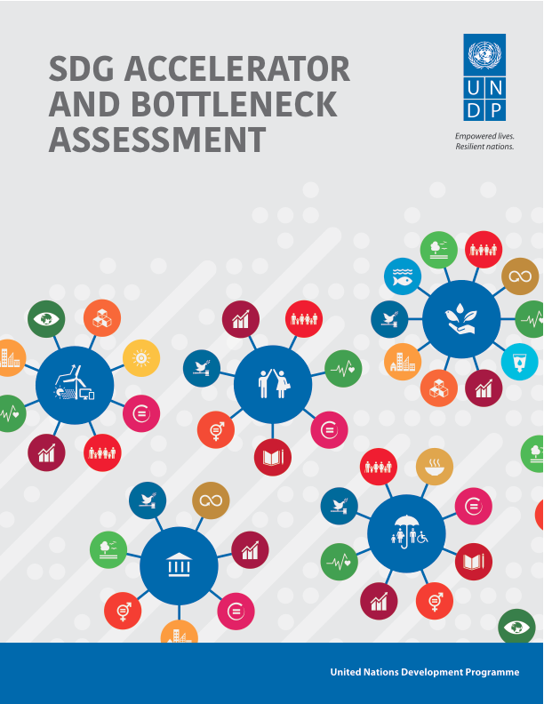
Acceleration
There is growing emphasis on acceleration
A move towards greater policy integration under the economic and social pillars
Gaps in integration for the environment pillar
Increased attention to governance and institutions, but not enough on human rights (Comoros, Gambia, Mali)
Policy integration was greater in Africa and the LDCs (Burkina Faso, Comoros)
A consistent focus on leaving no one behind
Social protection features in accelerators for countries at diverse stages of development (Gambia)
Varying record on gender equality (Mauritius)
New avenues to bridge the humanitarian /peace /development divide (Burkina Faso, Mali)
Notes:
Let us concentrate a bit on the concept of integration which our main focus in this session
The question here is….if sustainable development is our ultimate objective, how do achieve that? How do we do sustainable development? And to answer that question, we have to understand that the SDGs are indivisible and integrated in nature. As we see here, sustainable development brings together the economy, the social, the environment, governance.
Because of this feature,, we believe that we should simultaneously focus on all these to get the whole picture and try understand how policies in these different areas interact.
Because at some point, trade-offs but also potential synergies across areas will come up and we need to take this into consideration when we do sustainable development, and this is also why the concept of integration becomes relevant in the context of the Social Policy Framework for Africa.

Slide 9
Addressing complexity
Modelling tools
Approach
  Sound, adapted and based on NATIONAL development PRIORITIES.
  A suite of models. No single model can cover all relevant issues.
  Accessible, unrestrained from proprietary specification (open source).
  User-friendly, communication effective.
  Tapping research and the knowledge-creation communities.
  Responding to demands for CAPACITY-BUILDING.
Socio- economic impact
Economy-wide
Integrated Assessment System Modelling
Energy systems
Integrated assessment system
Electricity for all
Notes:
Five quantitative modelling tools are being used by UNDESA and UNDP to help countries assess sustainable development policy options.
The Climate, Land-use, Energy and Water Systems analysis and model (CLEWS)
Economy-wide models
Socioeconomic microsimulations
Energy systems models
Geo-spatial electrification access modelling
The tools use, to the extent possible, open source software and state-of-the-art knowledge. Continuous development and improvement, backed by a global community of experts, spurs innovation and overcomes challenges.
Integrated Assessment models, such as the CLEWS, provides a unifying framework to study interlinkages across climate, land, energy and water systems.
Economy-wide Models that are useful to assess the implications of alternative policies on the economy, including employment, output, trade, investments, savings, poverty, among others.
Energy Systems Dynamic Models that can assist medium and long term energy planning by identifying the minimum cost path of meeting energy demand under alternative scenarios and investment portfolios.
The electrification modelling tool uses open geo-spatial data to analyse prospects for universal access to electricity by 2030 with the least cost technology for countries in Africa
Socio-Economic Micro-Simulations are used to undertake detailed evaluations of the socio-economic impacts of alternative development policies in the areas of poverty eradication, inequality reduction, enhanced food security and energy access.

Slide 10


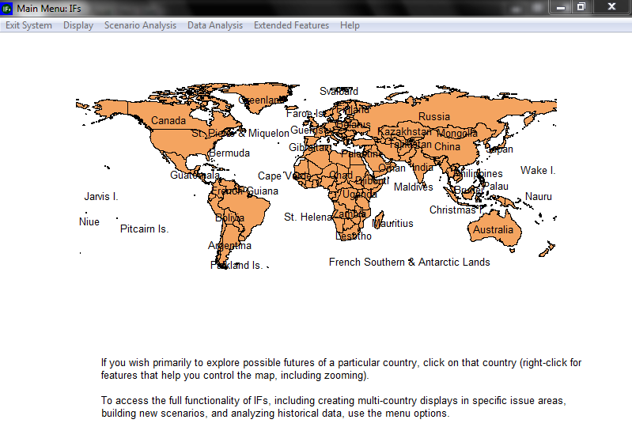
The International Futures System
Basic Features
Dynamic, recursive, 1-year steps (myopic) to 2100
Hard-linked, heavily integrated models
User interface for data and scenario analysis
Transparent/open, no cost at Pardee.du.edu (download and web versions)
Notes:
International Futures (IFs) software is a tool developed by the Frederick S. Pardee Center under the University of Denver. The IFs forecasting tool allows for thinking about long-term policies at national, regional and global levels. IFs integrates forecasts across different sub-models, including: population, economy, agriculture, education, energy, sociopolitical, international political, environment, technology, infrastructure, and health. As the sub-models are dynamically connected, the model simulates how changes in one system lead to changes across all other systems. The integrated nature of the model makes it a powerful tool to analyze policies and planning for the future.
IFs uses historical data, trends and dynamic relationships to forecast indicators for 186 countries for every year from 2010 to 2100. It is a unique software package that has wide-ranging and flexible capacity, and is able to provide forward-looking, policy-relevant material that frames uncertainty around global development. The software assists with understanding the state of the world, by exploring trends and learning about the dynamics of global systems. It helps in thinking about the future we want to see, and enables us to think systematically about goals and priorities.

Slide 11
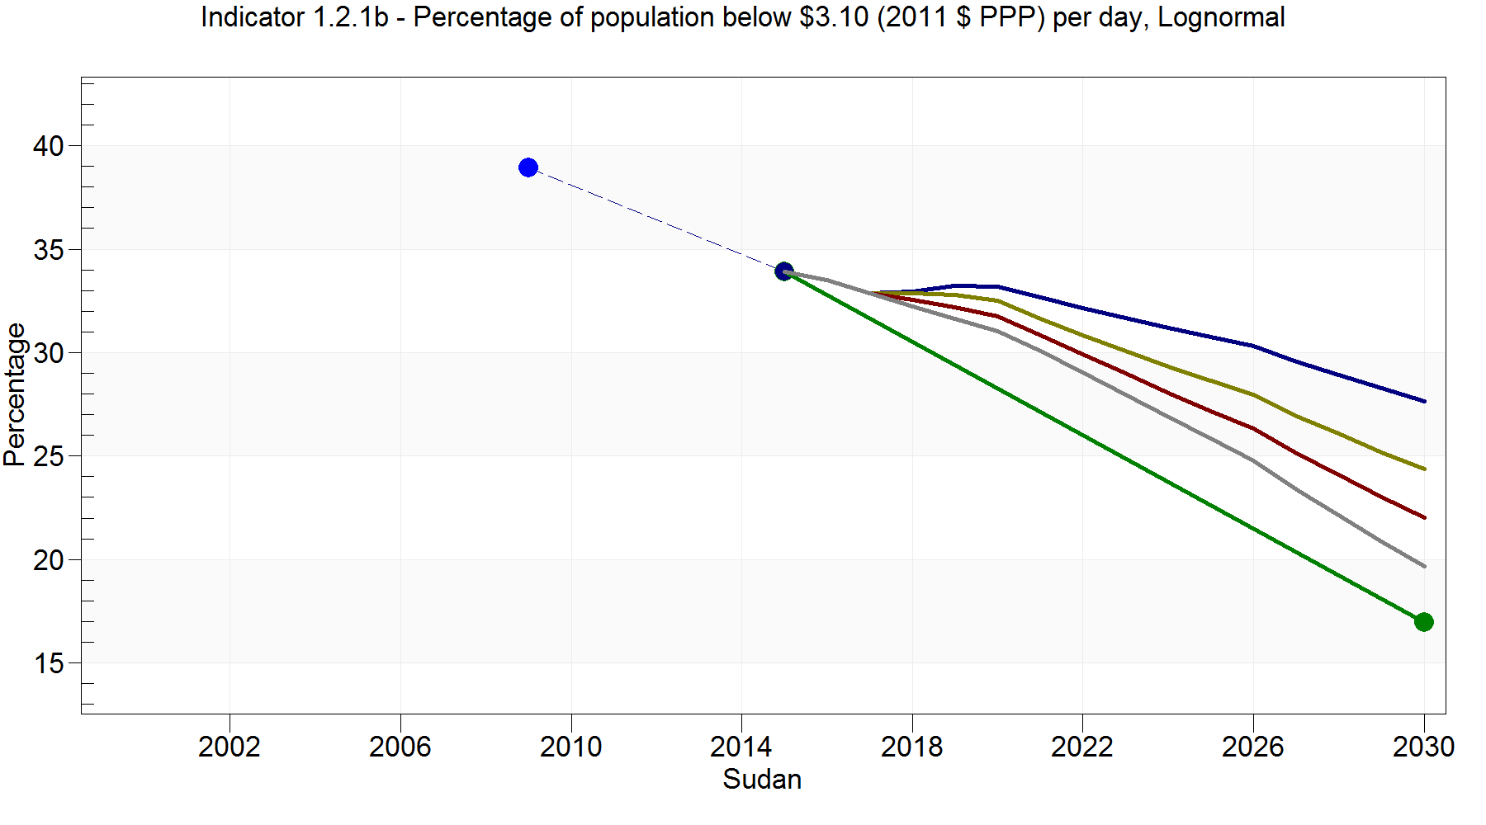
SDG 1 and SudanPeace+FertilityLow
Agricultural intensification has been identified as a potential accelerator of SDG attainment for Sudan. In this display, the results of 1.5-fold and 2-fold increases in yield relative to the Current Path forecast are modeled. Under this initial analysis, increasing agricultural yield has significant poverty reduction potential.
Current Path |  | SudanPeace |  | SudanPeace+Yields1.5 |  | SudanPeace+Yields2.0 |  | SDG Goal Path
Source: Forecast values from IFs 7.30, Frederick S. Pardee Center for International Futures, University of Denver

Slide 12
Poverty Risk Analysis Tool
Povrisk
Eradicating poverty requires a closer look at the dynamics of poverty.
Poverty reduction is not a one-way transition out of poverty: many people exit or fall back into poverty every year.
The determinants of exiting poverty are not necessarily the same than those correlated to falling back into poverty
In LAC for example “exiting poverty” was correlated with education and labour market characteristics, and “falling back into poverty” was correlated with social protection, systems of care, access to assets, and labour qualifications.
Flows out of poverty:
14% per year
Net change in poverty:
2% per year
Poverty line
Flows into poverty:
12% per year

Slide 13
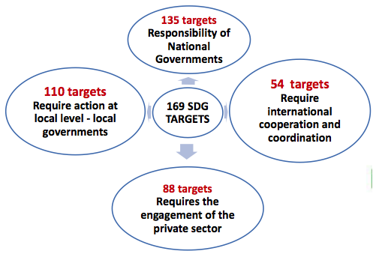


Participation and Engagement
Wider range of stakeholders since 2016 and HLPF (President’s and PM’s office)
Multistakeholder engagement
Institutionalizing stakeholder engagement (sustained commitment and participation)
Validation of findings
Tapping the power of innovation (new forms of participation)
Notes:
Let us concentrate a bit on the concept of integration which our main focus in this session
The question here is….if sustainable development is our ultimate objective, how do achieve that? How do we do sustainable development? And to answer that question, we have to understand that the SDGs are indivisible and integrated in nature. As we see here, sustainable development brings together the economy, the social, the environment, governance.
Because of this feature,, we believe that we should simultaneously focus on all these to get the whole picture and try understand how policies in these different areas interact.
Because at some point, trade-offs but also potential synergies across areas will come up and we need to take this into consideration when we do sustainable development, and this is also why the concept of integration becomes relevant in the context of the Social Policy Framework for Africa.

Slide 14
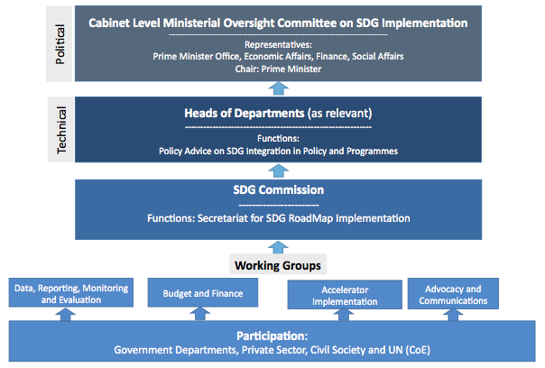
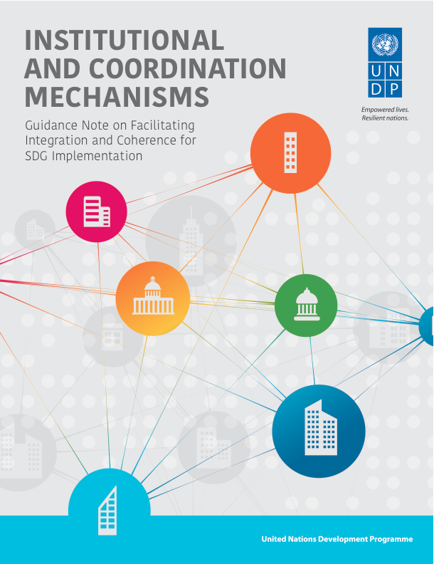
Institutional Coordination
One of the most decisive factor in succeeding on the goals
A checklist of key ingredients
How to link and coordinate different branches of government (national, local and sectoral)
Central role for NSA in SDG coordination mechanisms
Notes:
Let us concentrate a bit on the concept of integration which our main focus in this session
The question here is….if sustainable development is our ultimate objective, how do achieve that? How do we do sustainable development? And to answer that question, we have to understand that the SDGs are indivisible and integrated in nature. As we see here, sustainable development brings together the economy, the social, the environment, governance.
Because of this feature,, we believe that we should simultaneously focus on all these to get the whole picture and try understand how policies in these different areas interact.
Because at some point, trade-offs but also potential synergies across areas will come up and we need to take this into consideration when we do sustainable development, and this is also why the concept of integration becomes relevant in the context of the Social Policy Framework for Africa.

Slide 15
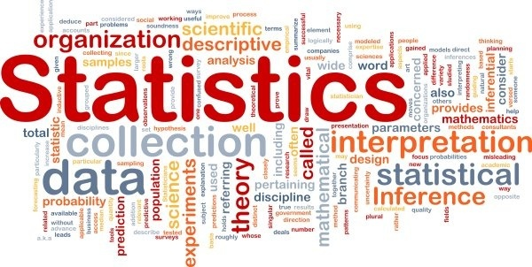
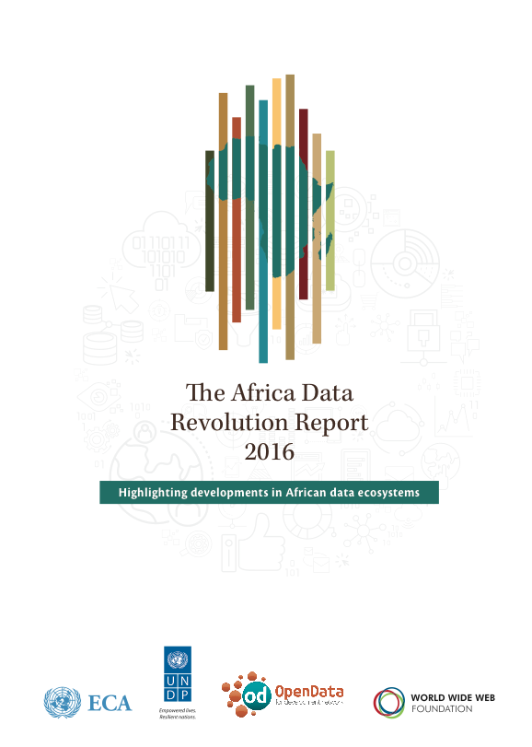
Indicators, Data and Statistics
Recommendations on improving the production and use of data
Attention to data availability and use of different « tiers » of SDG indicators
Preparatory assessments of data capacities have been emphasized
Assessments of data availability and the readiness of national statistical systems (Comoros, Gambia)
Missions addressed entry points for engagement around data
Coordination capacities
Data ecosystems
Notes:
Let us concentrate a bit on the concept of integration which our main focus in this session
The question here is….if sustainable development is our ultimate objective, how do achieve that? How do we do sustainable development? And to answer that question, we have to understand that the SDGs are indivisible and integrated in nature. As we see here, sustainable development brings together the economy, the social, the environment, governance.
Because of this feature,, we believe that we should simultaneously focus on all these to get the whole picture and try understand how policies in these different areas interact.
Because at some point, trade-offs but also potential synergies across areas will come up and we need to take this into consideration when we do sustainable development, and this is also why the concept of integration becomes relevant in the context of the Social Policy Framework for Africa.

Slide 16
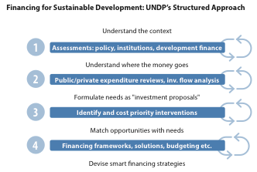

Financing
One of the most consistent area of demand from recent MAPS countries
Assessing diverse financing options towards integrated strategies (DFAs: Benin, Mozambique, The Gambia, etc.)
Limited capacities for detailed analysis
More rigour needed on PPP recommendations
Leveraging finance: integrated partnerships and use of full range of financing tools (external, domestic, public, private)
SDG Costing approach in Benin
The trillion-dollar question: How much will it cost to achieve the SDGs?
Notes:
Let us concentrate a bit on the concept of integration which our main focus in this session
The question here is….if sustainable development is our ultimate objective, how do achieve that? How do we do sustainable development? And to answer that question, we have to understand that the SDGs are indivisible and integrated in nature. As we see here, sustainable development brings together the economy, the social, the environment, governance.
Because of this feature,, we believe that we should simultaneously focus on all these to get the whole picture and try understand how policies in these different areas interact.
Because at some point, trade-offs but also potential synergies across areas will come up and we need to take this into consideration when we do sustainable development, and this is also why the concept of integration becomes relevant in the context of the Social Policy Framework for Africa.

Slide 17
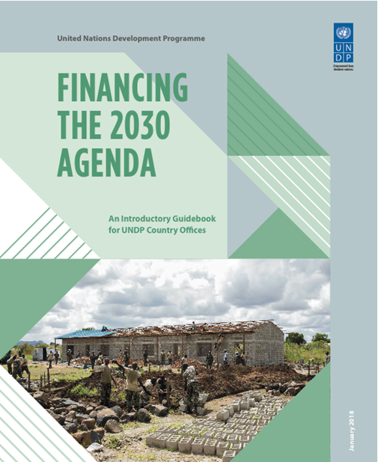
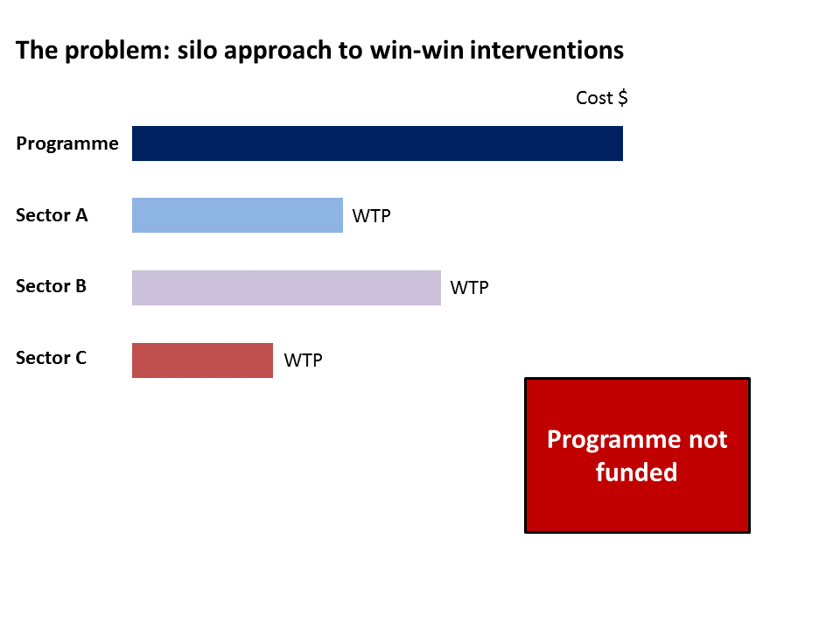
Co-Financing Approach
Win-win interventions such as social protection are needed to realize the broad and interconnected SDGs.
However, these interventions are less likely to be prioritized, financed and taken to scale where sectors evaluate costs and benefits in isolation.
The result is welfare loss and suboptimal resource allocation.
Notes:
The objective for the tool is to assist policymakers in identifying areas of intervention with benefits across multiple sectors and SDGs. This should provide the basis for different ministries (and donors) to come together and co-finance such interventions.
The co-financing approach was borne of a particular problem – namely that implementing sectors/payers do not typically consider the effects of an intervention or investment area beyond their primary mandates/interests. That is, in the conventional cost-effectiveness framework, each sector decides which programmes to finance based on its own cost-effectiveness calculations, for its own specific outcomes. For instance, when deciding how to spend a fixed amount of money, the agricultural sector will likely choose the intervention option that generates the highest agricultural yields. It is unlikely to factor in any downstream impacts (e.g. school completion rates). When programme outcomes are assessed from a single sector perspective, they may be undervalued, and as a result under-provided. Some programmes may not be funded at all, if they are not deemed a cost-effective investment from any single sector’s perspective.

Slide 18
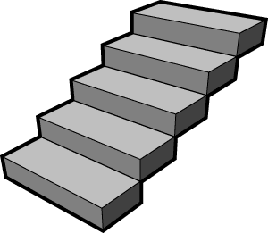
The Way Forward
Achieve more systematic engagement within UN, with AU and other partners
Build complementarities and work collaboratively to help countries address key development challenges and achieve sustainable development.
Give a more prominent role to South-South cooperation and innovation
Move towards a more explicit focus on poverty
Take MAPS to the subnational level (localization)
Deepen risk analysis
Regularly monitor progress towards inclusive sustainable development
Notes:
Let us concentrate a bit on the concept of integration which our main focus in this session
The question here is….if sustainable development is our ultimate objective, how do achieve that? How do we do sustainable development? And to answer that question, we have to understand that the SDGs are indivisible and integrated in nature. As we see here, sustainable development brings together the economy, the social, the environment, governance.
Because of this feature,, we believe that we should simultaneously focus on all these to get the whole picture and try understand how policies in these different areas interact.
Because at some point, trade-offs but also potential synergies across areas will come up and we need to take this into consideration when we do sustainable development, and this is also why the concept of integration becomes relevant in the context of the Social Policy Framework for Africa.

Slide 19
THANK YOU

Slide 20
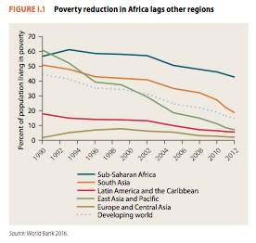
SSA: Context and Challenges
POVERTY
GOVERNANCE
Conflict, crises, fragility, weak institutions, transparency and accountability,…
IMPLEMENTATION
System and integrated approach
Finance
Policy coherence
Data and statistics
Transparency
Monitoring and evaluation
Innovation
Capacity building
Partnerships
Political commitment
Private sector engagement
ECONOMY, SOCIAL
Industrialization, low labour productivity, lack of diversification, unemployment, demography, education, social protection, infrastructure, urbanization, energy,…
ENVIRONMENT
Climate change, water scarcity, land degradation, sustainable production and consumption,…
Notes:
Let us concentrate a bit on the concept of integration which our main focus in this session
The question here is….if sustainable development is our ultimate objective, how do achieve that? How do we do sustainable development? And to answer that question, we have to understand that the SDGs are indivisible and integrated in nature. As we see here, sustainable development brings together the economy, the social, the environment, governance.
Because of this feature,, we believe that we should simultaneously focus on all these to get the whole picture and try understand how policies in these different areas interact.
Because at some point, trade-offs but also potential synergies across areas will come up and we need to take this into consideration when we do sustainable development, and this is also why the concept of integration becomes relevant in the context of the Social Policy Framework for Africa.

Slide 21
Acceleration
Efficacité des Institutions et lutte contre la corruption
Réduction des risques de catastrophes et CC
Processus politiques transparents et inclusifs
Décentralisation et restauration de l’autorité de l’Etat
Lutte contre la vulnérabilité et éradication de la pauvreté
Gouvernance politique et institutionnelle
Résilience des populations et communautés
Fragilité et Insécurité
Transformation économique et sociale
Sécurité et justice
Environnement des affaires et infrastructures
Protection sociale
Réconciliation Nationale et Cohésion sociale
Sécurité
Industrialisation et diversification économique
Etat de droit,
droits de l’Homme
Notes:
Let us concentrate a bit on the concept of integration which our main focus in this session
The question here is….if sustainable development is our ultimate objective, how do achieve that? How do we do sustainable development? And to answer that question, we have to understand that the SDGs are indivisible and integrated in nature. As we see here, sustainable development brings together the economy, the social, the environment, governance.
Because of this feature,, we believe that we should simultaneously focus on all these to get the whole picture and try understand how policies in these different areas interact.
Because at some point, trade-offs but also potential synergies across areas will come up and we need to take this into consideration when we do sustainable development, and this is also why the concept of integration becomes relevant in the context of the Social Policy Framework for Africa.

