Slide 1

Implementing the Sustainable Development Goals and Agenda 2063:
A Sharing of Experiences and the Way Forward Post-Africa Regional Forum for Sustainable Development and Voluntary National Reviews
ECA
Ms. Fatima Denton
Director, Special Initiatives Division (SID)
UN Economic Commission for Africa
July 16, 2018
New York
Notes:
Introduction:
Welcome everybody to the presentation. Introduce speakers, panelists, etc.

Slide 2




A.
ECA
Mandate and role of the Africa Regional Forum on Sustainable Development
Africa Regional Forum on Sustainable Development is mandated by the UN General Assembly resolution and Resolutions of the Joint Annual Meetings of the African Union Specialized Technical Committee on Finance, Monetary Affairs, Economic Planning and Integration and the Economic Commission for Africa Conference of Ministers of Finance, Planning and Economic Development.
Review progress, and promote learning by sharing experiences, good practices and lessons learned;
Build a consensus on policy recommendations in the form of key messages to accelerate the implementation;
Promote coordination and coherence in implementation and follow-up;
Keep all the stakeholders in Africa mobilized and engaged, to strengthen their commitment towards concerted action; and
Contribute to the mobilisation of international support for efforts to achieve the SDGs and Agenda 2063 Goals.
Side Event - 2018 High Level Political Forum
UNECA.ORG
Notes:
The annual Africa Regional Forum on Sustainable Development is mandated by the UN General Assembly resolution and Resolutions of the Joint Annual Meetings of the African Union Specialized Technical Committee on Finance, Monetary Affairs, Economic Planning and Integration and the Economic Commission for Africa Conference of Ministers of Finance, Planning and Economic Development.
The Forum is an inter-governmental platform convened by the United Nations Economic Commission for Africa (ECA) in collaboration with the African Union Commission, African Development Bank and the United Nations System to:
Review progress, and promote learning by sharing experiences, good practices and lessons learned;
Build a consensus on policy recommendations in the form of key messages to accelerate the implementation. The key messages serve as Africa's collective regional input to the High Level Political Forum on Sustainable Development (HLPF) convened annually in New York;
Promote coordination and coherence in implementation and follow-up;
Keep all the stakeholders in Africa mobilized and engaged, to strengthen their commitment towards concerted action; and
Contribute to the mobilisation of international support for efforts to achieve the SDGs and Agenda 2063 Goals.
Since 2015, 4 Sessions of the annual Africa Regional Forum on Sustainable Development have been held.

Slide 3
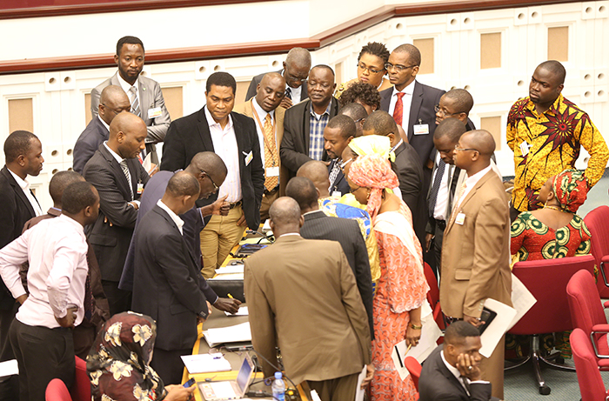
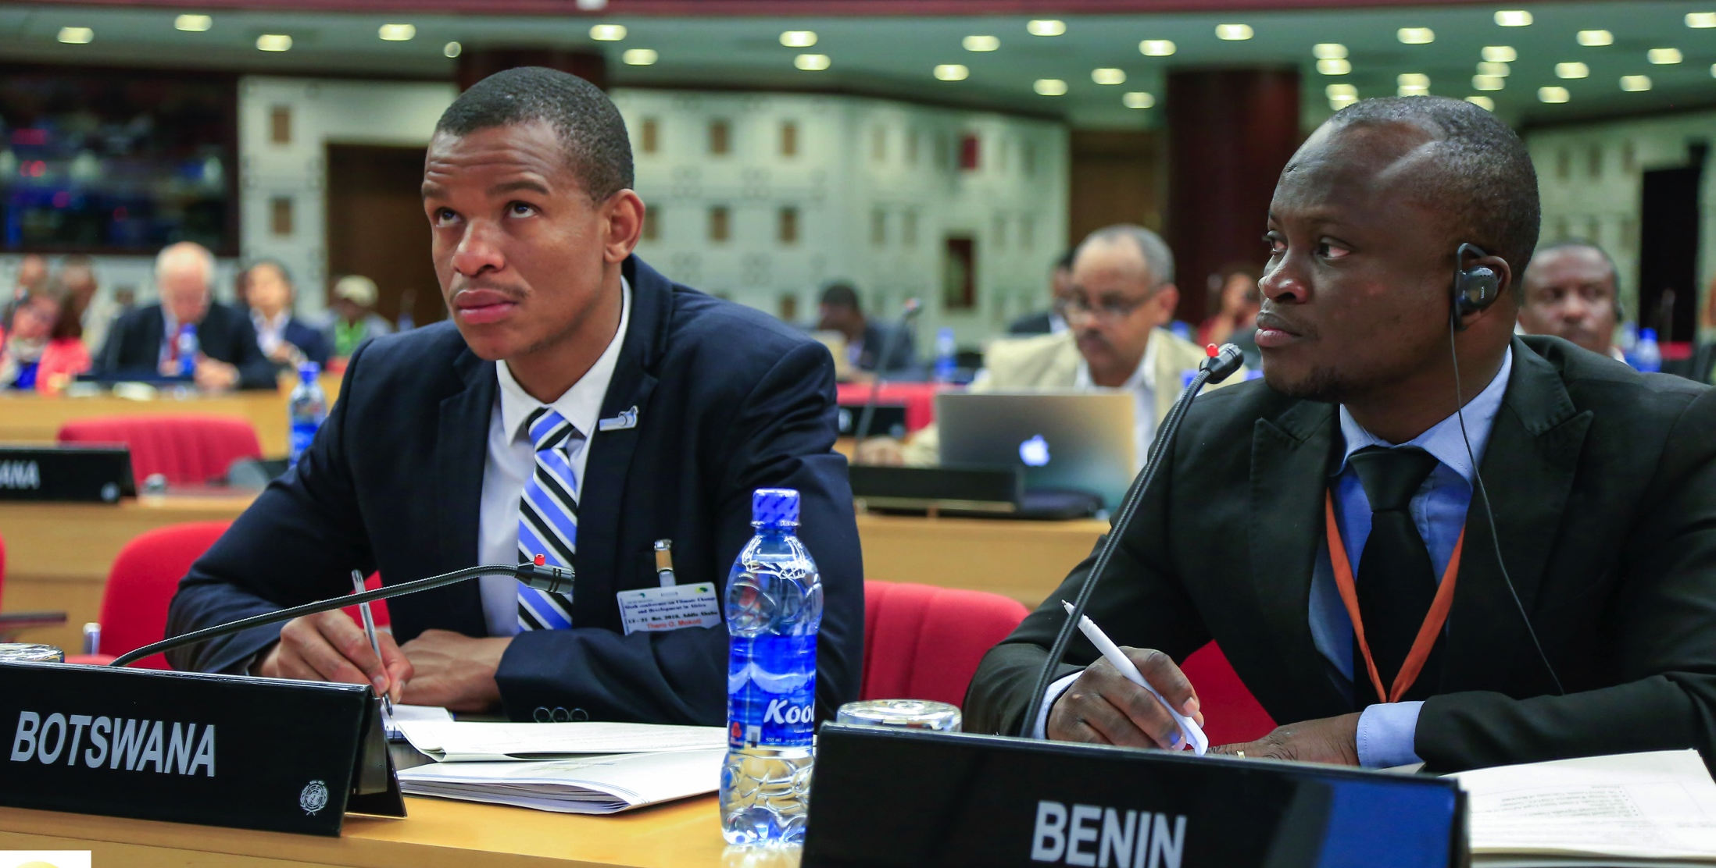
B.
ECA
Achievements of the Forum
Strengthened multi-stakeholder dialogue on the implementation of the Regional and Global development goals;
Promoted consensus on key policy recommendations for national, regional and global engagement and policy making;
Contributed to enhanced capacity of African countries to participate in the voluntary national reviews (VNRs);
Strengthened the capacity of member States to articulate Africa’s priorities;
Generated knowledge products including policy reports on the various sub-themes of the Forum.
Side Event - 2018 High Level Political Forum
UNECA.ORG
Notes:
Some of the achievements of the Forum include the following:
The Forum has been a consistent voice and has strengthened multi-stakeholder dialogue on the implementation of the Regional and Global development goals.
ARFSD has promoted consensus on key policy recommendations for national, regional and global engagement and policy making to ensure inclusive and integrated implementation of the 2030 Agenda and Agenda 2063.
The Forum has contributed to enhanced capacity of African countries to participate in the voluntary national reviews (VNRs) by providing space for peer learning.
ARFSD has strengthened the capacity of member States to articulate Africa’s priorities during sessions of the High-level Political Forum.
The work of the forum has generated knowledge products including policy reports on the various sub-themes of the Forum to support implementation of the regional and global goals.

Slide 4
C.
ECA
Lessons learned for the Forum to deliver better
Need to strengthen the role of the forum as a platform to support the implementation of the Agendas
The forum should give attention to SDG 17 in all its sessions
Need to strengthen the link between the HLPF and the ARFSD
Continuity of the Forum while adapting to the needs of Member States, major groups and other stakeholders
Experience sharing VNR events during the Forum
Follow-up on the outcomes of the VNRs and ARFSD
Evidence-based case studies.
Side Event - 2018 High Level Political Forum
UNECA.ORG
Notes:
The Forum is an important dialogue space for best practices and lessons learnt.
The role of the Forum as a platform to identify the synergies and tensions between the two agendas and their implementation, and the tools to support implementation of the Agendas needs to be strengthened. Moreover, the forum should give attention to SDG 17 in all its sessions.
There is the need to strengthen the link between the HLPF and the ARFSD. This was highlighted at the workshop held in January 2018 under the guidance of the bureau of the African Regional Forum on Sustainable Development, chaired by Togo. The workshop was organized by ECA in collaboration with the Office of the Special Advisor on Africa (OSAA) with the African Permanent Missions to the UN in New York who are deeply involved in the work of HLPF.
The workshop discussed the evolution of the format of the Forum to better serve Member States and stakeholders and meet the requirements of HLPF.
Moving forward, the workshop recommended that an Africa Day event during the HLPF in July 2018 should be organized to better support member States.
It is important for the Forum to become a continuous process that evolves with the needs and new challenges faced by its stakeholders mainly the member States and major groups and other stakeholders.
Experience sharing VNR events during the Forum are needed to enable the countries that have already conducted reviews to share their experiences to contribute to better preparation of other countries.
It is crucial to take follow-up on the outcomes of the VNRs and ARFSD – these processes are not an end in themselves, but a means to speed up implementation.
Evidence-based case studies would strengthen peer learning and contribute to scaling up and out of the good practices with across the region.
Allow for more space for VNR countries to reflect on shared problems and solutions
More space to discuss agenda 2030 and 2063 – this should not be an abstract exercise.
Create more space for civil society – moral conscience of the SDGs
Create more networking and solutions fora for different stakeholders to exchange ideas
Use the messages of the Forum as potential project ideas and in line with VNR identify ways of operaitinalizing the messages

Slide 5
C.
ECA
Lessons learned for the Forum to deliver better
Allow for more space for VNR countries to reflect on shared problems and solutions
More space to discuss agenda 2030 and 2063
Create more space for civil society – moral conscience of the SDGs
Create more networking and solutions fora for different stakeholders to exchange ideas
Use the messages of the Forum as potential project ideas and in line with VNR identify ways of operationalizing the messages
Evidence-based case studies.
Side Event - 2018 High Level Political Forum
UNECA.ORG
Notes:
The Forum is an important dialogue space for best practices and lessons learnt.
The role of the Forum as a platform to identify the synergies and tensions between the two agendas and their implementation, and the tools to support implementation of the Agendas needs to be strengthened. Moreover, the forum should give attention to SDG 17 in all its sessions.
There is the need to strengthen the link between the HLPF and the ARFSD. This was highlighted at the workshop held in January 2018 under the guidance of the bureau of the African Regional Forum on Sustainable Development, chaired by Togo. The workshop was organized by ECA in collaboration with the Office of the Special Advisor on Africa (OSAA) with the African Permanent Missions to the UN in New York who are deeply involved in the work of HLPF.
The workshop discussed the evolution of the format of the Forum to better serve Member States and stakeholders and meet the requirements of HLPF.
Moving forward, the workshop recommended that an Africa Day event during the HLPF in July 2018 should be organized to better support member States.
It is important for the Forum to become a continuous process that evolves with the needs and new challenges faced by its stakeholders mainly the member States and major groups and other stakeholders.
Experience sharing VNR events during the Forum are needed to enable the countries that have already conducted reviews to share their experiences to contribute to better preparation of other countries.
It is crucial to take follow-up on the outcomes of the VNRs and ARFSD – these processes are not an end in themselves, but a means to speed up implementation.
Evidence-based case studies would strengthen peer learning and contribute to scaling up and out of the good practices with across the region.
Allow for more space for VNR countries to reflect on shared problems and solutions
More space to discuss agenda 2030 and 2063 – this should not be an abstract exercise.
Create more space for civil society – moral conscience of the SDGs
Create more networking and solutions fora for different stakeholders to exchange ideas
Use the messages of the Forum as potential project ideas and in line with VNR identify ways of operaitinalizing the messages

Slide 6
Country Statements :
Workshop on Africa’s priorities and the ARFSD
ECA
Financing of the implementation of the two agendas is central and represents a real challenge for African countries
Need for greater and strengthened collaboration between countries on the implementation of the two agendas
Discussion should address main challenges such as inclusive sustainable industrialization, climate change and building resilience in Africa
Namibia challenges are linked to several SDGs and African priorities such as food security, agricultural transformation, gender, water stress, migration, poverty and biodiversity
Important to strengthen the link between the ARFSD and the HLPF
Representative of Rwanda
Representative of Ethiopia
Representative of Burkina Faso
Representative of Namibia
Representative of Djibouti
Side Event - 2018 High Level Political Forum
UNECA.ORG
Notes:
Please look at Workshop on Africa’s priorities and the ARFSD for more examples.

Slide 7
D.
ECA
Key recommendations and partnership action areas
Commissioning in partnership, evidence based tools, thematic, national or subregional case studies
Developing and implementing joint programmes/projects
Mobilising and providing technical and logistical support
Strengthening the diversity of stakeholders
Strengthening synergy and feedback between the Africa Regional Forum on Sustainable Development and other intergovernmental bodies
Important role that the Bureau of the Forum could carry out during the inter-sessional periods.
Side Event - 2018 High Level Political Forum
UNECA.ORG
Notes:
For the forum to deliver better on its mandate and objectives, ECA, AUC, African Development Bank and the UN System are invited to strengthen partnership in the following the key areas:
Commissioning in partnership, evidence based tools, thematic, national or subregional case studies to be presented at the ARFSD and HLPF to showcase good approaches, tools, practices and experiences to strengthen peer-learning during the ARFSD and HLPF sessions. Such studies could be aligned with HLPF selected SDGs or regional priorities, and serve as basis for joint events leading up to or in the margins of key and relevant national, subregional, regional and global meetings. These studies would also strengthen bottom up inputs to the work of the regional forum.
Developing and implementing joint programmes/projects including capacity development interventions to assist member States, civil society and private sector to address the challenges and build upon the opportunities articulated in both the VNR reports and the ARFSD outcomes/key messages. Some of the areas of intervention are data and statistics; strengthening inclusive bodies for planning and implementation of the goals.
Mobilising and providing technical and logistical support for more member States to participate in VNRs. To-date only 21 out of 54 countries have volunteered for VNRs.
Strengthening the diversity of stakeholders and voices at the ARFSD by identifying and providing financial support for more representatives of the member States, civil society, academia and private sector to engage in the activities of the ARFSD and HLPF. Budget constraints have limited the reach of the Forum to some critical constituencies. Key among the constituencies are the African Countries permanent missions to the UN who need to be actively engaged in the work of the Regional Forum so that Africa’s priorities are better reflected and articulated at the HLPF and relevant UN meetings.
Strengthening synergy and feedback between the Africa Regional Forum on Sustainable Development and other intergovernmental bodies to enhance dissemination and uptake of the outcomes and recommendations of the Forum. This is an important role that the Bureau of the Forum could carry out during the inter-sessional periods.

Slide 8

ECA
THANK YOU!
MERCI!
UNECA.ORG

