Slide 1
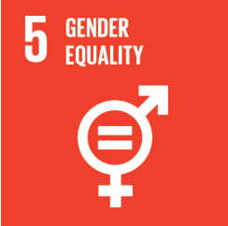
La Santé des femmes en Ethiopie : Faits et chiffres
Répondre aux besoins des femmes en matière de santé en Éthiopie :
Défis et opportunités
15 Février 2019
Centre de conférence des Nations unies CR3
La Santé des femmes en Ethiopie: Faits et chiffres

Slide 2
Examen de la santé des femmes en Ethiopie
2
Santé reproductive
Fertilité et planning familial
Mortalité maternelle
Accès à la santé reproductive
VIH
Prévalence du VIH
Services de conseil technique
Cancer
Cancer du sein
Cancer du col de l’utérus
Violence contre les femmes
Violence physique et sexuelle
Mutilation génitale des femmes
Mariage précoce
La Santé des femmes en Ethiopie: Faits et chiffres
UNECA.ORG
Notes:
The aim of this presentation is to provide insights into women’s health issues in Ethiopia focusing on persistent and emerging challenges. There are four pillars: reproductive health, HIV, cancer and violence against women.
The following slides will outline trends in women’s health as well as women’s access to healthcare and explore key factors that contribute to existing inequalities including education, wealth and location.

Slide 3
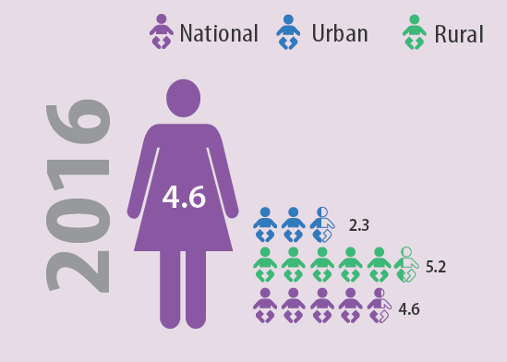
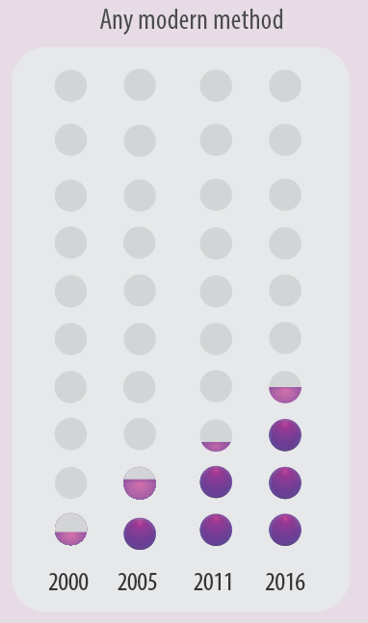
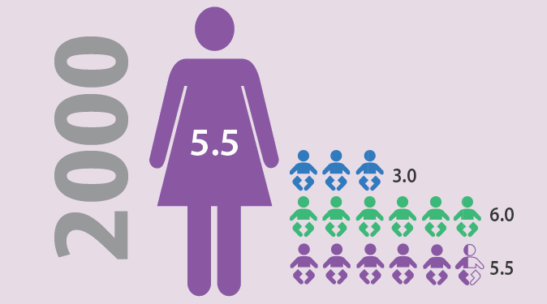
Santé reproductive : Fertilité et les contraceptifs
3
Source: EDHS 2000-2016
La Santé des femmes en Ethiopie: Faits et chiffres
UNECA.ORG
Notes:
From 2000 to 2016, fertility rate decreased from 5.5 to 4.6 births. This is a commendable progress reflecting a 16% reduction in total fertility rate.
This can partly be explained with the six-fold increase in the use of modern contraceptive methods among married women in the sampe period.

Slide 4
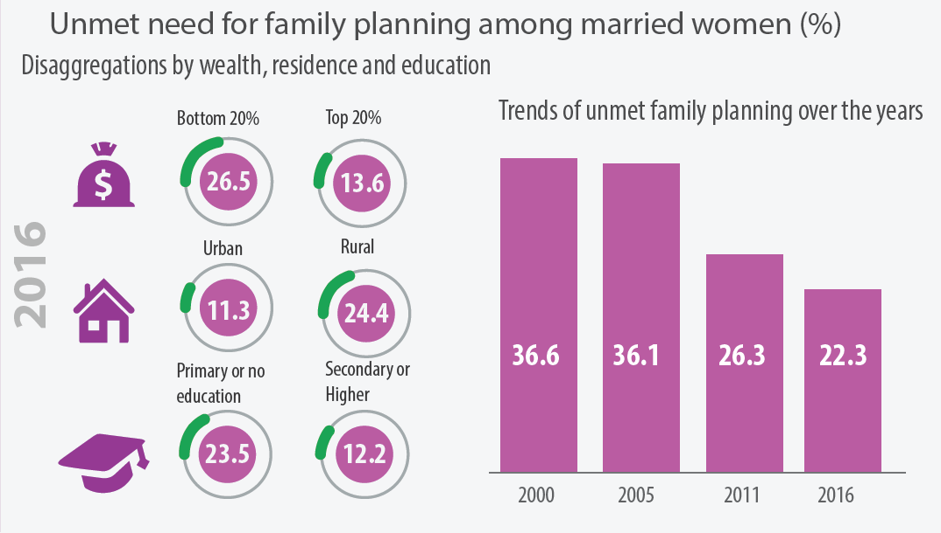
Santé reproductive: Besoin non satisfait pour le PF
4
Source: EDHS 2000- 2016
La Santé des femmes en Ethiopie: Faits et chiffres
UNECA.ORG
Notes:
Inequalities in accessing family planning must be addressed to further decrease the fertility rate. Women residing in rural areas, women with lower education and women living inhouseholds with lower wealth find it more difficult to access family planning.
While unmet need for family planning decreased in the last decade significantly, more than 1 in every 5 Ethiopian women report unmet need. Eliminating such unmet need will require more targeted policy actions based on the three contours of inequality explored earlier.

Slide 5
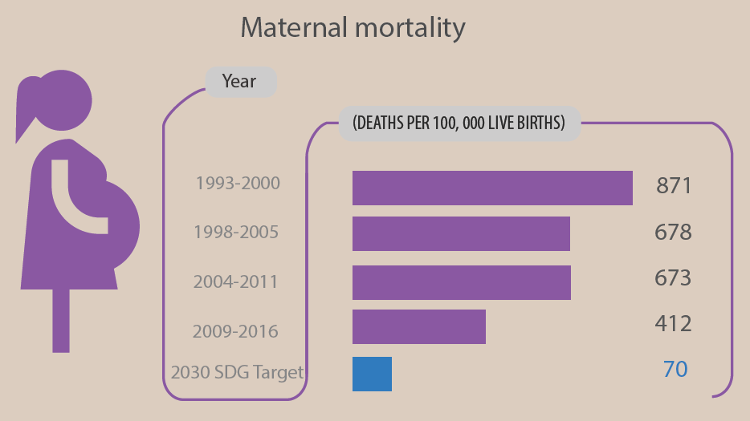
Santé reproductive: Mortalité maternelle
5
Source: EDHS 2000-2016
La Santé des femmes en Ethiopie: Faits et chiffres
UNECA.ORG
Notes:
Ethiopia halved its maternal mortality ration in the last couple of decades. Further progress is needed at accelerated pace to reach the SDG target of 70 by 2030.

Slide 6
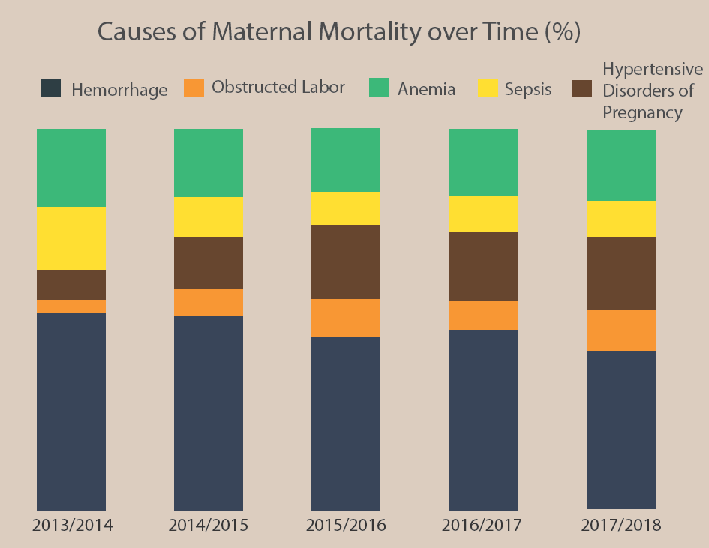
Santé reproductive: Mortalité maternelle
6
Source: EFY, MSDR System, 2013-2018
La Santé des femmes en Ethiopie: Faits et chiffres
UNECA.ORG
Notes:
Despite a steady decline by 20% from 2006 to 2010, hemorrhage continuous to be the main cause of maternal death in Ethiopia.

Slide 7
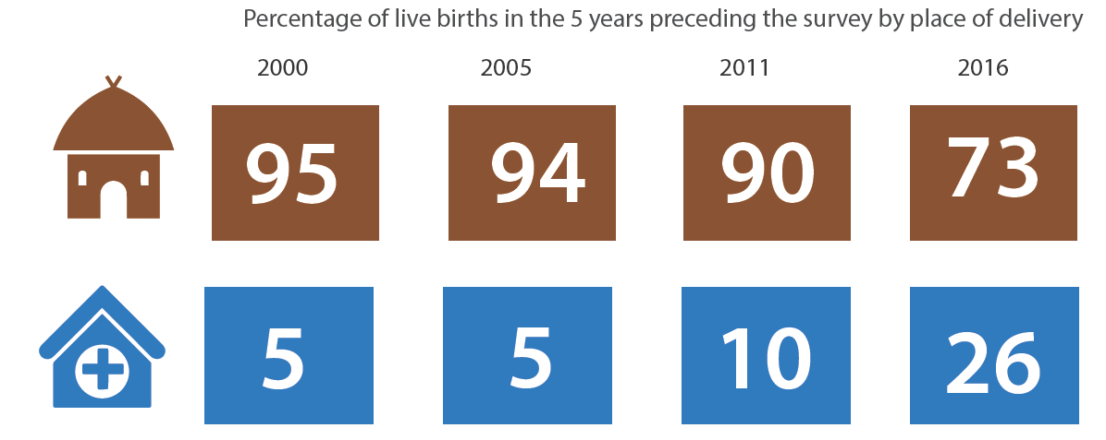
Santé reproductive: Mortalité maternelle
7
Source: EDHS 2016
La Santé des femmes en Ethiopie: Faits et chiffres
UNECA.ORG
Notes:
The share of live births taking place in health facilities has increased fivefold from 2000 to 2016. However more than two-third still deliver at home.

Slide 8
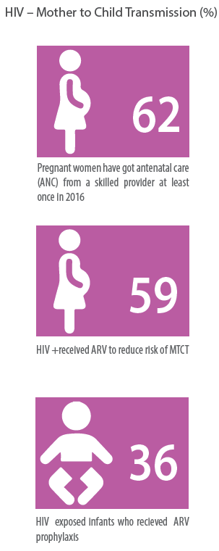
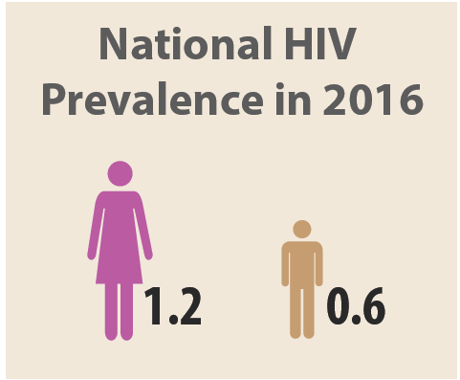
VIH : Prévalence et transmission de la mère à l’enfant
8
Source: PTCMT 2017
Source: EDHS 2016
La Santé des femmes en Ethiopie: Faits et chiffres
UNECA.ORG
Notes:
There is a substantial gender gap in HIV prevalence in Ethiopia. Gambela, Addis Ababa, Dire Dawa and Harari are the top four regions with highest prevalence rates reaching 5.7% in Gambela for women.

Slide 9
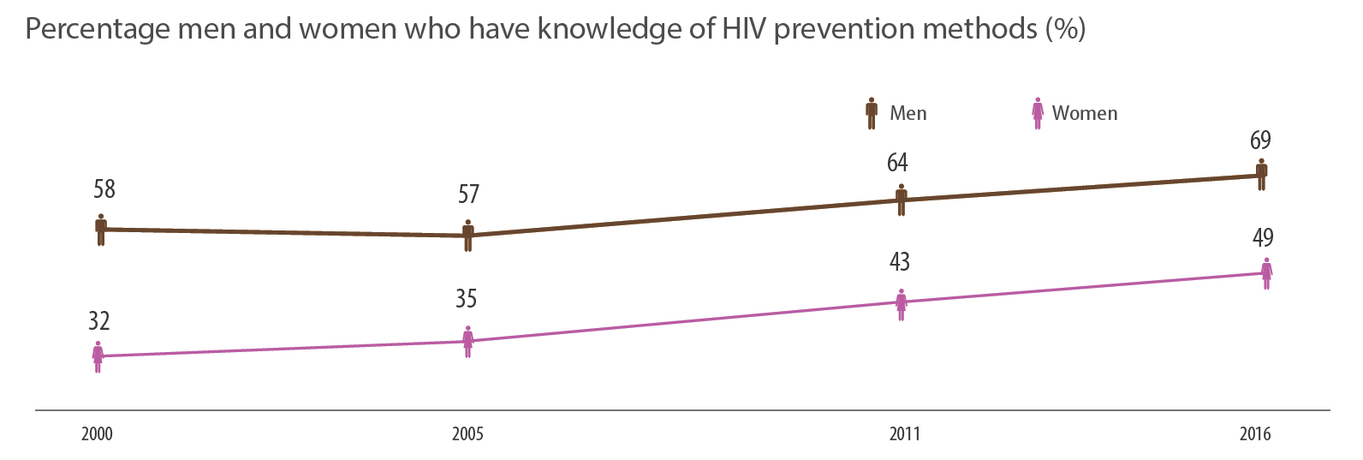
VIH: connaissance sur les méthodes de prévention
9
Source: EDHS 2016
La Santé des femmes en Ethiopie: Faits et chiffres
UNECA.ORG
Notes:
Men are more likely to know about HIV prevention methods than women in Ethiopia. This gender gap has remained wide since early 2000s partly contributing to higher prevalence rates among women, particularly the younger cohorts.

Slide 10
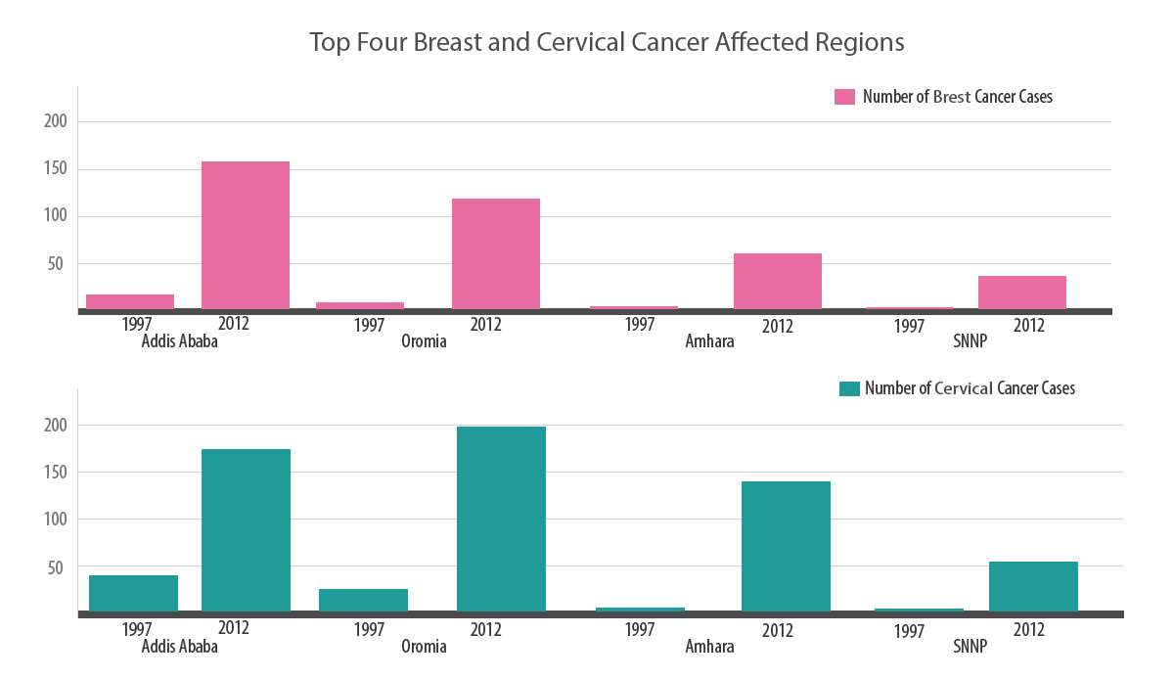
Cancer: Nombre de cas
10
Source: Abate SM, Yilmaz, Assefa M, Tigeneh W (2016) Trends of Breast Cancer in Ethiopia. Int J Cancer Res Mol Mech 2( 1); Abate SM (2015) Trends of Cervical Cancer in Ethiopia. Cervical Cancer 1: 103
La Santé des femmes en Ethiopie: Faits et chiffres
UNECA.ORG
Notes:
Cancer is an emerging health challenge particularly for women. The number of cases for breast and cervical cancer has increases substantially from mid-1990s to 2010s.

Slide 11
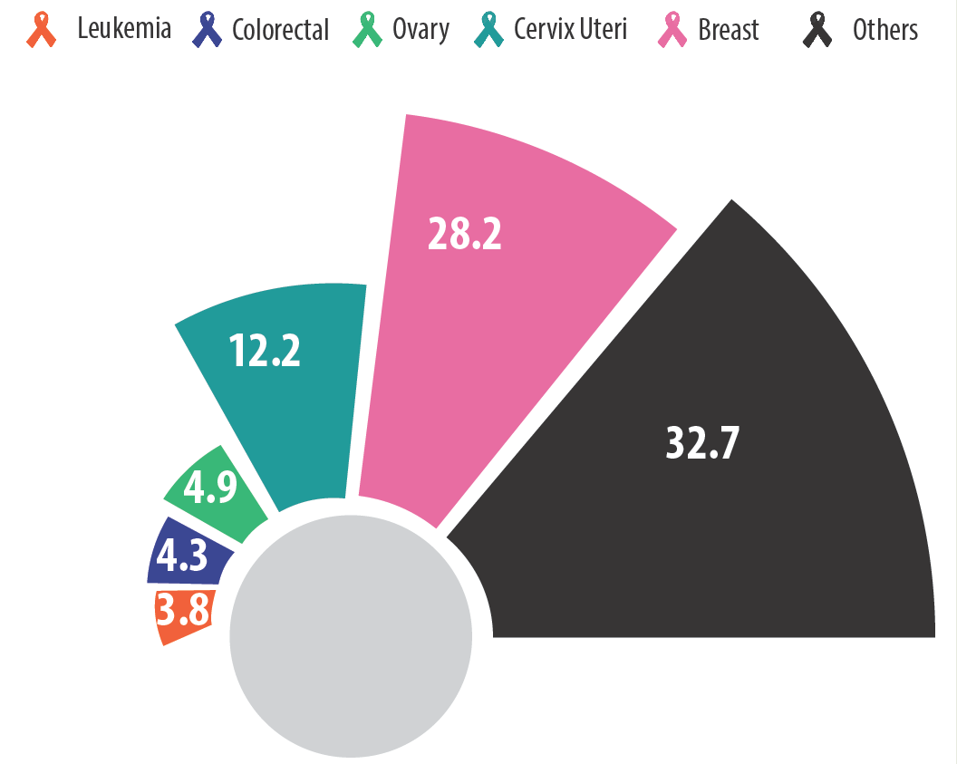
Cancer : Taux d’incidence du cancer sur 100 000 habitants
11
Source: Solomon Tessema Memirie, Mahlet Kifle Habtemariam, Mathewos Asefa, Biniyam Tefera Deressa, Getamesay Abayneh, Biniam Tsegaye, Mihiret Woldetinsae Abraha, Girma Ababi, Ahmedin Jemal, Timothy R. Rebbeck, and Stéphane Verguet. “Estimates of Cancer Incidence in Ethiopia in 2015 Using Population Based Registry Data”, Journal of Global Oncology, 4: 1-11.
La Santé des femmes en Ethiopie: Faits et chiffres
UNECA.ORG
Notes:
Breast and cervical cancer clearly dominates the type of cancers women experience in Ethiopia.
This makes service availability for cancer screening extremely important. With respect to cervical cancer screening, service availability remains at 2% indicating major supply side weaknesses.

Slide 12
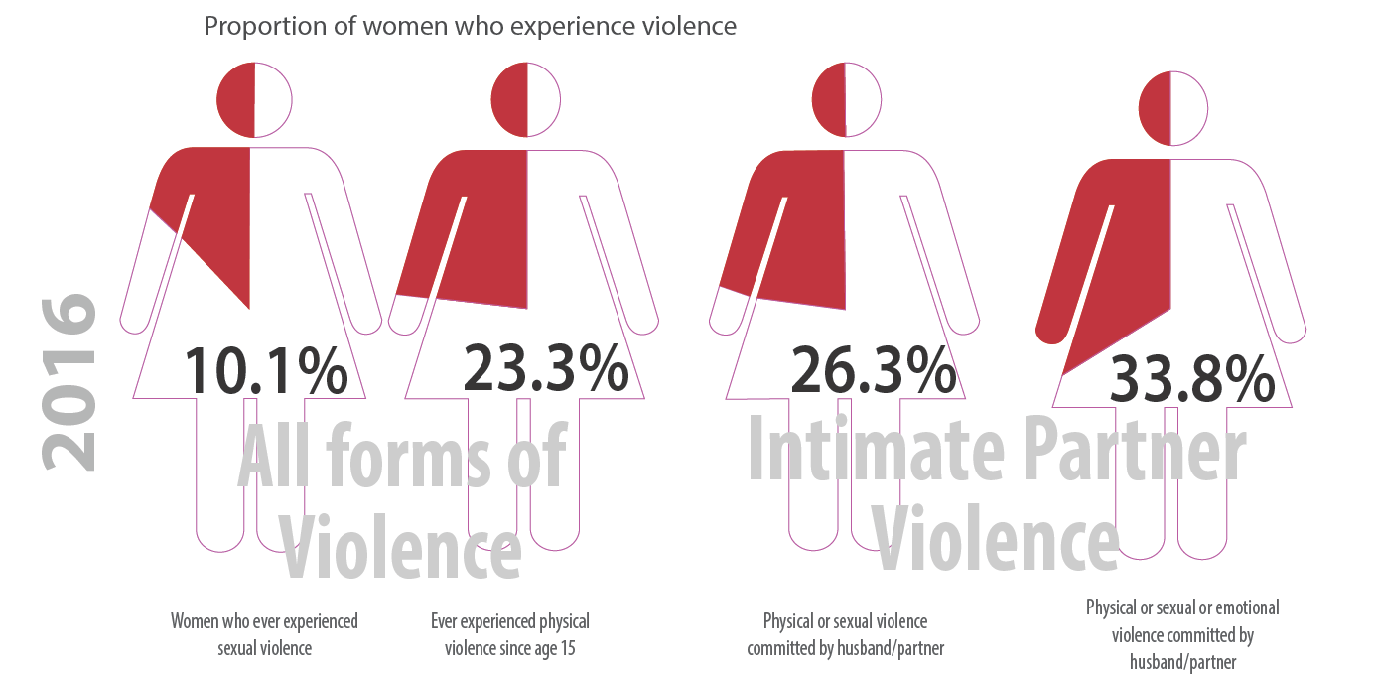
Violence contre les femmes et violence conjugale
12
Source: EDHS 2016
La Santé des femmes en Ethiopie: Faits et chiffres
UNECA.ORG
Notes:
As of 2016, violence against women remains a severe public health problem faced by women. Ethiopia’s average is equivalent to the global average.

Slide 13
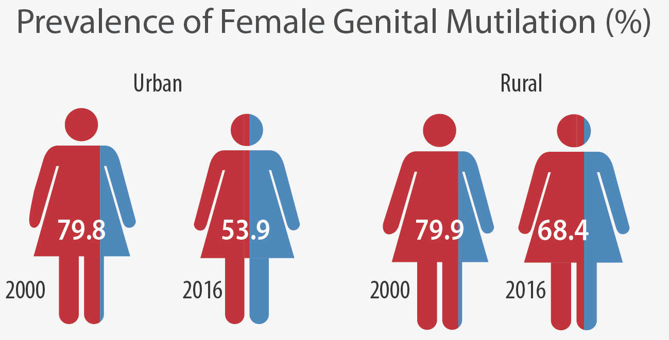
Violence contre les femmes: Mutilation génitale des femmes
13
Source: EDHS 2016
La Santé des femmes en Ethiopie: Faits et chiffres
UNECA.ORG
Notes:
FGM is a harmful practice against women which has shown significant reductions particularly in urban Ethiopia. However, as of 2016, the practice is highly prevalent both in urban and rural areas.

Slide 14
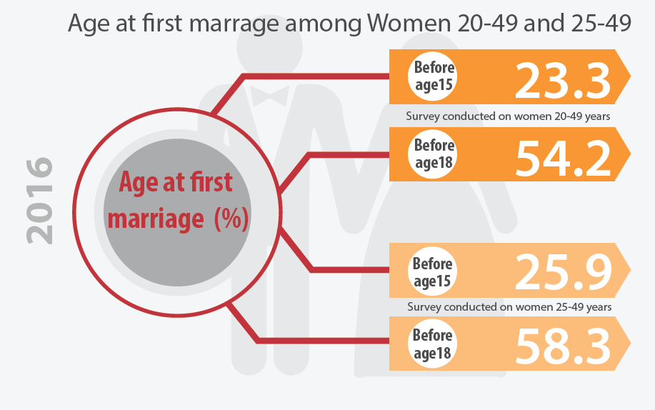
Violence contre les femmes : Mariage précoce
14
Source: EDHS 2016
La Santé des femmes en Ethiopie: Faits et chiffres
UNECA.ORG
Notes:
Early marriage is a major challenge against girls human capital formation. The figures above point toward major challenges.
Median age at first marriage increases with education. While women with no education on average marry at age 16, women with more than secondary education marry at age 24.

Slide 15
MERCI DE VOTRE ATTENTION!
more info:
Ngone Diop
diopn@un.org
UNECA.ORG

