Slide 1
DEVELOPING NATIONAL ACTION PLANS

Slide 2
Two main components
1) Plan to implement the AGDI
2) Plan to use the AGDI report to influence national development strategies and plans

Slide 3
1- Plan for the implementation of the AGDI
Define detailed plan which includes detailed:
Detailed activities to be undertaken by whom i.e. The Ministry, the National Advisory Panel; Research team and;
When i.e. exact date for each of the activities

Slide 4
Sample of an action plan
Activity | Responsible organ/structure | Timeframe/implementation data | Remarks
Prepare and submit to the Ministry responsible of Gender a report of the methodological workshop | Participants to the methodological workshop | Immediately after the workshop | The report is key to update the Minister who will update Cabinet if necessary
Sign MoU with ECA | Ministry, ECA | Upon reception
Set up the NAP Recruitment of the national research team | Ministry in charge of Gender, using the TORs developed by ECA Same | Tbd by the Ministry , should be done after the workshop Same | It is critical to set up the NAP immediately after the methodological workshop to kick start the implementation of the AGDI

Slide 5
Sample of an action plan (con’td)
Launch the implementation of the AGDI in the country | Ministry responsible for gender | After the setting up of the NAP | It is advisable for the Ministry to launch the implementation of the AGDI, bring all actors together and clarify individual and collective responsibilities
Undertake comprehensive research, data collection team | National research team under the oversight of the NAP | Tbd by the NAP and reflected in the contract for the research
Data analysis, writing of the AGDI report | National research team under the oversight of the NAP | Tbd by the NAP and reflected in the contract for the research

Slide 6
2- PLAN FOR THE USE OF AGDI REPORT
Overarching objective of the implementation of the AGDI: use the report (finding, data, etc.) for action towards greater gender equality and women’s empowerment in Africa
Important reminder: AGDI is not only a M&E tool. It is a gender responsive planning, implementation, M&E tool.
AGDI report should be used to bring about positive change: change in women’s lives and status; equitable sustainable development; etc.
-------- ----------- How? ----------------

Slide 7
THE HOW?
Fitting into the national development context and framework
Key parameters :
Country’s long-term development strategy, objectives, priorities
Example: sound macroeconomic framework; inclusive economic growth; poverty eradication; job creation, sustainable development; etc.
National development strategies /plan are informed by regional/continental and global development landscapes and frameworks i.e.
Agenda 2063: regional
Agenda 203 for Sustainable Development Goals (SDGs): global

Slide 8
Using AGDI to integrate gender into national strategies, policies that are informed by regional and global development frameworks
At national level: data from AGDI report should be used to integrate gender dimensions into National Growth Strategy; National Poverty Reduction, National Sustainable Development
Data from country AGDI report should be used to integrate gender into public finance and country budget.
Worthy of note: following the adoption of the AUC Agenda 2063 and the 2030 Agenda for SGDs
spearheaded by the UN. Country development strategies, policies, plans will be informed by both agenda
Key action: African M/S are domesticating/factoring both agendas into their national development strategies, policies and plans

Slide 9
Agenda 2063
National development strategies,
plans
Agenda 2030 for SDGs

Slide 10
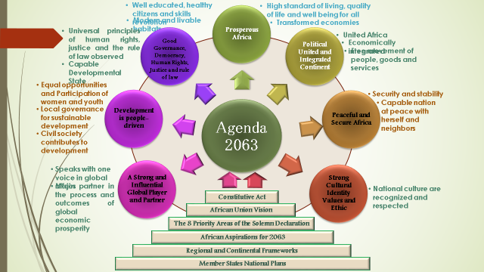
Agenda 2063 – Transforming Africa

Slide 11
The SDGs (Agenda 2030) – Transforming Our World
No poverty
Zero hunger
Good health and wellbeing
Quality education
Gender equality
Clean water and sanitation
Affordable and clean energy
Decent work and economic growth
Industry, innovation and infrastructure
Reduce inequalities
Climate Action
Peace, Justice and Strong institutions
Life below water
Life on Land
Peace, Justice and Strong institutions
Partnership for the Goals

Slide 12
Sustainable development priorities in the Africa’s 5 Subregions (Source: Africa Regional Report on the SDGs, ECA/AUC/AfDB, February 2015)
North Africa: climate change and environmental challenges; dependence on primary commodities and low economic diversification; insufficient employment-generating growth; food insecurity; inequality and lack of access to basic services; gender equality and women’s empowerment energy insecurity and the need for investments in renewable energy.
West Africa: tackling poverty; gender equality and women’s empowerment ; improvements in education quality; improved access to affordable and good quality health; sustainable water, energy and transport infrastructure development, and inclusive growth; agriculture and food security; proper environmental and natural resource management; social protection for the poor and vulnerable; sanitation and urban management; and enhancing partnerships for development.
Central Africa: economic diversification to deal with over dependence on natural resources; infrastructural development; poverty, hunger and malnutrition; improvements in water and sanitation; improvements in access and quality of education; enhancing gender equality and women’s empowerment empowerment; unemployment and underemployment; and improvements in environmental, water resources and urban management.

Slide 13
Sustainable development priorities in the Africa’s 5 Subregions (cont’d)
Eastern Africa: high and sustained economic growth to translate into jobs and human development; gender equality and women’s improvements in education and skills development; increased agricultural productivity and value addition; sustainable energy development; improvements in access to affordable health care; tackling environmental and climate related challenges; and infrastructural development.
Southern Africa: fight against poverty and inequality; improvements in health and nutrition; improvements in education; promotion of gender equality and women’s empowerment; sustainable environmental management and climate change.

Slide 14
Using AGDI to integrate gender into national strategies, policies that are informed by regional and global development frameworks (cont’d)
Use data (quantitative and qualitative) from the AGDI report to:
Undertake country gender responsive situation analysis;
Identify national priorities which are coherent with Agenda 2063 and Agenda 2030 for SDGs frameworks;
Develop national action plans for implementation of Agenda 2063 and Agenda 2030 for SDGs;
Implement nation plans by address gender issues into national resources, budgets;
Monitor and evaluation nation plans , will also inform country SDGs reports to be submit every 4 year;
Define policy actions in order to respond to the identified development challenges, using a systematic gender responsive approach.

Slide 15
I THANK YOU

