Slide 1
Meeting of the Committee of Experts All day event 9.00 - 18.45 Réunion du Comité d’experts Journée entière 9.00 - 18.45

Slide 2
United Nations system support to the African Union and its NEPAD Programme Aida Opoku-Mensah OiC - Capacity Development Division

Slide 3
Outline
Introduction
Implementing the decisions of African Heads of States and Ministers of Finance, Planning and Economic Development
Direct Technical assistance to the African Union and its NEPAD programme
Support coordinated through nine through the nine clusters of the Regional Coordination Mechanism of United Nations Agencies working in Africa (RCM-Africa), convened by the Economic Commission for Africa (ECA).
RCM Challenges
Recommendations and Way forward

Slide 4
Introduction
Overview of results achieved by the UN system in support of the African Union and its NEPAD programme since April 2015
The report provides 3 perspectives:
Implementation of the decisions of African Heads of States and Ministers of Finance, Planning and Economic Development
Direct technical assistance to the African Union and its NEPAD programme
Support coordinated through the nine clusters of the Regional Coordination Mechanism of United Nations Agencies working in Africa (RCM-Africa), convened ECA

Slide 5
Key Decisions
Implementation

Slide 6
Implementation (1)
Harmonizing policy, legal and regulatory frameworks to enhance private sector financing of trans boundary infrastructure in Africa
ECA, in collaboration with the RECs and NEPAD Agency have begun to map policies, laws and regulations across Africa which pertain to investment in trans-boundary infrastructure
ECOWAS, SADC, COMESA have been covered
EAC and AMU to follow
Upon completion, a framework will be submitted to the African Heads of States which hopefully opens up the space for private sector investment in trans- boundary infrastructure
Implementation of Dakar Agenda for Action on African infrastructure
ECA designed Project 16-16-16 to support the implementation of the Dakar Agenda for Action in 16 countries, focusing on the 16 projects identified at the Dakar Financing Summit, beginning in 2016

Slide 7
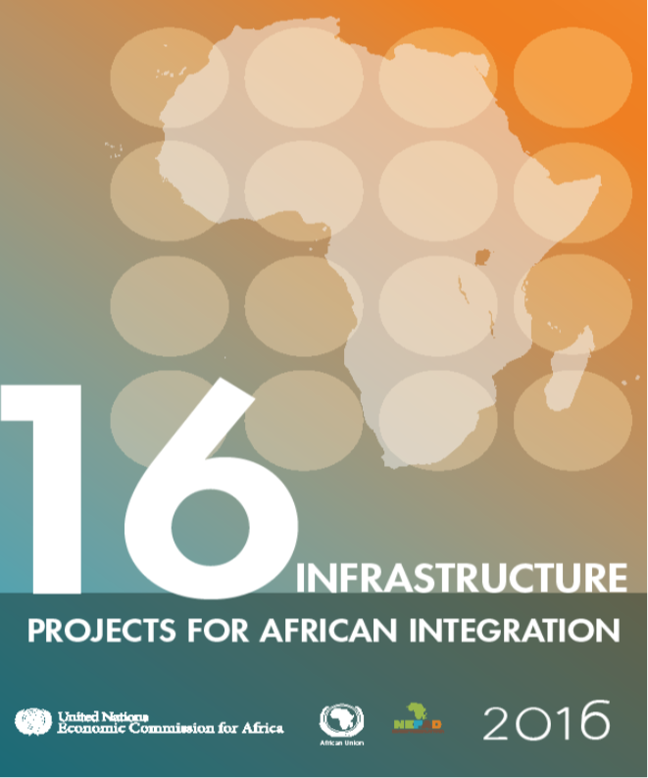
Implementation (2)
Provide continuous support to the AU Agenda 2063 and post-2015 processes
The United Nations System developed the UN-AU Partnership on Africa’s Integration and Development Agenda (PAIDA) which will be used to provide coordinated, committed and unconditional support to the AU’s Agenda 2063 and the post 2015 process
Engage in global advocacy to enhance domestic resources mobilization and private sector financing of infrastructure in Africa
ECA and NEPAD Agency have completed a report which fuses the 16 DFS projects with the study on domestic resource mobilization in Africa. Titled “16: Infrastructure projects for African integration”, the report will be launched in May 2016

Slide 8
Implementation (3)
Supporting negotiations on a continental free trade area (CFTA)
ECA coordinated United Nations system efforts through the African Trade Policy Centre, to promote active engagement in negotiations on a continental free trade area, including in the preparation of draft negotiation texts

Slide 9
Implementation (3)
Implementing Agenda 2063: planning, mobilizing and financing for development
In December 2015, ECA led the UN system efforts to provide technical support to the AU Commission on a framework for monitoring the 10 year plan for the implementation of Agenda 2063

Slide 10
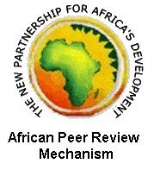
Technical support to AU & its organs (1)
Two ECA senior advisers were sent to the APRM Secretariat & NEPAD Agency to provide direct technical support & advisory services
Led by ECA, the UN system provided continuous support to the APRM in areas such as country reviews and awareness workshops, and provided substantive support to the Africa Power Initiative
ECA held two high-level dialogues (in South Africa and Rwanda) with senior public officers to raise awareness of African planners on Agenda 2063 and ensure their contributions to the Agenda.

Slide 11
Technical support to AU & its organs (2)
Restructuring & reinvigoration of APRM
The UN system, represented by ECA and UNDP, provided direct support to the APRM secretariat with respect to its restructuring
As part of the revitalisation process, the UN System, led by ECA, provided substantive support to the APRM Special Summit of Heads of State and Government in January where critical decisions were taken about the future of APRM
Technical EGM with new CEO, Addis

Slide 12
Technical support to AU & its organs (3)
Experts from ECA and the UN System helped in preparing the Country Review Report of Djibouti in August 2015, mainly on development planning, MTEF and management of natural resources
ECA also provided technical assistance to The Sudan APRM National Focal Point and the National Governing Council to finalise the country’s self-assessment report
An Experts’ meeting was held in Lagos Nigeria in December 2015 to review and validate a study on “Mainstreaming the Governance of Natural Resources in the APRM process”

Slide 13
Supporting the AU and its NEPAD Programme as one UN system
The Regional Coordination Mechanism of UN agencies & organizations working in Africa in support of the AU and NEPAD

Slide 14
Regional Coordinating Mechanism (RCM)
ECA, as the Secretariat of the RCM, continues to lead the UN system in coordinating UN support for the AU and its NEPAD programme, ensuring synergy and reducing transaction costs
In October 2015, the RCM-Africa Secretariat organised a workshop to determine how joint programming tools could be used to develop a framework to strengthen coordination at regional and sub-regional levels
A handbook that could be used to build the capacity of participants and enhance coordination among partners in support of the AU and its NEPAD Programme was also developed
Another workshop on enhancing monitoring and evaluation in RCM-Africa was held in Nazareth, Ethiopia, on 1 and 2 October 2015
On 11-12 February 2016, the RCM-Africa Secretariat organised a retreat of the Coordinators of RCM-Africa on the theme “Strengthening the Regional Coordination Mechanism for Effectiveness in the implementation of Agenda 2063 and the Sustainable Development Goals.

Slide 15
Reports from RCM Clusters (1)
Environment, Population and Urbanisation Cluster
UNEP with AUC, UNECA, UNDP, ILO, AfDB, NPCA, RECs, WWF, UNIDO and DANIDA have jointly been undertaking assessment reports to identify the opportunities and challenges of a transition to a green economy in various countries
Social and Human Development Cluster
The ILO in collaboration with ECA, UNICEF and UNDP are supporting the development of a Protocol on Social Protection and Social Security to the AU Charter on Human and Peoples Rights. They are also assisting with the revision of the AU’s 2008 Social Policy Framework in relation to the Agenda 2063 and Sustainable Development Goals 2030
Governance Cluster
The UNDP in partnership with AUC undertook a review of the pilot implementation of the Governance, Peace and Security statistics component of the Strategy for the Harmonization of Statistics in Africa (SHaSHA) in 9 countries namely Kenya, Malawi, Cameroon, Cape Verde, Cote d’Ivoire, Mali, Uganda, Tunisia and Burundi

Slide 16
Reports from RCM Clusters (2)
Science and Technology Cluster
UNESCO, in partnership with the AU, has started a process to develop six ‘UNESCO Green Academies’ in Ethiopia, as well as one ‘UNESCO Green Academy’ in Sierra Leone, South Sudan and Tanzania. The overall aim is to establish at least one “UNESCO Green Academy in each African country.
Infrastructure Development Cluster
ECA in collaboration with AUC, WHO and The World Bank organised a side event on implementing and achieving the Road Safety Decade Goals, the challenges and opportunities for Africa, at the Second High Level Road Safety Conference in held in November 2015 in Brazil
Peace and Security Cluster
The Cluster convened two meetings in May 2015 to discuss the humanitarian situation in Burundi and the potential consequences of the crisis on neighbouring countries. The meetings stressed the need to have multi-dimensional analysis of the crisis in Burundi and the importance of maintaining holistic view in engagement

Slide 17
Reports from RCM Clusters (3)
Advocacy and Communication Cluster
NEPAD Agency, OSAA and UNDP collaborated with the World Bank, JICA, Government of Japan and Columbia University’s Initiative of Policy Dialogue to organise the TICAD VI pre-event “Toward TICAD VI in 2016: Africa’s Transformation through Industrial Development and Implementing the Agenda 2063” in New York at the margins of the high-level segment of the 70th United Nations General Assembly
Industry and Market Access Cluster
ECA, UNCTAD and AUC participated in the preparations leading to the launch of the negotiations of the Continental Free Trade Area. Activities included studies around AGOA, EPAs and the TFTA in the context of the CFTA. The CFTA negotiations were successfully launched during the AU Summit in June 2015.

Slide 18
RCM Challenges (1)
Resource Constraints
No specific RCM budget is allocated to support the implementation of planned programmes and activities
Financial and capacity constraints limit many UN agencies from contributing effectively to the work of the clusters
The small size of AU staff dedicated to the work of the joint RCM Secretariat limits the Secretariat’s capacity in terms of organizing the annual RCM-Africa sessions and the implementation of decisions

Slide 19
RCM Challenges (2)
Communication
Low level of cooperation between the advocacy and communications cluster and other clusters exist
Minimal awareness of RCM-Africa and its achievements at senior management levels of the African Union and its organs
Planning
Lack of regular intra cluster and inter cluster interactions and cooperation
Difficulties in elaborating joint programmes due to varying programming and budget cycles
Risk of institutional memory loss as clusters are often managed by just one staff member

Slide 20
Recommendations & Way Forward (1)
Sustainable resources
In the short term, all UN system entities should deepen their collaboration, including by pooling their resources, in support of the AU and its NEPAD programme
Follow-up pledges by the UN Deputy Secretary-General to discuss regular RCM funding with the Chief Executives Board (CEB) at the UNHQ
In the medium to long term member States should ensure that PAIDA, the proposed UN-AU partnership framework receive full budgetary support from the UN to strengthen efforts by the UN system and AU organs to work together on Africa’s priorities

Slide 21
Recommendations & Way Forward (1)
Communications
Regular briefings on RCM-Africa and its activities should be organised for the Commissioners and Department Directors of the AUC, the leadership of NEPAD Agency and those in charge of RECs for greater awareness, involvement, ownership and leadership
Communication-related activities should be factored into cluster programmes and provided for in the relevant budgets. RCM Quarterly newsletters and other means of communication should be resuscitated/developed to promote RCM-Africa
Planning
All clusters should prioritise intra cluster and inter cluster collaboration, cooperation, partnerships and communication, in line with previous decisions of RCM-Africa, in order to create synergy in their work and ensure maximum effectiveness
In place of the current Annual Business Plan, clusters should produce biennial work programme based exclusively on priorities identified directly by the African Union and its NEPAD programme

Slide 22
Thank you for your kind attention!
For more information: aida@uneca.org

