Slide 1
Meeting of the Committee of Experts All day event 9.00 - 18.45 Réunion du Comité d’experts Journée entière 9.00 - 18.45

Slide 2
Implementation of first five-year priority programme on employment, poverty eradication and inclusive development by regional economic communities

Slide 3
9th Joint Annual Meetings of the African Union Specialized Technical Committee on Finance, Monetary Affairs, Economic Planning and Integration and the ECA Conference of African Ministers of Finance, Planning and Economic Development.
31 March 2016 - 5 April 2016, Addis-Ababa, Ethiopia
“First Five Year Priority Programme on Employment, Poverty Eradication and Inclusive Development”
Presented by
Mr Oumar DIOP
Social Affairs Department
African Union Commission

Slide 4
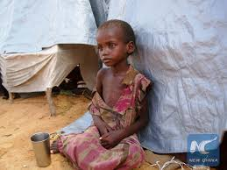
Outline of the presentation
I. Introduction
II. Key characteristics of the Five Year Priority Programme
III. The First 5YPP, Agenda 2063 and Agenda 2030
IV. Domestication of the First Five Year Priority Programme on Employment, Poverty Eradication and Inclusive Development
V. Financing Mechanism - Employment and Social Cohesion Fund

Slide 5
I. Introduction
Policy instruments adopted by AU Summit, Addis Ababa, January 2015
Declaration and Plan of Action on Employment, Poverty Eradication and Inclusive Development, with its Follow-Up Mechanism
AU-ILO-IOM-ECA Joint Programme on Labour Migration Governance for Development and Integration
Public-Private Partnerships Framework on Employment and Poverty Eradication

Slide 6
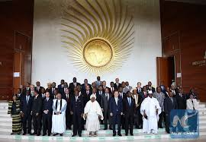
II. Key characteristics of the Five Year Priority Programme
Six Key Priority Areas of the Declaration and Plan of Action on Employment, Poverty Eradication and Inclusive Development endorsed by the Assembly:
Political Leadership, Accountability and Good Governance;
Youth and Women Employment;
Social Protection and Productivity for Sustainable and Inclusive Growth;
Well-functioning and Inclusive Labour Market Institutions;
Labour Migration and Regional Economic Integration;
Partnerships and Resource Mobilization.

Slide 7
III. The First 5YPP, Agenda 2063 and Agenda 2030
2023 targets on employment, poverty eradication, social protection and social security of the First Ten Year Implementation Plan of the Agenda 2063
Under the Priority Area Incomes, Jobs and decent work
1. Increase 2013 per capita income by at least 30%
2. Reduce 2013 unemployment rate by at least 25%
3. Reduce Youth and Women unemployment rate by 2% per annum
4. Reduce underemployment rate by 50%
5. Reduce 2013 vulnerable unemployment rate by at least 25%
Under the Priority Area Social security and protection including Persons with Disabilities
1. At least 30% of vulnerable populations including persons with disabilities, older persons and children provided with social protection.
2. All persons working in the formal sector are provided with social security.
3. At least 20% of the informal sector and rural labor have access to social security.

Slide 8
III. The First 5YPP, Agenda 2063 and Agenda 2030
SDGs (Agenda 2030):
Achieve full and productive employment and decent work for all women and men, including for young people and persons with disabilities, and equal pay for work of equal value”, by 2030 (Target 8.5),
Substantially reduce the proportion of youth not in employment, education or training”, by 2010 (Target 8.6).

Slide 9
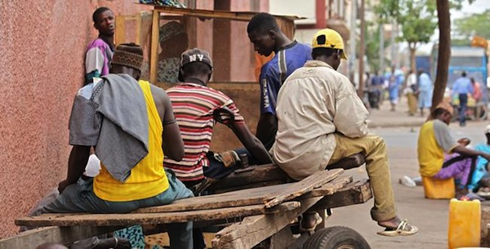
Five Year Priority Programme Strategy
Key priority area 1: Political leadership, accountability and good governance
Improved accountability
Improved policy coherence
Measuring and reporting on the state of inclusive development.
Participation of Citizens and non-state actors enabled
Key priority area 2: Youth and women employment
Youth and women employment mainstreamed and given appropriate prominence in relevant AU policies and programmes.
Continental TVET and employment policies, strategies and programmes.
Inclusive participation of women and youth in post-conflict countries
Special initiatives:
AUC/ILO/ECA Initiative on Youth Employment
Rural Employment Strategy
Digital Work Africa
Social Business Strategy
Natural resources beneficiation: Diamond Model

Slide 10
Five Year Priority Programme Strategy
Key priority area 3, Social protection and productivity for sustainable and inclusive growth
Social Protection and Social Security coverage expanded in Africa.
Productivity increased and competitiveness improved in African economies: MSMEs, Green Productivity and Public Service
Incremental transitioning of the Informal Economy to the Formal Economy facilitated.
Key priority area 4: Well-functioning and inclusive labour markets
Strategic leadership and planning role played by Ministries of Labour and Labour Market Institutions in the economic and social development agenda of Africa
Value addition created through labour, employment and social protection services provided by Labour Market Institutions

Slide 11
Five Year Priority Programme Strategy
Key priority area 5: Labour migration and regional economic integration
Increased ratification, domestication and implementation of key international labour standards on labour migration
Improved use of databases on labour migrants’ skills, economic activities, education, working conditions, and social protection
Social Security access and portability regimes
Labour migration governance, policy and administrative responsibilities effectively carried out by capable Labour Market Institutions
Tripartite policy consultation and coordination on Labour Migration operational at continental and regional levels
Key priority area 6: Partnership and resource mobilization
Strengthened capacities of AUC/RECs/MS for mobilizing resources (local and other resources)
Effective partnership(s) among key stakeholders in delivering the results for the 5YPP – advocacy, lobbying and communication.

Slide 12
Five Year Priority Programme Strategy
Domestication of the First Five Year Priority Programme on Employment, Poverty Eradication and Inclusive Development
Principle of domestication in Agenda 2063:
“RECs will be the focal points for the facilitation of the adoption, implementation, monitoring and evaluation of all continental frameworks related to Agenda 2063 by Member States”
Process of domestication in Agenda 2063
Adapt / align continental long /medium term Agenda 2063 10 Year Plans / Guidelines to regional plans
Coordinate the preparation and execution of regional projects / programmes as per Agenda 2063.

Slide 13
Five Year Priority Programme Strategy
Crucial actions implied in the domestication process:
Planning on the basis of the targets and indicators of the First Ten Year Plan on employment, labour, social protection/security and productivity
Establishment of baseline information using the targets and indicators of the First Ten Year Plan of Agenda 2063, and of the AU Labour, Employment and TVET Minimum List of Indicators.

Slide 14
Five Year Priority Programme Strategy
Agenda 2063 related policies on employment and social protection:
the First Five Year Priority Programme on Employment, Poverty Eradication and Inclusive Development,
the Productivity Agenda for Africa and Social Dialogue Guidelines
the Labour Market Information Systems Harmonization and Coordination Framework
the Public-Private Partnerships Framework on Jobs Creation and Inclusive Development
the AU-ILO-IOM-ECA Joint Programme on Labour Migration Management
the AU-AfDB-ILO-ECA Joint Initiative on Youth Employment
the Programme on Upgrading the Informal Economy
the Social Protection Plan for Informal Economy and Rural Workers

Slide 15
Five Year Priority Programme Strategy
Financing Mechanism - Employment and Social Cohesion Fund
Under the AU Assembly Declaration on Employment, Poverty Eradication and Inclusive Development (Assembly/AU/20/Decl/6(XXIV)):
“INCREASE significantly and appropriately the budgetary resources allocated to employment policies financing and put employment among our development priorities with international partners in the true spirit of the Paris Declaration and Accra Call for Action”.
AUC, in collaboration with the AfDB and international development partners, to consider the establishment of the Employment and Social Cohesion Fund as financing mechanism for the Declaration and its Plan of Action
Policy Coherence: UN, international financial institutions, bilateral and multilateral institutions, regional and continental development banks to adopt policies in coherence with the present Declaration and its Plan of Action, including UNDAF processes the Decent Work Country Programme
How to leverage Pension Funds for employment policies funding?

Slide 16
Five Year Priority Programme Strategy
Tentative calendar of domestication:
As per the calendar of the First 10YP of Agenda 2063, consultations with RECs should be completed in 2016. It is intended to complete the domestication with RECs and selected MS by end of 2017.
AUC and the REC Secretariats must agree on the timeline.
AUC will facilitate the review of the relevant regional policy and legal frameworks, in line with the First Five Year Priority Programme and the other related frameworks.
The review will conclude with the drafting of a Regional Domestication Document on Employment, Poverty Eradication and Inclusive Development.
Validation meeting of the Domestication Document

Slide 17
THANKS FOR KIND ATTENTION

