Slide 1
Report of the second session of the Committee on Gender and Social Development
Director, Social Development Policy Division, UNECA
11 - 15 May 2018
Addis Ababa, Ethiopia
2018 Conference of Ministers
Fifty-first session of the Commission

Slide 2
Introduction
2
SDPD established in response to member States increasing call for aligning social development to the priorities of member States with a focus on inclusive development.
Specifically, SDPD focuses on employment and social protection, population and youth, migration and ageing, and urbanization - all with a gender lens.
Title of the presentation goes here | Sub-Title goes here
Overview of recent economic and social conditions in Africa
UNECA.ORG
Notes:
Growth is recovering in most African countries as the global economy rebounds. Increased private consumption and investment, rising commodity prices, strong external demand and favourable weather conditions underpinned this growth;
Africa’s fiscal and current account deficits remain stable since 2016 but still relatively high;
Varying monetary policy stance, as inflation remains high in most African countries;
Africa’s trade performance rebounds though it remains relatively low as compared to previous years;

Slide 3
Structure of SDPD
UNECA.ORG

Slide 4
Committee on Gender and Social Development
Committee on Gender and Social Development (CGSD) formed in 2011 through a merger of the Committee on Women in Development and the Committee on Human and Social Development.
CGSD a statutory body of experts and policymakers, for providing guidance and advice to the Social Development Policy Division through the review of activities implemented and strategic vision and direction for the next biennium.
Both subprogramme 6 and subprogramme 9 contribute to the CGSD.
UNECA.ORG

Slide 5
Committee on Gender and Social Development
The second session of the CGSD was held on 11-12 October 2017 to review progress on gender and social development in Africa, and identify achievements, challenges, and implementation gaps to ensure the desired impacts.
The Committee provided guidance and expert opinion on the Division’s priorities and activities, and made recommendations for strengthening ECA programmes to better serve the needs of member States and regional economic communities, taking into account the regional context and country specificities.
The meeting was attended by representatives from 39 member States and a number of UN bodies.
A number of conclusions and recommendations were adopted at the end of the two-day session to guide the Division’s work in 2018-2019.
UNECA.ORG

Slide 6
SDPD Activities
UNECA.ORG

Slide 7
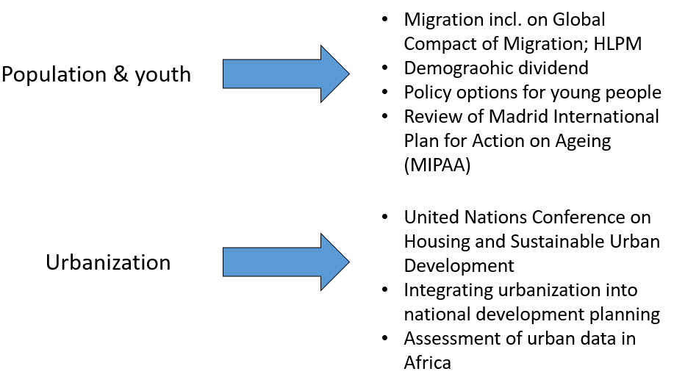
Analytical Work
UNECA.ORG

Slide 8
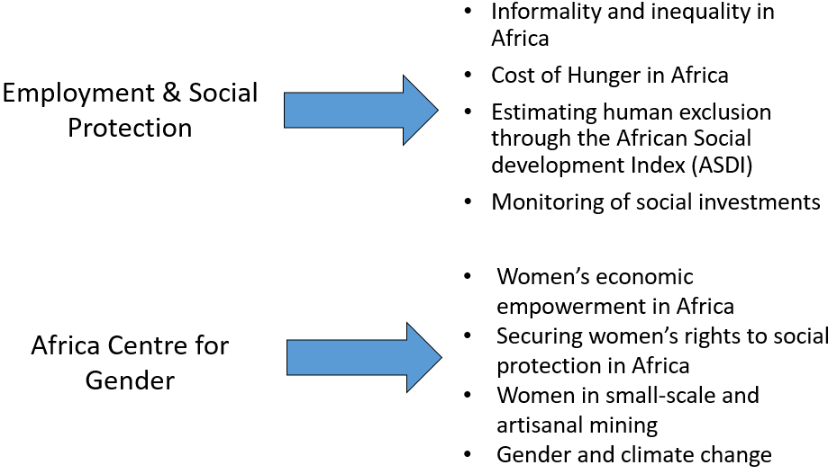
Analytical Work
UNECA.ORG

Slide 9
Analytical Work
UNECA.ORG

Slide 10
Policy and Advisory Services
Facilitated national dialogue on the importance of urbanization for the achievement of national growth and transformation priorities (5 countries)
Constituted high-level panel on migration in response to a resolution adopted at the Conference of Ministers of Finance, Planning and Economic Development held in Addis Ababa in March and April 2016.
Leading consultations on the continent (with the International Organization for Migration) to prepare Africa’s contribution to the global compact for safe, orderly and regular migration.
Strengthening countries’ capacities to conceptualize, design and implement equity-oriented policies (2 countries).
Supporting countries’ efforts to accelerate achievement of gender equality and women’s empowerment.
UNECA.ORG

Slide 11
Development of knowledge tools
Guidebook on integrating urbanization in national development plans.
Expand the implementation of the African Gender and Development Index (AGDI) and the gender parity marker, which provides an indicative measure of the resources being allocated to the promotion of gender equality.
African Social Development Index (ASDI) that estimates the depth of human exclusion and contributes to improved targeting of social policies by member States.
Youth Policy Toolbox that acts as a repository of knowledge, experience and good practices and contain learning modules for policymakers to have a useful resource for developing inclusive and responsive policies on young people.
Operational guide on the Addis Ababa Declaration on Population and Development Beyond 2014 to provide member States with specific guidance for implementing the Declaration and monitor the implementation of the declaration.
UNECA.ORG

Slide 12
Knowledge sharing
Technical backstopping of the development of a common African position on Habitat III by the African Union, which served as a central instrument for Africa’s engagement in the Habitat III process.
Organized high-level policy dialogue on national development planning which focused on integrating urbanization into national development planning in Africa.
UNECA.ORG

Slide 13
Trainings and capacity-strengthening
Collaborating with the African Institute for Economic Development and Planning (IDEP) to
Develop an e-learning course on the Economic Report on Africa 2017, targeting policymakers and practitioners.
Deliver training on ‘Social Policy for Development Planners’.
Working with UN agencies and other partners to support member States strengthen national capacities to formulate suitable policies to reduce poverty and inequality, and monitor investments in social protection and achieve the SDG targets.
UNECA.ORG

Slide 14
Partnerships
Collaborated with Regional Economic Communities (RECs), member States, UN agencies, and research institutes on inclusive and sustainable development in implementing the 2030 Agenda and Agenda 2063.
Partnership with the Rockefeller Foundation Africa Office for Eastern Africa supported both the training of member States in the process and application of the African Social Development Index.
UNECA.ORG

Slide 15
Partnerships
Working with the African Union and UN-Habitat to develop a harmonized regional framework for the implementation of the New Urban Agenda in Africa.
Together with the UNFPA and the African Union Commission, has been instrumental in the formation of the African Population Experts Committee.
Collaborating with the AUC and other partners to support the implementation of the Five-Year Priority Programme on employment, poverty eradication, and inclusive development.
UNECA.ORG

Slide 16
Results from partnership survey, 2015
Feedback on our knowledge products provided by AUC, member States and research institutes
Instrumental in “tackling African inequalities in the context of African transformation”.
Analytical research was deemed responsive to African development issues.
However requested Division’s future activities to focus on:
Enhancing capacity-building with member states and other partners
Strengthening partnerships with national institutions, including non-State actors, to build their sense of ownership and accountability to member States.
UNECA.ORG

Slide 17
Results from partnership survey, 2015
With the “unfinished business of the MDGs” and the ambitious targets of the SDGs and Agenda 2063, the Division’s work in this biennium (2018-2019) acquires additional urgency.
UNECA.ORG

Slide 18
Planned activities for 2018-2019
Basic principles
Enhance and sustain policy impact of our work by strengthening messaging and outreach, and maintaining continuity of the knowledge generated in the 2016-2017 biennium.
Stronger emphasis on
policy research and preparing knowledge products, such as policy briefs, that are readily available in the public domain;
technical and policy advisory support to member States to integrate the SDG and Agenda 2063 targets in national plans; and
strengthening national capacities to formulate, implement and monitor suitable policies and programmes for inclusive and sustainable development.
UNECA.ORG

Slide 19
Planned activities for 2018-2019
Support member States through:
Policy Research on youth for inclusive sustainable development
Technical support on ICPD+25
Strengthening of national capacities in production of quality urban data
Capacitating planners to integrate urbanization in national plans
Review of interlinkages between urbanization and agricultural transformation
Accelerating achievement of gender equality and women’s empowerment.
Enhance capacities of member States to:
contribute to the Global Compact on Migration
design and implement suitable policies to address the challenges of informal employment and mis-match of skills, especially for youth and women.
more effectively monitor investments in social protection policies and programmes and contribute to achieving the SDG targets on social protection.
develop suitable policies to implement the AUC’s Five-Year Priority Programme and contribute to poverty eradication, employment and inclusive development.
UNECA.ORG

Slide 20
THANK YOU!
Follow the conversation: #2018COM
More: www.uneca.org/cfm2018

