Slide 1
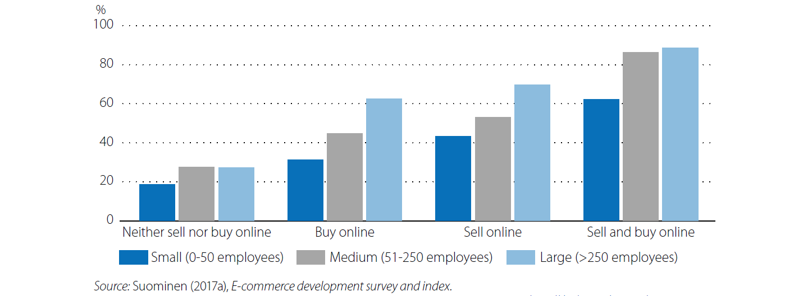
Percentage of companies that export, by company size and online activity

Slide 2
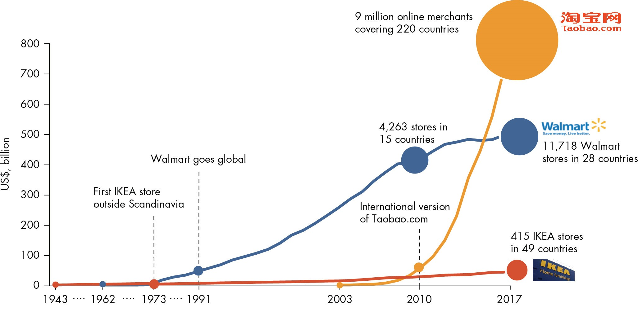
Recent technological advances to improve firm growth
Source : Analyses des auteurs, à partir des rapports annuels de Walmart, de Statista.com et de NetEase.com

