Slide 1
Enhancing Fiscal Policy Through Digitization: The Case of Egypt
Ministry of Finance of Egypt
March 2019

Slide 2
Agenda
1
Digital Economy Opportunities and challenges
2
Egypt Economic and Social Reform Program
3
Macro-fiscal Results of Program Implementation
4
The Way Forward

Slide 3
(1) Digital Economy Opportunities and challenges

Slide 4
Digital Economy Opportunities and challenges
Countries in Africa have a little more than a decade to achieve the Sustainable Development Goals, which are aimed at lifting millions of Africans out of extreme poverty, reducing inequality and enhancing sustainable development. Notwithstanding the effects of fiscal reforms, which resulted in an increase in revenue to gross domestic product ratios to an annual average that exceeds 15% between 2000 and 2017, there remains a significant financing gap to bridge in order to achieve the Goals.
Experiences across the globe demonstrate that fiscal policy effectiveness and efficiency can significantly benefit from digitization processes. African countries have the potential to increase tax revenues by between 3% and 4%, by bringing into the tax bracket the “hard to tax” sectors such as agriculture and the digital economy, and the informal sectors. The use of digital technology alone has the potential to raise fiscal revenue by a similar percentage.

Slide 5
Digital Economy Opportunities and challenges
1. Opportunities:
The use of digital technology in revenue mobilization and management could potentially strengthen the capacity of African Governments to implement and monitor more effective tax and expenditure policies. Digital technology, especially in big data analytics, has the potential to increase revenue and improve tax administration through:
lowering the cost of compliance,
lowering the cost of tax collection,
Increasing compliance.
Through big data analytics, revenue authorities can identify new sources of revenue, in addition to being able to deepen engagement with current and potential taxpayers, in a cost-effective way.

Slide 6
Digital Economy Opportunities and challenges
2. Challenges:
The digital economy, however, presents several challenges that make it difficult for Governments to collect revenue. It has certain attributes and among them:
The use of data, the value of which is often difficult to estimate,
The ability to conduct business without a physical presence. At present, tax policies in most countries in Africa are aimed at a more traditional economy, and do not consider the distinctive nature of the digital economy, resulting in loss of revenue for Governments.
Accordingly, Governments need to rethink their taxation frameworks with the aim of accommodating the digital economy.

Slide 7
(2) Egypt Economic and Social Reform Program

Slide 8
Economic Reform Program
During the past two years, the Egyptian government started a comprehensive economic and social reform program, that aims at enhancing competitiveness of the Egyptian economy addressing macroeconomic imbalances, upgrading our infrastructure base and public services, and improving our human capital base.
This reform program will help Egypt achieve its sustainable development goals (SDGs) targets and contribute to better living conditions for our people. Particularly, Egypt's fiscal reforms aim at improving the structure of the budget, while allowing the redirection of part of the savings to finance a number of social programs.

Slide 9
Objectives of the Economic Reform Program: Stability, inclusion, and structural reforms to support competitiveness & job creation
Key Reform Pillars
Growth friendly rationalization of spending and enhancing of revenues
Controlling inflation and establishing a flexible ER regime to maintain competitiveness
Securing reliable energy supplies over the medium term
Robust & Stable macro-economic indicators
Social Inclusion (efficient and targeted protection for low income groups)
Reform Program
Deepening Structural Reforms (Industry, Investments & Exports)
Improving and easing the business environment
Stabilization on tax policies
Infrastructure development with expanding private sector role
Streamlining and supporting manufacturing base
Encouraging export-oriented sectors
Supporting SMEs and Entrepreneurship
UHC for all the population
New modern education system
Social security pensions reforms
Cash transfer programs
Social Housing Project
Increasing spending on education and health

Slide 10
Key reforms have been implemented to address Egypt’s structural imbalances
Floatation of the currency November 2016
Elimination of capital controls including the repatriation mechanism
VAT Law
Eliminating regressive and inefficient energy subsidy
Implementation of the electricity tariff increase for the fifth year in a row
Announced two comprehensive social packages
Launched a comprehensive tax policy and administrative reform.

Slide 11
(3) Macro-fiscal Results of Program Implementation

Slide 12
A higher and more resilience growth path
Implemented reforms and restored confidence in the economy are driving strong and diversified growth recovery. We have achieved 5.3% real growth in 2017/2018, the highest rate since the financial crisis.

Slide 13
Growth is becoming more diversified with higher investment contribution
Economic growth has been broadly balanced with investments contributing almost 50% of realized growth for the first time in years. Net exports also switched to contribute positively to growth after years of being a drag.

Slide 14
A decelerating unemployment rate and creating more real jobs
With the pick-up in growth rate that is job rich, unemployment rates are trending downward to reach 8.9% by end December 2018, marking its lowest rate since 2010.

Slide 15
A significant fiscal consolidation is ongoing driven by
long-lasting reforms on revenues & expenditure sides

Slide 16
July-February outturns confirm that Egypt’s fiscal consolidation is on track

Slide 17
Debt to GDP declined by 10% in 2017/18 due to pick up in economic growth & ongoing fiscal consolidation

Slide 18
Non-sovereign tax revenues is picking up, targeting an increase of 0.5% of GDP next fiscal year

Slide 19
On the external side, current account deficit is narrowing significantly

Slide 20
Driven by improvements in Egypt’s key foreign exchange inflows
Source: Central Bank of Egypt

Slide 21
These led to pick-ups in Net International Reserves to reach a high of $ 44.1 billion by end Feb. 2019, more than 8 months of imports coverage

Slide 22
(4) The Way Forward

Slide 23
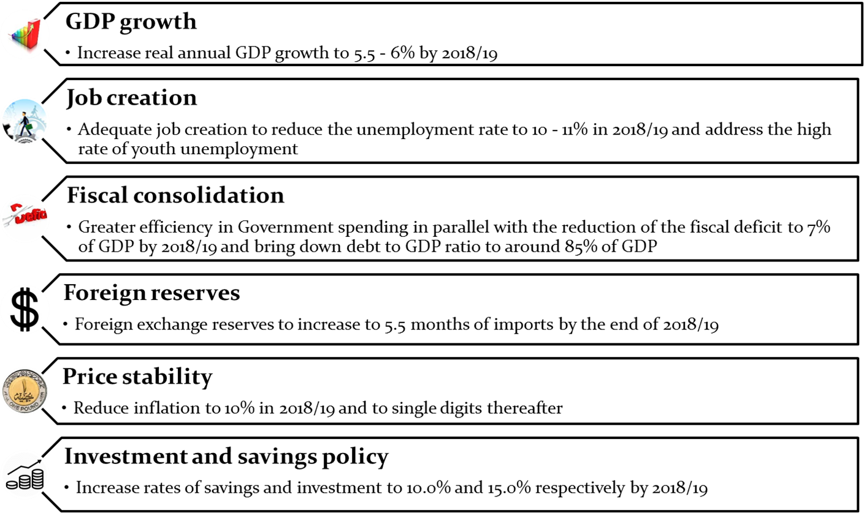
Macro-Fiscal Medium Term Targets

Slide 24
Continue to strengthen fiscal framework and macroeconomic stability
Improve predictability of planned policies by publishing medium term strategies
Enhance Risk Management capabilities
Adopt top down strategic budgeting and focus more on value for money
Focusing on sustaining a higher growth path led by the private sector
Improve productivity (Increase land availability)
Enhance competition
Enhance the independence and capacity of Egyptian Competition Authority. (A new law was submitted to the parliament)
Ensure more opportunities to the private sector through IPO program, which includes 23 companies, with a potential increase in market value of around EGP430 billion over a duration of around 30 months.
A modern and efficient procurement system is now in place that would help us achieve value for money.
Adopt a modern and effective tax regime for SMEs (pay reduced flat tax rate)

Slide 25
Fiscal Reform through Tax Modernization
As tax represented around 75% of the budget. Realizing Egypt’s tax potential requires policy reforms, tax administration reforms and institutional reforms such as issuing Medium Term Revenue strategy (MTRS). We are currently working on preparing our first MTRS in the coming period.
Our vision is:
Set a stable tax policy in both, the short and long term.
Achieve the fiscal, economic and social objectives of the tax, and raise tax revenues ratio to GDP by 1% annually, to reach approximately 18% by fiscal year 2022.
Broadening the tax base by modernizing our current tax legislations and policies in line with international best practices.
Improving effectiveness and efficiency of our tax system by simplifying, automating and streamlining tax procedures.
Enhancing tax administration and upgrading skills of our people through the implementation “Tax Administration Modernization Programs”.

Slide 26
Fiscal Reform through Tax Modernization
Tax Administration Reforms
Starting the compulsory submission of tax returners electronically since 1st January 2019
The automated integration of both the income and VAT tax systems by unifying procedures, work flow, and database.
The issuance of the smart tax card for tax payers, which will provide significant control and regulation.
The introduction of E-Invoice B2B where companies will register and produce all VAT receipts and invoices, to oversee all transactions and reduce fake receipts.
The introduction of Small and Micro Business tax treatment
The introduction of E-Commerce and on-line Advertisements law
The Modernization of ETA offices to improve operational performance through modernizing The IT system and enhancing ETA asset management
Aligning tax reform agenda with “international best tax practices” through: Becoming a member of Base Erosion and Profit Shifting (‘BEPS’) - activating a modern transfer pricing regime to support fair and effective taxation – Joining the Global Forum on Transparency and Exchange of Information.

Slide 27
Fiscal Reform through Digitization of Treasury Transactions
Automation of Payroll System:
Issuance of the Egyptian government card for the disbursement of salaries of government employees including all accounting units of the state budget and the economic authorities.
Report the breakdown of wages, rewards, allowances and other components of the wage bill, on daily, weekly and monthly basis.
Completion of the contractual procedures of the payroll system for the government employees under for 3,200 accounting units.
Activation of the system through 11 banks in addition to the Egyptian Post Office.
Issue 4.9 million cards for employees in service. The E-payment system directly transfer to the employees' bank accounts -opened in advance by the Ministry of Finance –so as to be then cached by ATM cards issued by the Ministry for all employees.

Slide 28
Digitization of Treasury Transactions is a key tool to reach Fiscal Consolidation
Payment and Collection:
Full activation of GFMIS
Payable for suppliers and contractors dealing with the government are transferred directly in their banking accounts after being deducted from the TSA
Ministry of Finance had a cooperation protocol with the CBE under which, sub-accounts related to the different administrative bodies at the CBE, reaching almost 60 thousands in number, were closed and substituted by the TSA at the Central Accounting Unit at the Ministry of Finance.
Cancelation of paper checks and execution of transactions by electronic payment orders.
Through settlement between all units in the banking system of the TSA by payment order (settlement permit).
Optimizing the E-Collection System of Tax and Customs through the CBE protocol.
A new law for “Non-Cash Transactions” are about to be activated, prohibiting cash payments for governmental services.

Slide 29
Thank You

