Slide 1
Fiscal Reform in the Philippines
A Case Study

Slide 2
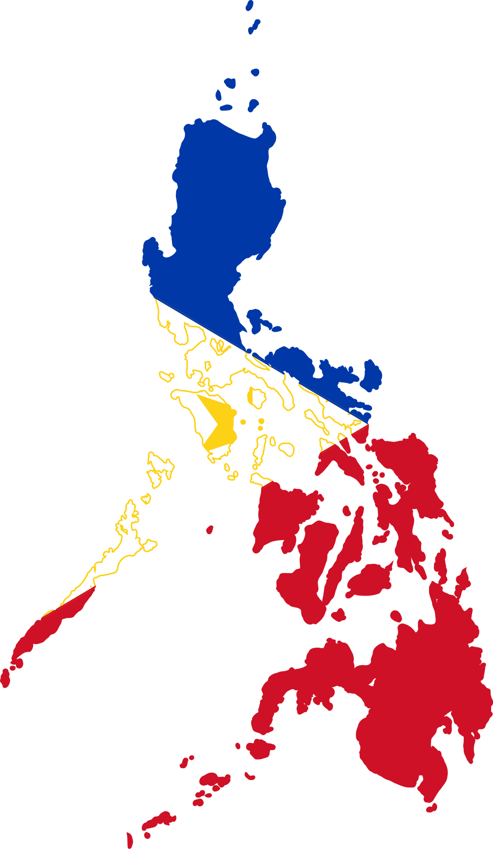
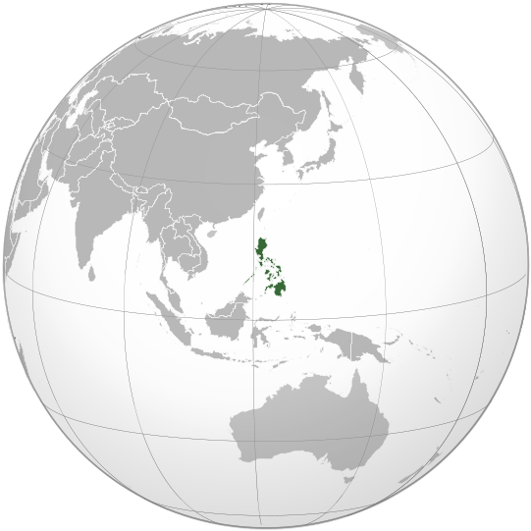
The Philippines Today
6.2% GDP growth in 2018
6% average from 2010-present
20 years of uninterrupted economic expansion
Investment Grade
Credit Rating Agency | Rating
Moody’s | Baa2/stable
S&P | BBB/positive
Fitch | BBB/stable
Declining Debt Burden
Indicator | 2018
National Government Debt | 41.9% of GDP
Debt Service | 2.6% of GDP
Outstanding External Debt Stock | 23.3% of GDP
External Debt Share | 34.5% of total debt stock
Average fiscal deficit over 10 years at 2.2%
5.3% unemployment in 2018
Moderate inflation pressures in 2018 at 5.2%

Slide 3
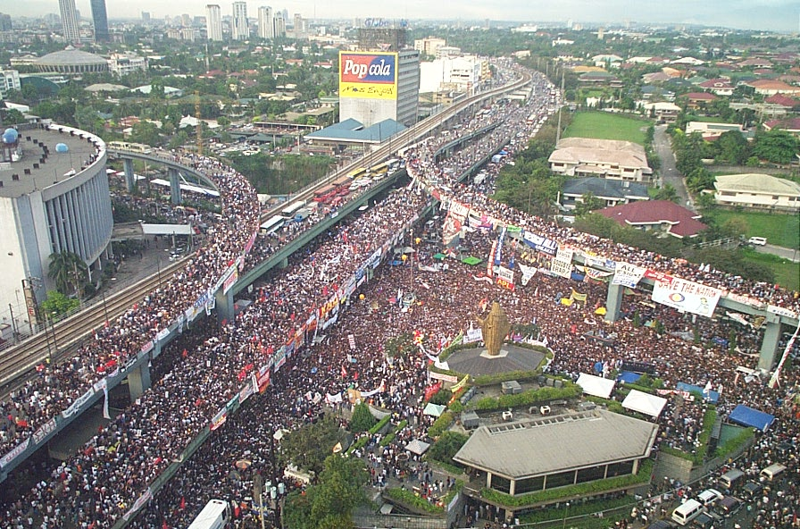
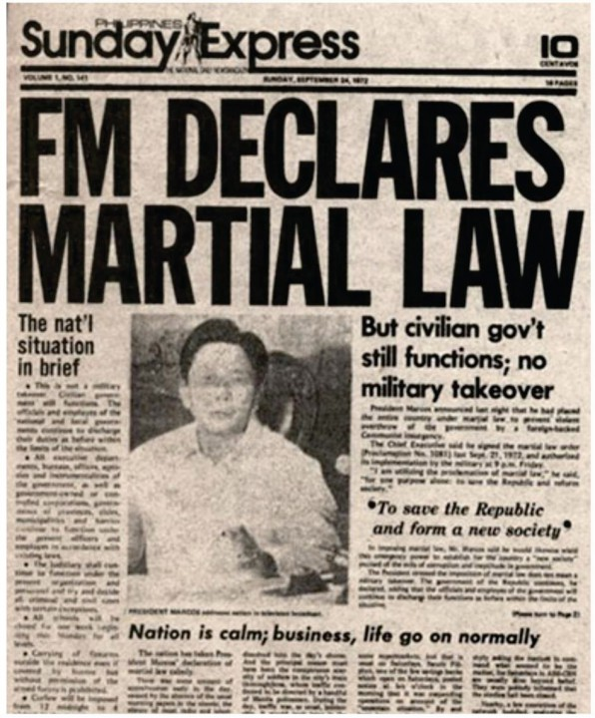
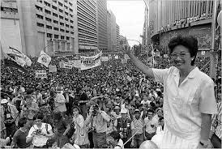
Tug of War Between Reform and Regress

Slide 4
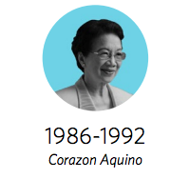
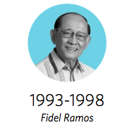
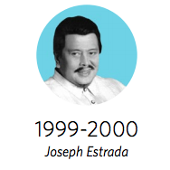
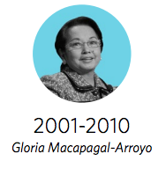
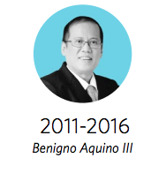
Overview of Reforms after the 1986 Revolution
restructuring/rescheduling but honoring all debts
asset privatization
tax reform (introduction of VAT at 10%)
Build-Operate-Transfer Law
foreign investments incentives
liberalization: tariff, industries, foreign investments
institutional reforms: BSP, PEZA, BCDA
1997 National Internal Revenue Code (NIRC)
VAT restructuring & exemptions
EDSA People Power 2
Microfinance framework
General Banking Law
Motor Vehicle User Charge
Retail Trade Liberalization Act
Liberalization of Energy Sector
Credit Information System
Expanded VAT
2nd Sin Tax Reform
Expanded personal income tax exemptions
Raised then lowered corporate income taxes
Revenue administration and enforcement programs
Procurement Reform
Anti-corruption campaign
Budget reforms; open gov’t
GCG Law
PPP Program Launched
Open Skies Policy
Sin Tax Reform
K-12 and Ladderized Education
Tax Incentives Transparency
Customs Modernization
Data Privacy
Mining Sector Reforms
Full Banking Liberalization
refers to fiscal reforms

Slide 5
Overview of Ongoing Reforms under Rodrigo Duterte
Tax Reform for Acceleration and Inclusion (comprehensive tax reform, first since 1997)
US$180 billion Build, Build, Build Infrastructure Program
Ease of Doing Business Act
National ID
National Payments System
Universal Health Care
BSP Charter strengthening the central bank
Social Security Act
Rice Tariffication
pending in Congress: TRAIN Package 2
pending in Congress: Sin Tax 2+
refers to fiscal reforms

Slide 6
10 Lessons Learned

Slide 7
Confidence as our first currency
1
Ratings Change |  | Outlook Change
Positive | Negative | Positive | Negative
2 | 0 | 2 | 2
Higher Investment
Good Governance
Ratings Change |  | Outlook Change
Positive | Negative | Positive | Negative
0 | 0 | 1 | 2
Virtuous Cycle
Ratings upgrades
Ratings Change |  | Outlook Change
Positive | Negative | Positive | Negative
1 | 6 | 11 | 12
GDP growth
Investor Confidence
Ratings Change |  | Outlook Change
Positive | Negative | Positive | Negative
15 | 0 | 9 | 0

Slide 8
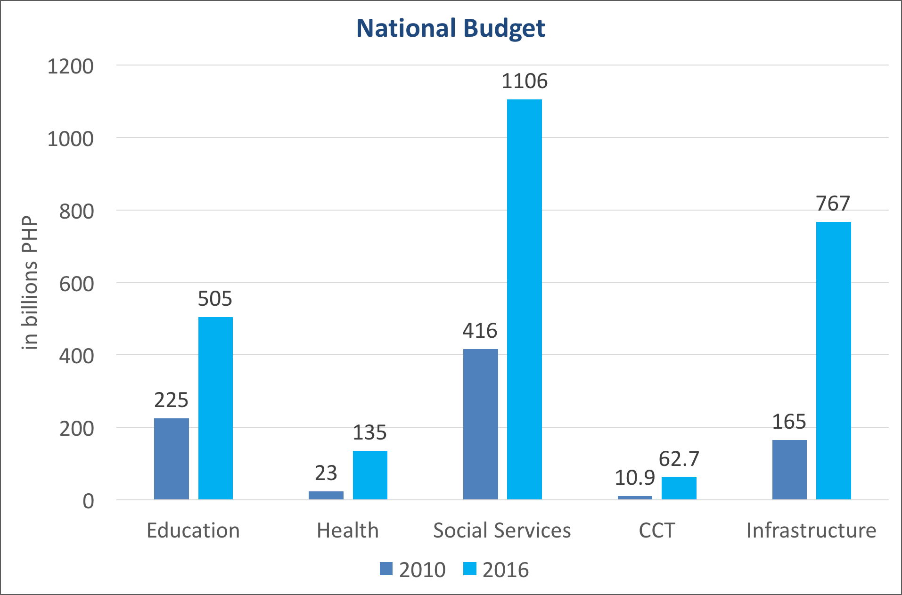

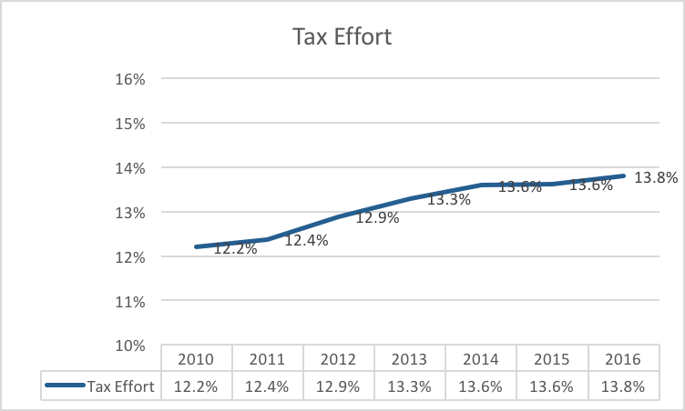
There’s more to fiscal reform than revenues
2
Raising Revenues
Expense rationalization
Addressing corruption
Fiscal Policy Toolbox
Increase in revenue + reduction in expense wastage +
reduction in interest expense =
expanded fiscal space for public investments

Slide 9

Trojan horses can house fiscal reforms
3
Fiscal Reform
Increased Fiscal Space
Development Outcomes
Logic of Reform
Packaging and Selling the Reform reflects the logic of reform
Fiscal Reform
Intended Outcome (e.g. expanded health coverage, better infrastructure)

Slide 10


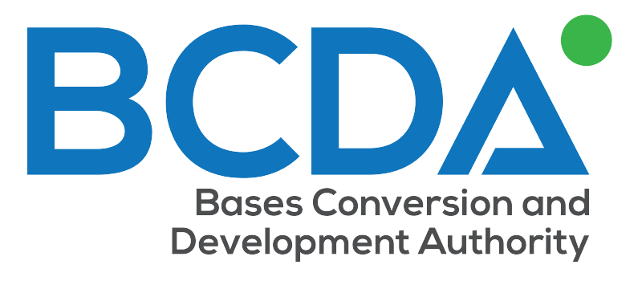





Institutionalize reforms to make them last
4

Slide 11
Using technology and media to disrupt the status quo
5
1) Technology for Greater Transparency & Accountability
eFiling
IRSIS – revenue stamping system with QR codes
Customs Modernization & National Single Window
Open Data, Tax Watch, FIU, Name & Shame Campaigns
2) Taking on a Law Enforcement Role
RATS – 222 cases filed worth PHP 26.2 billion in duties and taxes
RATE – 463 cases filed with PHP 77.4 billion worth of tax liabilities
RIPS - 282 revenue collection officers charged
Summary of Key Objectives
Use technology to disrupt low tax compliance status quo
Make tax compliance and administration easier and simpler
Increase the risks of corruption
Increase the incentives to perform
3) Restructuring Incentives to Reshape Behavior
Lateral Attrition Law
Exemption from Salary Standardization
Agency Budget Autonomy

Slide 12
Think Holistically: fiscal reform as part of larger whole
6
Structural Reform
ease of doing business
Fiscal Reform
revenue optimization
Investment
Investing in health, education, infrastructure
Liberalization
trade/tariff liberalization
expense rationalization
minimizing leakages
prudent debt management
enforcing and strengthening the rule of law
liberalization of industries (case to case basis)
entry of foreign investment and players
eliminating corruption
creating competitive labor markets
increasing productivity
judicious incentives

Slide 13


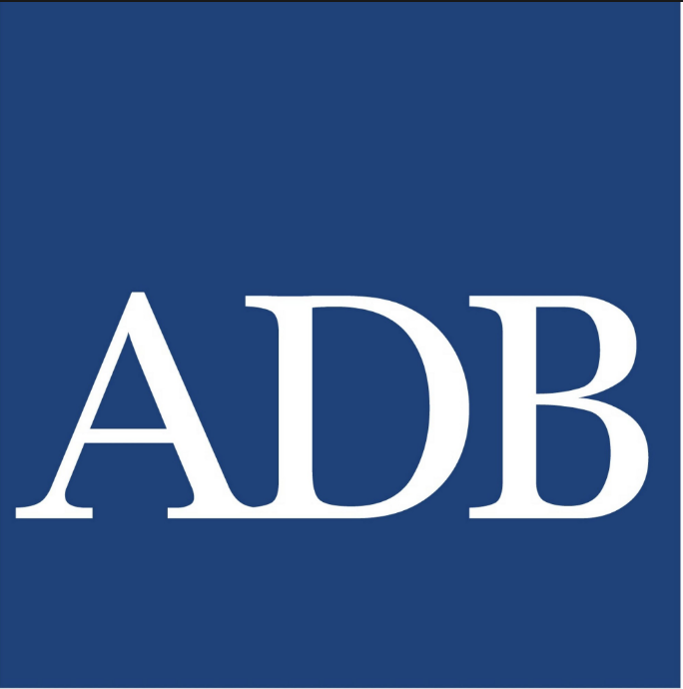

Fear not the multilaterals
7

Slide 14
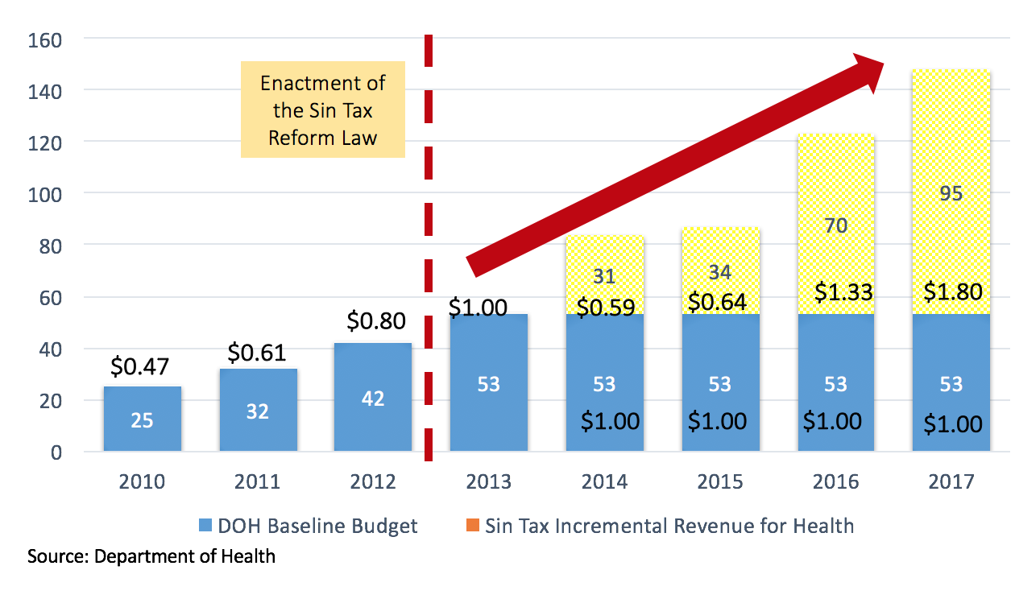
Compromise is not only acceptable, but necessary
8
example 1: earmarking tobacco taxation to the health budget
example 2: negotiating with the Department of Trade and Industry on Tax Incentives Management and Transparency

Slide 15
Stakeholders strengthen the reform process
9
employing creative approaches to weaken or deal with entrenched interests (case: sin tax reform of 2012)
consulting each antagonistic stakeholder group and finding a way to bypass opposition (case: subsidies for public utility vehicle drivers in raising fuel excises taxes)
this inclusive approach ensures that reforms are less likely to be reversed as there are more groups with interests vested in the enacted reform

Slide 16
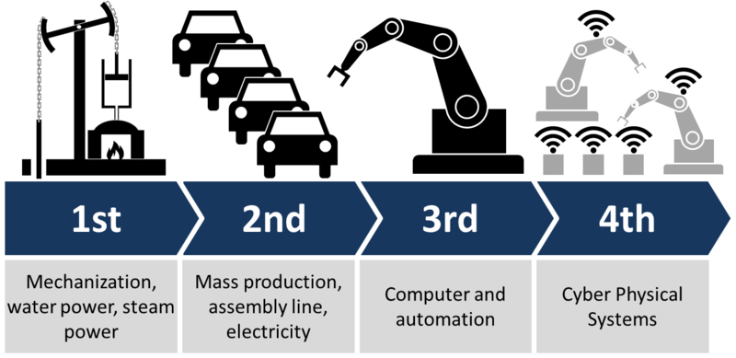
Reform is always a work in progress
10
Ongoing process in an infinite continuum
Not always a straight line, often incremental at best
What’s on the horizon?

Slide 17
END
Cesar V. Purisima
Asia Fellow, Milken Institute
Secretary of Finance, Republic of the Philippines (2005, 2010-2016)

