Slide 1
52st Session of the Conference of African Ministers of Finance, Planning and Economic Development
Fiscal Policy, Trade and the Private Sector in a Digital Era.
Ms. Vera Songwe,
Executive Secretary
Economic Commission for Africa
Notes:
Indicate that slides show, necessarily, a very brief highlight of material: for considerably more detail, audience can see upcoming ARIA IX report

Slide 2


www.uneca.org

Slide 3


Slide 4
9 Programmatic Clusters
Macroeconomics & Governance
Private Sector Development & Finance
Data & Statistics
Technology, Climate Change & Natural Resource Management
Regional Integration and Trade
Gender equality and Women empowerment
Poverty, Inequality and Social Policy
Economic Development and Planning
Sub regional activities

Slide 5
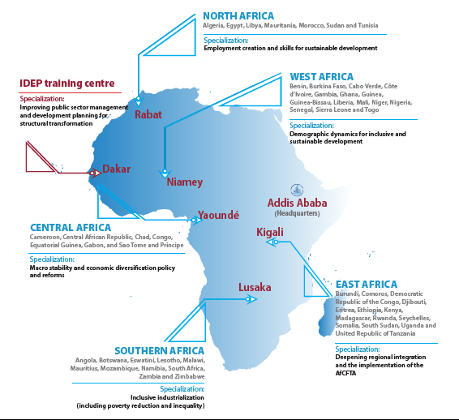

Slide 6
Positive growth outlook
www.uneca.org

Slide 7
GDP per capita stagnating/falling in some countries

Slide 8
African Poverty Clock
https://www.africanpoverty.io/index.html

Slide 9
Estimated Financing Gaps
SDGs:
USD 614-638 Billion annually
Infrastructure:
USD 130-170 Billion annually
Healthcare financing:
USD 66 Billion annualy
www.uneca.org

Slide 10
Tax-to-GDP-ratios across regions
www.uneca.org

Slide 11
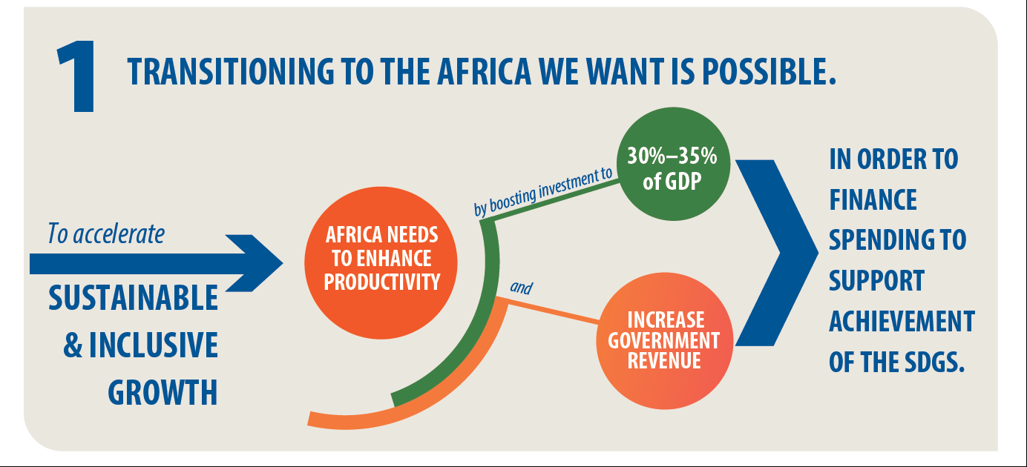


Slide 12
Trade: Intra and extra-group merchandise for selected regions (percentage, average 2012-2016)
Source: Based on data from UNCTADStat
www.uneca.org

Slide 13
Intra-African trade as a share of GDP
UNECA.ORG

Slide 14
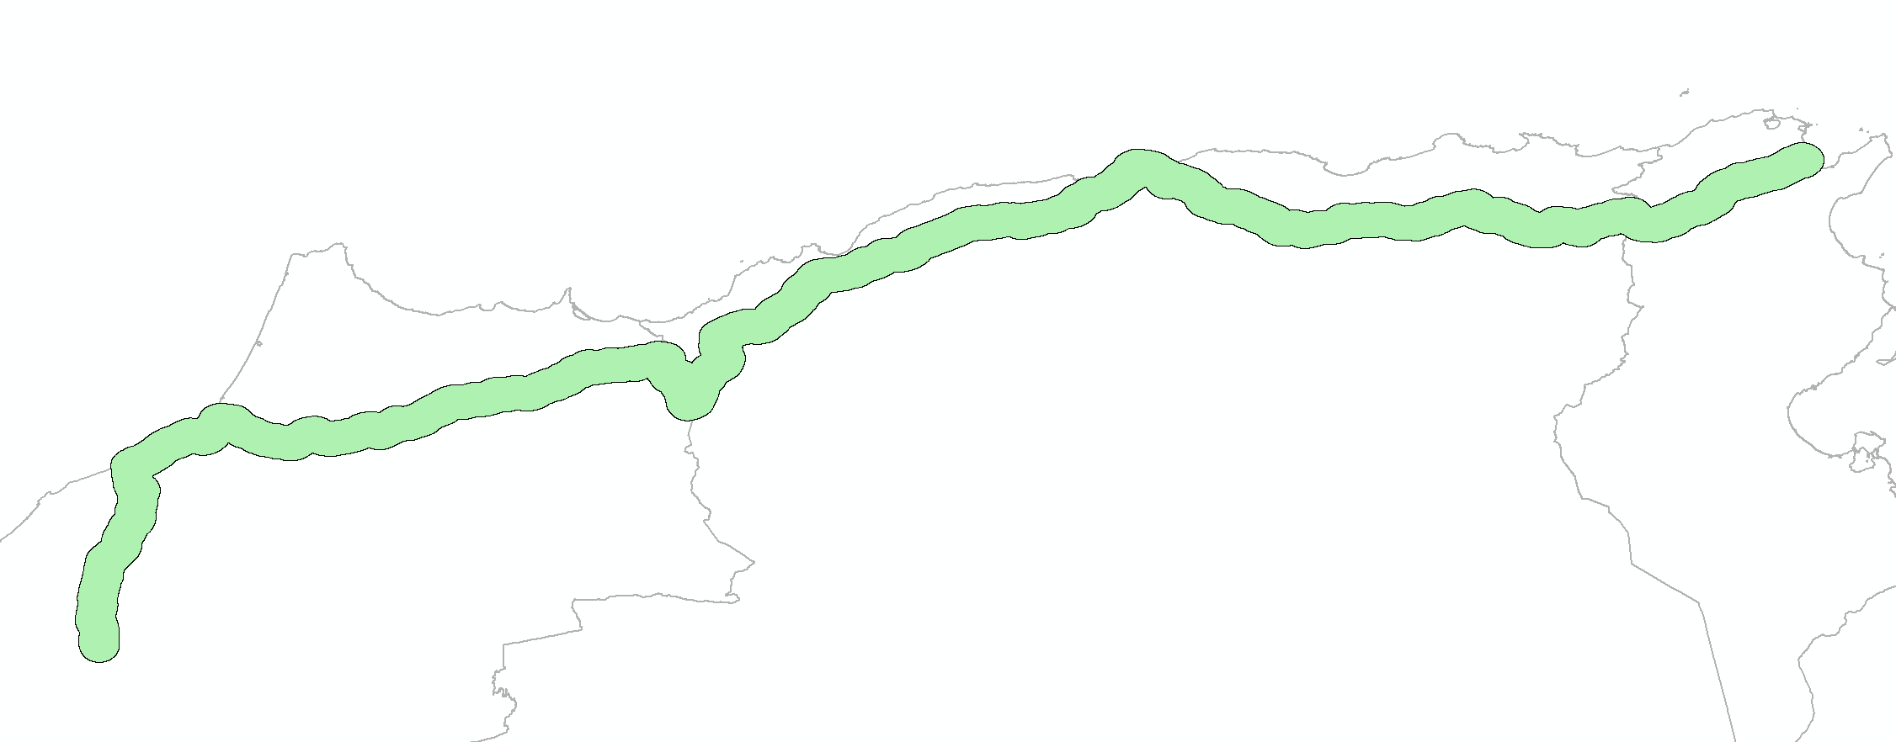
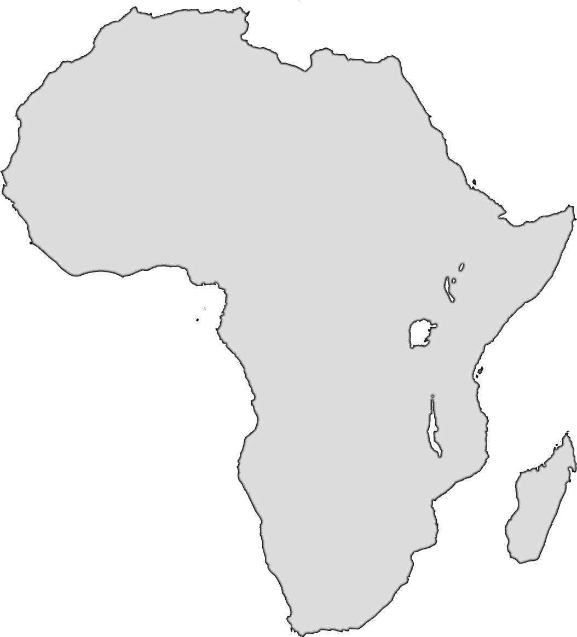
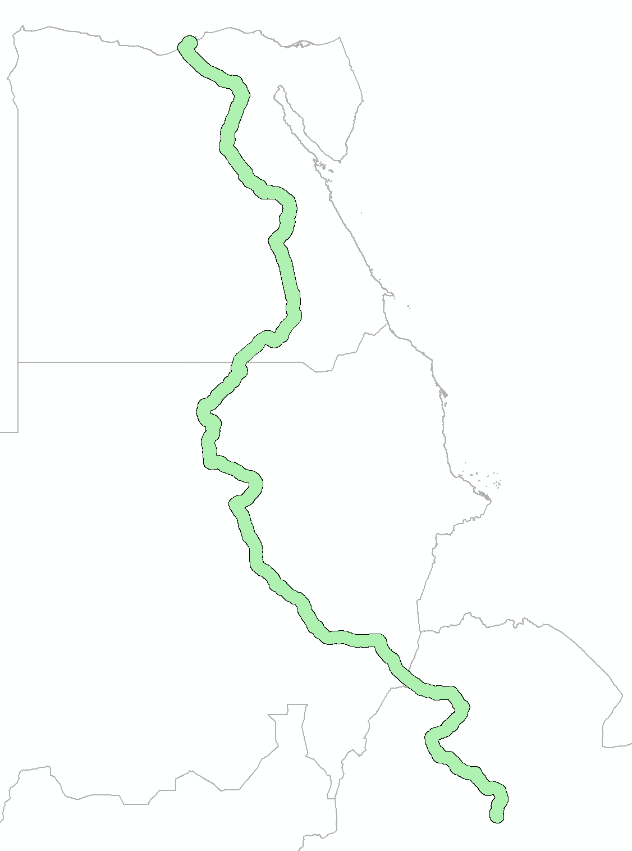
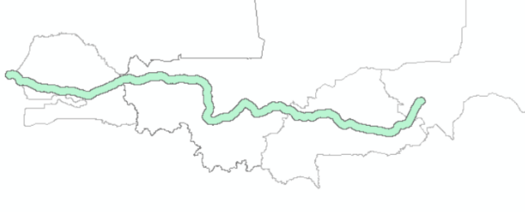
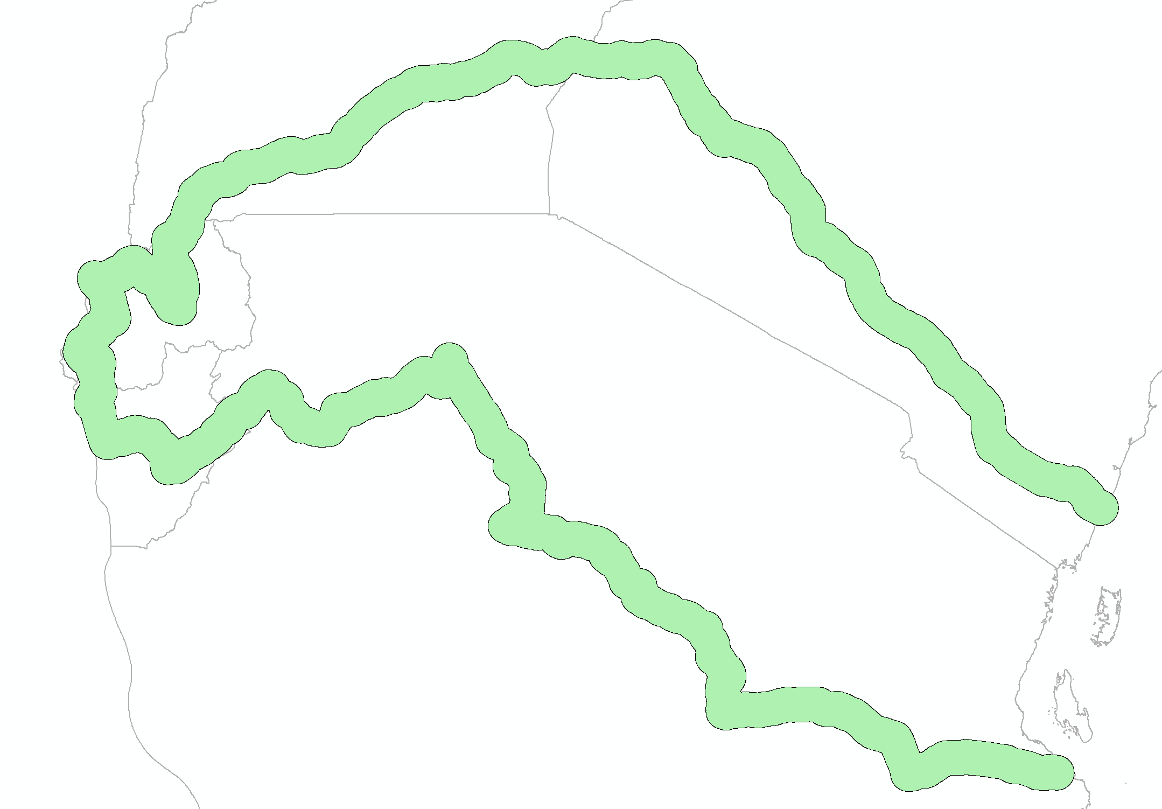
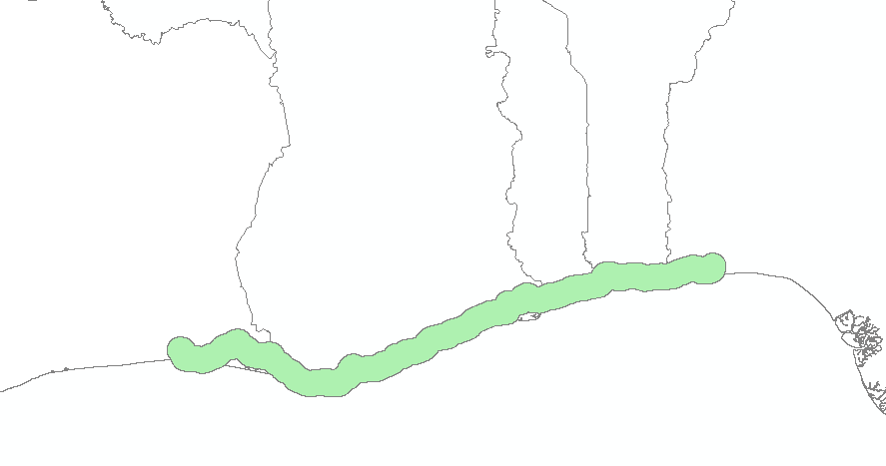
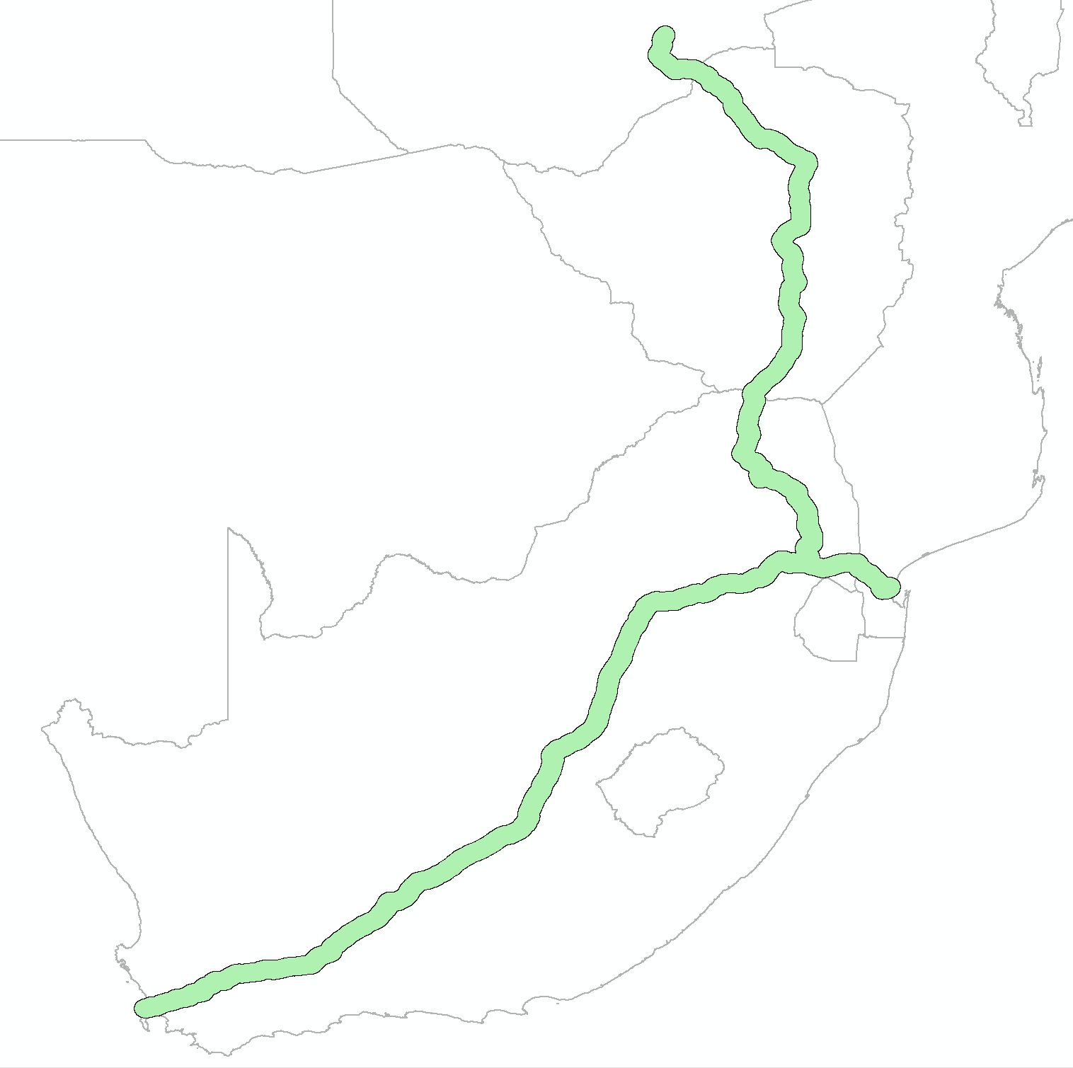
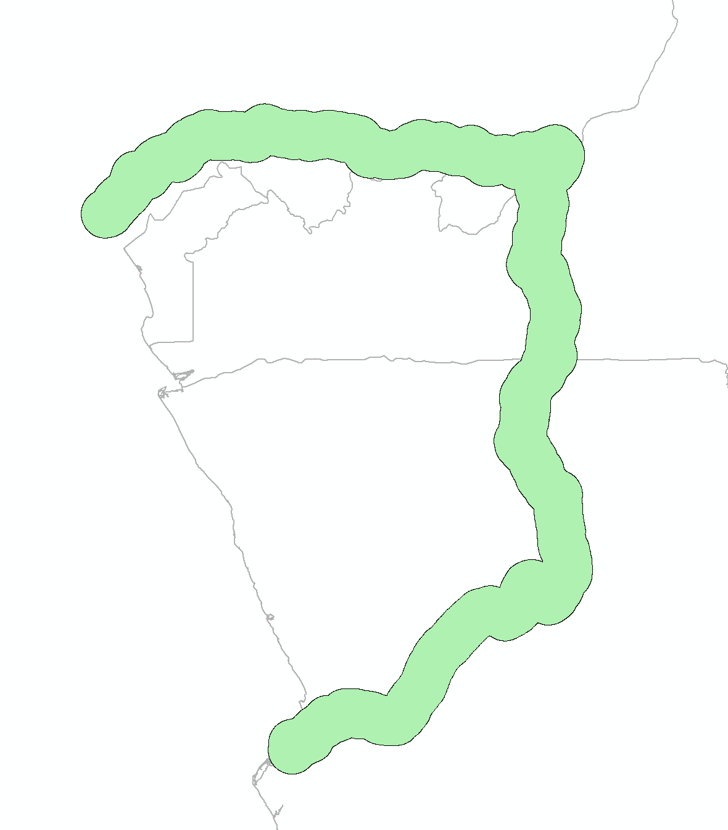
Addressing Non-Tariff Barriers: Logistics
Alexandria to Addis Ababa:
3,944 km
Marrakesh to Tunis: 2,323 km
Dakar to Niamey: 2,570 km
Abidjan to Lagos:
990 km
Mombasa to Dar es Salaam: 3,882 km
Point-Noire to Luanda:
1,343 km
Cape Town to Lusaka:
3,017 km
UNECA.ORG
Notes:
Eliminating tariffs and removing non-tariffs barriers, such as cumbersome border procedures and significant infrastructure bottlenecks is critical in critical to addressing this. This is precisely the overarching objective of the recently signed Agreement Establishing the African Continental Free Trade Area (AfCFTA), which is championed by the African Union Commission (AUC) and the eight Regional Economic Communities (RECs).

Slide 15
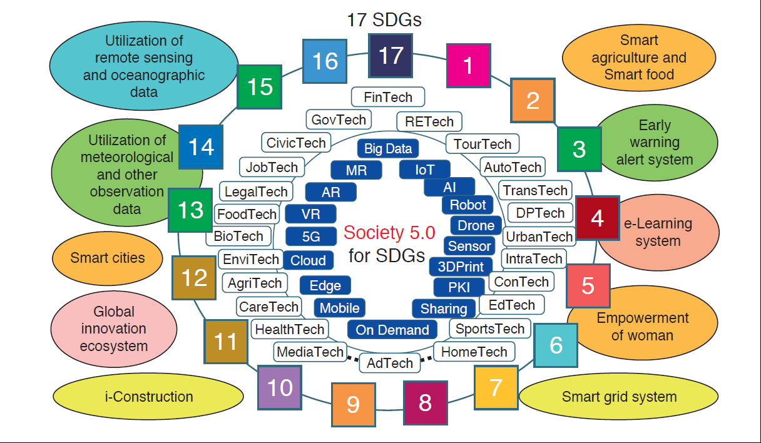
Opportunities in Digitalization

Slide 16
Leveraging digitalization could lower tax administration costs
www.uneca.org

Slide 17
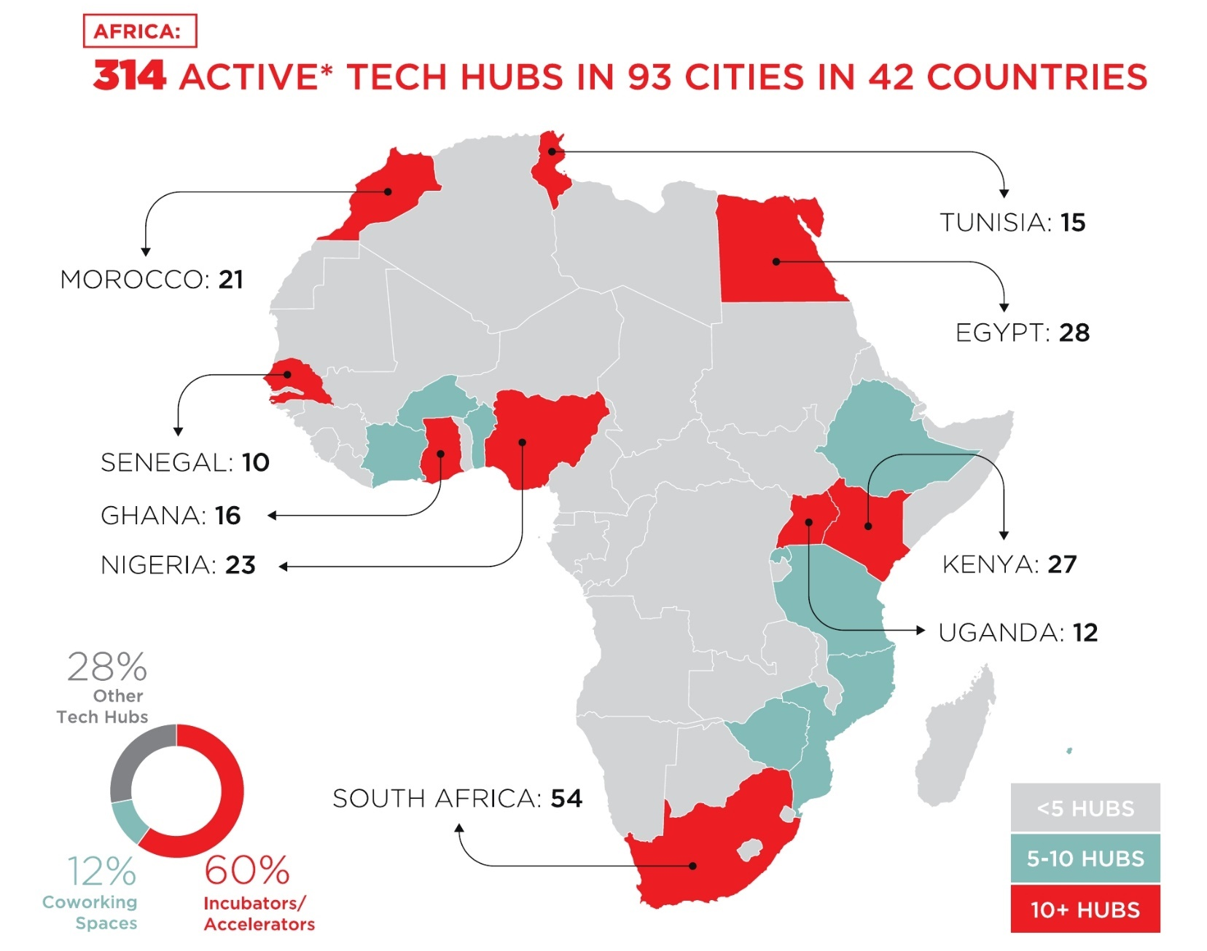
Tech hubs in Africa
www.uneca.org

Slide 18







ECA Digital Center of Excellence
Harmonization, Regulation, Infrastructure
Capacity & Skills, Sovereignty,
Privacy & Cyber security
Mobile access & connectivity
SIM registration
Mobile transactions
Financial inclusion
E-payments
P2P transfers
Access to financial services
Economic opportunity
Sharing economy
Opening small business
Digital trade
Cross-border trade
Democratic process
Fair, fast and secure voting, tracked to an individual’s verified digital id
Domestic accountability
My digital identity
Social Services
Maternal & child health services tracking
eHealth, virtual health services
Educational enrollment
Public Finance
Domestic Resource Mobilization
Effective targeting
Payroll Integrity
Government services
Social Intervention programs
Cash transfers
Pensions
Leaving no one behind
18
UNECA.ORG

Slide 19

Thank you
www.uneca.org

