Slide 1
Robert Lisinge Chief: Energy, Infrastructure & Services Section Private Sector Development and Finance Division Policy and regulatory environment for innovative financing of sustainable energy and infrastructure development in Africa
Economic Commission for Africa
Committee on Private Sector Development, Regional Integration, Trade, Infrastructure, Industry and Technology
11-12 December 2019
Addis Ababa, Ethiopia

Slide 2
Contents
Infrastructure financing gap
Energy infrastructure
Transport infrastructure
PIDA Implementation
Key issues and questions

Slide 3
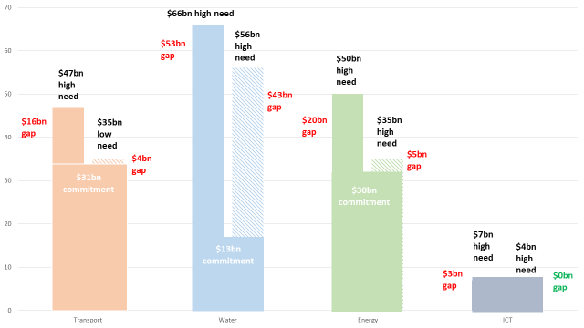
Current infrastructure financing in Africa at a glance
$34bn
Source: ICA (2018). Infrastructure Financing Trends in Africa 2018. ICA & AfDB, Abidjan

Slide 4
Key messages
Investment in infrastructure is crucial in supporting and sustaining the growth dividends in Africa
Continent’s infrastructure funding needs is $130-$170 billion p.a., and the current financing gap is $52-$92 billion p.a.
The construction and operation of infrastructure facilities in Africa have traditionally been dominated by the public sector
Governments experience enormous financial challenges in providing critical infrastructure
New sources of financing and investments are needed across all infrastructure assets except ICT (construction and operations)
Private sector investments and financing hold promise but of $100.8 invested in infrastructure – private sector only invested $11.824m
More than 50% in energy sector
More than 60% in South Africa

Slide 5
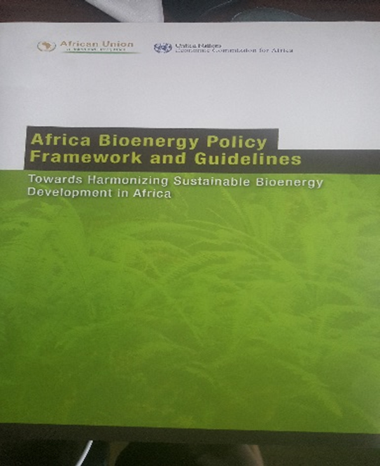
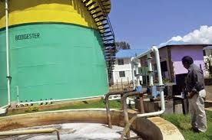
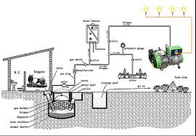
Innovative financing & investment in modern bioenergy
Since 2012, ECA, AUC and AUDA-NEPAD championing modern bioenergy development – AU Declaration (2013)
Followed by mainstreaming of bioenergy policies & guidelines (2014-2017) – several capacity building programs
Support provided to AUC and RECs in developing Regional Bioenergy Strategy and Investment Plans (complete for East Africa)
Next steps:
Assist African regions to complete regional bioenergy strategies and & investment plans
As per the 2019 STC resolution, assist in the establishment of Bioenergy Risk Mitigation Facility to incubate projects & assist with early project preparation

Slide 6
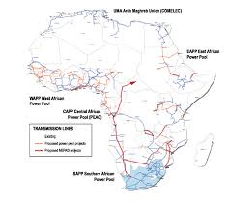
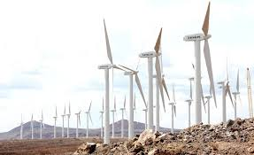
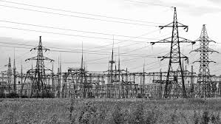
Regulations for private sector investment in power
Developed methodology to investigate effectiveness of electricity sector policy, and legislative and regulatory frameworks to attract market appetite of private investors
Market openness (energy market structure and governance)
Market attractiveness (sector economics):
Market readiness (market maturity)
Next steps:
Undertaking case studies in 15 African countries from the 5 regions using the developed methodology
Country-based validation on regulatory openness, attractiveness and readiness
Consolidated Africa-wide study and recommendations

Slide 7
On-demand technical support to African member states
Energy planning & policy dialogue for 18 African countries in support of AUDA-NEPAD
Electrification planning using OSeMOSYS (Open-Source Energy Modelling System) & OnSSET (Open Source Spatial Electrification Tool) for the Horn of Africa countries
Eritrea on statistical capacity development, including energy statistics – in partnership with UNDP and EU
Angola on potential crowding-in of private sector investors in the Angolan capital market, including energy
Ethiopia for tariff related to energy contracts and private sector engagement

Slide 8
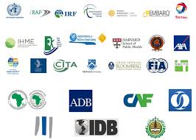
Road safety: African post-2020 strategy and action plan
African post-2020 Road Safety Strategy and Action Plan drafted & presented at the 4th African Road Safety Conference jointly organized by ECA & AUC in Addis Ababa from 30th Sep-1 Oct 2019
Addressing low performance by African countries in implementation of Action Plan, incl. lack of political leadership and accountability, & inadequate involvement of the private sector and civil society
ECA, AUC, SSATP & AfDB recommended to support the creation of Centres of Excellence on road safety involving African universities, and to strengthen national commitments to road safety.

Slide 9
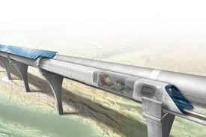
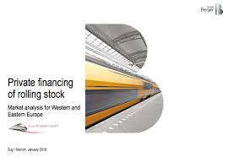
Luxembourg Protocol to finance railway stock
Luxembourg Protocol is new legal instrument that will allow States to pass on the cost of railway stock to the private sector
Attracting private capital to support existing & new rail projects by facilitating the provision of finance from banks and other funders for rolling stock procurement
A growing number of countries are working towards its ratification
Advocacy by ECA and partners in various platforms incl. STC, special and dedicated high-level workshops with Africa Member States
Continental High Speed Rail Project

Slide 10
Technical support to the implementation of PIDA
Common African Position for Infrastructure Partnerships
Why does Africa need a common strategy for engaging with non-African countries and organisations in infrastructure partnerships?
On what specific issues do African countries and organisations need guidance in their engagement with non-African countries and organisations?
What are the different mechanism applied in Africa’s partnerships with non-African countries and organisations and how could PIDA be incorporated/mainstreamed in these mechanisms?
Technical support to the development of the Continental Power Systems Masterplan to be undertaken in 2020

Slide 11
Emerging issues and key question
Public-private partnerships for infrastructure financing and operation
Digitalization of transport planning and energy transmission and distribution
Implications of the AfCFTA for regional transport infrastructure and services
Key Question for Discussion
What are challenges to private sector investment in energy and infrastructure projects in Africa?
What are the challenges encountered PPPs in Africa & what can be done to address these?
What should be the region’s principles and strategies for engaging with non-African countries and organizations in its regional infrastructure development?
What could be considered as KPIs for effective infrastructure partnerships with non-African countries and organizations from an African perspective?

Slide 12
THANK YOU!

