Slide 1
The African Continental Free Trade Area:
An update on the establishment of the agreement and status of negotiations on phase II
Laura Páez,
Chief, Market Institutions Section
Regional Integration and Trade Division
11 December 2019
Addis Ababa, Ethiopia

Slide 2
Outline
  Introduction & Background
  Main Accomplishments:
    Analysis of AfCFTA effects
    Issues relating to Phase II
    Launch of workstream on DITE
    Compendium on investment
    Electronic investment guides (iGuides)
    Research on BITs & DTTs & Intra-African Investment
    2nd edition of the ARII
  Recommendations and Conclusions
Notes:
This presentation summarizes what has been captured in the Parliamentary document titled ”The African Continental Free Trade Area: An update on the establishment of the agreement and status of negotiations on phase II“ that is contained in your folders.
Main accomplishments:
i) Further analysis of the effect of the Agreement Establishing the AfCFTA, focusing on its expected impact and on how member States may be able to maximize its benefits;
ii) Issues relating to the elaboration of phase II negotiations relating to the African Continental Free Trade Area (investment, intellectual property rights and competition policy)
iii) The launch of a new work stream on digital trade and the digital economy; iv) Collection and compilation of data on intra-African investments
v) the launch of the electronic investment guides (iGuides);
vi) Assessment of the linkages between double taxation agreements and bilateral investment treaties and of drivers on intra-African investment
vii) preparation of the second iteration of the African Regional Integration Index.

Slide 3





Introduction and Background
Important changes during the 2018-2019 Biennium:
The last session of the CRCI was held in 2017
Member States called for a review of ECA’s intergovernmental structure and mandated the reconstitution of Committees (Resolutions 943 & 957)
The establishment of this Committee responds to the call under the new strategic directors & core functions
Convening
Operations
Think Tank
Notes:
The establishment of the new Committee on Private Sector Development, Regional Integration, Trade, Infrastructure, Industry and Technology (PSRTTIT), responds to the reform efforts to have a more coordinated and streamlined approach, under the new strategic directions and core functions of the Commission. These are:
In this vein, the main accomplishments of ECA subprogramme 2 for the biennium 2018–2019 will be presented under that lens today and also tomorrow.

Slide 4
Accomplishments: Analysis on AfCFTA Effects
Flagship Report
Assessing Regional Integration in Africa IX (2019)
Analysis of the Issues Affecting Implementation of the AfCFTA:
Tools & Programmes to support Negotiations & implementation
Toolkit on trade in goods
Toolkit on trade in services
AfCFTA Q&A
Support for AfCFTA national implementation strategies in 14 countries
3 Regional Forums
Internal & External Threats
Phase II Issues: Investment, Intellectual Property and Competition Policy
E-Commerce in the AfCFTA
Progress towards Regional Integration
AfCFTA regional fora:
East Africa (Ethiopia)
West Africa (Senegal)
North Africa (Morocco)
Trainings on AfCFTA for policy makers & Journalists
DA projects on value chains
Notes:
The signing of the Agreement Establishing the AfCFTA by 54 African Union member States was a historic moment for economic integration in Africa. By 1 April 2019,, the threshold of ratification by 22 countries required for the agreement’s entry into force had been reached, with 27 ratifications by October 2019. The speed of ratification was unprecedented n. The momentum behind this free trade initiative inspired the focus of the ninth edition of the ECA flagship report, Assessing Regional Integration in Africa, which asked what the next steps might be for the AfCFTA.
ARIA IX provides an assessment of the risks ahead for the AfCFTA and describes the steps to success. It looks ahead to phase II negotiations relating to investment, intellectual property rights and competition policy, providing a preparatory situational analysis of the policy environment in Africa, and options for negotiators to consider in these areas during their negotiations.
The most recent empirical assessment by ECA of the modalities of the agreement on goods indicated that the gross domestic product (GDP) and trade in Africa would increase. Intra-African trade is expected to increase by between $50 billion (or 15 per cent) and $70 billion (or 25 per cent). About two thirds of the intra-African trade gains were expected to be in industry, offering opportunities for Africa to industrialize. Small countries need not fear as least developed countries in Africa would register the largest increases in intra-African exports of industrial products. Despite the decrease in tariff revenues, African welfare gains were set to increase slightly.
During 2018–2019, collaborations took place between ECA Subprogramme 2 and the African Union Commission – and other institutions – to support member States in organizing consultations and sensitization forums. Consultations took place in : Algeria, Benin, Cameroon, Congo, Côte d’Ivoire, the Democratic Republic of the Congo, Egypt, Ethiopia, Gabon, the Gambia, Guinea, Mauritania, the Niger, Rwanda, Senegal, Sierra Leone, Togo, Tunisia, Tanzania and Zimbabwe. Three large regional forums were held in Ethiopia, Senegal, Morocco with others scheduled in Southern and Central Africa.
Moreover, to ensure effective implementation of the Agreement, the Subprogramme provided support in the development of relevant national strategies and setting up national committees in the following 14 countries: Cameroon, Chad, Côte d’Ivoire, Djibouti, the Gambia, Guinea, Kenya, Mauritania, the Niger, Senegal, Sierra Leone, Togo, Zambia and Zimbabwe. The strategies are expected to complement the broader development framework, especially in relation to the trade policy environment of each country. It is expected that national strategies will facilitate the identification of both key opportunities for trade and value addition and constraints as well as assessments of the measures and capacities needed to take full advantage of national, regional and global markets within the AfCFTA.
Implementation of the Agreement also requires the existence of adequate infrastructure systems, including metrology, standardization, accreditation, quality management and conformity assessment. Compliance with standards and technical regulations is important for signalling and guaranteeing the quality of produced and traded goods. In that regard and following requests from member States, Subprogramme 2 has undertaken a research project to identify products and value chains to be prioritized for harmonization at the level of the regional economic community, in support of the coordination and advisory role on standards’ harmonization under the Agreement Establishing the African Continental Free Trade Area of the African Organization for Standardization.
Activities focused on the important trade and industrialization nexus and regional value chain development were undertaken during the period in review, with the following specific contributions:
Partnership with the Organization for Economic Cooperation and Development (OECD) and the Government of Egypt to use the product transformation policy review tool centred on regional value chain development in the context of the African Continental Free Trade Area;
In efforts to promote regional value chains across Africa, the Subprogramme collaborated with UNCTAD)to improve the capacity of cotton value chain stakeholders, including government officials, the private sector and farmers associations, in Uganda, Zambia and Zimbabwe, to assess the potential value, market situation and prospects for cotton by-products, including in the regional context. On the services front, the Subprogramme strengthened capacities of national and regional services trade policymakers to measure value chains and design services policies aimed at increasing integration and penetration into regional and global value chains. In that regard, in the period 2018–2019, six countries benefited from ECA support, in close collaboration with UNCTAD, namely: Ethiopia, the Gambia, Kenya, Mali, Nigeria and Togo.
In 2019, ECA and the African Export Import Bank launched a new pilot project on the enhanced quality of informal cross-border trade in the COWAS region. The pilot project is focusing on data collection, since this was identified as an essential first step to justify the importance of informal cross-border trade to policymakers and investors in the region. The specific objective of the pilot is to develop and execute a comprehensive survey methodology to collect data on such trade along the Abidjan–Lagos Corridor, which can subsequently be rolled out elsewhere on the continent. The data collection exercise, successfully launched in September 2019, will continue for a period of four months. Its findings are expected to shed light on the volume, value and variety of products traded along the corridor and on the constraints to formalization. The data collected will also be gender-disaggregated, which will help to provide a better picture on the gendered dimensions of informal cross-border trade, which is typically female-dominated.
Work on trade and gender was extended in order to identify and enhance the links between trade and women’s economic empowerment. Specific contributions included:
Organizing the 2018 Continental Trade and Gender Workshop on the margins of the Intra-African Trade Fair of the African Export-Import Bank;
Carrying out a comparative study of mainstreaming gender in trade policy at the regional economic community level;
Preparing policy briefs on options for mainstreaming gender in the implementation of the Agreement Establishing the African Continental Free Trade Area;
Developing and delivering trade, gender and development training to senior public officials at the African Institute for Economic Development and Planning (IDEP), which is the training arm of ECA;

Slide 5
Accomplishments:
Issues Relating to AfCFTA Phase II
Drafted Base Texts of AfCFTA Phase II Protocols with AU Commission
Analysis
Support to Negotiations
Publications ARIA IX & “Towards a Common Investment Area in the AfCFTA: Policy Options for Levelling the Investment Playing Field”
Notes:
In 2019, ECA and the African Union, together with the regional economic communities and experts in the above fields, drafted the base text of the protocols after lengthy consultations and exchange of best-practice information.
The negotiating team will consider the options provided by the draft protocols, including the possible establishment of new African Union entities to lead the competition policy initiatives; addressing continental innovation protection through intellectual property rights; and working towards the overall goal of intra-African investments through a comprehensive and effective investment protocol.
To assist the continent to achieve its regional integration goals, Subprogramme 2 is currently drafting a publication on Policy options towards levelling the playing field for intra-African investment through the establishment of a common investment area in the AfCFTA.

Slide 6
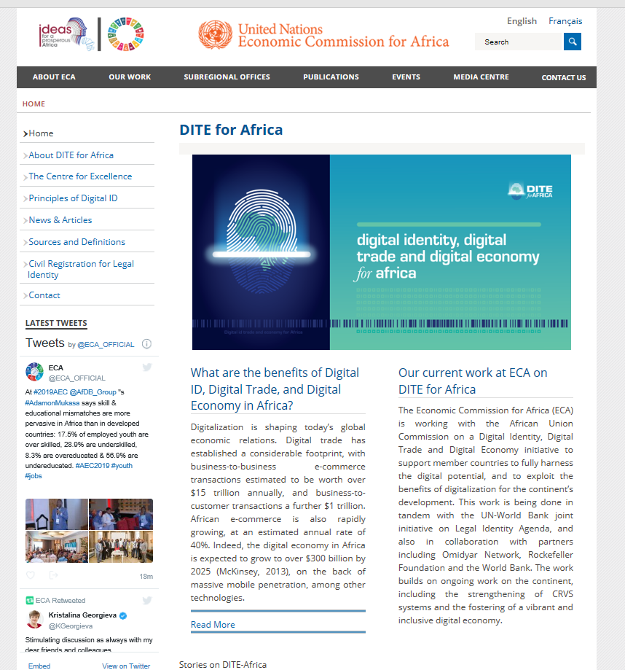
Accomplishments: Launch of Workstream on DITE
Developed an integrated work approach which coordinates expertise within ECA for delivery of technical assistance through ECA’s Digital Center of Excellence
Trade, Statistics, Technology, Private Sector & others
Participated in international and regional forae on e-commerce issues advocating for an African position on DITE
(UNCTAD and AU e-commerce conferences, Ethiopia, Kenya, Switzerland, Senegal)
Launched digital dialogues within countries to assess digital policy landscape and link digitalization to economic performance
South Africa, Seychelles
Contributed to AU Digital Transformation Strategy (2020-2030)
Foundational Pillars, Interoperability, Digital Trade and Digital Identity
https://www.uneca.org/dite-africa
Notes:
This cross-cutting work stream considers the interplay of digitization and trade diversification and industrialization, e-commerce for boosting intra-African trade and inclusion in the digital age. It covers the following topics:

Slide 7
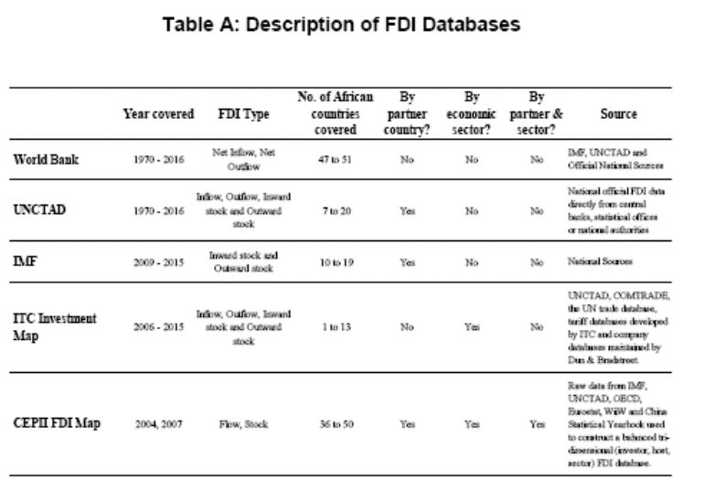
Accomplishments: Compendium on Investment
Developed & compiled data on investment to build an empirical foundation for African policy-oriented FDI research & bridge data gaps
Notes:
This publication was issued in the context of the biennial programme (2016–2017). During the tenth session of the Committee on Regional Cooperation and Integration, ECA member States recommended that further work be done to develop a database on investment in the coming biennium (2018–2019).
The Compendium on Investment was updated in 2019 to include recent figures on the flow of global foreign direct investment (FDI) to the continent and intra-African investment disaggregated by country of origin and economic sector. The Database was used to:
i) Support the research of African fellows: ”Cross-country evidence on the relationship between intra-African investment and business regulatory Environment
ii) Contributed to the Africa Arab Factbook which explores areas of potential cooperation between Arab and African countries focusing on opportunities for economic transformation.
iii) Produced Investment Profiles for African countries (highlighting the major trends and patterns of global FDI flows and intra-African investment in each member State)
Iv) Inform the World Investment Forum 2018 of existing data gaps in Africa to enable more exhaustive and comprehensive analysis of FDI drivers and policies in the continent.

Slide 8
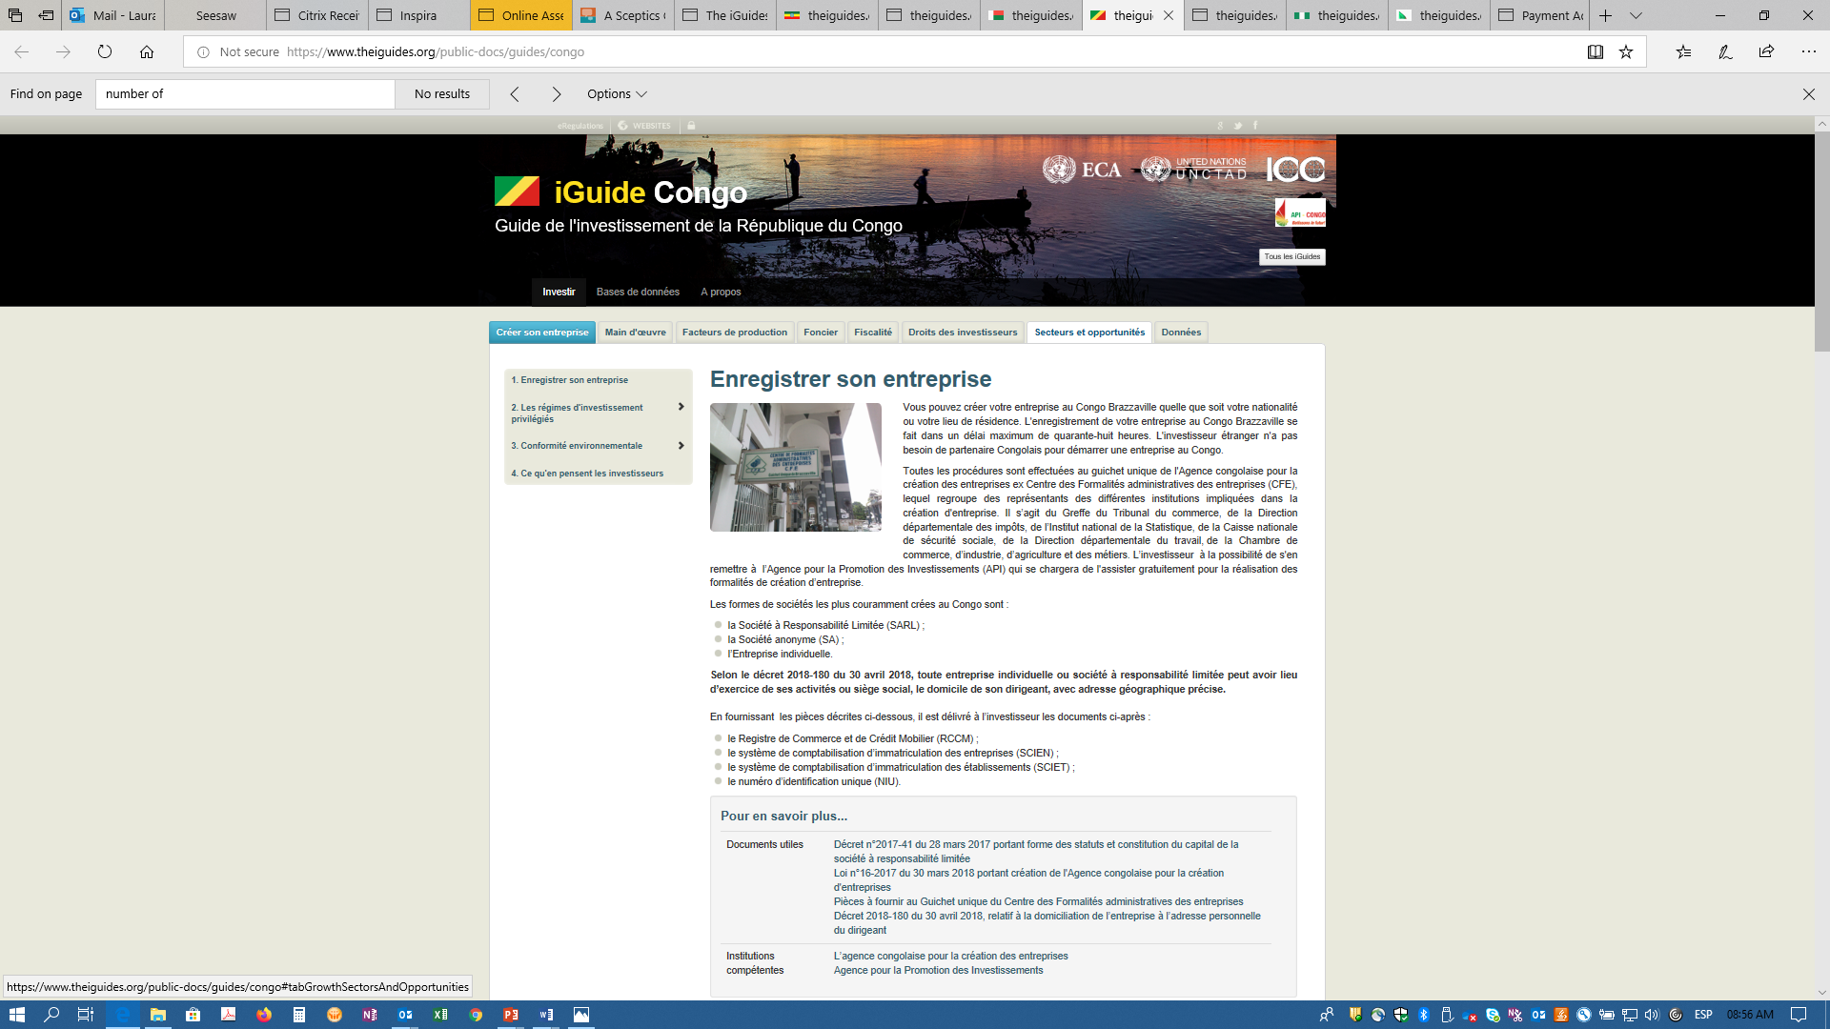
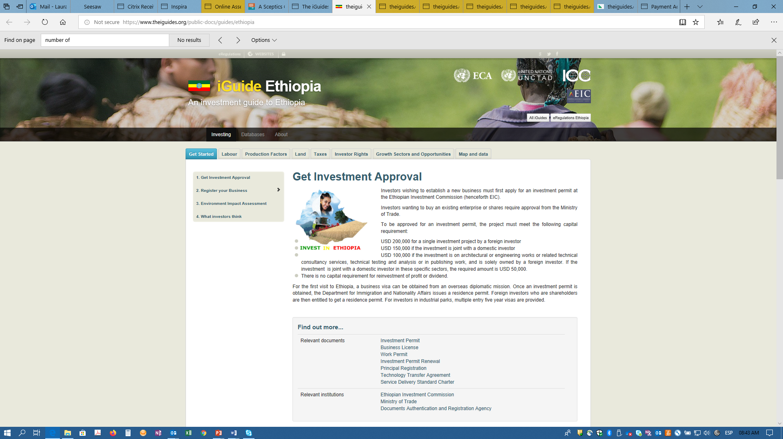
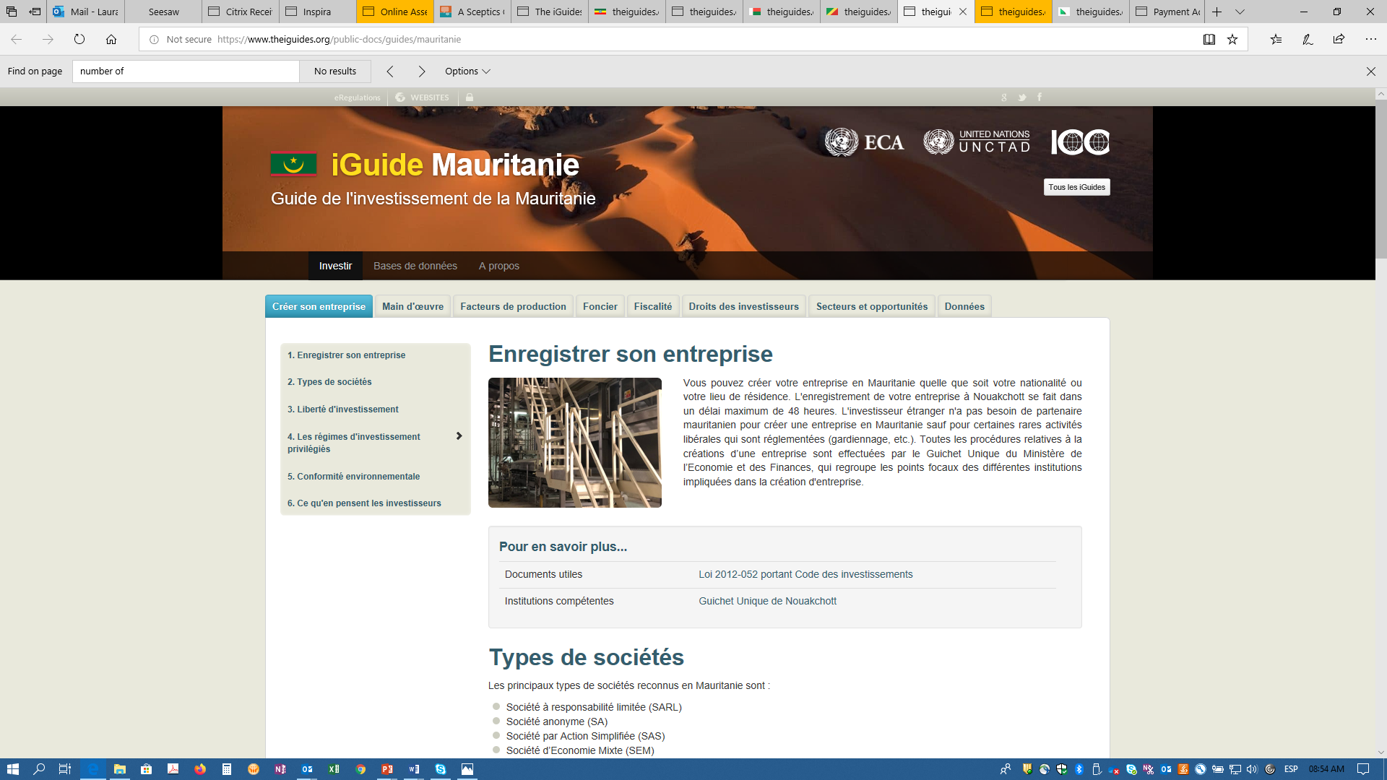
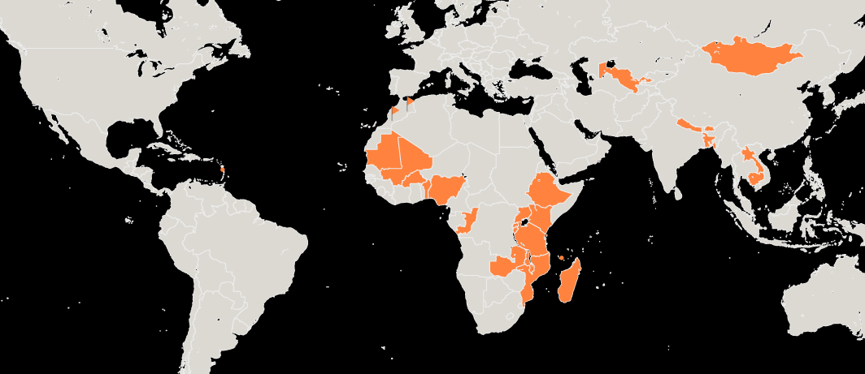

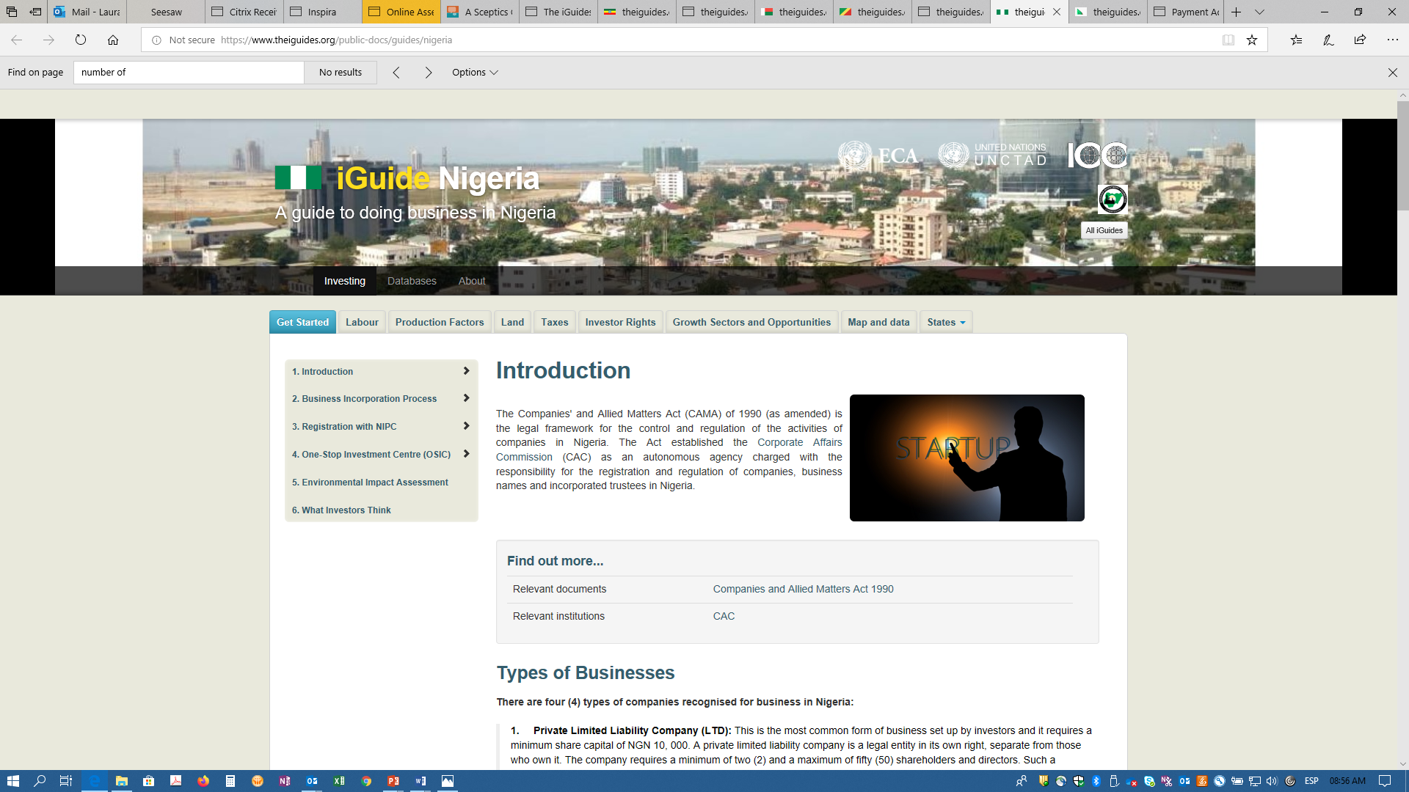

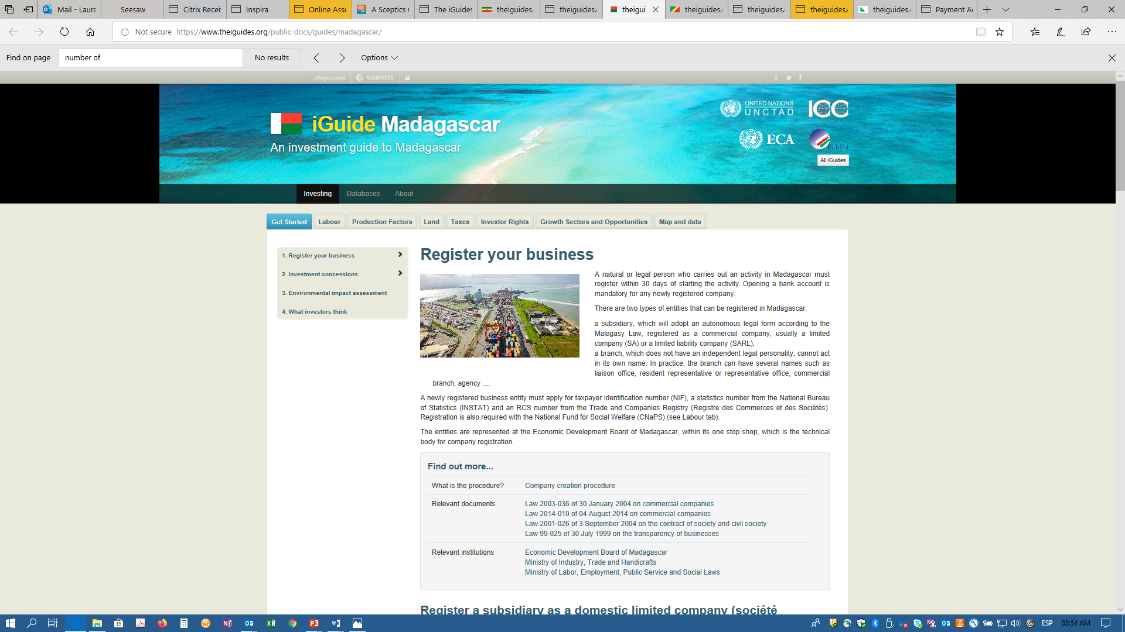
Accomplishments: Electronic Investment Guides
Launching of the iGuides in 7 African countries
www.theiguides.org
Notes:
The iGuide is an easy-to-use online tool providing potential investors with useful information concerning investment opportunities, costs and applicable laws and procedures. It is developed and maintained by the national investment promotion agencies in collaboration with UNCTAD and ECA.
The iGuide is a demand-driven project that offers technical assistance and capacity-building to member States and is intended to help them attract more investments conducive to their development and structural transformation. The iGuide was made available to 14 countries in Africa, Asia and Latin America and the Caribbean. During the period 2018–2019, iGuides were launched in seven African countries. The Subprogramme continues to work with these member States on the “after care” services. In 2020 an exhaustive review will be conducted to assess the impact and usability of the iGuides.

Slide 9
Accomplishments: Research on BITs & DTTs
& Intra-African Investment
Developed knowledge products on investment issues to advance the global IIA reforms in Africa & provide an analytical basis for AfCFTA negotiations on investment
Notes:
ECA was mandated by the Ministers of Trade of the African Union to conduct a study on the linkages between DTTs and BITs in 2018.
BITs are signed primarily to protect foreign investors in the host country, whereas DTTs are designed primarily to prevent instances of double taxation.
The policy credibility of Subprogramme 2 was enhanced by sharing evidence-based recommendations in two of its reports, presented during the World Investment Forum 2018. The work done in the Subprogramme proved influential in the continuing debate on the IIA reform, as well as for phase II negotiations of the AfCFTA. ECA attended and provided a presentation at the twelfth Annual Forum of Developing Country Investment Negotiators in Colombia in March 2019.
The knowledge generated enabled member States to become informed and position themselves to: review, negotiate, renegotiate or terminate investment agreements with careful consideration of the legal, policy, economic and social implications of such agreements to ensure that a balance was struck between protecting investment and preserving policy space for development objectives; and contemplate opportunities for expanding intra-African investment in the context of the AfCFTA.

Slide 10
Accomplishments: 2nd Edition of the ARII
In partnership with the AUC and the AfDB, ECA responded to the call by African member States to deepen and strengthen the analysis on measuring progress in regional integration, both at the subregional and continental levels
Notes:
Work on the African Regional Integration Index (ARII) included organizing (in partnership with AfDB and the African Union Commission) an Expert Group Meeting in Addis Ababa in January 2019 to review the methodology and discuss the main findings and policy recommendation of the draft of the ARII Report 2019. The report was also discussed during the sidelines of the COM 2019 in March this year, to seek further feedback from member States and RECs.
ARII also supports the decisions of the African Union to advance regional integration. The main objective of ARII is to monitor and evaluate the status of regional integration of African countries to encourage sharing of best practices. ARII also aims to provide the required incentive for member States to enhance their regional integration performance.

Slide 11
Recommendations & Conclusions
As AfCFTA negotiations evolve…
Member States will need more analytical work to inform their decisions
They will also need technical support to engage & implement the agreements
Subprogramme 2 must therefore
Conduct comprehensive evaluations (economic, poverty & social impacts)
Expand the analysis & technical support services value chains
Further the scope of work on movement of persons
Deepen the analytical work on invesment, competition, IPR and DITE
Tackle the data gaps in these areas, in partnership with stakeholders
Notes:
We note that as … To fulfill and in anticipation of such requests, the Subprogramme must...
A comprehensive evaluation of the expected economic impacts of AfCFTA negotiation, including services is required. Beyond trade-related impacts, employment and poverty implications should also be considered. ECA is committed to helping to fill data gaps, starting with the issues of services and employment. The Subprogramme will continue to provide technical support effective implementation of the AfCFTA with a view to fully maximizing gains while promoting the scaling up of regional value chains as a way to integrate global value chains.
In 2020 the Subprogramme will scale up its pilot project on informal cross-border trade and apply the methodology to other corridors and regions on the continent, with the goal of developing a single continental framework for informal cross-border trade data collection in the context of implementation and monitoring of the AfCFTA. The Subprogramme 2 proposes research on the structural and policy underpinnings to facilitate African Customs Union to support the implementation of the Agreement Establishing the AfCFTA.
A new work programme on human rights and inclusivity implications of the trade and climate change nexus will be launched in partnership with OHCHR and the Friedrich-Ebert-Stiftung. It will explore the role of trade in adjusting to shifts in agricultural and food production patterns resulting from climate change. It will focus on strategies for green industrialization and technological leapfrogging to ensure a low carbon and sustainable growth. The findings are expected to support the policy debate and the United Nations Climate Change Conference – 26th Conference of the Parties in 2020.
DITE work stream will engage more deeply in the themes of e-commerce in free trade agreements and support the implementation of the African Union Digital Trade and Digital Economy Strategy. It will also support preparations across the continent for multilateral and plurilateral e-commerce negotiations through a study on the practical issues of e-commerce entrepreneurship to identify African interests and possible negotiating positions.

Slide 12
THANK YOU!

