Slide 1
Analysis of Dispute resolution systems as a means of fighting Land Corruption and promoting Access to Justice: The case of Kenya and Ghana
SAMUEL KIMEU; MARY MANENO - TRANSPARENCY INTERNATIONAL KENYA

Slide 2
LAND CORRUPTION DEFINED
The abuse of entrusted power for private gain within land administration and management.
Citizens being forced to pay bribes to register their property
The sexual extortion of women in return for land access
Secretive deals between investors and authorities
Unaccountable urban planning
Customary laws that deny land rights to vulnerable groups.
Exclusion of women and youths in land decision making processes

Slide 3
THE RIGHT TO LEGAL AID
The right to free legal aid for citizens who cannot afford legal representation is an essential component of the right to a fair trial.
In line with the International Covenant on Civil and Political Rights (ICCPR) and the UN Principles and Guidelines , many countries, have enacted laws that provide for and guarantee the right to free legal representation for indigent and vulnerable persons.

Slide 4
THE RIGHT TO LEGAL AID
The Constitution of Kenya 2010 recognises access to justice for all as a fundamental right and obliges the State to not only respect and protect, but also promote its realization in the fullest sense.
To enhance access to justice, the Kenyan government enacted the Legal Aid Act 2016 to facilitate the provision of legal aid to the poor. Besides the Act, there also exists the National Action Plan on Legal Aid (2017-2022) whose underlying spirit is ‘Towards access to justice for all in Kenya.’

Slide 5
SDGs and Access to Justice
The Sustainable Development Goals give particular emphasis to land rights, urban land and corruption, particularly Goal 16 which provides for Peace, justice and strong institutions.
Promote peaceful and inclusive societies… provide access to justice for all. Targets include substantially reducing corruption and bribery and developing effective, accountable and transparent institutions, among others.

Slide 6
CHALLENGES WITH FORMAL JUSTICE SYSTEMS
The justice sector is characterised by legal, institutional, structural, procedural, economic, political and socio-cultural challenges.
Land cases in their very nature are quite technical and complex hence require legal expertise that can only be availed through legal representation or through adequate capacity building.
Technical land laws, overlapping or conflicting customary and statutory legal frameworks compound matters for vulnerable groups.
Institutional weaknesses due to poor accountability mechanisms are a precursor that allows corruption to thrive at the expense of justice for all (Corruption in Judiciaries).

Slide 7
THE CASE OF KENYA AND GHANA
Ownership Rights
Custodian of land
The Role of Tindana/ Chiefs
Dispute Resolution – Formal Vis a vis Informal Institutions
Shift towards Alternative Dispute Resolution/ Informal Systems in resolving land corruption cases? What will it take?

Slide 8
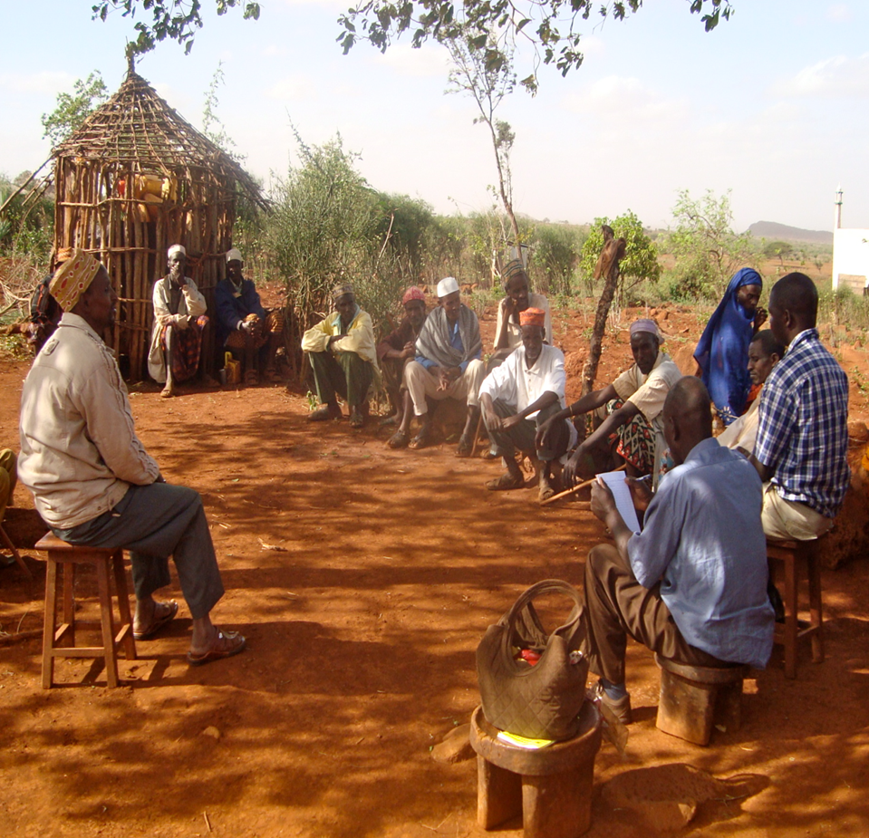
Alternative Dispute Resolution?

Slide 9
RECOMMENDATIONS TO ADDRESS CHALLENGES TO ACCESS TO JUSTICE
Governments should encourage and institutionalise alternative dispute resolution to ease the backlog in courts and ensure expedient resolution of justice.
There should be clearly defined structures to recognise and affect customary systems of justice, as a beneficial way to increase access to justice for all citizens.
The government should collaborate with civil society and the private sector, to educate citizens on their land rights and assisting them in accessing justice.
There should be establishment of legislative and administrative frameworks for compliance with the objectives of human rights treaties and implementing the rulings of regional courts.

Slide 10
RECOMMENDATIONS…
A functioning justice chain that is gender responsive should be encouraged, so as to take cognisance of the gender issues at play in access to justice in land matters.
There is need to sensitize chiefs and their communities about the impact of their actions in land transfers and illegal land dealings; to promote transparency of land transactions; and improving access to dispute resolution mechanisms.
There is need for the civil society and parliament to engage in oversight to strengthen overall accountability in the justice system.
ADR can also be replicated and expanded to the national level while maintaining adequate human and financial resources.

Slide 11
CONCLUSION
The sustained implementation of Constitutions in Kenya and Ghana is indeed critical to ensuring the necessary raft of land reforms required to achieve sustainable peace, development and prosperity.
Despite the enactment of many laws to safeguard access to justice, the law in action paints a different picture from what is well espoused in books and legislation.
Much more remains to be done to address the long existing challenges experienced by average citizens in accessing justice over land cases. More of this particularly relates to a strict implementation of laws on access to justice to the latter.

Slide 12
….We have learned that the rule of law delayed is lasting peace denied, and that justice is a handmaiden of true peace. We must take a comprehensive approach to Justice and the Rule of Law. It should encompass the entire criminal justice chain, not only police, but lawyers, prosecutors, judges, prison officers[…] a “one-size-fits-all” does not work. Local actors must be involved from the start…” - Kofi Annan, Former UN Secretary-General

Slide 13
THE END
THANK YOU!
MERCI BEAUCOUP!
ASANTE SANA!

