Slide 1
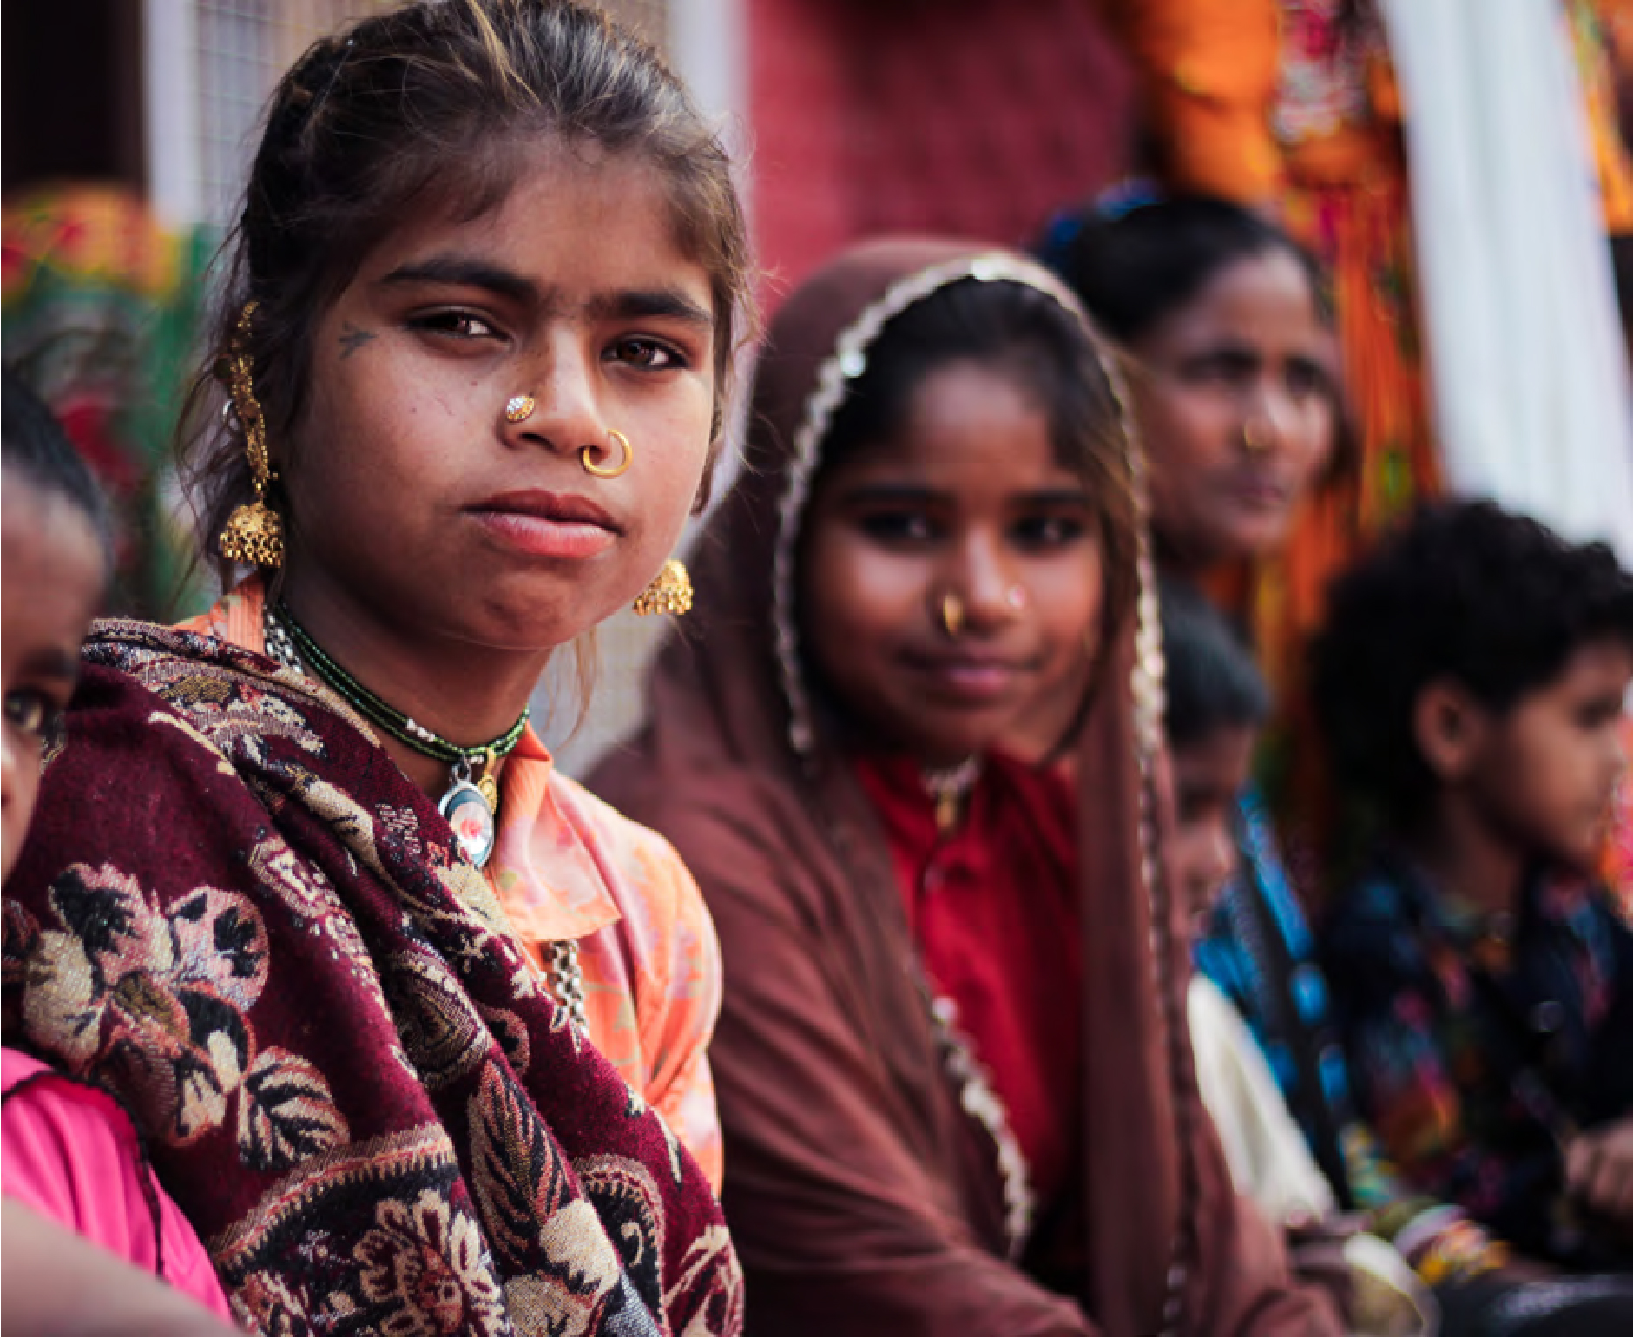

Gender and perceived tenure security (PTS)
Evidence from 33 countries

Slide 2
CONTEXT & EVIDENCE BASE
Women face restricted access/control to productive land and property
Securing women’s land rights is linked to overwhelmingly positive social, environmental and economic outcomes
Obvious policy implication: making access and user rights more secure - through both formal and informal means – to provide greater access to productive land and property for women. For example:
  Awarding titles
  Changing attitudes, norms and legal frameworks
  Raising awareness through legal empowerment
Problem: most data and evidence comes from few and specific case studies, which does not allow for larger scale comparison. Global data on PTS can help as perceptions influence behaviour.
Notes:
Why?
Measure the “tenure security gap” between formal/legal & informal/customary tenure regimes
Assess the link between policy interventions and social, economic and environmental outcomes. Perceptions influence behaviour.

Slide 3
Data and MEASURES
Data:
Prindex data from 33 countries: 25,048 men and 28,132 women (~15,000 each are located in Africa)
Global indicators:
  World Bank government effectiveness, ‘Women Business and the Law’
  OECD Social, Inequality and Gender Index,
  World Justice Project ‘Rule of Law’
  Georgetown Institute’s Women, Peace and Security Index
Measures:
Perceived risk of eviction:
  In the next five years, how likely or unlikely is it that you could lose the right to use this property, or part of this property, against your will?
Perceived worry of eviction (incl. in divorce/spousal death scenarios)

Slide 4
RESEARCH QUESTIONS
Do men and women feel more or less secure about their land and property?
Does formalization help decrease gender gaps in perceived tenure security?
Does institutional variation (both formal and informal) help explain cross-country differences?

Slide 5
BACKGround making sense of PTS & GENDER
PERCEIVED TENURE SECURITY
yes
Owners
43.5% (m) 36.8% (f)
Men: 80.3%
Inherited property
Men: 40.2%
Women: 78.2%
Women: 31.2%
no
SWP
28.8% (m) 39.5% (f)
Men: 72.4%
Women: 69.2%
Tenants
21.6% (m) 17.0% (f)
Men: 54.5%
Women: 48.5%
Total
Men: 72.1%
Women: 69.3%
MEDIATORS
e.g. socioeconomic disadvantage or unequal life chances
MEDIATORS
e.g. discriminatory laws, weak governance, opinion shifters, de facto security (e.g. past experience of eviction)
Prindex data (2018). Based on likelihood question. Note:global weights are adjusted for the differences in population size and number of observations

Slide 6
BACKGround making sense of PTS
DE JURE SECURITY
(formal docs)
PERCEIVED TENURE SECURITY
yes
Owners
43.5% (m) 36.8% (f)
Men: 81.8%
Men: 80.3%
Inherited property
Men: 40.2%
Women: 78.7%
Women: 78.2%
Women: 31.2%
no
SWP
28.8% (m) 39.5% (f)
Men: 46.2%
Men: 72.4%
Women: 42%
Women: 69.2%
Tenants
21.6% (m) 17.0% (f)
Men: 59.6%
Men: 54.5%
Women: 54.3%
Women: 48.5%
Total
Men: 65%
Men: 72.1%
Women: 58.2%
Women: 69.3%
MEDIATORS
e.g. socioeconomic disadvantage
MEDIATORS
e.g. discriminatory customs/laws
MEDIATORS
e.g. weak governance, opinion shifters, de facto security (e.g. past experience of eviction)
Prindex data (2018). Based on likelihood question. Note:global weights are adjusted for the differences in population size and number of observations

Slide 7
BACKGround making sense of PTS & GENDER in Africa
DE JURE SECURITY
(formal docs)
PERCEIVED TENURE SECURITY
yes
Owners
40.8% (m) 32.0% (f)
Men: 62.8%
Men: 78.1%
Inherited property
Men: 42.8%
Women: 59%
Women: 74.4%
Women: 28.2%
no
SWP
28.5% (m) 41.9% (f)
Men: 35.5%
Men: 71%
Women: 31.5%
Women: 66.3%
Tenants
23.1% (m) 17.1% (f)
Men: 54.8%
Men: 54.6%
Women: 50.1%
Women: 48.9%
Total
Men: 51.6%
Men: 69.7%
Women: 43.8%
Women: 65.6%
MEDIATORS
e.g. socioeconomic disadvantage
MEDIATORS
e.g. discriminatory customs/laws
MEDIATORS
e.g. weak governance, opinion shifters, de facto security (e.g. past experience of eviction)
Prindex data (2018). Based on likelihood question. Note:global weights are adjusted for the differences in population size and number of observations

Slide 8
Q1 CONT’D LARGE CROSS-COUNTRY DIFFERENCES EXIST

Slide 9
Q1 yes, but depends HOW YOU ASK THE QUESTION
Depends:
Whether you use the likelihood (risk) or worry question
Family situation (divorce/spousal death scenario)
Female gender coefficient of regression results in 30 countries
Female gender coefficient of regression results in 20 African countries
 | Likelihood | Worry | Worry (divorce) | Worry (spousal death)
Owners | -0.004 (0.012) | -0.021* (0.012) | -0.066*** (0.016) | -0.070*** (0.016)
Tenants | -0.020 (0.016) | -0.014 (0.017) | -0.057** (0.027) | -0.085*** (0.029)
SWP | -0.015 (0.011) | -0.020* (0.012) | -0.107*** (0.021) | -0.111*** (0.021)
 | Likelihood | Worry | Worry (divorce) | Worry (spousal death)
Owners | -0.012 (0.013) | -0.003 (0.015) | -0.089*** (0.020) | -0.112*** (0.020)
Tenants | -0.025 (0.020) | -0.009 (0.019) | -0.125** (0.034) | -0.132*** (0.034)
SWP | -0.037*** (0.015) | -0.023 (0.015) | -0.212*** (0.026) | -0.208*** (0.026)
Robust standard errors in parentheses; *** p<0.01, ** p<0.05, * p<0.1. Robust standard errors in parentheses.
Note: controls include Individual-, household- and property characteristics as well as controls for de jure security, de facto security, opinion shifters, framing and country-fixed effects

Slide 10
Q2 FORMALISATION PRIMARILY affects owners
Globally = formalisation only positively associated with PTS among owners using likelihood & worry question (not in divorce/spousal death scenarios)
Africa = weak effect, except among female owners in a divorce scenario where joint titling is crucial
Significant controls of PTS for models run separately between women and men in 30 countries
Tenure status | Women only | Men only | Observed among both (examples)
Owners | Formal documentation (+) Framing (+) Property inherited (+) Right to inherit (+) Children in HH (-) | Named formal document (+) Age (+) Wealth (+) | De facto security (+) Opinion shifters (+) Property bought/constructed (+) Low income (-) Land used productively (-)
Tenants | Land used productively (-) | - De facto security (+) | Low income (-)
Stay with permission | Water connection (+) Children in HH (-) HH head (-) |  | Formal documentation (+) De facto security (+) Low income (-)
(+) positive coefficient; (-) negative coefficient

Slide 11
Q3 Institutions clearly play a role
Differences between women and men in the interaction between institutions and de jure tenure security
Type | Measure | Source | Owners | Tenants | SWP
Formal | % formalisation | Prindex | Men (+) | Women (+) | Same (+)
 | Rule of Law | WJP | Same (+) | Same (+) | Women (+)
 | Gov’t effectiveness | WB | Men (+) | Women (+) | Same (+)
 | Corruption | WB | Same (+) | Same (+) | Women (+)
Informal | SIGI | OECD | Insignificant | Insignificant | Women (+)
 | Family code | OECD | Insignificant | Men (-) | Insignificant
 | Physical integrity | OECD | Men (+) | Same (-) | Same (-)
 | Access to resources | OECD | Same | Same (+) | Men (-)
 | % female educated | OECD | Women (+) | Men (-) | Women (+)
 | WPS Index | WPS | Women (+) | Same (+) | Women (+)
 | Financial inclusion | WPS | Women (+) | Insignificant | Women (+)
(+) stronger/significant positive effect; (-) stronger/significant negative effect

Slide 12
CONCLUSIONS & IMPLICATIONS
Policy implications:
  Strengthening gender-equal informal institutions has disproportionate impact on improving women’s tenure security. Titling or legal changes are in themselves not sufficient and awareness-raising campaigns, educational measures and other interventions aimed at social and customary norms may be more efficient
  PTS can help identify targeted policy interventions: e.g. among married females who are worried about divorce or spousal death scenarios. In Africa, they need to be targeted with joint titles.
Research implications:
  Results are country-specific: need more country-specific deep-dive studies (contact: j.feyertag@odi.org.uk)
  Important pathways for gender-sensitive research on tenure security. How do these results link to development outcomes?

