Slide 1

Use of high-resolution earth observation data for land use change monitoring in Cameroon
Verhegghen A (1), Rembold F (1), Beauchamp E (2), Nguiffo S (3)
CLPA-2019, Abidjan, 26 November 2019
European Commission, Joint Research Center
International Institute for Environment and Development (IIED)
Centre for Environment and Development (CED)

Slide 2
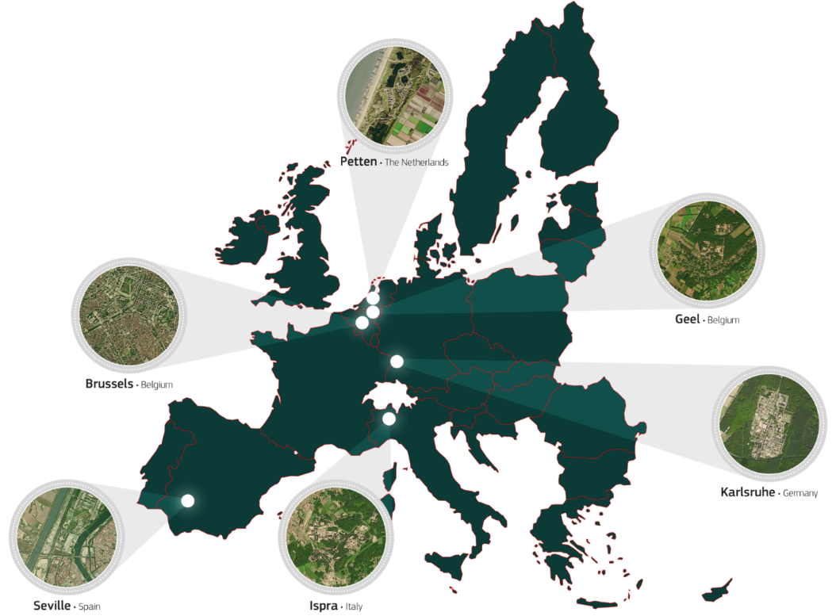
The Joint Research Centre at a glance
In-house science service of the European Commission
Independent, evidence-based scientific and technical support for EU policies
3000 staff Almost 75% are scientists and researchers.

Slide 3
EO for land use change monitoring
Monitoring of land use change in Africa limited by low transparency, remoteness of areas, conflicts about tenure rights
Potential of Earth Observation (EO) for mapping and monitoring land use change thanks to growing high resolution data availability
Geospatial dimension of land governance
EU support to VGGT related projects
Where relevant, JRC assists with knowledge about use of geospatial methods and Earth Observation
Support to the LandCam project

Slide 4
LandCam project - Cameroon
LandCam aims to improve customary and formal land and natural resource rights of communities in Cameroon
Supports the revision of Cameroon’s Land Law by piloting approaches on the ground and helping citizens participate in the reform process.
Dialogues between all stakeholders - government, civil society, private sector and local communities - to link local evidence from three sites and national reform proceedings
Centre pour l’Environnement et le Développement (CED)
Réseau de lutte contre la faim (RELUFA)
International Institute for Environment and Development (IIED)

Slide 5
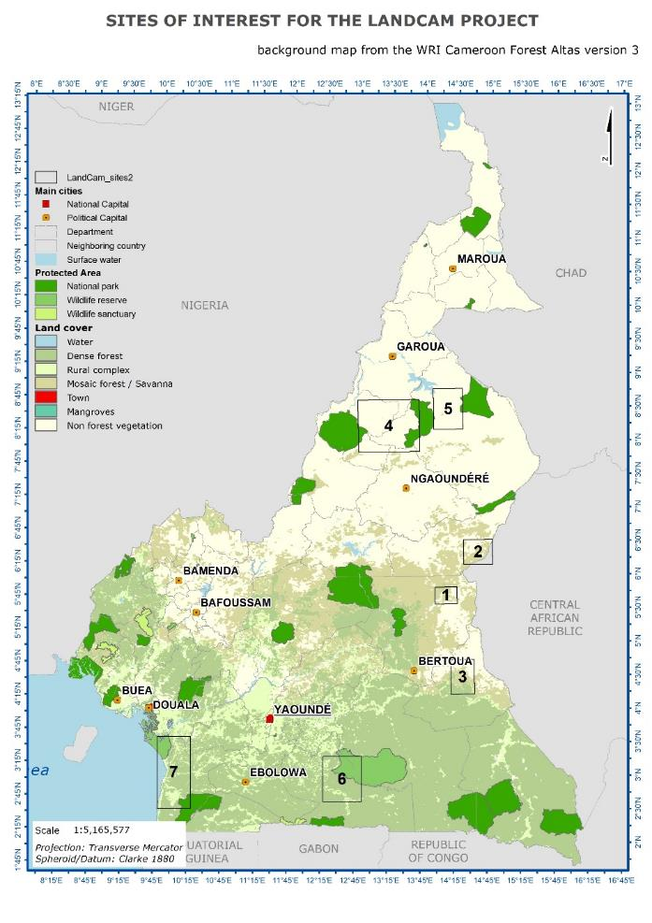
Land use change in Cameroon
Small-scale mining activities - impact on the forest cover (sites 1, 2&3)
Migration in the North – agricultural intensification and encroachment in protected areas (sites 4&5)
Rubber and oil palm plantations – implementation status (sites 6&7)

Slide 6
Earth observation data
Existing thematic products derived mostly from the Landsat archive (forest change, water, built-up, crop masks,…)
Free and open data of COPERNICUS (Sentinel sensors), 5 - 10 days revisit capacity, 10 m spatial resolution range
  Sentinel 2 (Optical)
  Sentinel 1 (SAR)

Slide 7
Small-scale mining activities
Impact of small-scale mining activities (mainly gold mining) on the forest cover
Two products using the Landsat archive to monitor forest changes (tree cover loss and regrowth)
  Global Forest change (2000-2018)
  Tropical Moist Forest dataset (1990-2018)
Analysis of the tree cover loss in the study sites and in a 500 meter buffer from rivers

Slide 8
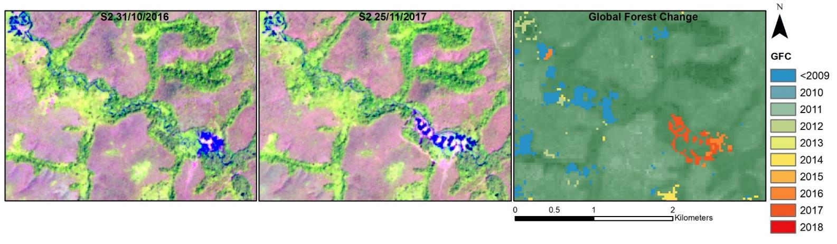
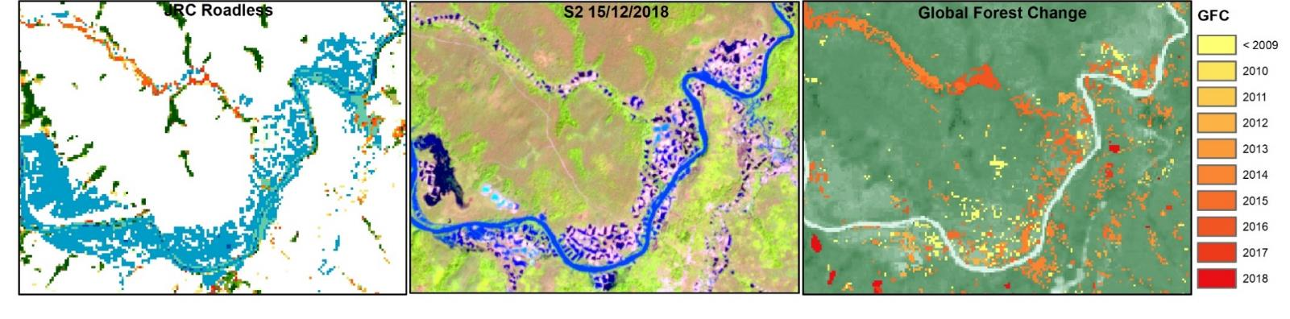
Small scale mining progression in Sentinel 2 imageries
Small scale mining as water (JRC TMF) or tree cover loss (GFC)

Slide 9
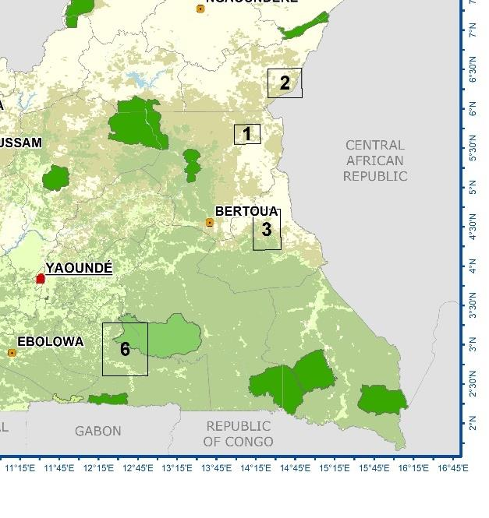
Tree cover loss from GFC 2009-2018 in the three sites

Slide 10
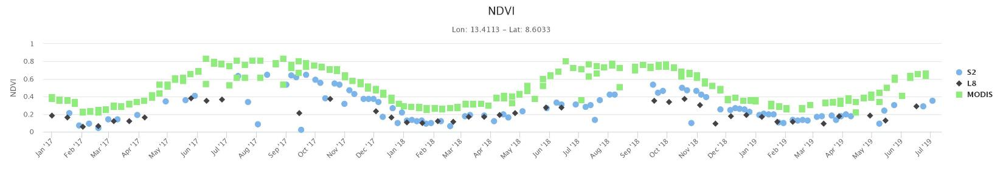
Migration in northern Cameroon
Agricultural intensification and encroachment in protected areas
JRC Crop and Grassland masks as indicator of the agricultural land localization before 2016 (250 m)
JRC GHSL built up grid (30 m)
Sentinel 2 for visual inspection – ASAP High Resolution Viewer

Slide 11
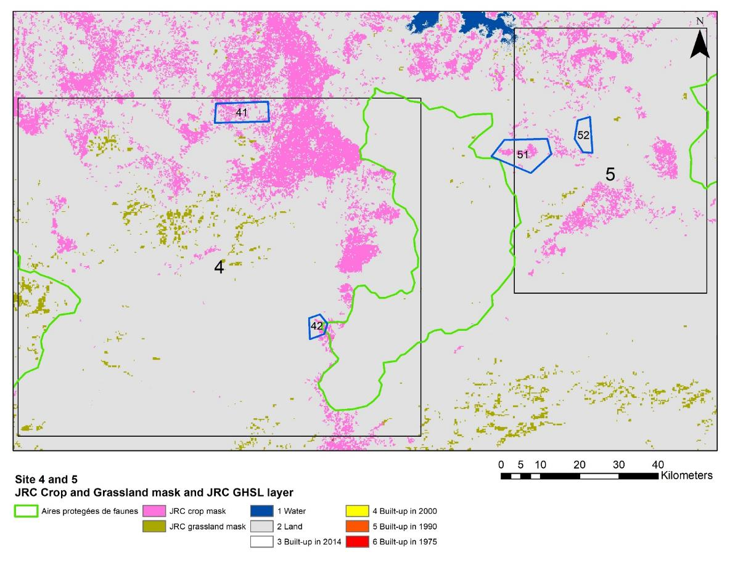
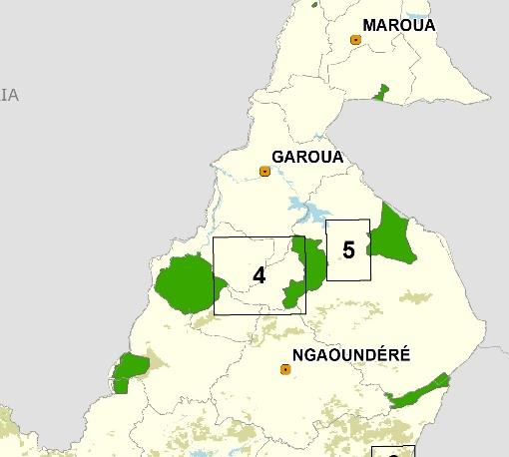
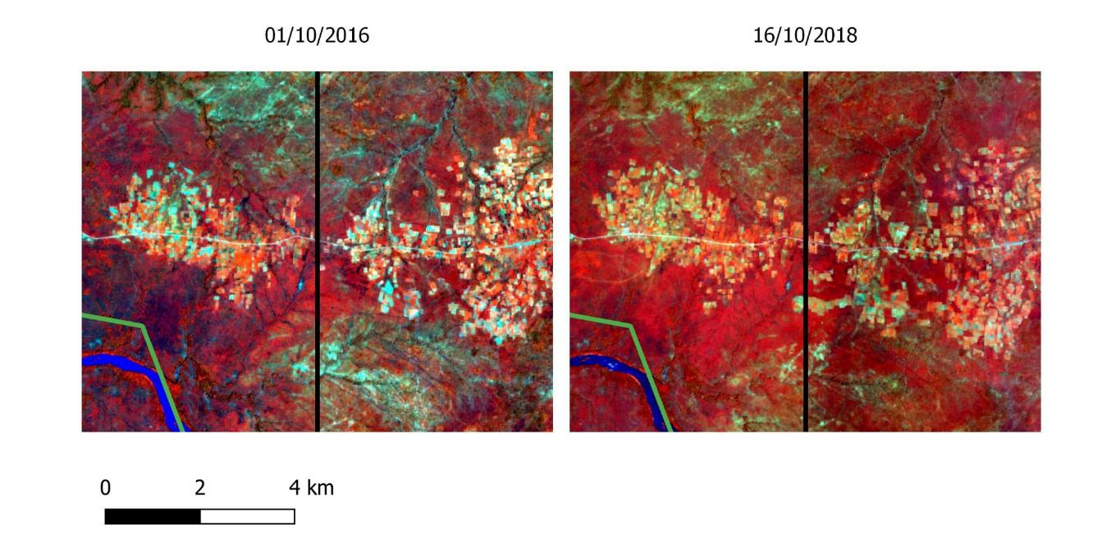
Migration in the North
Agriculture intensification and encroachment in protected area ?

Slide 12
Rubber and Oil Palm plantations
Monitoring the activities inside and outside the concessions, verify the implementation status
Two products using the Landsat archive to monitor forest changes (tree cover loss and regrowth)
  Global Forest change (2000-2018)
  Tropical Moist Forest dataset (1990-2018)
Sentinel 2 for visual inspection

Slide 13
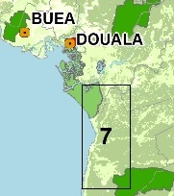
Rubber and oil palm plantations
Intensification of tree cover loss in site 7 for 2000-2018 (Global Forest Change)
Total area site 7: 665 km2
Tree cover area in 2000: 590 km2

Slide 14
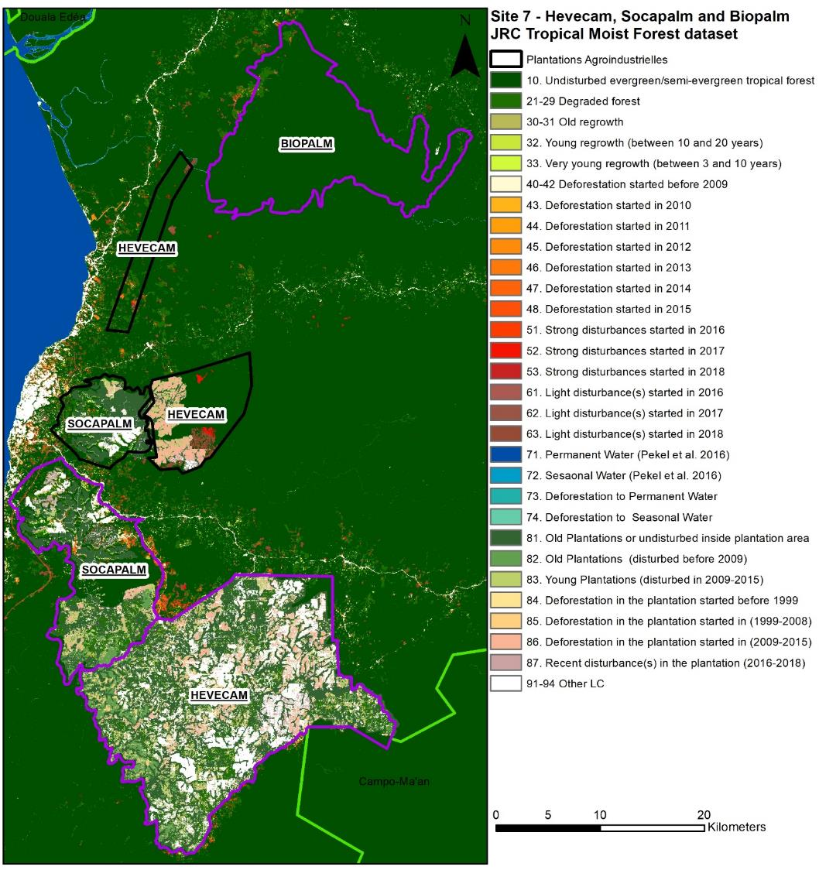
Implementation Status

Slide 15
Implementation Status

Slide 16
Implementation Status

Slide 17
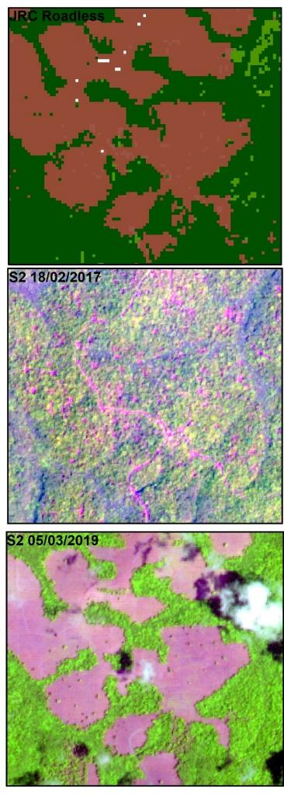
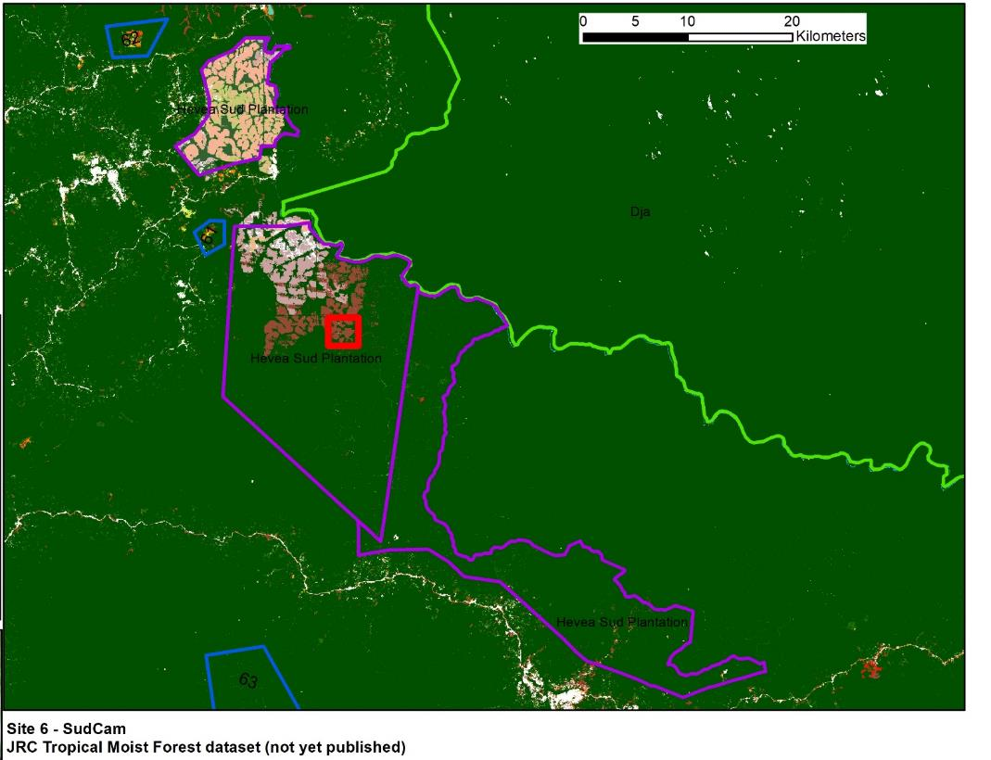
Agro industrial – SudCam and protected area
Rubber plantation
New activity 2016-2018
No visible encroachment in the PA

Slide 18
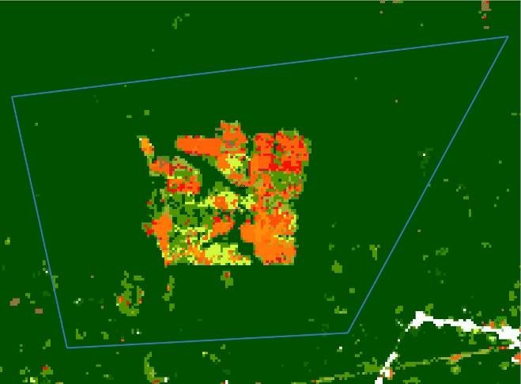
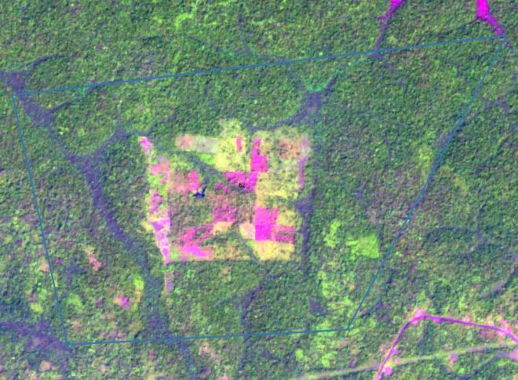
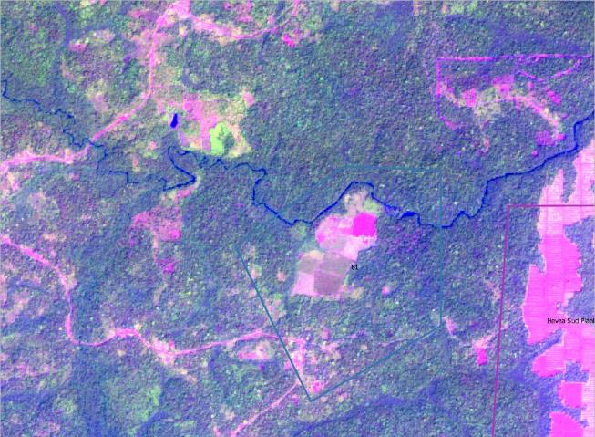
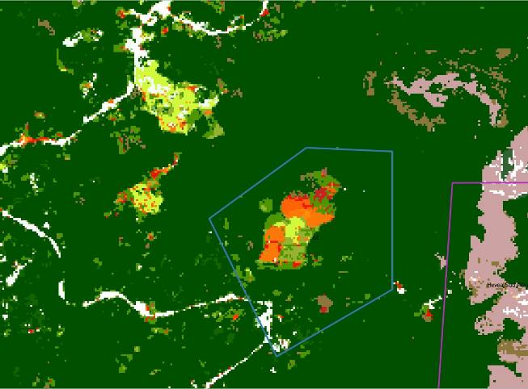
Agro industrial – SudCam and protected area
Plantations outside the concession?
2018/01/04
2018/01/04

Slide 19
EO for independent and transparent evidences of land use change
Land use change is fast-paced yet is difficult to assess in several areas due to lack of access
Thematic products and Copernicus satellite imageries are freely available to the public
With new products, EO has the potential to improve transparency of often unregulated processes that affect local communities adversely
Basic toolkit for the identification of land use changes by combining thematic datasets and recent 10-m resolution satellite images could help democratize access to EO

Slide 20
Conclusions
Baseline or supporting evidence in land policy issues analysis or land laws reform justification at different levels (institutional and civil society)
Increasing availability of EO and computing capabilities is easing the access to the information
But need of :
  combination of several EO sources, ground-truth and field survey data, analytical expertise
  Improved collaboration between remote sensing experts, practitioners and policy-makers

Slide 21
Questions?

