Slide 1
Efficiency and Equity Impacts of Informal Land Rental Market Among A1 and A2 farmers in Zimbabwe
By
SIMBARASHE TATSVAREI
Department of Agribusiness Management and Entrepreneurship
Marondera University of Agricultural Sciences and Technology, Zimbabwe
November, 25 - 29, 2019 | ABIDJAN, COTE D’IVOIRE

Slide 2
Introduction and Background
Economic growth in agriculture is twice as effective in reducing poverty compared to other sectors of the economy (World Bank, 2012).
Maximum utilisation of land as a resource in agriculture can lead to attainment of economic growth (Deininger and Jin, 2009).

Slide 3
A Study by Vranken and Swinnen (2006) concluded that in economies characterised by high transaction costs, defective credit markets and thin land sales markets (like Zimbabwe), land rental markets can improve efficiency and equity by equalizing the marginal product of land among different households.
On the other hand, studies have shown that land rental markets can lead to concentration of land resulting in inefficiency from diseconomies of scale which repudiates equity gains (Feng, 2008).

Slide 4
Land policy in Zimbabwe had impacts on agricultural sector growth from way back in 1930 up to fast track land resettlement program (FTLRP) period (from 2000).
FTLRP gave rise to A1 and A2 farming models.
The underlying assumption was that beneficiaries would maximise on use of land, improve their welfare, equity and agricultural growth.
In the aftermath of the reform, land utilisation reduced drastically due to lack of capital and knowhow among the resettled farmers.
Many resettled farmers began to rent out land among themselves, white former farmers and other indigenous blacks without access to land.

Slide 5
This led to the prevalence of an informal land rental market.
Informal because there was a political perception that rentals were illegal though no institutional framework to that effect existed.
Most participants in the market disguised it as investment partnership, which was an acceptable practise.
It is therefore imperative to understand how the different categories of farmers (renting-in, renting-out and autarky) were faring in terms of their efficiency and whether land could be distributed more equally through these markets.
The analysis provide a platform to decide whether formalising these markets can bring overall positive impacts to the nation.

Slide 6
Overall objective
The overall objective was to evaluate land use efficiency and equity for rental market participating farmers in Mashonaland East province, Zimbabwe under A1 and A2 models.
Methodology
Data collection was carried out in Goromonzi and Marondera districts
Sample size was 339, representing farmers renting-in, renting-out and in autarky.
Multistage sampling methods were used for selecting interviewees.
Data was entered in CsPro and analysed using STATA and SPSS.

Slide 7
Efficiency measurement analytical model
A log-linearised Cobb-Douglas model was used as follows:
ln Y_{i} = b_{0i} +b_{1i} ln X₁i + b_{1i} ln X_{2i} + b_{3i} ln X_{3i} + b_{4i} ln X_{4i} + b_{5i} ln X_{5i} + b_{6i} ln X_{6i} + b_{7i} ln X_{7i} + b_{8i} ln X_{8i} + V_{i} – U_{i}
Y = gross agricultural output value
X₁= total expenditures on crop production i.e. seed, inorganic fertilizers, herbicides and pesticides, animal and mechanical traction, and soil quality
X₂= total area cultivated (ha)
X₃= total labour days
X₄= total area on crop production
X₅= total value of agricultural assets
X₆= household head age
X₇= share of irrigated area (ha)
X₈= number of years of education for household head

Slide 8
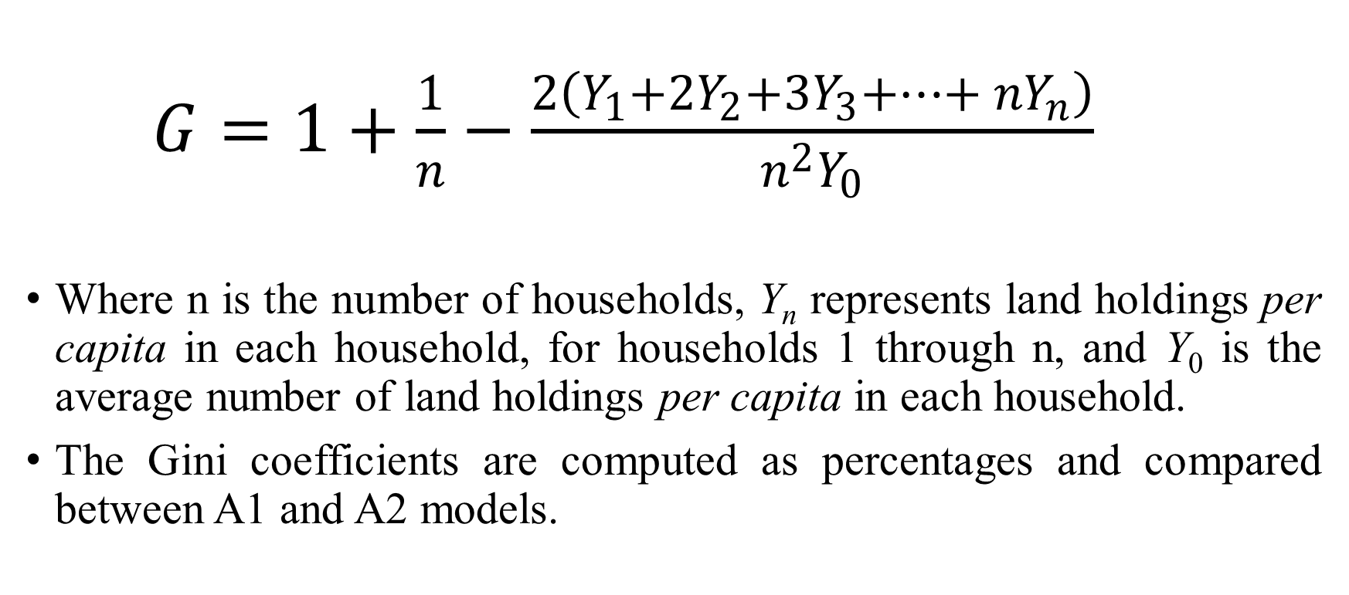
Equity measurement :Gini coefficient
$G=1+\frac{1}{n}−\frac{2\left(Y_{1}+{2Y}_{2}+{3Y}_{3}+…+ {nY}_{n}\right)}{n^{2}Y_{0}}$
Where n is the number of households, Y_{n} represents land holdings per capita in each household, for households 1 through n, and Y₀ is the average number of land holdings per capita in each household.
The Gini coefficients are computed as percentages and compared between A1 and A2 models.

Slide 9
Results – HH demographics
67.6% Goromonzi, 32.4% Marondera
78.5% A1, 21.5% A2
79.9% male headed, 20.1% female headed.
82% couples, 14% widowed, 3.4% divorced/separated
5% never been to school, primary 21%, secondary 58%, tertiary 16%,
Agric main source of income (77%), Pensioners (8.8%), formal employment (8.3%) and others (5.9%)
51.3% not all involved in rental markets, 22.1% involved in some way in renting-in and 26.5% involved in renting-out
Equilibrium renting price of about $75/ha

Slide 10
Efficiency Indicators for Selected Categories of Farmers
Settlement type | Farmer category | Technical efficiency | Allocative efficiency | Economic efficiency
A1 model | Autarky | 0.734 (0.014) | 0.769 (0.010) | 0.565 (0.010)
 | Renting-in | 0.748 (0.020) | 0.774 (0.014) | 0.579 (0.015)
 | Renting-out | 0.759 (0.018) | 0.779 (0.016) | 0.592 (0.182)
A2 model | Autarky | 0.764 (0.029) | 0.782 (0.029) | 0.598 (0.301)
 | Renting-in | 0.786 (0.045) | 0.802 (0.301) | 0.631 (0.297)
 | Renting-out | 0.744 (0.029) | 0.752 (0.231) | 0.560 (0.281)
Overall | Autarky | 0.739 (0.013) | 0.771 (0.009) | 0.570 (0.010)
 | Renting-in | 0.754 (0.019) | 0.779 (0.013) | 0.588 (0.013)
 | Renting-out | 0.755 (0.015) | 0.772 (0.013) | 0.583 (0.015)
A1 Overall |  | 0.743 (0.01) | 0.773 (0.007) | 0.575 (0.008)
A2 overall |  | 0.762 (0.019) | 0.776 (0.016) | 0.592 (0.017)
Sample |  | 0.747 (0.008) | 0.773 (0.006) | 0.578 (0.007)

Slide 11
Determinants of Farmer inefficiency
Variables | Autarky | Renting-in | Renting-out
Log_Value_Assets | 0.079 (0.065) | -0.059(0.091) | -0.720 (1.864)
log_Hhh_Age | 0.060* (0.562) | 0.783 (0.943) | 0.007**(1.067)
Credit | 1.731**(2.592) | 0.207*(0.949) | 1.150** (1.985)
log_Irrig_share | -0.274(0.443) | 0.879** (0.380) | -0.287 (0.433)
Gender_hh | -0.113* (0.438) | -0.308 (0.870) | -1.239 (1.467)
Livestock | 0.565*(0.693) | 0.118* (0.540) | 0.216*** (0.672)
log_Irrig | -0.565 (0.693) | -0.832** (0.343) | -0.588(1.014)
Experience | 0.292* (0.875) | 0.302** (0.442) | 0.316*** (2.212)
Married | -0.302 (0.442) | 0.375(0.907) | 0.009 (0.647)
Log_Exp_Crop | 0.801*** (0.048) | 0.808*** (0.044) | 0.692*** (0.062)
Log_Area_crop_prod | 0.575*** (0.136) | 0.146** (0.070) | 0.485*** (0.101)
Log_Labor | 0.078* (0.041) | 0.155*** (0.046) | -0.026 (0.060)
Observations | 279 | 134 | 144
Mean efficiency | 0.570 (0.215) 541.34*** 0.000 | 0.588 (0.258) 1160.56*** 0.000 | 0.583 (0.196) 288.84*** 0.000
Wald chi2(3)
Prob > chi2

Slide 12
Autarky farmers – age, access to credit, gender, livestock assets, farming experience, labour type and area under crop
For farmers renting-in – credit, proportion and size of irrigation land, livestock assets, labour, farming experience, type and size of enterprise
For farmers renting-out – age, access to credit, livestock assets, experience, type and size of enterprise

Slide 13
Descriptive summaries of land owned and land operated
Category | N(number) | Mean land owned (ha) | Mean land operated (ha)
Goromonzi | 229 | 30.18 | 27.88
Marondera | 110 | 21.43 | 9.62
A1 farmers | 266 | 4.8 | 5.12
A2 farmers | 73 | 93.65 | 83.32
Male-headed | 271 | 22.05 | 31.37
Female headed | 68 | 31.46 | 24.32
Overall | 339 | 23.93 | 21.96

Slide 14
Gini coefficients of land owned and land operated
Category | Gini land owned | Gini land operated
Goromonzi | 0.78 | 0.76
Marondera | 0.51 | 0.48
A1 farmers | 0.12 | 0.24
A2 farmers | 0.56 | 0.56
Male-headed | 0.74 | 0.73
Female headed | 0.76 | 0.74
Overall | 0.75 | 0.74

Slide 15
Inequality in land owned was higher for Goromonzi district, male and female headed households as well as overall sample
Inequality was much lower in Marondera and among A2 farmers.
Equality was very strong among A1 farmers, as land holding was almost standardised at 6 hectares per household.

Slide 16
Conclusions
Farmers renting-in land were most economically efficient, followed renting-out and last were farmers not participating in land rental markets, though the differences seemed to be marginal
Implied that land rentals alone not a panacea to increased efficiency, but need to be buttressed with other measures that can enhance productivity.
Overall major sources of inefficiency were access to credit, crop type and area, availability of labour and farming experience
Implications are that besides formalising land rentals, policy should also focus on enhancing access to credit, encouraging farmers to specialise and capitalise production and engage in enterprises consistent with natural ecological zones

Slide 17
By participation in land rental markets, inequality was reduced for farmers in the two districts as well as male and female households.
Inequality was increased marginally among A1 farmers.
Overall the position was that participation in land rental markets had resulted in reduced inequality in land holding among the sampled farmers.
These results are consistent with most of the studies that have been carried out on both efficiency and equity.

