Slide 1
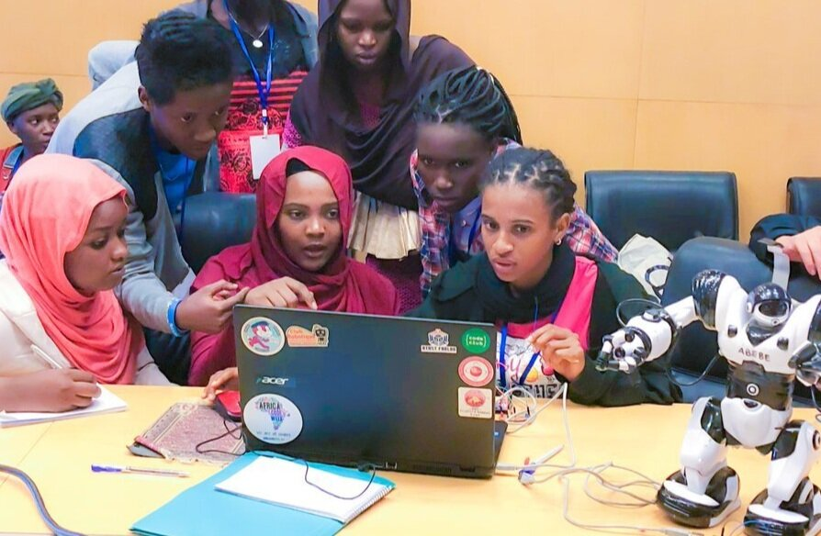
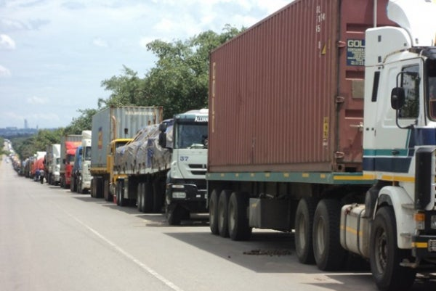
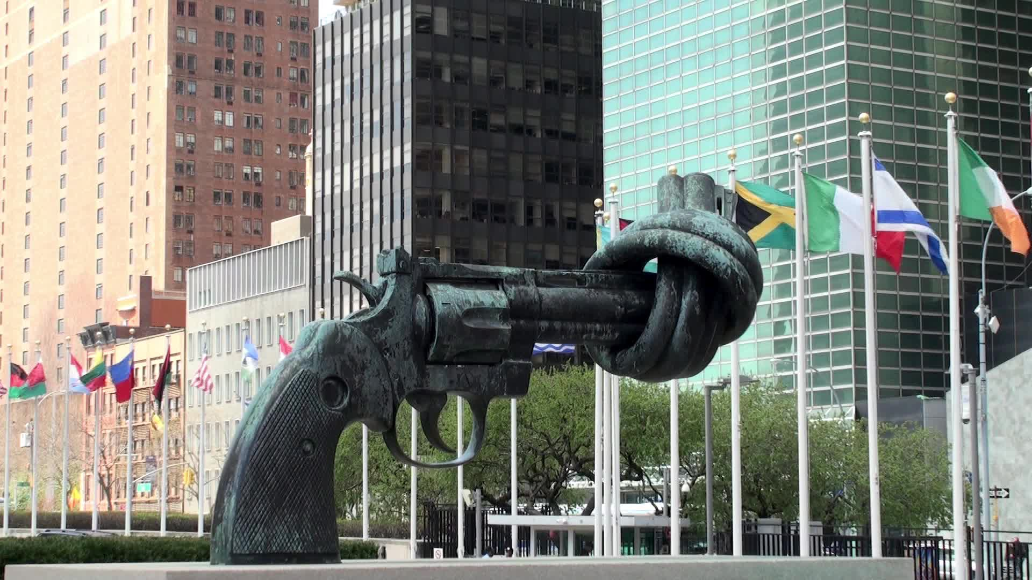
Africa Stakeholders
Consultative Meeting “Review of the implementation of commitments made towards Africa’s development: a decade to deliver on commitments”
1:00 – 2:45 pm 26 February 2020 Elephant Hills Hotel Conference Room: Chipala Island 3 Victoria Falls, Zimbabwe Side Event at the 6th Africa Regional Forum on Sustainable Development

