Slide 1
The Economics and Politics of Foreign Aid and Domestic Revenue Mobilization
Abrams Mbu Enow Tagem
University of Nottingham
African Economic Conference
4 - 6 December 2017

Slide 2
Importance of DRM
The advent of SDGs underpins the importance of domestic revenue mobilization, especially increasing taxes.
Social sector spending on key areas like health, education and social protection is equally important.
Aim of the paper
Does a foreign aid influence tax/GDP ratios in the long-run?

Slide 3
Constraints on DRM
Weak tax administrations and revenue systems.
Tax bases are small and narrow:
Difficulties in taxing bases that are growing (resource extraction, MNCs, high net wealth individuals).
The income tax base (formal sector employment) and the consumption tax base (private spending) are growing slowly.
Large informal and agricultural (subsistence) sectors.
The political environment and influence of interest groups:
Too many tax incentives.
Corrupt practices and extensive rent-seeking by politicians in charge of tax policy.

Slide 4
Aid, Donors and Taxation
Due to the aforementioned constraints on DRM aid plays a role in influencing DRM.
The impact of aid on taxes reflects a revenue choice depending on political economy factors, based on the relative political costs of aid and tax.
Accountability: Donors have to account to their parliaments; they need to monitor their aid. Recipients have to account to donors on how aid is spent; and also to their own constituencies.
Autonomy: Donors attach conditions on their aid and recipients need to meet these conditions. Aid dependence = inflexibility.
Bureaucratic costs: Donor proliferation (aid heterogeneity, different disbursment and monitoring mechanisms) makes costs of aid high. Tax administration/policy reform makes costs of tax low.

Slide 5
Aid, Donors and Taxtion (2)
Donors also influence policy choices through:
Technical assistance (transfer of knowledge).
Conditionality (e.g. Revenue conditionality in donor-supported programs).
Stability of aid flows:
Unstable aid may undermine positive effects of aid; with a negative impact on taxes.
Unstable aid flows may also underpin efforts to strengthen DRM.

Slide 6
Research Questions
Does a long-run equilibrium relationship between the aid/GDP and tax/GDP ratios exist? (Behavioural effects).
Does the composition of aid matter for the tax/GDP ratio? (Technical assistance)
Does revenue conditionality in donor programs improve revenue performance? (Conditionality effects).
What is the impact of aid volatility on revenue performance? (Volatility effects)

Slide 7
Econometric Issues
Non-stationarity in aid/GDP and tax/GDP ratios: albeit with positive and/or negative trends.
Heterogeneity in fiscal behaviour across developing countries.
Short-run and long-run dynamics between aid and tax.
Macroeconomic (business cycle) influences: recent financial crisis, devaluation of the CFA franc in 1994, trade liberalization episodes in the 1980s and 1990s, conflict (fragility), the recent scourge of terrorism.
Simultaneity and endogeneity.

Slide 8
Literature Review
Behavioural effects of aid on taxes: Morrissey and Torrance (2015); Clist and Morrissey (2011).
Heterogeneous effects of aid grants and loans: Gupta et al., (2004); Benedek et al., (2012); Clist and Morrissey (2011).
Technical assistance.
Stability of aid flows: Lensink and Morrissey (2000).
Conditionality effects of aid on taxes: Crivelli and Gupta (2016, 2017).

Slide 9
Data (1)
Annual time-series data for 84 developing countries from 1980-2013.
Net ODA disbursements, Loans, Grants and Technical assistance; all as percentages of GDP (OECD-DAC 2016).
Total government revenue, total tax revenue, total non-resource tax revenue; all as percentages of GDP (UNU-WIDER/ICTD GRD 2016).

Slide 10
Data (2)

Slide 11
Data (3)

Slide 12
Data (4)

Slide 13
Empirical Methods
Dynamic Common Correlated Effects Mean Group Estimator (CCEMG) by Chudik and Pesaran (2015). Error Correction Model (ECM):
Distinguishes LR from SR dynamics.
Incorporates cross-country heterogeneity (in SR and LR).
Allows for nonstationarity.
Essentially, it wipes out macroeconomic (business cycle) effects: see slide 7

Slide 14
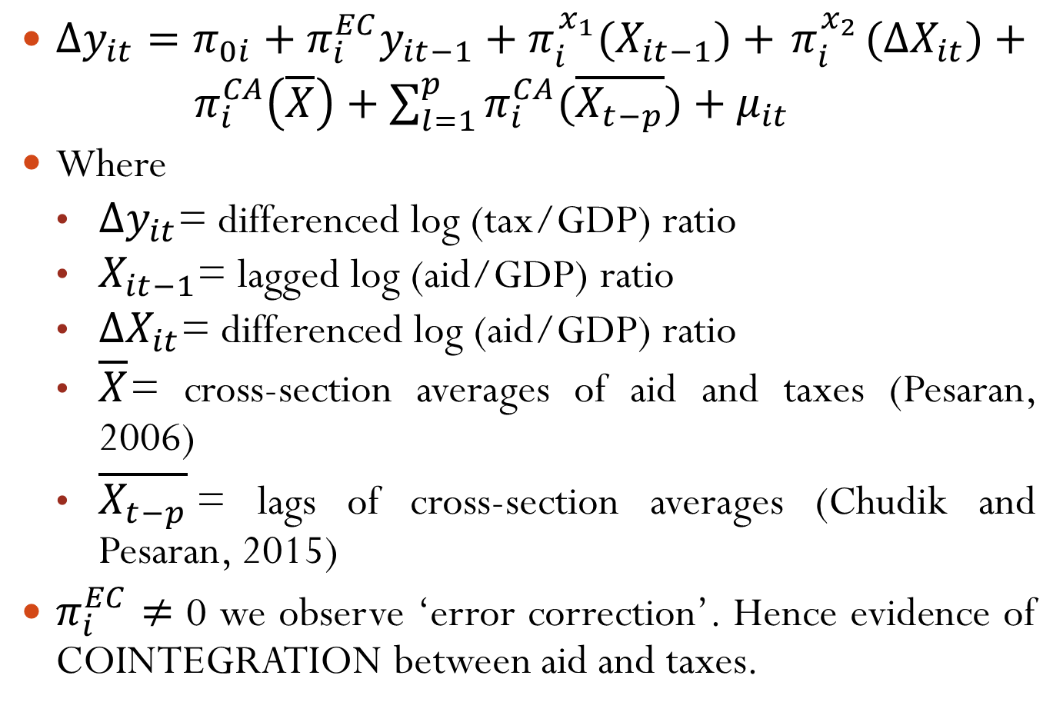
$∆y_{it}=π_{0i}+π_{i}^{EC}y_{it−1}+π_{i}^{x_{1}}{(X}_{it−1})+{ π}_{i}^{x_{2}}{(∆X}_{it})+{ π}_{i}^{CA}\left(\overline{X}\right)+\sum_{l=1}^{p}{π_{i}^{CA}(\overline{X_{t−p}})}+μ_{it}$
Where
$∆y_{it}$= differenced log (tax/GDP) ratio
$X_{it−1}$= lagged log (aid/GDP) ratio
$∆X_{it}$= differenced log (aid/GDP) ratio
$\overline{X}$= cross-section averages of aid and taxes (Pesaran, 2006)
$\overline{X_{t−p}}$= lags of cross-section averages (Chudik and Pesaran, 2015)
$π_{i}^{EC}$ $≠$ 0 we observe ‘error correction’. Hence evidence of COINTEGRATION between aid and taxes.

Slide 15
Results
Cointegrating (equilibrium) relationship between the aid/GDP and tax/GDP ratios.
Long-run positive relationship between aid and taxes:
Arguments suggest recipients prefer increasing taxes since the political costs are lower than the political costs of aid.

Slide 17
Exploratory Analysis
Heterogeneity in aid flows (grants and loans).
Effects of technical assistance on tax/GDP ratios.
Conditionality effects of aid on taxes.
Stability of aid flows.

Slide 21
Conclusion
Tax/GDP ratios are sustained by foreign aid, and this relationship can be interpreted as a behavioural representation.
Political costs of aid are greater than those for taxes.
Technical assistance is equally important.
Aid should be more predictable.

Slide 22
APPENDICES
Poltical costs of accountability: Knack and Rahman (2007); Besley and Person (2014); Ricciuti, Savoia and Sen (2016).
Bureaucratic costs of aid and taxation:
Bureaucratic costs of aid: Knack and Rahman (2007); Acharya, de Lima and Moore (2007); Djankov, Montalvo and Reynal-Querol (2009).
Bureaucratic costs of taxation: Moore (2014); Fossat and Bua (2013); Ahlerup, Baskaran and Bigsten (2015).

Slide 23
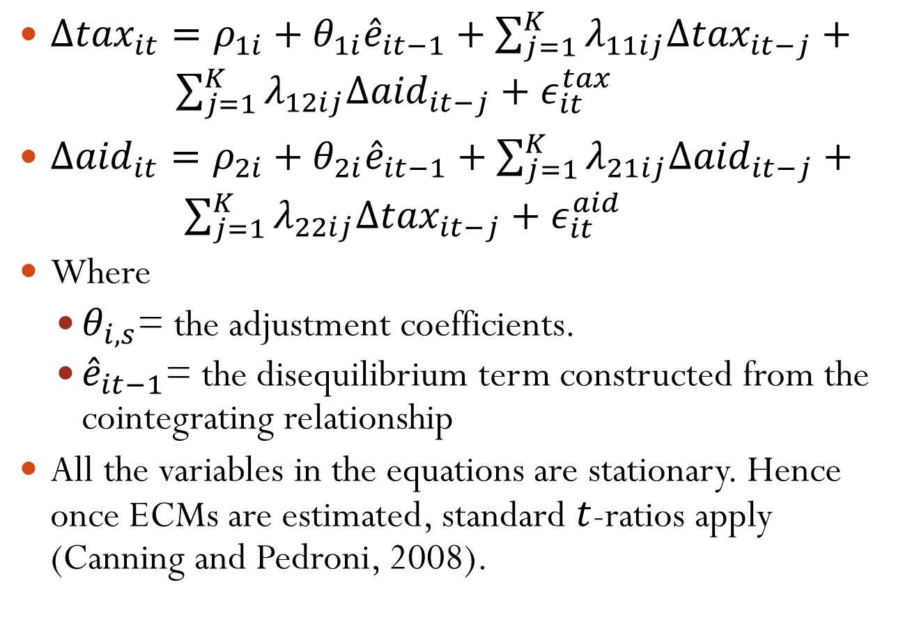
Weak Exogeneity (1)
$∆{tax}_{it}=ρ_{1i}+θ_{1i}{\hat{e}}_{it−1}+\sum_{j=1}^{K}{λ_{11ij}{Δtax}_{it−j}}+ \sum_{j=1}^{K}{λ_{12ij}{Δaid}_{it−j}}+ε_{it}^{tax}$
$∆{aid}_{it}=ρ_{2i}+θ_{2i}{\hat{e}}_{it−1}+\sum_{j=1}^{K}{λ_{21ij}{Δaid}_{it−j}}+ \sum_{j=1}^{K}{λ_{22ij}{Δtax}_{it−j}}+ε_{it}^{aid}$
Where
$θ_{i,s}$= the adjustment coefficients.
${\hat{e}}_{it−1}$= the disequilibrium term constructed from the cointegrating relationship
All the variables in the equations are stationary. Hence once ECMs are estimated, standard $t$-ratios apply (Canning and Pedroni, 2008).

Slide 24
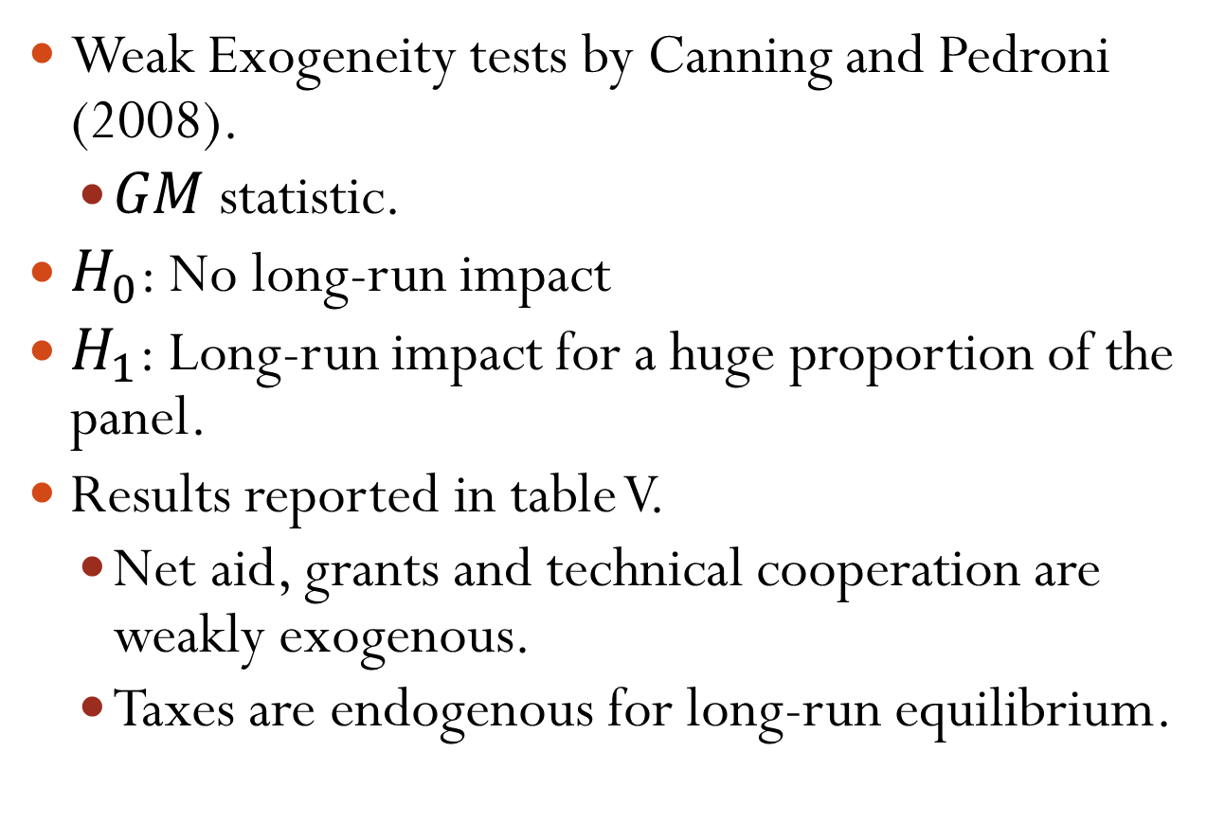
Weak Exogeneity (2)
Weak Exogeneity tests by Canning and Pedroni (2008).
$GM$ statistic.
$H_{0}$: No long-run impact
$H_{1}$: Long-run impact for a huge proportion of the panel.
Results reported in table V.
Net aid, grants and technical cooperation are weakly exogenous.
Taxes are endogenous for long-run equilibrium.

