Slide 1
Remittances, Institutional Quality and Economic Growth in Sub-Saharan Africa
OJAPINWA, TAIWO VICTOR
University of Lagos, Nigeria
12/05/2017

Slide 2
Background
Few people would disagree that, past decades had witnessed a dramatic increase in international capital flows to developing countries(See figure 1) and SSA specifically(See figure 2).
The increasing financial weight and stability of remittances to SSA have heralded heated argument among researchers Ratha (2003) and Chami et al (2003) and policymakers.
Meanwhile, Ramirez and Sharma (2008) assert that, the extent to which remittances contribute to economic growth depend on the quality and the environment of the financial system of the recipient countries.

Slide 3
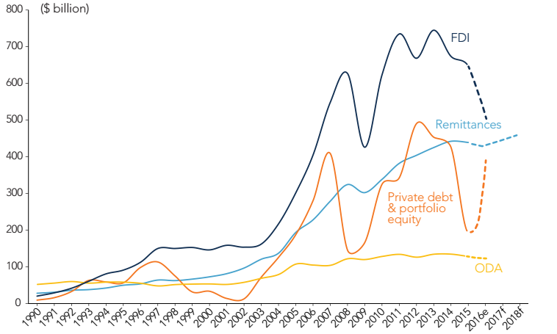
Figure 1: Trends in Remittances and other capital flows
Notes:
World Bank 2016

Slide 5
Intro contd
Meanwhile, several literatures also point out that quality of non-financial institutions like control of corruption, political stability, respect of rule of law, democratic accountability and so on are crucial for the development of the financial markets.
This implies that the exact impact of international remittance inflows on economic growth might largely be conditional on the quality of both financial and non financial institutions of the particular economy under consideration.
This reinforces Douglas North 1990 and World Bank reports (1997c) assertion that, ‘institutions matters’ for long-run growth.

Slide 6
Objectives
To examine the role of institutional quality (financial and non-financial) on the impact of remittances on growth in SSA
Test hierarchy of institutions hypothesis
remittances
institutions
growth
growth
remittances
financial institutions
Non-financial institutions

Slide 7
Literature Review - Empirical Literature

Slide 8
Literature cond

Slide 9
Justifications
This study is justified since it shifts the frontier of the literature towards providing answers to the question that does not only link remittances and growth but also remittances, financial and non financial institutional qualities and growth, an aspect usually ignored in the literature.
It focuses on the hierarchy of institutions hypothesis.
It focuses on SSA. Why?

Slide 10
Theoretical Literature Review
Institutional quality as motivation to remit:
Altruistic
Self- interest/Portfolio
Loan repayment/Co-insurance
Institutional qualities & hierarchy:
(Financial or non-financial)
Economic or political institutions
Rule of law
Regulatory qualities
Control of corruption
Government effectiveness
Voice and accountability
Extended neoclassical growth theory:
Neoclassical theory of international capital flows with bank as a maturity transformation theory

Slide 11
Methodology –Model specification
Impact of remittances on growth
Impact of remittances and Institutional quality on
growth

Slide 12
Methodology contd
Method of Analysis
Dynamic panel data regression analysis
Estimation Techniques
System GMM(SGMM)
The Scope
Macroeconomic impact of remittances on economic growth in 33 SSA countries from 1996 to 2015

Slide 14
Table 5.5: System GMM: Remittances, Institutional Quality and Economic Growth
Variables | Coefficient | t-Statistics | Probability
LGDPG(-1) | 0.2426* (0.0664) | 3.6510 | 0.0003
FDI LGCON INV | 0.0097** (0.0036) -0.0437 (0.0803) 0.14596** (0.0786) | 2.7237 -0.54450 1.8574 | 0.0067 0.5860 0.0638
REM*INV | 0.0090* 0.0033 | 2.7072 | 0.0070
CPI ODA | -0.0032 (0.0033) 0.0074** (0.0033) | -0.9749 2.2530 | 0.3300 0.0247
FD | 0.00363* (0.0009) | 3.7098 | 0.0002
REM*FD | 0.0109* (0.0061) | 1.7941 | 0.0733
PG LTOPEN | 0.1036** (0.0479) -0.1277 (0.0869) | 2.1591 -1.4694 | 0.0313 0.1423
INSQ | 0.7356** (0.3941) | 1.8665 | 0.0626
PSAVT VA RQ GEFF ROL COC | 0.7550* (0.3446) 1.2953* (0.3971) 1.1629* (0.4446) 1.3718* (0.4598) 1.2466* (0.3495) 1.2124 (0.4683) | 2.1909 3.2616 2.6154 2.9831 3.5661 2.5888 | 0.0291 0.0012 0.0093 0.0030 0.0004 0.0100
REM*INSQ REM*POLINSQ REM*ECINSQ Observation(panel) | 0.0423 (0.0188) 0.0082 (0.0117) 0.0257* (0.0074) 500 | 2.2581 0.6952 3.4721 500 | 0.0244 0.4872 0.0006 500
Cross-sections Periods Std error | 0.62 | 33
Instrument rank Hansen J Stat | 27.73 |  | 33

Slide 15
Summary of Findings
Remittances have negative impact on growth.
Remittances positively affect financial development.
We find strong evidence of a positive interaction between remittances and financial depth.
Non financial institutional factor as a whole has positive and significant impact on growth.
Finally, economic-institutions channel to growth is positive and significant but political-institution channel is only positive.

Slide 16
Conclusions
Both financial and non financial Institutions matters and matters for remittance impact on growth.
Remittances can only have positive impact on economic growth in an environment with sound financial and non financial institutional framework.
While, economic institutional channel is proximately related to growth, political institutional channel is deeply related, hence supports hierarchy of institution hypothesis.

Slide 17
Policy implications
Policies geared towards creating quality financial system and vibrant regulatory qualities, strong rule of law and control of corruption should be strengthened so as to encourage migrants to remit money for investment activities which can lead to economic growth.
Finally, and just as crucial, government should keep in mind that remittances to SSA may only lead to economic growth when quality non-financial and financial institutions are established with competitive monetary policies that entice migrants to remit for investment purposes in their home countries - SSA countries here.

Slide 18
The end
Thank you for your attention !

