Slide 1
Incentives and Firms’ Productivity: Exploring Multidimensional Fiscal Incentives in a Developing Country EFOBI Uchenna Rapuluchukwu, TANANKEM Voufo Belmondo*, and BEECROFT Ibukun *Ministry of Economy, Planning and Regional Development (MINEPAT) – Cameroon
www.minepat.gov.cm
Presentation at the African Economic Conference
Addis Ababa, Ethiopia, 4th to 6nd December, 2017

Slide 2
Outline
Introduction
What was done
Knowledge gaps to be filled
How it was done
The results?
Conclusion
Ministry of Economy, Planning and Regional Development (MINEPAT) – Cameroon
www.minepat.gov.cm

Slide 3
Introduction - 1
Expected benefits of increasing manufacturing sector productivity
creation of jobs for sustained growth and economic diversification
increased household consumption through improvement in the value of products and price efficiency
development of other primary sectors through backward linkages that come with the demand for intermediate goods
Ministry of Economy, Planning and Regional Development (MINEPAT) – Cameroon
www.minepat.gov.cm

Slide 4
Introduction - 2
UNCTAD (2015) - the improvement of the productivity of firms is one possible way for developing countries to attain sustainable industrial development.
Government involvement is a precursor for firms’ productivity and sustained industrialisation process in Africa.
Ministry of Economy, Planning and Regional Development (MINEPAT) – Cameroon
www.minepat.gov.cm

Slide 5
What was done
The paper investigates the impact of fiscal incentives on firms’ productivity
Case study - Cameroonian firms
Ministry of Economy, Planning and Regional Development (MINEPAT) – Cameroon
www.minepat.gov.cm

Slide 6
Knowledge Gaps to be filled
Focus on Africa
Lack of econometric studies that analyse the impact of government incentives on firms’ productivity, with a special attention to African countries
Multidimensional measures of fiscal incentives with a unique empirical application.
Macro studies
Policy documents
Ministry of Economy, Planning and Regional Development (MINEPAT) – Cameroon
www.minepat.gov.cm
Notes:
The closest to our study focused has focused on how fiscal incentives attract foreign investment to Africa, using macro data analysis (Cleeve, 2008). Arnold, Mattoo and Narciso (2008) attempted to go beyond macro analysis to consider firm-level data, but focused on services inputs.
At best, there has been policy documents, and with country specific cases

Slide 7
How it was done (1) – The Data
World Bank Enterprise Surveys
300 manufacturing firms in Cameroonian
2007 – 2009
Manufacturing firms involved in cross-border trading
More than five employees
Ministry of Economy, Planning and Regional Development (MINEPAT) – Cameroon
www.minepat.gov.cm
Notes:
More than five employees – more likely to be involved in international trade

Slide 8
How it was done (2) – The Variables
We calculated the productivity of firms using the ratio of firms’ output (sales) to firms’ input (total asset available to the firm).
The WBE Survey contains measures of assessing firms’ beneficiary status from fiscal incentives such as:
import duty exemption
profit tax exemption
export financing
Ministry of Economy, Planning and Regional Development (MINEPAT) – Cameroon
www.minepat.gov.cm

Slide 9
How it was done (3) – The Variables
Other firm characteristics that formed the basis of our evaluation include:
Productive capacity - current resale value of the machinery and equipment
Size of the firm - value of land owned by the firm
Labour input - cost of labour (including wages, salaries and bonuses)
Cost on power - average yearly expenses on fuel to generate power
Ministry of Economy, Planning and Regional Development (MINEPAT) – Cameroon
www.minepat.gov.cm
Notes:
The propensity scores were developed using these variables
Firms have an incentive to overstate depreciation and understate their physical capital due to tax purposes (Clarke, 2011),

Slide 10
How it was done (4) – Technique of Estimation
Impact evaluation methodology
Evaluates what could have been the effect of the introduction of fiscal incentives on firms’ productivity assuming they did not benefit from the introduction of the incentives.
Propensity score matching, which estimates the mean effect of benefiting from the fiscal incentives on the firms productivity, when compared to a counterfactual non-beneficiary.
Hence, ATT = E(Y_{i}¹ – Y_{i}⁰|P_{i}=1)
To identify the appropriate counterfactual comparison group, we adhered to the following guide:
Ministry of Economy, Planning and Regional Development (MINEPAT) – Cameroon
www.minepat.gov.cm

Slide 11
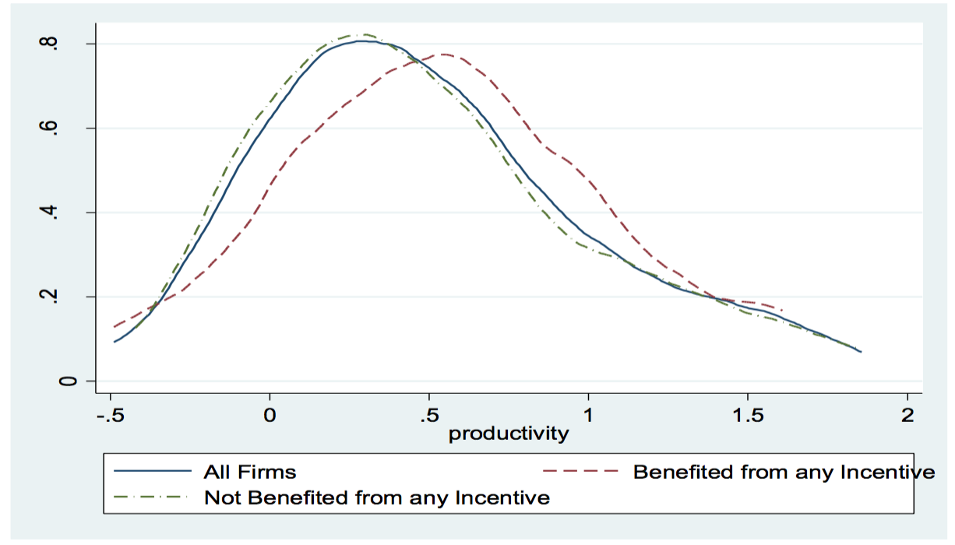
Productivity of Firms by their Benefiting from any of the Incentives (i.e. Import Duty Exemptions, Profit Tax Exemption and Export Financing)
Ministry of Economy, Planning and Regional Development (MINEPAT) – Cameroon
www.minepat.gov.cm
Notes:
Kernel Density biased towards the right, implying higher productivity for firms that benefited from the incentive

Slide 12
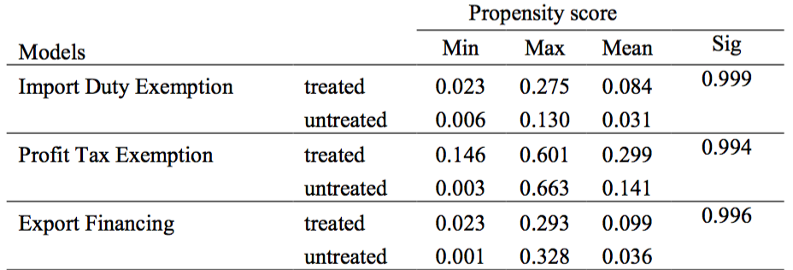
Propensity Scores of Treated and Untreated Group
There is no significant difference existing in the distribution of the scores (means).
The region of the common support for all the estimated PSM indicates that there was a balance between covariates of participants and non-participants
Ministry of Economy, Planning and Regional Development (MINEPAT) – Cameroon
www.minepat.gov.cm
Notes:
Rule of thumb is that the common support must be greater than zero and less than 1

Slide 13
Average Treatment Effect for Productivity
Ministry of Economy, Planning and Regional Development (MINEPAT) – Cameroon
www.minepat.gov.cm
Notes:
Table 5.3
profit tax treatment, participants are able to increase their productivity by about 27.1
export finance scheme, beneficiaries had a positive improvement in their productivity by about 89.4 percent higher

Slide 14
The results? - 1
The findings suggest that participation in the different forms of incentives are associated with higher productivity
Particularly, there was a significant and positive impact of the productivity of firms that benefit from profit tax exemption and export financing.
Ministry of Economy, Planning and Regional Development (MINEPAT) – Cameroon
www.minepat.gov.cm

Slide 15
The results? - 2
However, when considering import duty exemption, the significance of this variable was not consistent.
Ministry of Economy, Planning and Regional Development (MINEPAT) – Cameroon
www.minepat.gov.cm

Slide 16
Conclusion
The paper provides support for the argument that the government’s involvement in the firm should be targeted at rewarding outputs and not supporting processes
This can stir up firms’ efficiency because firms that benefit from these incentives have to:
be profitable
be able to produce outputs that can be consumed beyond the Cameroonian market
This provides an essential element of a strategy for industrialisation.
Ministry of Economy, Planning and Regional Development (MINEPAT) – Cameroon
www.minepat.gov.cm

Slide 17
THANK YOU FOR LISTENING
Ministry of Economy, Planning and Regional Development (MINEPAT) – Cameroon
www.minepat.gov.cm

