Slide 1
Impact of Remittances on Food Consumption and Nutrition of Migrant’s Household: Empirical Evidence from Nigeria
Raphael Babatunde
Department of Agricultural Economics and Farm Management,
University of Ilorin, Nigeria
African Economic Conference, 4 -6 December, 2017, United Nations Conference Centre, Addis Ababa, Ethiopia.

Slide 2
Outline
Background
Motivations
Data and methodology
  The Nigerian context
  Data
  Identification strategy
Results
Conclusion

Slide 3
Migration has become an important livelihood strategy among households in developing countries due to many factors:
Background
It provides migrant households with remittances that are uncorrelated with agricultural income
There are about 232 million migrants in the world today who live and work outside their country of origin (World Bank, 2014)
Remittances sent home is believed to have a huge impact on the welfare of the families left behind

Slide 4
Remittances to developing countries have increased dramatically in the last decade:
It has increased by 8.4% annually on average since 2013
It amount to about USD 436 billion in 2014 (World Bank, 2014)
Comparable to Foreign Direct Investment (FDI) and even larger than Overseas Development Assistance (ODA) in some countries
It is expected to exceed USD 1 trillion over the next five years
While most remittance flows to Sub-Saharan Africa are underreported, evidences show that remittances to the region are small compared to Asia and Latin America
The region received about USD 33 billion in 2013
Nigeria, Egypt, Sudan and Senegal are the largest recipients in that order

Slide 5
Two motives for sending remittances have been identified in the literature: insurance and investment motives
Insurance motive:
  Migration is seen as a risk-sharing behaviour between the migrants and the households
  Remittances serve as insurance against income and consumption shocks in the absence of a functioning insurance market
Investment motive:
  Migration is seen as a potential source of investment capital in the absence of a functioning capital market
  Remittances are seen as contribution to investment in household assets later to be inherited

Slide 6
Motivation
In development economic literatures, very little attention has been devoted to examining the nutritional impact of remittances on the migrant households
Studies examining the poverty impact of remittances are more common
Effects of remittances on dietary quality and diversity, micronutrients intake and child’s nutritional status are rarely examined
Consequently there are no concrete policies on migration and remittances in developing countries
Remittances may have a positive effect on income and food consumption, but may also have a negative effect of reducing labour availability within the household

Slide 7
Objectives
The objective of this study is to examine the impact of remittances on food security and nutrition of rural households in Kwara State, Nigeria.
It is important to understand the link between remittances and nutrition of sending households so as to guide policy formulation
To be able to include migration and remittances as components of food security strategies in developing countries

Slide 8
Data and Methodology
The Nigeria Context:
With estimated population of about 180 million people, poverty and food insecurity are widespread in the country. Though average income and calorie intake have increased over the year, about 52% are still living below the poverty line and 9% are under-nourished
During the era of oil boom, Nigeria was a major migration destination but migrant population in Nigeria decline dramatically after the civil war and end of the oil boom
Migration to other countries has continue to increase, and Nigeria accounts for the largest share of African migrant population in Europe and North America
Remittances to Nigeria amount to USD 21 billion in 2014, making the country the highest recipient in SSA and sixth in the world
An estimated 5.5% of household income in Nigeria is from remittances

Slide 9
Data
Survey data were collected from Kwara state, north-central Nigeria
70% of the population of 2.4 million are smallholder farmers and malnutrition and poverty are prevalent in the state
Local and international migration are common in the state because of the poverty level
Data were collected from 240 farm households across 40 villages in the state
Data about household characteristics, income, migration, remittances, food consumption and child anthropometry were collected
From the 7-days food recall data, calorie intake, dietary quality and diversity and micronutrients intake were estimated using food composition table
Child anthropometric data were converted to z-scores using the standard reference group procedure

Slide 10
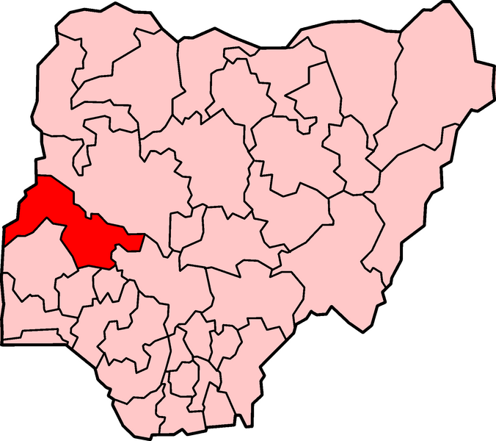
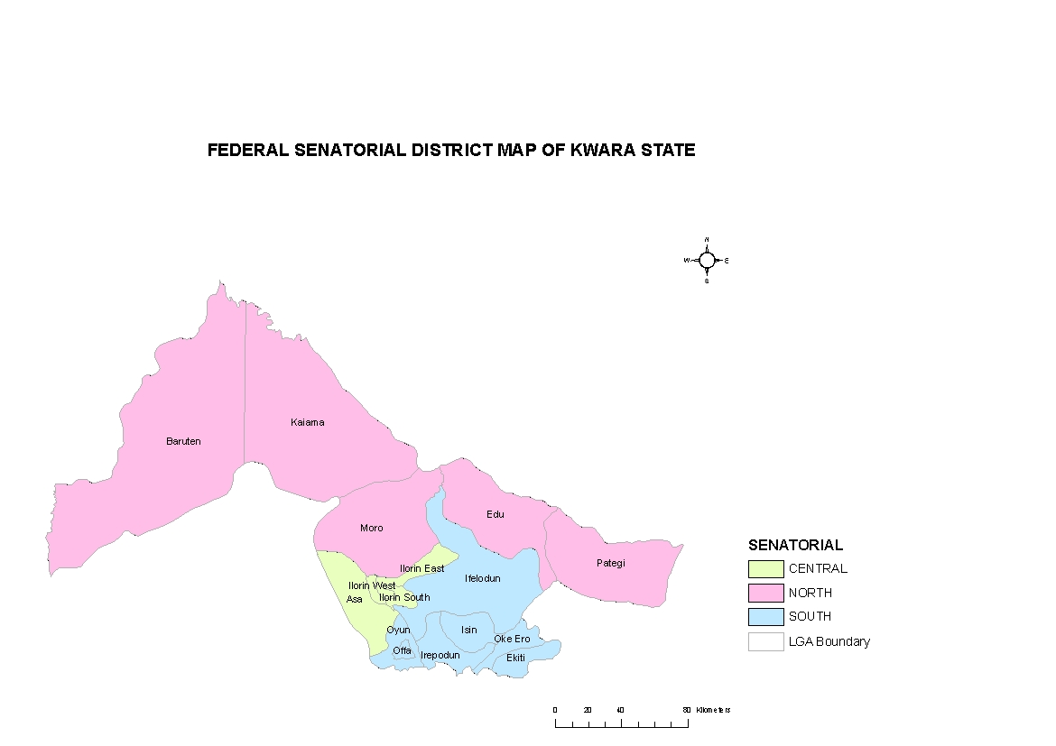

Kwara state
Map of the study area

Slide 11
Identification strategy
To deal with the endogeneity of the remittance variable, an Instrumental Variable approach with cluster correction was used. A general model of household food security and nutrition was specify as:
FN = food security and nutrition indicators such as calorie intake,
dietary quality, dietary diversity, micronutrients intake and
child nutritional status as measured by z-scores
R = remittances in naira per capita
Y = household income minus remittances in naira capita
X = vector of household head variables
H = vector of other households variables
ε = the random error term
Problem of identifying suitable instruments for remittances and net income
Assets, electricity, tapped water and tarred road were used as instruments

Slide 12
Results
Table 2: Sample characteristics
Variable | Definition and unit | Mean | SD
CAL_SS | Household calorie intake in kcal/AE/day | 2427.5 | 704.0
DIET_Q | Calorie intake from high value food in kcal/AE/day | 436.9 | 126.7
DIET_D | Number of food groups consumed in 7-days recall | 5.30 | 1.63
IRON_SS | Household Iron intake in mg/day/AE | 26.57 | 8.58
VITA_SS | Household Vitamin A intake in µg RE/day/AE | 289.0 | 86.66
HFA_Z | Child height-for-age Z-scores | 0.455 | 2.64
WFA_Z | Child weight-for-age Z-scores | -0.586 | 1.40
WFH_Z | Child weight-for-age Z-scores | -0.991 | 1.88
HH_SIZE | Number of household members in AE | 5.08 | 1.31
GENDER | Gender of household head, male = 1 | 0.90 | 0.31
AGE_HHH | Age of household head in years | 59.1 | 6.80
EDU_HHH | Education of household head in years of schooling | 6.89 | 3.93
FAM_SIZE | Area cultivated by the household in ha | 1.90 | 0.58
D_MARKET | Distance to the nearest market place in km | 11.71 | 12.89
NET_INC | Household income minus remittances in naira/AE | 28634.4 | 23223.4
REM_INC | Remittance income per year in naira/AE | 1161.3 | 2471.8
TOT_INC | Total household income in naira/AE | 30245.7 | 23416.3
AC_REM | Access to remittance income, yes = 1 | 0.61 | 0.48

Slide 13
Table 3: Per capita income composition of households by access to remittances
 | All households (N = 220) | Remittances recipient households (N = 134) | Remittances non- recipient households (N = 86)
Farm income | 15226.5 (50.3) | 14980.4 (46.1) | 15609.9 (54.5)
Agricultural wage income | 3946.6 (13.1) | 4278.5 (13.2) | 3429.6 (12.8)
Non-agricultural wage income | 1828.6 (6.0) | 1852.3 (5.7) | 1792.5 (6.7)
Self-employed income | 7285.2 (24.1) | 8402.5 (25.8) | 5544.4 (20.7)
Remittances | 1611.3 (5.3) | 2645.5 (8.1) | -
Pensions, dividends | 347.1 (1.1) | 358.8 (1.1) | 328.6 (1.2)
Total income | 30245.7 | 32518.1 | 26705.2
Notes: Figures in bracket are the percentage of the respective income sources in total household income

Slide 14
Total annual income of remittances recipient households were
higher than the non-recipient households
Remittances contribute to higher income of recipient
households?
Remittances contribute about 8% on average to total income of
recipient households
Self-employed income contribute larger share of income of
remittances recipient households, while farm income contribute
more to total income of non-recipient households
Households investing remittances in self-employed business?

Slide 15
Table 4: Mean assets, food security and nutrition by access to remittances
 | All household (N = 220) | Rem. recipient households (N = 134) | Rem. non- recipient households (N = 86) | T-test (receiver vs. non-receiver)
Household assets
Farm size (ha) | 1.90 | 1.91 | 1.89 | 1.41
Assets (naira) | 73761.8 | 79350.4 | 65054.0 | 1.67*
Education (years) | 6.89 | 7.42 | 6.04 | 0.72
Calorie and micronutrients intake
Calorie intake (kcal/day/AE) | 2427.5 | 2462.6 | 2372.7 | 3.48***
Dietary quality (kcal/day/AE) | 436.9 | 443.2 | 427.1 | 1.12
Dietary diversity (number) | 5.30 | 5.37 | 5.15 | 0.98
Iron intake (mg/day/AE) | 26.6 | 27.4 | 25.3 | 1.87*
Vitamin A intake (µg RE/day/AE) | 289.0 | 291.0 | 285.9 | -1.20
Child nutritional status
Height-for-age Z-score | 0.456 | 0.992 | -0.124 | 2.01**
Weight-for-age Z-score | -0.586 | -0.415 | -0.771 | -0.09
Weight-for-height Z-score | -0.991 | -1.15 | -0.811 | 1.01

Slide 16
Table 5: Effects of remittances on calorie intake and nutrition
Variables | Calorie intake (IV) | Dietary quality (IV) | Dietary diversity (POISSON) | Iron intake (IV) | Vit. A intake (IV)
Constant | 2939.6** (6.66) | 439.3*** (4.42) | 1.94*** (5.65) | 22.71*** (3.51) | 270.5*** (3.70)
HH_SIZE | -106.9** (-2.22) | -14.22* (-1.92) | -0.054** (-2.01) | -0.068* (-1.88) | -7.52 (-0.96)
GENDER | 423.8** (2.55) | 49.11** (2.00) | 0.181 (1.62) | 4.19*** (2.62) | 29.48* (1.93)
AGE_HHH | -9.55 (-1.48) | -2.37** (-2.19) | -0.01 (-1.09) | -0.149** (-2.12) | -1.47* (-1.85)
EDU_HHH | 6.46 (0.39) | 4.68 (1.18) | 0.016** (2.42) | 0.019** (2.29) | -3.13 (-1.08)
FAM_SIZE | 197.2** (2.47) | 30.37* (1.79) | 0.027 (0.51) | 0.010 (0.01) | 21.48* (1.72)
D_MARKET | -9.19** (-2.06) | 0.428 (0.42) | -0.002* (-1.88) | 0.029 (0.44) | 0.464 (0.61)
REM_INC | 0.010** (2.08) | 0.0001 (0.24) | 1.29E-06 (0.81) | 0.0002 (1.06) | 0.002 (0.92)
NET_INC | 0.021*** (4.03) | 0.0004*** (2.69) | 2.29E-06** (2.34) | 0.0002*** (2.64) | 0.003** (2.57)
Adj. R²/ χ² | 0.251 | 0.287 | 44.04 | 0.341 | 0.177
Hausman chi² | 11.02 | 5.55 |  | 12.61 | 6.39
Notes:
Table 4: Effect of remittances on calorie intake and nutrition

Slide 17
Table 6: Effect of remittances on child nutritional status
Variables | Height-for-age (Z-score) | Weight-for-age (Z-score) | Weight-for-height (Z-score)
Constant | 7.37*** (2.88) | -1.10 (-0.97) | -6.72*** (-3.62)
HH_SIZE | -0.047 (-0.21) | 0.099 (0.99) | 0.092 (0.56)
G_CHILD | 0.765 (1.57) | 0.338 (1.55) | -0.191 (-0.54)
A_CHILD | -0.137*** (-4.10) | -0.063 (-1.56) | -0.067*** (-2.80)
EDU_HHH | 0.169** (0.21) | 0.023 (0.66) | 0.021 (0.37)
EDU_MOT | 0.043** (2.47) | 0.071* (1.74) | 0.139** (2.07)
FAM_SIZE | 0.736* (1.67) | 0.342* (1.73) | 0.147 (0.46)
D_MARKET | 0.015 (0.67) | 0.018 (1.43) | 0.008 (0.48)
TOILET | 1.00* (1.95) | 1.39*** (6.09) | 1.08*** (2.91)
REM_INC | 0.000 (1.00) | -0.001 (-1.01) | 0.0001 (1.12)
NET_INC | 0.0001 (0.74) | 0.0001** (2.00) | 0.000 (1.55)
Adjusted R² | 0.138 | 0.362 | 0.278

Slide 18
Summary of major findings
About 61% of all the household received remittances in the last one year
Remittances contribute to higher income among the recipient households (sending households)
Descriptive results indicate that income, assets and calorie intake were higher in remittances recipient households
- suggesting that remittances has the potential to improve income,
asset and nutrition

Slide 19
Econometric analysis shows that household income net of remittances improves calorie consumption and nutrition in the recipient households
Results also revealed that remittances has a positive and significant effect on calorie intake
- This implies that migration and remittances can increase calorie
consumption of poor households

Slide 20
Remittances do not have any significant effect on dietary quality, dietary diversity, micronutrients intake and child nutritional status
Possible reasons:
Remittances may not be use to buy quality food and micronutrients
Remittances may be spent on other non-food items, such as cloth, shelter,
education and leisure
Problem of data and methodological limitations. For example the small sample size
and the problems of finding appropriate instruments for the income variables in the IV
model
Remittances may also be underreported since it comes irregularly and through
informal channels. The amount captured in the data are not sufficient enough
to have an overall impact on household nutrition
Remittances may be in the control of men rather than women in the household, who
do not use them for household nutrition

Slide 21
Policy implications
Given the positive effect of remittances on income and calorie
consumption, migration and remittances should be incorporated into food
security and poverty reduction programmes in developing countries
Policies that will facilitate remittances flow by reducing the cost of
migration should be pursued
Since remittances presently has no visible effect on dietary quality and
nutrition of recipient households, effort should be devoted to removing
the difficulty in transmitting remittances as well as educating recipient
households on utilization of remittances for nutrition purposes
The result should be interpreted cautiously

Slide 22
Thank you for your attention

Slide 23
Table A1: First stage regression explaining remittances and household net income
 | Remittance income (naira/AE) | Net income (naira/AE)
Constant | 5125.9*** (2.77) | 23115.940* (1.81)
HH_SIZE | 372.1*** (2.76) | -5911.196*** (-6.35)
GENDER | 506.4 (0.89) | -2000.667 (-0.51)
AGE_HHH | -19.5 (-0.80) | 148.640 (0.87)
EDU_HHH | 53.6 (0.85) | 1265.180*** (2.89)
FAM_SIZE | -53.0 (-0.17) | 6535.976*** (3.11)
D_MARKET | 25.7* (1.66) | -354.732*** (-3.31)
ASSETS | -5655.0 (-1.57) | 86.439*** (3.48)
ELECT | -220.9 (-0.47) | 7218.709** (2.24)
T_WATER | -156.1** (-2.31) | 1559.110 (0.47)
T_ROAD | -524.9* (-1.86) | -241.973 (-0.08)
Adjusted R² | 0.211 | 0.497
Notes: The number of observations in all models is N = 220. Figures in parentheses are t-values.
*, **, *** statistically significant at the 10%, 5%, and 1% level, respectively.

