Slide 1
Financial repression and Capital controls on outflows in Sudan: an evaluation of fiscal effects
Sawsan Abdul-Jalil
University of Khartoum
Dept. Economics
University of Khartoum
African Economic Conference 2017
“Governance for Structural Transformation”
4-6 December 2017, Addis Ababa, Ethiopia
Notes:
Hello everyone. My name is Sawsan, I am a lecturer at the University of Khartoum, Sudan. the title of my presentation is “ financial repression and capital controls on outflows in Sudan: an evaluation of fiscal effects”. The purpose of the paper is to evaluate the fiscal effect of capital controls on outflows via financial repression. Interestingly, the fiscal revenue was estimated to be negative. I will hereafter use the term “capital controls to refer to capital controls on outflows

Slide 2
outline
Introduction
Methodology
Main findings
Limitations
Notes:
My presentation today will fall into 5 sections, firstly, I will start with providing the background of my study, research question and the objectives of the study. After that I will move to explain the Methodologies I took to answer my research question. I will follow that with the main findings by highlighting the limitations of the research

Slide 3
Introduction: Background
Several empirical works found that capital controls on outflows have a positive fiscal effect, mainly through two channels:
Allowing the government to reduce the cost of domestic borrowing
Maximization of seigniorage
Since the secession in 2011 and the loss of the critical oil revenues, Sudan has been struggling to improve its fiscal stance
The IMF is advising the government to lift controls on capital outflows
Would relaxing capital controls on outflow effect adversely the fiscal balance of the government?
Notes:
A less discussed area in the debate on capital controls is the fiscal aspect
The literature on the fiscal effect of capital controls on outflows found empirical evidence that these controls generates fiscal revenue for the government.
Mainly through two channels: 1- As capital controls on outflows restrict the movement of capital outside the economy the government then can take advantage and lowers the domestic costs of its borrowing
2- capital controls on outflows increases the revenue from creating money or seigniorage
I thought this causality is relevant in the case of Sudan, which, in 2011 separated from South Sudan, loosing oil revenue which was a critical source for government revenue (70%). And since that time, the government has been unsuccessful in improving the fiscal stance. As the fiscal deficit continued to grow. At the same time, the IMF is advising the government to lift the capital controls as they drive investment away from the country.
So, the an interesting question arrive, and that is, whether capital liberalization will worsen the fiscal balance of the government or not?

Slide 4
Estimation of the revenue from financial repression (Giovannini and De Melo, 1991)
Giovannini & De Melo (1991) estimate the revenue generated by financial repression in presence of capital controls
Their methodology is based on the idea that financial repression enables the government to borrow at a lower rate than the foreign rate
Hence, The revenue from financial repression is the difference between foreign and domestic costs of borrowing
Notes:
My second methodology was an empirical one, where I estimated the revenue from financial repression in the presence of capital controls. This method gives an estimation of the fiscal relevance of capital controls.
The estimation method is based on the model proposed by Giovannini and De Melo (1991).
The main idea of their model is that, financial repression in combination with capital controls will allow the government to create a wedge between the foreign and domestic costs of borrowing, and borrow at a lesser cost domestically. Which is a financial gain
Therefore, the revenue from financial repression can be calculated as the difference between the cost of foreign and domestic costs of borrowing

Slide 5
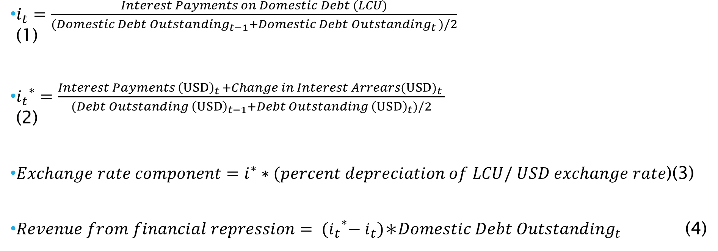
Estimation of the revenue from financial repression (Giovannini and De Melo, 1991)
$i_{t}=\frac{Interest Payments on Domestic Debt (LCU)}{{(Domestic Debt Outstanding}_{t−1}+{Domestic Debt Outstanding}_{t })/2}$ (1)
${i_{t}}^{∗}=\frac{Interest Payments{ \left(USD\right)}_{t }+Change in Interest Arrears{(USD)}_{t} }{(Debt Outstanding {\left(USD\right)}_{t−1}+Debt Outstanding{ \left(USD\right)}_{t})/2}$ (2)
$Exchange rate component=i^{∗}∗(percent depreciation of LCU/ USD exchange rate$)(3)
$Revenue from financial repression= {{(i}_{t}}^{∗}−i_{t})\text{∗}{Domestic Debt Outstanding}_{t }$ (4)
Notes:
The first equation gives the effective domestic interest rate, where the total interest payments in local currency are divided by the average domestic debt outstanding for two periods
The second equation is the foreign effective interest rate, interest payments in USD and interest arrears are divided by the average external debt stocks in USD in two periods

Slide 6
Estimation of the revenue from financial repression, Data
Due to data availability, only short-term debt was taken into consideration
Data were sourced out of Sudan Company for Financial Services, World Bank-World Development Indicators, World Bank- International Debt statistics
All data covers the period from 2000-2014

Slide 7
Main Findings: Negative revenues from financial repression
Table : Financial repression revenue, in averages, Sudan, 2000-2014
Financial | Interest rate differential |  | Exchange rate component
repression | component
revenue as % of
GDP | As % per | As a % of | As % per | As a % of
 | annum | GDP | annum | GDP
-0.8 | -0.2 | -0.8 | 0.0 | 0.0
Source: Author’s computations
Notes:
The table represents the results of the estimation of the revenue from financial repression, surprisingly, and in contrast to the results obtained by Giovannini and de Melo (1991) in their sample. The average financial repression revenue was -0.8% of GDP.

Slide 8
Main findings: why the revenue from financial repression is negative?
Exchange rate stability
High domestic cost of borrowing
Notes:
I had two interpretations for my results that deviated from the results of Giovannini and De Melo Exchange rate stability: for the period till 2004, the Sudanese Pound was pegged to the USD, I see that as a result from a fear of inflation and external debt crisis, another factor was the economic boom brought by the exportation of oil, in 2004 Sudan adopted a managed float exchange rate regime
High domestic cost of borrowing visa a vis external cost of borrowing, I this as a way for the government to mitigate the limited access to external credit and domestic resources.

Slide 9
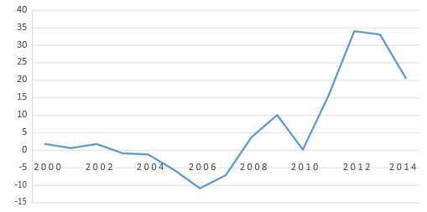
Main findings: Exchange rate stability
Change in official exchange rate, SDG/USD, year average, in percent, Sudan, 2000-2014
Source: Based on WB (2016)
Notes:
I had two interpretations for my results that deviated from the results of Giovannini and De Melo Exchange rate stability: for the period till 2004, the Sudanese Pound was pegged to the USD, I see that as a result from a fear of inflation and external debt crisis, another factor was the economic boom brought by the exportation of oil, in 2004 Sudan adopted a managed float exchange rate regime
High domestic cost of borrowing visa a vis external cost of borrowing, I this as a way for the government to mitigate the limited access to external credit and domestic resources.

Slide 10
Main findings: High domestic cost of borrowing
Issuance of GMCs, in million USD, and GMC average annual yield (in percent), Sudan, 2000-2014
Years | Issuance | Profit-margin %
2000-2004 | 2063 | 25
2005-2009 | 3583 | 17
2010-2014 | 45035 | 18
SCFS. (2014)

Slide 11
limitations
Not accounting for Seigniorage
Data availability

Slide 12
Thank you
Notes:
This was my presentation, thank you for your patience. I will love to answer your questions

Slide 13
Determinants of capital controls in sudan
Several studies found correlation between the imposition of capital controls and several structural country characteristics (Alesina, Grilli & Milesi-Ferretti, 1993; Aizenman & Guidotti, 1994; Milesi-Ferretti, 1998)
Inefficient tax system
Financially repressed sector
These aspects were analyzed in the case of Sudan using several indicators such as: Tax/GDP, the tax structure, M2/GDP, reserve requirement, bank credit to bank deposit, domestic credit and reserve requirement.
Notes:
I followed two methodologies to answer the research question, first, I took a structural approach, in which, capital controls on outflows are a dependent on the political and institutional characteristics of the country.
Out of these characteristics I choose two, which I had data available to analyze them: 1- the inefficiency of the tax system: inefficiency in this context implies that revenue generated from tax collection is constrained. Therefore capital controls can be introduced as alternative strategy to collect revenue
2- Financial repression: the term in general refers to the group of measures taken by governments that aims either to reduce government debt or to facilitate a domestic market for government debt, in this regard, capital controls on outflows play a crucial part in the implementation of financial repression measures. And thus, research found in most cases financial repression was accompanied by capital controls.
I analyzed these determinants using several descriptive indicators such as, Tax/GDP ratio, the tax structure, M2/GDP in addition to monetary policies of financial repression. Namely, the reserve requirement and credit policies.

Slide 14
Main findings: inefficiency of the tax system
Graph: Tax/GDP, in percent, Sudan, 1970-2006
Source: Based on Alamir (2007, p. 241)
Notes:
The first finding was that the tax system in Sudan is inefficient. The main indicator that I used to assess the efficiency of the tax system in Sudan was the Tax/GDP ratio. As it can be seen in this graph, the tax/GDP ratio has been declining in Sudan for more than three decades
This a result of colonial tax system that was focusing on commodity taxation, weak tax administration and structural factors of the economy such as the big informal sector.

Slide 15
Financial repression in Sudan
Graph : M2/GDP, in percent, Sudan, 1965-2014
Source: WB (2016)
Notes:
Secondly, the financial system in Sudan is repressed, one of the indicators used in the literature for financial repression is the M2/GDP ratio. A low value of the ratio implies a low level of financial intermediation and financial development. A sign of financial repression. The graph depicts the trend of the M2/GDP ratio for Sudan an selected countries that operate an Islamic financial system as Sudan. Throughout the sample period Sudan exhibited the lowest ratio among the peers

Slide 16
Efficiency of the tax system
Table 1: Tax/ GDP, in percent, selected Sub-Saharan countries, 1990- 1995
Country/ years | 1990 | 1991 | 1992 | 1993 | 1994 | 1995 | Country
 |  |  |  |  |  |  | average
Angola | 22 | 15 | 25 | 37 | 39 | 28 | 28
Botswana | 40 | 37 | 37 | 33 | 29 | 27 | 34
Cameroon | 10 | 10 | 10 | 8 | 10 | 11 | 10
Ethiopia | 10 | 8 | 8 | 11 | 13 | 12 | 10
Ghana | 11 | 12 | 10 | 13 | 17 | 15 | 13
Ivory coast | 18 | 17 | 17 | 15 | 16 | 18 | 17
Kenya | 20 | 20 | 20 | 25 | 25 | 26 | 23
Senegal | 16 | 17 | 15 | 14 | 12 | 14 | 15
Sudan | 5 | 6 | 7 | 6 | 7 | 7 | 6
Uganda | 7 | 6 | 7 | 8 | 9 | 10 | 8
Period average | 16 | 15 | 16 | 17 | 18 | 17 | 16
excluding Sudan
Source: Based on Stosky & WoldeMariam (1997, p. 50-55)

