Slide 1
Social Capital and the Willingness to Pay for Environmental Good in African Countries
Urbain Thierry YOGO
CEREG-University of Yaoundé II
AEC Conference, October 2011

Slide 2
Motivation
The issue of environmental preservation is nowadays a common concern for both developed and developing countries.
One of a conventional wisdom as regard to this issue is that the emergence of environmental awareness depends of the level of development.
Low income countries such as African countries are less likely to exhibit a strong demand and WTP for environment quality.

Slide 3
Why Should We Care
African countries are most vulnerables to climate change and environmental shocks.
A weak WTP for environmental good induces a low ability to design an appropriate en vironmental policy without relying upon external resources.

Slide 4
Knowledge Gap
At the sole exception of Polyzou and al (2011), to our knowledge, there is no study dealing explicitly with the relationship between social capital and the willingness to pay for environmental goods in general, African countries to be specific.
Much of studies are country specific and cannot be easily generalized. Few existing contributions related to a group of countries and considering an environmental damage perspective as a whole.
Few studies dealing with the endogeneity of social capital while addressing their potential effects on the WTP.

Slide 5
Contribution of the Paper
using five waves of the World Value Survey (1981-2007) and mobilizing ordered Logit specifications, we explore the effects of social capital on the WTP for environmental preservation in thirteen African countries
Dealing with the plausible endogeneity of social capital using instrumental variable approach.

Slide 6
Outline
Theoretical background.
Social capital and the WTP data.
Empirical Modelling.
Results.
Policy implications.

Slide 7
Theoretical Background
Information effects: Social capital helps sharing informations about environmental issues and could lead to an awareness vis à vis those issues and therefore increase the WTP for environment preservation (Polyzou and al, 2011).
Peer effect: Social capital influences individuals’ environmental preferences due to their perception that other members of their community will act in a similar manner aiming on the protection of the common good (Pretty, 2003, Wiser, 2007)

Slide 8
Social capital and the WTP data.
Social capital is measured by a binary variable of generalized trust.
The question asked is: « Generally speaking, would you say that most people can be trusted or you can’t be too careful when dealing with people? “

Slide 9
Generalized trust comparing African versus non African countries

Slide 10
WTP is measured by an ordered variable after the following question:
“would you agree to give a part of your income for environment?”.
-Strongly agree, agree, disagree, strongly disagree.

Slide 11
Willingness to pay for environment, comparing African and non African countries

Slide 12
Data Sources
World Value Survey, four Waves (1981-2007)
13 African Countries: Algeria, Burkina Faso, Ghana, Tanzania, Nigeria, Ethiopia, Egypt, Rwanda, Uganda, Zambia, Zimbabwe, South Africa, Morroco.

Slide 13
Relationship between WTP and Generalized Trust: Basic Correlation

Slide 14
Empirical Modeling
Econometric model of the effects of social capital on the WTP: Ordered Logit estimates.
Econometric model of the effects of social capital on the WTP: Instrumental Variable estimates.

Slide 15
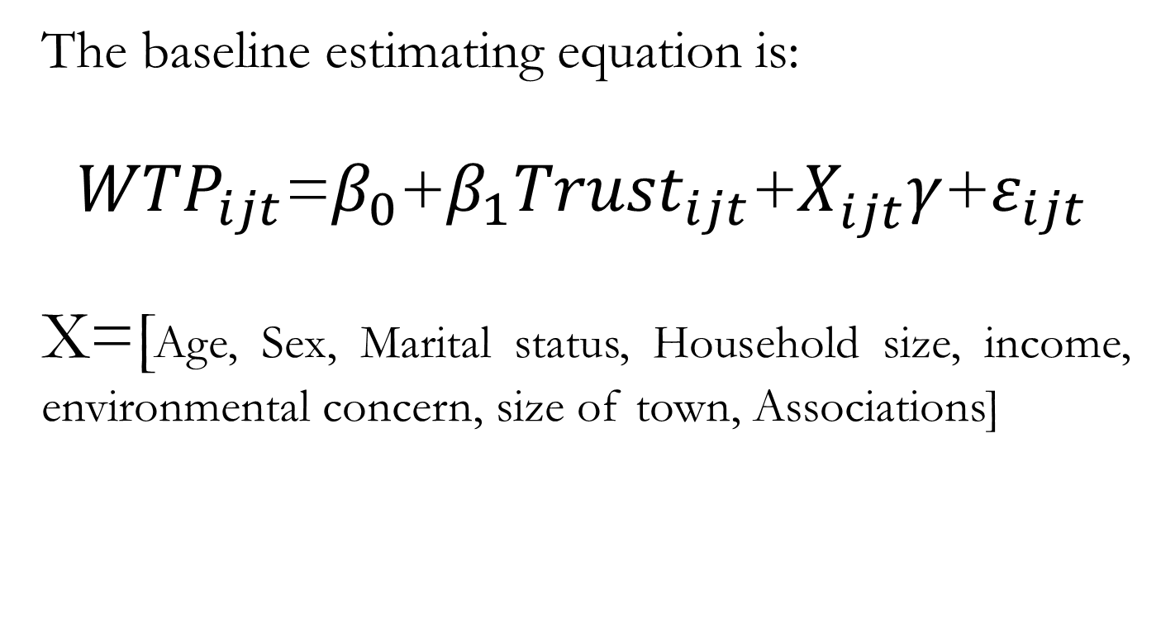
Econometric model of the effects of social capital on the WTP: Ordered Logit Estimates
The baseline estimating equation is:
${WTP}_{ijt}$=$β_{0}$+$β_{1}{Trust}_{ijt}$+$X_{ijt}^{}γ$+$ε_{ijt}$
X=[Age, Sex, Marital status, Household size, income, environmental concern, size of town, Associations]

Slide 16
Econometric model of the effects of social capital on the WTP: Instrumental Variable estimates.
Trust may be measured with error.
Reverse causality: WTP Trust.
Slave exports between 1400 and 1900 are used as an instrument for social capital.

Slide 17
ECONOMETRIC RESULTS

Slide 18
Table I :Relationship between Social Capital and the Willingness to Pay for environment goods
Dependent Variable | Willingness to pay for environment goods
 | (1) | (2) | (3) | (4) | (5)
Social Capital | 0.147** | 0.223** | 0.221** | 0.222** | 0.225**
 | (0.0659) | (0.0905) | (0.0905) | (0.0906) | (0.0903)
Country dummies | Yes | Yes | Yes | Yes | Yes
Time dummies | Yes | Yes | Yes | Yes | Yes
Log Likelihood | -10683.06 | -5091.6285 | -5091.3777 | -5091.0523 | -5099.4744
Prob>Chi2 | [0,000] | [0,000] | [0,000] | [0,000] | [0,000]
Observations | 8,789 | 4,195 | 4,195 | 4,195 | 4,195
Notes: Robust standard errors in parentheses. *** p<0.01, ** p<0.05, * p<0.1.

Slide 19
Table II: Relationship between social capital and the Willingness to Pay : IV regressions results
 | (1) | (2) | (3) | (4)
 | IV regression | IV regression | IV regression | First Stage
Dependent Variable | WTP | WTP | WTP | Social Capital
Social Capital | 1.041*** | 0.872*** | 0.858***
 | (0.159) | (0.152) | (0.152)
Log(Slave exports) |  |  |  | -0.0161***
 |  |  |  | (0.00335)
Time dummies | Yes | Yes | Yes | Yes
Prob>Chi2 | [0.000] | [0.000] | [0.000]
Instrument F-test stat |  |  |  | 22.93
Observations | 8848 | 8835 | 8789 | 6803
Notes: Robust standard errors in parentheses. *** p<0.01, ** p<0.05, * p<0.1

Slide 20
Policy Implications
Investing in participatory processes to bring people together in order to deliberate on common problems, and form new groups or associations capable of developing practices of common benefit
Promoting civil associations enable to convey reliable and useful information about environment issues and stimulate peer effects among their members.
Promoting individual leadership enable to foster altruistic preferences and concern for the common good and to enhance group identification.

Slide 21
Thank You for Your Attention

