Slide 1
Demographic change, the IMPACT model, and food security in sub-Saharan Africa
Kevin J.A. Thomas and Tukufu Zuberi

Slide 2
Background
Africa is the only region where hunger trends recently increased; close to one third of its population lives in chronic hunger (Sanchez et. al 2005)
Population growth: a major influence on the consumption and availability of food
Sub-Saharan Africa has exceptionally high population growth rates
International Model for Policy Analysis of Agricultural Commodities and Trade (IMPACT)
Uses population growth projections to assess trends in various indicators of food insecurity

Slide 3
Africa’s population growth projections
Africa’s population will increase from 1 to 2 billion between 2009 and 2050 under constant demographic conditions
Regional growth rate differences (Medium variant)
East Africa: about 2.2% per year
West Africa: about 2.2% per year
Central Africa: 2% per year
North Africa: 1.07% per year
South Africa: 0.38% per year
By 2050, 8 of the top 10 fastest growing countries in the world will be found in sub-Saharan Africa

Slide 4
Population growth and the demand for food
Key influence: the interaction between population growth and socioeconomic trends
Over the next four decades, the fastest growth rates will occur among Africa’s socioeconomically disadvantaged populations
Future growth will constrain food consumption without corresponding increases in living standards
Income constraints among the poor will negatively affect their demand for food in local markets
Regional variations in population and income trends are associated with geographic disparities in future food demands

Slide 5
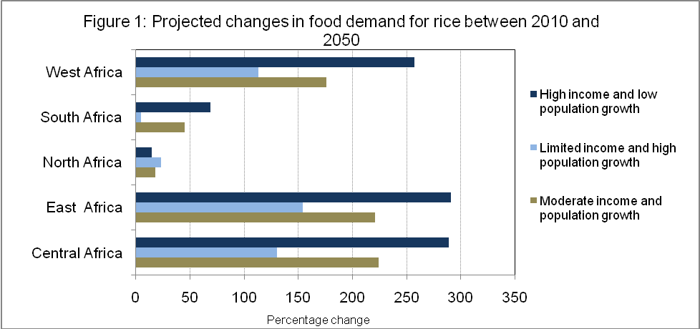

Slide 6
Natural resource constraints
Expected increases in food demand will require more efficient exploitation of natural resources in food production processes
Key consideration:
Natural resources are finite; practical limits will be encountered in their expanded use for food production
Sub-Saharan Africa’s rapid population growth will reduce the per capita availability of these resources
Other resource constraints are also important
E.g. declining soil fertility, pollution
They can potentially undermine the fundamental basis of future food production

Slide 7
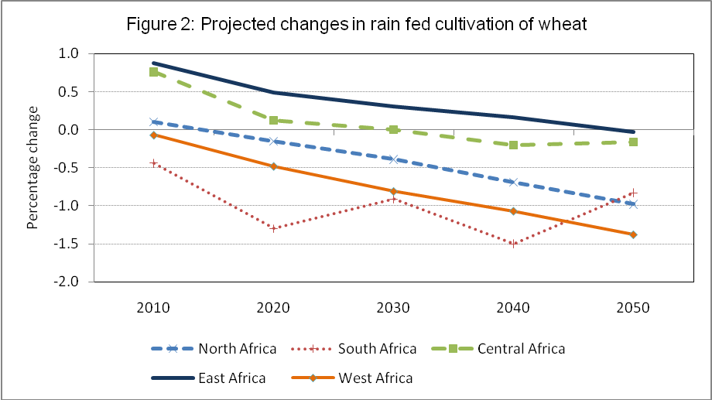

Slide 8
Population growth and the supply of food
Growth-induced increases in food demand needs to be matched by increases food supply to achieve food security
In other regions, key natural resource constraints have been overcome with improved agricultural technologies
Sub-Saharan Africa’s capacity to produce similar increases is strikingly low
As population increases, expanding food stocks alone will not improve food security
Expansions should be meaningful enough to increase the per capita availability of food

Slide 9
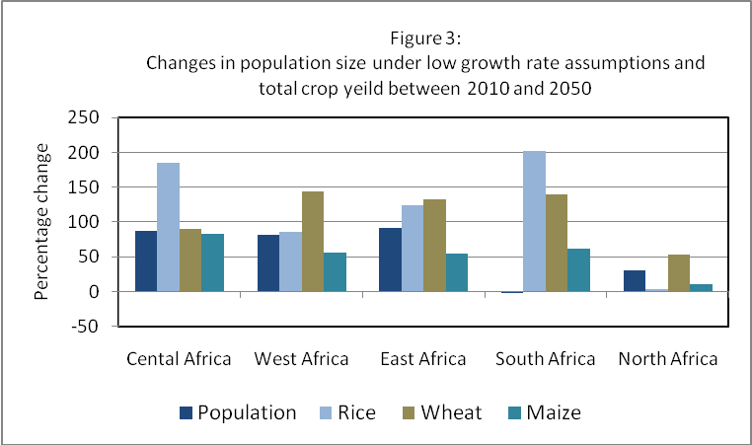
Population growth and the supply of food

Slide 10
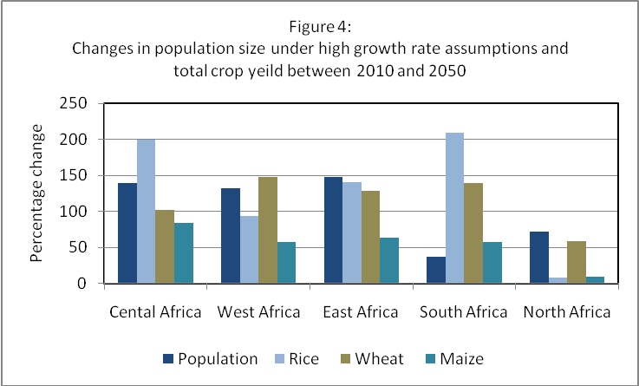
Population growth and the supply of food

Slide 11
Caloric Availability
Some African societies have experienced widespread hunger and malnutrition even with modest increases in food production
The differential growth dilemma
Food calorie trends in sub-Saharan Africa will remain unchanged between 2000 and 2050 (Hubert et. al. 2011).
Between 2000 and 2050 sub-Saharan Africa’ population will grow by 1.8% annually
Per capita calorie trends will decline if rapid population growth is accompanied by limited income growth in sub-Saharan Africa

Slide 12
Implications for malnutrition
Population growth will be among the most critical determinants of malnutrition in sub-Saharan Africa
Two specific dimensions are important
Population growth will increase the size of Africa’s populations exposed to the risks of malnutrition and hunger
Population growth will affect other proximate factors, e.g. the size of Africa’s population in poverty, natural resource use, and caloric availability
Rapid population growth, in the context of high levels of poverty, will have the most adverse implications for food security

Slide 13
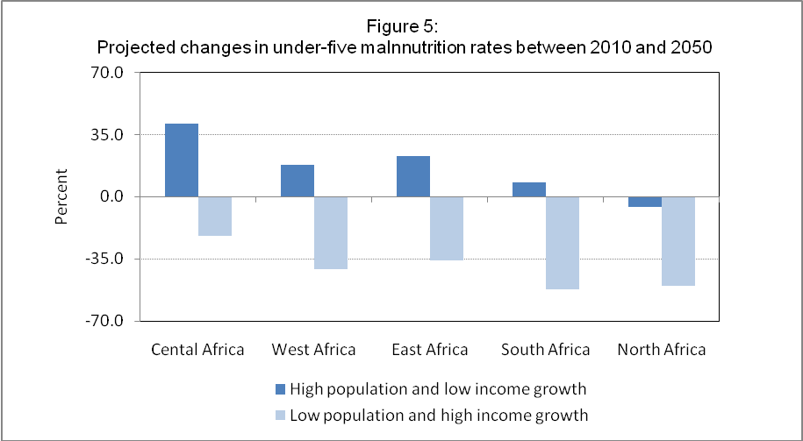

Slide 14
Conclusions and implications
Sub-Saharan Africa’s high growth rates have multidimensional implications for food security
Its expected impacts have adverse implications for the dynamics of hunger and malnutrition
Concentrated among vulnerable populations
Food security can be improved by targeted policies mitigating the causes and consequences of rapid population growth
Enhanced poverty safety nets in rural areas improves livelihoods and decreases fertility
Technological expansion needs to be encouraged to increase crop yields in ways that will match population growth trends

